Slide 1
Most questions for Grade 4 OAKS , Read to Perform a Task, asks students to find answers to questions by looking at graphs and charts.
Grade 4
Oregon State Released Practice Tests
Booklet #4-9
Specified State Standards Listed Under:
Read to Perform a Task
Blank
The Test Samples in this Booklet were taken from the Oregon State Department of Education WEB Site, unless otherwise noted.
Page 11

Slide 2
Teaching Information page:
Grade 4
Oregon State Released Practice Tests
Read to Perform a Task
(Other state practice tests may be included as credited. Any other state practice released test included aligns with Oregon’s OAKS format and standards.)
O.D.E. Standards in this booklet include:
(Note: These specific standards are assessed under the English/Language Arts Standards heading: Read to Perform a Task or R.P.T. on OAKS
Read to Perform a Task: Power Standard
EL.04.RE.17 Locate information in titles, tables of contents, chapter headings, illustrations, captions, glossaries, indexes, graphs, charts, diagrams, and tables to aid understanding of grade-level text.
EL.04.RE.18 Find information in specialized materials (e.g., atlas, magazine, catalog).
EL.04.RE.19 Use structural features found in informational text (e.g., headings and subheadings) to strengthen comprehension.
Note: The boxed standards are NOT Power Standards but are
assessed on the OAKS test.
Page 1
Page 10

Slide 3
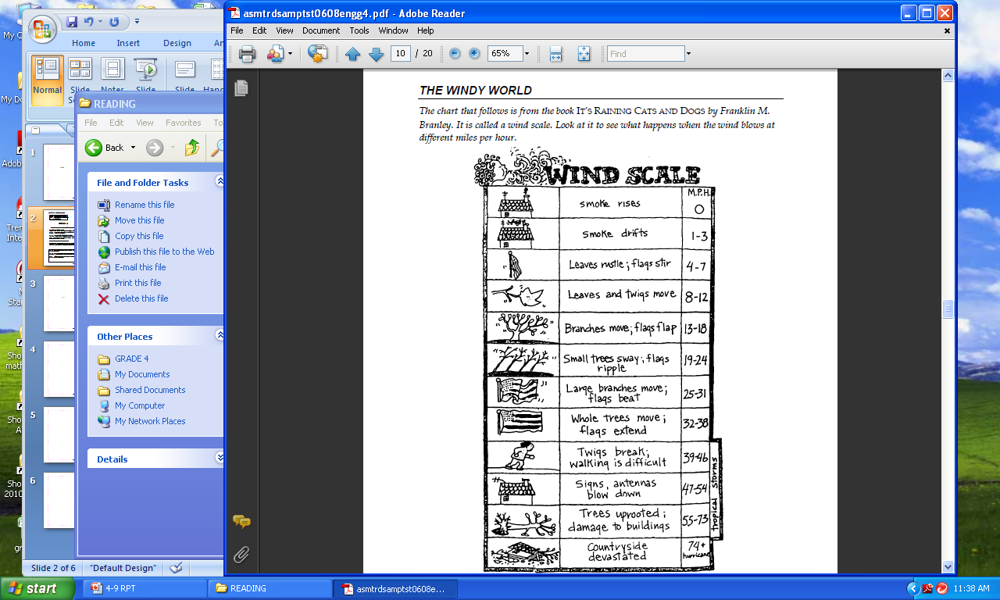
The Windy World
The chart that follows is from the book “It’s Raining Cats and Dogs” by Franklin M. Branley. It is called a wind scale. Look at it to see what happens when the wind blows at different miles per hour.
Page 9
ODE 2006-2008 State Released Sample Tests
Page 2

Slide 4
The Windy World
At what wind speed does the wind scale tell you that flags flap?
13-18 m.p.h.
19-24 m.p.h.
25-31 m.p.h.
32-38 m.p.h.
At what wind speed do twigs break?
8-12 m.p.h.
13-18 m.p.h.
25-31 m.p.h.
39-46 m.p.h.
If the wind were blowing at 6 m.p.h., which of these would probably happen?
Branches would move.
Leaves would rustle.
Walking would be difficult.
Trees would fall over.
Page 3
Page 8

Slide 5
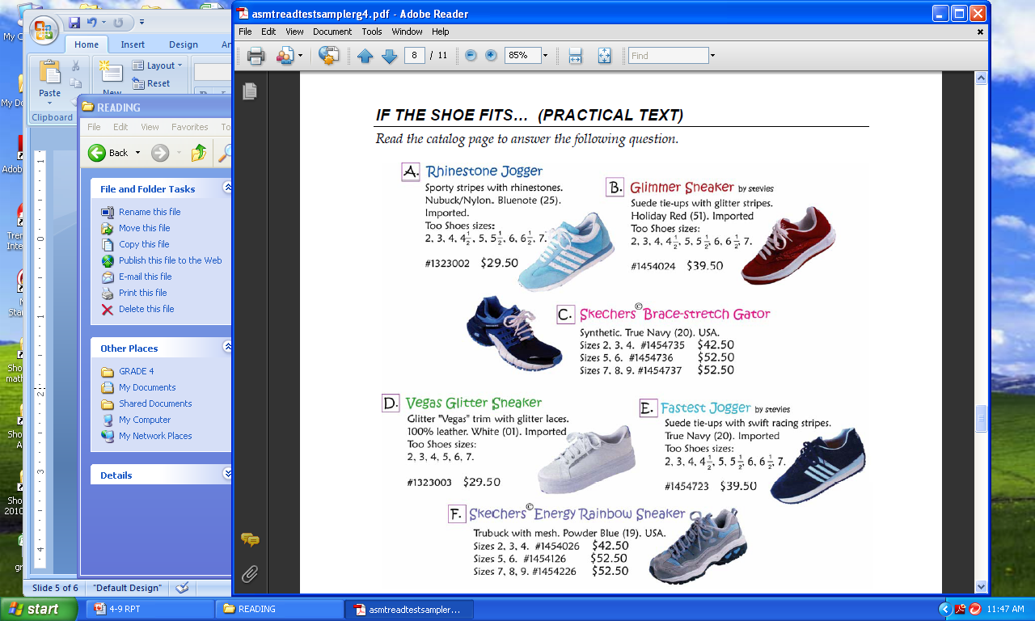
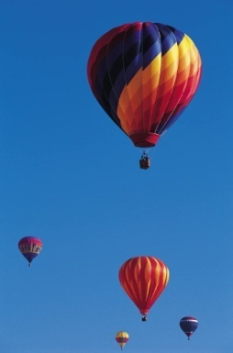
WE HAVE LIFT-OFF!
As the air in it cools, the balloon will descend. Another word for descend would be
drop.
rise.
float.
shrink.
The stitches around the open end of the bag are put there to
add decoration to the balloon.
allow air to escape from the balloon.
pull the bag into a balloon shape.
cut down on the weight of the balloon.
The second step to making a hot air balloon involves
attaching the plastic bag.
putting air in the plastic bag.
sewing the plastic cup.
preparing the plastic cup.
How many of the steps in the directions would involve using the needle?
1
2
3
4
IF THE SHOE FITS . . . . (PRACTICAL TEXT)
Read the catalog page to answer the following questions.
ODE 2005 State Released Grade 4 Sampler
Page 7
Page 4

Slide 6
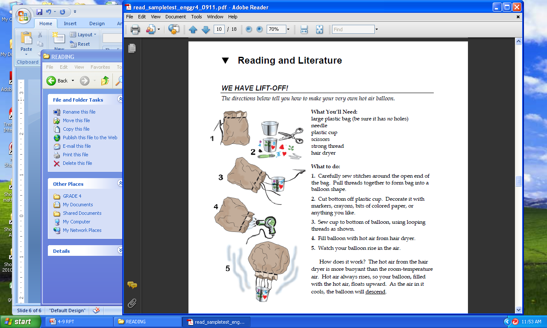
IF THE SHOE FITS
Which sneakers are decorated with glitter?
B and F
B and D
A and F
D and A
Which sneaker costs more the bigger the size you buy?
Glimmer Sneaker by Stevies
Vegas Glitter Sneaker
Skechers Brace-Stretch Gator
Rhinestone Jogger
Which sneakers cost the same?
B and F
C and E
A and F
A and D
WE HAVE LIFT-OFF!
The directions below tell you how to make your very own hot air balloon.
ODE 2009 – 2011 State Released Sample Tests
Page 5
Page 6

