Slide 1
Opinion Writing…
Performance Task
Pre-Assessment
Photo credit: Thinkstock
Teacher Directions

Slide 2
Background
This is a pre-assessment to measure the task of writing an opinion piece. Full compositions or essays are always part of a Performance Task. A complete SBAC performance task would normally have:
Part 1: 30 Minutes
A Classroom Activity
Reading the Passages
Taking Notes
3 Research Questions
Part 2: 35 Minutes
Writing A Full-Composition
For grade K, the teacher should read the passage aloud to the students. Teachers may model note-taking for students if desired. In grade K there are no research questions.
DIRECTIONS
Allow approximately 30 minutes for Part 1 and approximately 35 minutes for Part 2, but the prompt should not be strictly timed. Students should take the time they need to write and proofread.
Read the story, present the question, and allow a few minutes for discussion with a partner. Give out lined or unlined paper. Then, use your typical classroom writing process to support students in completing the writing prompt.
The response should include a picture and whatever sentences, words, or letters the child can add. An adult may assist with sounding out or spelling words and/or transcribe the child's words if desired.
Please distinguish the child's independent production from words or letters produced with adult help by underlining any part of the writing done with teacher support.
We understand that, especially in the fall, most Kindergartners have had limited experience with writing.
The Best Pet
Student Directions, Part 1
20 - 30 minutes
Teacher Directions to Students (after reading):
•What do you think? Which pet is best—a cat or a dog?
• Turn and talk to a partner about which pet you chose. Be sure to tell your partner WHY you picked that pet. Allow time for students to discuss their choices.
Student Directions, Part 2
35 Minutes
• Listen to the story again.
• Now, use this paper to draw a picture of the pet you chose. I will help you write words under your picture to tell more about your
This classroom activity and text is from Achieve The Core

Slide 3
Grade Equivalent | 1.1
Lexile Measure | 490
Mean Sentence Length | 7.81
Mean Log Word Frequency | 3.54
Word Count | 203
Source #1:
The Best Pet
Bob and his friend Ann don't agree on which pet is best. Listen to find out what they each think.
My friend Ann says her pet is better than mine! I have a brown cat named Fluffy. Ann has a black and white dog named Spot. We each think our pet is the best.
I told Ann that cats are better pets because they are clean, quiet and very cute. Cats wash themselves with their tongues. You don’t have to walk them. They use a litter box. Also, cats are sweet and quiet. I think dogs are too noisy! They bark a lot. They don't clean themselves or use a litter box. Dogs need someone to give them baths, train them and walk them. Dogs are more work.
Ann says that cats are no fun! She says that dogs are better to play with. Spot always wags his tail when he sees her. He can even do tricks. He barks when she says, “Speak”. He knows how to roll over! Ann says dogs are also better because they protect their owners. Spot always barks when there is someone at the door. It makes Ann feel safe. So, Ann thinks dogs are best.
I guess Ann’s dog is pretty cool, but so is Fluffy. Maybe different kinds of pets are good for different people.

Slide 4
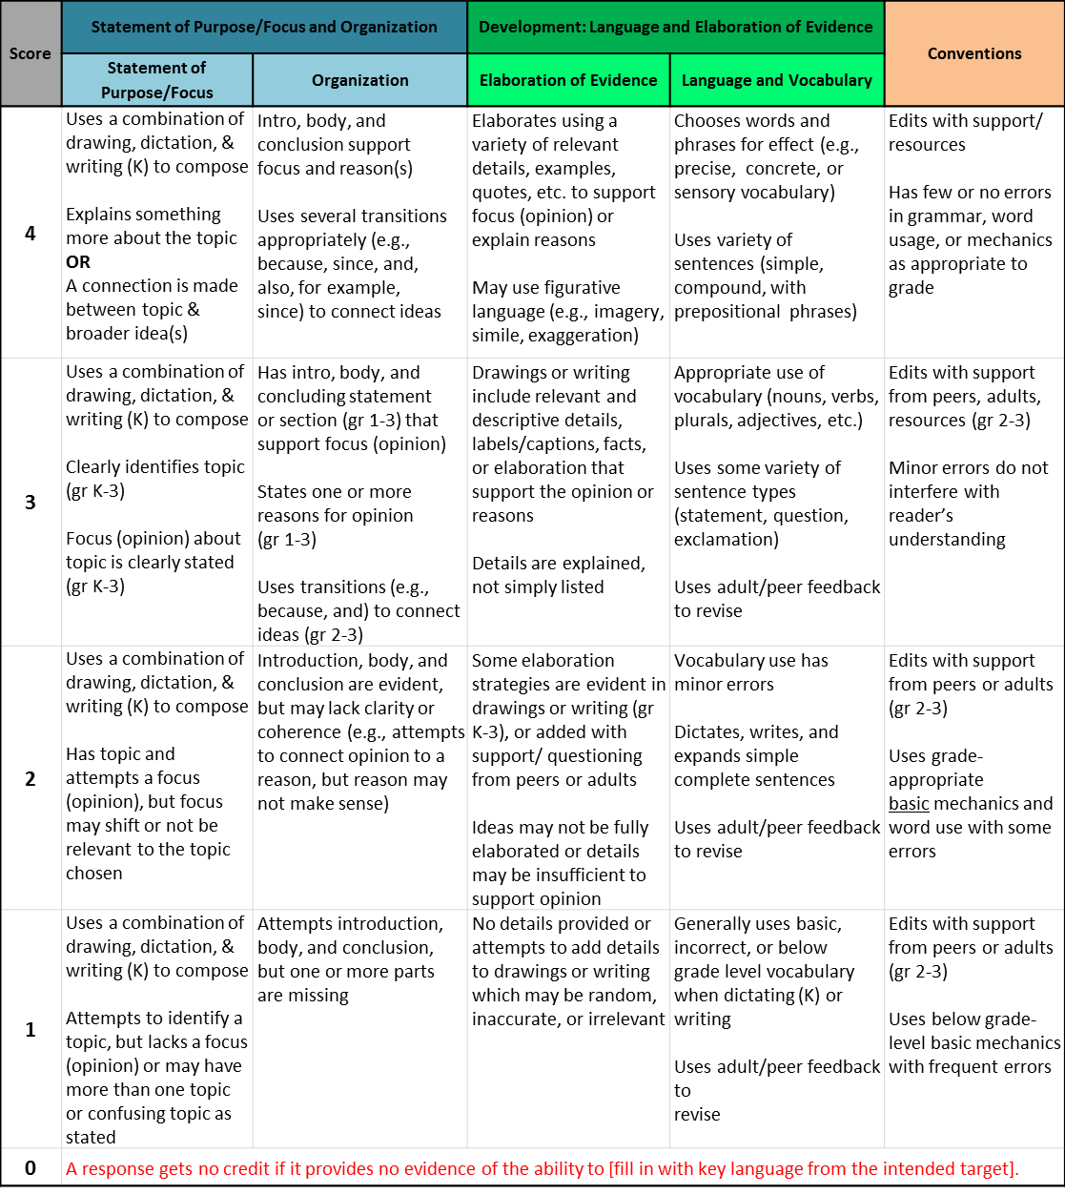
Grades K - 2: Generic 4-Point Opinion Writing Rubric
NOTE: Anchor papers illustrate how descriptors for each performance level are evidenced at each grade.
Working Drafts of ELA rubrics for assessing CCSS writing standards --- © (2010) Karin Hess, National Center for Assessment [khess@nciea.org] using several
sources: CCSS for writing; Learning Progressions Framework for ELA (Hess, 2011); the VT analytic writing rubrics; Biggam & Itterly, Literacy Profiles; Hill,
Developmental Continuum; Exemplars Young Writers rubrics; and input from NYC K-5 performance assessment pilot Assessment Development Leaders
CCSS Writing Standard #1a: Compose Opinion Pieces on Topics/ Persuasive Writing K-3
Students compose opinion pieces on topics by stating and supporting a point of view /judgment with reasons and information.

Slide 5
Opinion Writing Pre-Assessment
Student and Class Scoring: |  |  | School Year: | 2014-15 | Grade:
 |  | Teachers Name:
 |  | School:
Student Name: |  |  | Focus and Organization | Elaboration and Evidence | Conventions | Student Total | ELP Score
 |  |  | Score | Score | Score
1. | Daffy Duck and Friends |  | 3 | 3 | 4 | 10
2. | Mickey Mouse |  | 4 | 4 | 4 | 12
3. | Minnie Mouse |  | 4 | 4 | 3 | 11
4. | Road Runner |  | 4 | 4 | 0 | 8
 |  |  |  |  |  | 0
 |  |  |  |  |  | 0
 |  |  |  |  |  | 0
 |  |  |  |  |  | 0
 |  |  |  |  |  | 0
 |  |  |  |  |  | 0
 |  |  |  |  |  | 0
 |  |  |  |  |  | 0
 |  |  |  |  |  | 0
 |  |  |  |  |  | 0
 |  |  |  |  |  | 0
 |  |  |  |  |  | 0
 |  |  |  |  |  | 0
 |  |  |  |  |  | 0
 |  |  |  |  |  | 0
 |  |  |  |  |  | 0
 |  |  |  |  |  | 0
 |  |  |  |  |  | 0
 |  |  |  |  |  | 0
 |  |  |  |  |  | 0
 |  |  |  |  |  | 0
 |  |  |  |  |  | 0
 |  |  |  |  |  | 0
 |  |  |  |  |  | 0
 |  |  |  |  |  | 0
 |  |  |  |  |  | 0
 |  |  |  |  |  | 0
 |  |  |  |  |  | 0
 |  |  |  |  |  | 0
 |  |  |  |  |  | 0
 |  |  |  |  |  | 0
4 | Total Students
 | % Proficient |  | 25% | 25% | 25% | 50%
 | % Exemplary |  | 75% | 75% | 50% | 50%
Scoring Key:
Total # Correct
1
= Emerging
0 - 4
2
= Developing
5 - 7
3
= Proficient
8 - 10
4
= Exemplary
11 - 12
To use the Excel Version of this Score sheet. http://sresource.homestead.com/index.html

Slide 6
ELP 1st Grade Band Standards Organized by Modality
Receptive modalities*: Ways in which students receive communications from others (e.g., listening, reading, viewing). Instruction and assessment of receptive modalities focus on students’ communication of their understanding of the meaning of communications from others. | Listening & reading | 9 - create clear and coherent grade-appropriate speech and text | 10 - make accurate use of standard English to communicate in grade-appropriate speech and writing | 1 | construct meaning from oral presentations and literary and informational text through grade-appropriate listening, reading, and viewing
 |  |  |  | 8 | determine the meaning of words and phrases in oral presentations and literary and informational text
Productive modalities*: Ways in which students communicate to others (e.g., speaking, writing, and drawing). Instruction and assessment of productive modalities focus on students’ communication of their own understanding or interpretation. | Speaking & Writing |  |  | 3 | speak and write about grade-appropriate complex literary and informational texts and topics
 |  |  |  | 4 | construct grade-appropriate oral and written claims and support them with reasoning and evidence
 |  |  |  | 7 | adapt language choices to purpose, task, and audience when speaking and writing
Interactive modalities*: Collaborative use of receptive and productive modalities as “students engage in conversations, provide and obtain information, express feelings and emotions, and exchange opinions” (Phillips, 2008, p. 3). | Listening, speaking, reading, and writing |  |  | 2 | participate in grade-appropriate oral and written exchanges of information, ideas, and analyses, responding to peer, audience, or reader comments and questions
 |  |  |  | 5 | conduct research and evaluate and communicate findings to answer questions or solve problems
 |  |  |  | 6 | analyze and critique the arguments of others orally and in writing
Standard | An ELL can… | By the end of an English language proficiency level, an ELL in 1st Grade can . . .
4 Productive (S & W) | …construct grade-appropriate oral and written claims and support them with reasoning and evidence. | 1 | 2 | 3 | 4 | 5
 |  | …express an preference or opinion about a familiar topic. | …express an opinion about a familiar topic. | …express an opinion about a familiar topic or story, & give a reason for the opinion. | …express opinions about a variety of texts & topics, & give a reason for the opinion. | …express an opinions about a variety of texts & topics, introducing the topic & giving a reason for the opinion, & providing a sense of closure.
This performance task is based on writing. As an option if you’d like to monitor growth for ELP as a second goal, teachers can choose to assess ELP standard 4 because it aligns with this specific performance task. Your student’s full composition can be analyzed to identify English language proficiency levels. It is evident that students will be navigating through the modalities to get to the end product. However, it is important to keep in mind what the full opinion writing performance task is assessing and how deeply the student understands class content and language. The ELP growth goal is to provide the “just-right scaffolds” for students to demonstrate their understanding in order for them to move from one proficiency level to the next.
Oregon ELP Standards Aligned with Performance Task, 2014; Arcema Tovar

Slide 7
Opinion Writing…
Performance Task
Pre-Assessment
Student Name:______________________
Date: __________________

Slide 8
Which kind of pet is best, a cat or a dog?

