Slide 1

Read about TBEAR (research)
Use TBEAR as …
A Graphic Organizer
A Paragraph Maker
A Body Paragraph Outline
A Response Log
An Argument TBEAR
Part of a Dialectic Journal
An Opinion Article Writing Guide
A Literary Analysis Guide
A Way to Teach Introduction and Conclusion Paragraphs
Persuasive Essay Graphic Organizer
An Essay Outline
Part of a Writing Score Sheet
A Specific Narrative Technique Reflection and Response
A Writing Plan Tool with Grade Level CCSS
A Support to SBAC’s Task Model Evidence Statements
A Way To Scaffold “Write a Brief Text”
A Way To Scaffold “Revise a Brief Text”
A Way to Respond Across Domains
A Guide for Many Reasons to Write!

Slide 2
Using “gangsta” T-BEAR: Teaching a format for paragraph development in a literary response essay (Education Papers posted on February 28th, 2012 )
http://www.edu-papers.com/using-gangsta-t-bear-teaching-a-format-for-paragraph-development-in-a-literary-response-essay/
Research questions). To what extent will teaching a format for paragraph development that focuses on the skills of selecting, introducing, and analyzing a quotation influence students ability to organize and develop a literary response paragraph? 1) To what extent will students use the T-BEAR format for organizing and developing paragraphs when responding to an in-class writing prompt? 2) What effects does using a peer feedback questionnaire have on students organizing and developing literary response paragraphs? 3) How effective are reading journals in the identification of literary devices and the development of literary response paragraphs? 4) Which students will benefit the most from an intensive focus on organizing and developing literary response paragraphs? Research activities. Context: This study took place in an eighth-grade English class located in a suburban community in the Central Valley. The target class consisted of twenty-one students, of which six were females and fifteen were males. Of these twenty-one students, eight focus students of various skill and classification levels, language backgrounds, and ethnic diversities were chosen for closer study and evaluation. The study examined the effectiveness of focused instruction in paragraph development on students ability to write literary response essays focusing on five literary devices. The rationale for this study centered on students inability to write cohesive and articulate literary response essays. Their first literary response essay lacked quotations or evidence in support of main ideas. Additionally, students failed to address all five literary devices required by the schools proficiency standards: conflict, character, theme, symbol, and thoughts/recommendations. Furthermore, during an informal teacher observation of a quickwrite, students demonstrated anxiety towards writing. Methods and Data: The 5- week intervention began with a PowerPoint presentation on the Basic T-BEAR format that was the focus of the intervention. The acronym is as follows: T ＝ topic sentence, B ＝ bridge to evidence, E ＝ evidence, A ＝ analysis, R ＝ return to topic. After taking notes on the paragraph structure and literary device focused on for the week, students read a short story and wrote a practice paragraph on that weeks literary device. At the beginning and end of the study, students wrote literary response essays and completed student attitude surveys, which were the main measures of student progress. The in-the-midst data sets were peer evaluations of T-BEAR paragraphs, revised T-BEAR paragraphs, student writing journals in the form of graphic organizers used during reading, practice T-BEAR paragraphs for each of the five literary devices, and informal teacher observations recorded in a journal documented student engagement. Results: The pre- and post-attitude surveys conveyed the knowledge and confidence students developed in their writing, specifically their ability to develop a Basic literary response paragraph. On the baseline data students answered survey questions positively an average of 12% of the time but on the outcome data this percentage increased to 48%. Additionally, 95% of students were able to explain the importance of including quotations in their writing while 86% of students accurately identified how to choose an adequate quotation. The pre- and post- achievement paragraphs were representative of this writing ability and growth. On outcome paragraphs scores of one decreased by 24 percentage points from 38% to 14%) while scores of two increased by 5 percentage points from 62% to 67%). Additionally, scores of three increased by 19 percentage points from 0% to 19%). Thus, the student outcome achievement data reveal higher overall scores on T-BEAR paragraph elements resulting in increased cohesion and overall more articulate literary response essays. Grade level. Eighth grade Data collection methods. Observation — Student engagement/behavior tallies, Survey — Attitude, Writing assessment, Writing samples, Quickwrite, Observation — Teacher research journal, Student work, Evaluation/Feedback Curriculum areas. English Language Arts, Writing Instructional approaches. Class Discussion, Collaborative Learning, Graphic Organizers, Writing — Explicit Instruction, Writing — Organization, Writing — Peer Evaluation, Writing — Revision, Writing — Response to Literature

Slide 3
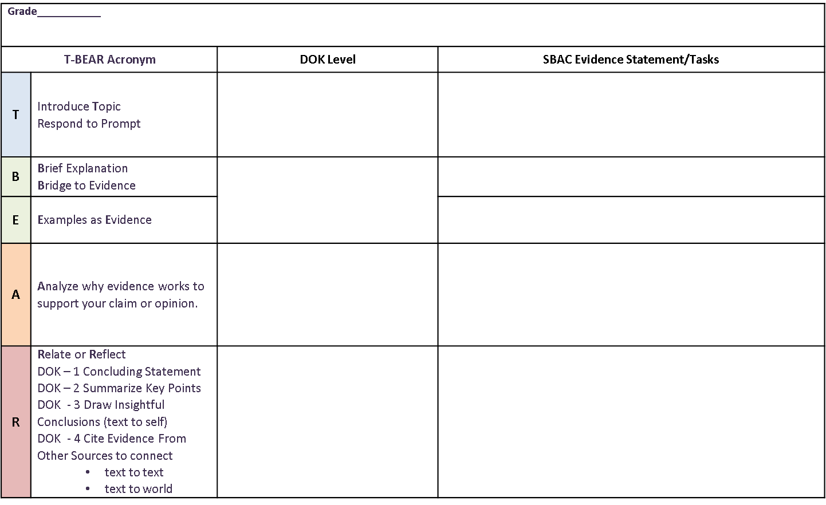
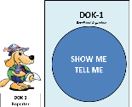
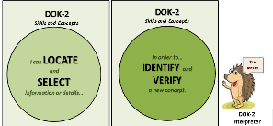
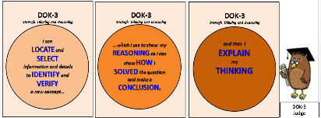
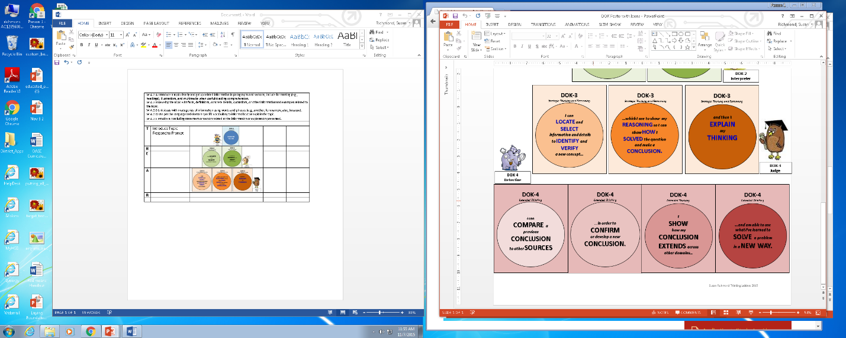
SBAC has Task Models for each Target. These task models have Statements of Evidence that can be used for formative assessments.
This TBEAR planner connects the TBEAR strategies to SBAC’s task model statements of evidence.
The evidence statements assess 5 writing forms:
Full-Writes
Write a Brief Text
Revise a Brief Text
Language and Vocabulary
Edit and Clarify

Slide 4
TBEAR Graphic Organizer
Sample Writing Prompt: After reading the story “Little Red Riding Hood,” what is your opinion about the intelligence or cleverness of the wolf? Support your opinion with evidence from the text.
T-BEAR Letter and what it represents | Helpful ways to begin… | Your topic or text and notes (e.g., evidence from text, facts, details, examples, page numbers)
T=Topic Sentence/ Thesis (focus or opinion) Clearly and directly respond to the prompt. This establishes the purpose. | In the story, Little Red Riding Hood, the author creates a character that clearly is/is not very intelligent or clever.
B = Brief explanation/ Bridge to evidence (context) Briefly explain and/or set the scene for those who do not know the topic/text. This should not retell the whole story, but focus on the aspect of the story that is important for your response. | This story is about a girl named Little Red Riding Hood who _______ Meanwhile, the wolf character tries many things to ______.
E = Examples Support the writer’s stance OR your opinion with specific textual references. Include quotation marks for direct quotes and page numbers, section, chapter, | For example, when ______, the wolf says, “_____” Also, the wolf tries to ___________.
A = Analysis Analyzes the examples/evidence. Writer digs deep to uncover meaning. Consider the meaning or implications of word choice, tone, imagery, author’s purpose, etc. | This part of the story shows that __________ The author uses these words “____” and “____” to describe the wolf as _____ Also, the illustrations also show the reader that…
R = Relate or Reflect Establish a connection to another literary text, historical occurrence, society, universal human behavior, etc. OR Reflect on the main idea or a lesson OR State a conclusion related to your stated opinion. | This kind of character is also in _____ This idea or lesson is similar to _______ Therefore,_______ Overall, _______ All of these examples show that _____
© (2010) T-BEAR Organizer Adapted by Karin K. Hess, Local Assessment Toolkit: Cognitive Rigor & Writing. Permission to reproduce is given when authorship is fully cited khess@nciea.org

Slide 5
Basic TBEAR (for students who have had prior introduction and scaffolds to TBEAR)
Name
T-BEAR Letter and what it represents | Your topic or text and notes (e.g., evidence from text, facts, details, examples, page numbers)
T=Topic Sentence/ Thesis (focus or opinion) Clearly and directly respond to the prompt. This establishes the purpose.
B = Brief explanation/ Bridge to evidence (context) Briefly explain and/or set the scene for those who do not know the topic/text. This should not retell the whole story, but focus on the aspect of the story that is important for your response.
E = Examples Support the writer’s stance OR your opinion with specific textual references. Include quotation marks for direct quotes and page numbers, section, chapter,
A = Analysis Analyzes the examples/evidence. Writer digs deep to uncover meaning. Consider the meaning or implications of word choice, tone, imagery, author’s purpose, etc.
R = Relate or Reflect Establish a connection to another literary text, historical occurrence, society, universal human behavior, etc. OR Reflect on the main idea or a lesson OR State a conclusion related to your stated opinion.
© (2010) T-BEAR Organizer Adapted by Karin K. Hess, Local Assessment Toolkit: Cognitive Rigor & Writing. Permission to reproduce is given when authorship is fully cited khess@nciea.org

Slide 6
TBEAR Graphic Organizer
Sample Writing Prompt: After reading the story “Little Red Riding Hood,” what is your opinion about the intelligence or cleverness of the wolf? Support your opinion with evidence from the text.
T-BEAR Letter and what it represents | Helpful ways to begin… | Your topic or text and notes (e.g., evidence from text, facts, details, examples, page numbers)
T=Topic Sentence/ Thesis (focus or opinion) Clearly and directly respond to the prompt. This establishes the purpose. | In the play, Death of a Salesman, Miller creates a character who _____
B = Brief explanation/ Bridge to evidence (context) Briefly explain and/or set the scene for those who do not know the topic/text. This should not retell the whole story, but focus on the aspect of the story that is important for your response. | In the story, Willy____ During this particular scene,_______
E = Examples Support the writer’s stance OR your opinion with specific textual references. Include quotation marks for direct quotes and page numbers, section, chapter, | For example, he states, “___________,” (52). For instance, the character believes that ____ (24).
A = Analysis Analyzes the examples/evidence. Writer digs deep to uncover meaning. Consider the meaning or implications of word choice, tone, imagery, author’s purpose, etc. | This passage reveals that______ The words “xyz” and “abc” suggest that _______ This example informs the reader that_____
R = Relate or Reflect Establish a connection to another literary text, historical occurrence, society, universal human behavior, etc. OR Reflect on the main idea or a lesson OR State a conclusion related to your stated opinion. | This idea is also depicted in _______________ Similar to___________ Therefore, _________ Overall, _________
© (2010) T-BEAR Organizer Adapted by Karin K. Hess, Local Assessment Toolkit: Cognitive Rigor & Writing. Permission to reproduce is given when authorship is fully cited khess@nciea.org

Slide 7
TBEAR Content Areas - Graphic Organizer
Sample Vocabulary Development – (Moving from Definitional to Conceptual) Mathematics, Science, Social Studies, Arts…
T-BEAR Letter and what it represents | Helpful ways to begin… | Your topic or text and notes (e.g., evidence from text, facts, details, examples, page numbers)
T=Topic Sentence/Term/Principle This establishes the focus & purpose of your paragraph, poster or illustration. State the term/principle/concept with a brief definition. | A line of symmetry is….[a line that divides a figure into two congruent parts, each of which is the mirror image of the other]
B = Brief explanation/ Bridge to evidence (context) Briefly explain or add context for those who do not know the term/concept. This should focus on aspects that further elaborate on the concept and bridge to some examples and non-examples. | When a figure having a line of symmetry is folded along the line…[the two parts should coincide or match exactly. That means that two parts are the same size and same shape.].
E = Examples Provide examples and non-examples and illustrate them graphically. If referencing a source, include quotation marks for direct quotes and/or page numbers, section, chapter, website, where located. | For example, www.amathsdictionaryforkids.com Shows that a line of symmetry can be drawn down the middle of a capital letter A; but cannot be drawn down the middle of the letters P or F to divide the parts into mirror images. Some figures can even have more than one line of symmetry such as this one does:
A = Analysis Analyzes the examples or evidence and tell why this concept is important or useful to math/science or applied in the real world. Consider the meaning or implications of not having/using the concept = so what? | The concept of symmetry is applied in geometry… It is also important to the design of…
R = Relate or Reflect Establish a connection to another term or concept (math, sci/soc studies/arts) OR Reflect on a key idea OR State a conclusion related to your focus | These examples show…. The concept of symmetry is related to/important to an understanding of… Therefore…. Overall…..
© (2010) T-BEAR Organizer Adapted by Karin K. Hess, Local Assessment Toolkit: Cognitive Rigor & Writing. Permission to reproduce is given when authorship is fully cited khess@nciea.org

Slide 8
TBEAR Cross Text Analysis
Sample Writing Prompt: After reading the story “Little Red Riding Hood,” what is your opinion about the intelligence or cleverness of the wolf? Support your opinion with evidence from the text.
T-BEAR Letter and what it represents | Text 1 | Text 2
T=Topic Sentence/ Thesis (focus or opinion) Clearly and directly respond to the prompt. This establishes the purpose. Explain how the two texts address the same focus.
B = Brief explanation/ Bridge to evidence (context) Briefly explain and/or set the scene for those who do not know the topic/text. This should not retell the whole story, but focus on the aspect of the story that is important for your response.
E = Examples Support the writer’s stance OR your opinion with specific textual references. Include quotation marks for direct quotes and page numbers, section, chapter,
A = Analysis Analyzes the examples/evidence. Writer digs deep to uncover meaning. Consider the meaning or implications of word choice, tone, imagery, author’s purpose, etc.
R = Relate or Reflect Establish a connection to another literary text, historical occurrence, society, universal human behavior, etc. Connect the two texts in one conclusion. OR Reflect on the main idea or a lesson OR State a conclusion related to your stated opinion.
© (2010) T-BEAR Organizer Adapted by Karin K. Hess, Local Assessment Toolkit: Cognitive Rigor & Writing. Permission to reproduce is given when authorship is fully cited khess@nciea.org

Slide 9
TBEAR Paragraph Maker
Name Thesis:
Topic sentence - Tie to thesis/research section
Bridge to evidence - Define / Explain evidence
Evidence – Source (with citation)
Analysis - State why significant
Restate – tie back into topic and thesis
Adopted From: © (2010) T-BEAR Organizer Adapted by Karin K. Hess, Local Assessment Toolkit: Cognitive Rigor & Writing. Permission to reproduce is given when authorship is fully cited khess@nciea.org

Slide 10
TBEAR Body Paragraph Outline
Name Thesis:
Topic Sentence
Evidence #1 (transition + lead-in + quotation/paraphrase/summary)
Analysis #1 – State why significant
Analysis #2 – State why Significant
Evidence #2 (transition + lead-in + quotation/paraphrase/summary)
Analysis #1 – State why significant
Analysis #2 – State why significant
Evidence #3 (transition + lead-in + quotation/paraphrase/summary)
Analysis #1 – State why significant
Analysis #2 – State why significant
Concluding sentence (transition to next paragraph)
Adopted From: © (2010) T-BEAR Organizer Adapted by Karin K. Hess, Local Assessment Toolkit: Cognitive Rigor & Writing. Permission to reproduce is given when authorship is fully cited khess@nciea.org

Slide 11
TBEAR RESPONSE LOG
Directions: Highlight, underline or mark TBEAR in the text below.
T | Topic Sentence or Opinion Statement + Literary Device and Reasoning
B | Bridge or Transition
E | Evidence
A | Analysis and Interpretation
R | Restatement Linking to Topic Sentence and Information Stated.
Text:
Adopted From: © (2010) T-BEAR Organizer Adapted by Karin K. Hess, Local Assessment Toolkit: Cognitive Rigor & Writing. Permission to reproduce is given when authorship is fully cited khess@nciea.org

Slide 12
Using TBEAR To Write an Argument REMEMBER
Write a Topic STATEMENT (you are not asking a question or using a hook). Write a plain statement of what side of the argument you will be taking about the article. Your claim should be arguable.
Background Information: Explain the argument you’ll be discussing. Introduce the article you’re using as your source.
Your evidence is a FACT or a DIRECT QUOTE from the article. Use lots of direct evidence. Organize your evidence!
Analysis: Write in third person. Connect the evidence to the topic and point you are making. Analysis is reporting facts.
Reflect why the evidence supports and advances your argument.

Slide 13
English AP Summer Assignments – Beckett, Room E212 Read the following book: The Amazing Adventures of Kavalier and Clay by Michael Chabon Keep a dialectic journal: As you read, keep a dialectical journal for each book. You should write these journals in one notebook. DO NOT TYPE YOUR JOURNALS! These journals will consist of quotations to which you respond critically for each work. Please label and date journals appropriately. Select one quotation or passage for approximately every 30 pages. Respond to the quotations, focus on the ways in which the author uses language to create an effect. What is it about the language that stands out and makes the passage distinctive? How does the passage reflect the author’s style and reveal larger themes of the work? I expect responses to be developed thoughtfully and intellectually. Responses should be approximately 60 words in length. The dialectical journals should be constructed in the following manner: Quote “Write the quote from the book Your response and analysis of the on the left side of the paper with quote should be written on the opposite the correct MLA citation” (176). side of the page. For the RESPONSE column, you have several ways to respond to a text and you only need to use one way. • Raise questions about the beliefs and values implied in the text • Give your personal reactions to the passage • Discuss the words, ideas, or actions of the author or a character • Tell what it reminds you of from your own experiences • Write about what it makes you think or feel • Argue with or speak to the character or author Write Your Essay: Authors hope to get a message across in their writings. Think about a significant message the author of the novel hopes to convey to his/her readers, then write an essay analyzing how the author conveys that message. Do not just tell what the message is, but analyze how the author gets that message across in his novel. You may consider such devices as character actions, character relationships, tone, setting, language, choices, figures of speech, symbols, and descriptions. These are not the only devices that you may choose to discuss in your essay. These are only suggestions. Keep this essay in 3rd person. Your essays must include: • For your heading, put your name, the date, my name, the class, and the assignment name in the top, left-hand corner (use MLA format…look up online if you don’t know what it is). http://owl.english.purdue.edu/owl/resource/747/01/ • An interesting title (centered) • An introduction with an interesting opener, the author and title, the thesis statement (the message the author hopes to convey/the argument you’ve identified), and (the ways/devices the author gets that message across/your stance on the argument) • Several body paragraphs with transitions, topic sentences, specific details from the novel, excellent support with your voice and insight, and at least six direct quotes for each essay with parenthetical documentation; for example: “This is a sentence from the novel that is in my paper” (21). • A solid conclusion which reiterates the thesis and ends in a strong, interesting way, leaving the reader with something to THINK about. Your Dialectic Journal may be a good aid in finding useful evidence/analysis for your essay Remember TBEAR for body paragraphs: T=Topic Sentence: this is like the thesis of that particular paragraph, what it is about B=Background or Build Up: provide more background for Topic Sentence or Build context for Evidence E=Evidence: in its most direct form, this should be a quote that supports the Topic Sentence A=Analysis: this is where you provide your explanation for what the Evidence means and how it supports the Topic Sentence (and therefore the Thesis of the whole essay) R=Return to Topic: this is where you conclude, returning the reader to the Topic at hand and transitioning to the next paragraph

Slide 14
This 4th grade student responded to the passage Raven’s Problem using the TBEAR writing strategy. As you can see the order of TBEAR is not always specific.

Slide 16
TBEAR Essay Outlining
Transcript of TBEAR Essay Outlining
In your introduction, you should briefly introduce the topic you are talking about. If you are writing a persuasive essay explaining why Rome was a great civilization, you will want to introduce some facts about Rome.
Body Paragraphs
Repeat the Process Three times...
Success
In your concluding paragraph, you should wrap up your essay. Argumentative essays are NOT English essays
Creativity should give way to facts, and clarity This is more like a police report than a story You will have to follow a specific format:
TBEAR
Thesis Statement:
The thesis statement is a sentence that introduces the topic of your essay and tells readers what your essay will be about. To write an effective thesis, take the prompt or question and turn it into a statement.
“T” Topic Sentence-
First Sentence: Introduce your essay with a topic sentence. This can be a general statement related to the essay prompt. Ex: Rome was a great and successful civilization that thrived hundreds of years.
“B” background-
Second sentence: Provide some background information. At its height the Roman Empire spread throughout Europe, North Africa, and parts of Asia. Part of Rome’s success was due to its numerous achievements.
Thesis:
Integrate the prompt of the essay into your thesis. Of all of Rome’s achievements, the most important ones were aqueducts, roads, and written laws.
“B” Background Information-
Sentences telling the reader background information. Pretend the reader has does not know about your topic.
“E” Example/Evidence-
Pull a quote or paraphrase from the text/story something that ties into or provides evidence for your thesis.
”A” Analysis-
Analyze your evidence from the text (This statement means ....This quote proves....This shows...This illustrates....).
“R” Restate/Review Thesis-
Restate your thesis to tie the paragraph together.
“T” Topic Sentence/Thesis-
Restate your topic sentence.
Conclusion:
“T” Topic Sentence/Thesis- Restate your topic sentence
Get the Reader to think about the issue you have presented and to think of any related or larger issue your essay connects with (2-3 sentences).

Slide 17

Topic Sentence: What is your paragraph about?
Build-A-Paragraph
With
T-BEAR!
Background: What basic info should the reader know about the topic?
Evidence: What are the important facts about the topic?
Analysis: What do YOU have to say about the evidence?
Restate: Rewrite the topic sentence, but in a new way, reflecting on the rest of the paragraph.

Slide 18
T-BEAR
(for body paragraphs)
T topic sentence (states what part of your thesis your are proving)
B buildup information (give some context for your evidence, clarify what you mean in the topic sentence)
E evidence (proof, examples, details, quotes)
A analysis (So what? Why does this matter? What is your opinion on the situation? Describe how your evidence proves your thesis is true.)
R restate topic sentence in a different way
T-BEAR is a formula for organizing a solid body paragraph. The parts of T-BEAR must go in order, but may be repeated or combined in various configurations, such as: T.B.E.A.R., T.B.E.A.E.A.R., T.B.E.B.E.A.R., T.B.E.A.B.E.A.R., T.B.E.A.E.A.E.A.R., T.B.EA.E.A.R., .TB.E.AR., etc… Even though “T-BEAR” is only 5 letters, writers should expect to write more than 5 sentences. For example, a body paragraph will likely need more than 1 sentence of evidence and/or more than 1 sentence of analysis. Writers add variety to an essay by mixing up the amount of evidence and analysis from one paragraph to the next.
SAMPLE PARAGRAPHS
T-BEAR for an informative essay – T.B.E.A.R
T - First of all, a teacher must want to work with other people. B - Because teachers come in contact with many students and colleagues on a daily basis, they must not be introverted, or shy and withdrawn. E - Mr. Moody, an English teacher at Inderkum High School, mentioned that he sees over 160 students per day and regularly collaborates with other members of his department, as well as school and district wide. A - Teachers, like Mr. Moody, must be outgoing and willing to share experiences with the students for their learning benefit, and faculty for their continuation of high standards of student achievement. R - Even though working with others is a job requirement for teachers, they must want to do it, too.
T-BEAR for an explanatory essay – T.B.E.A.R
T - A sense of satisfaction in helping others is the most important benefit of volunteering in the community. B - Not only will a volunteer aid those in need of some service, but he or she will also feel good about doing something nice for them without expecting something in return. E - Many high school students find time in their busy schedules to volunteer as tutors at their local elementary schools. A - They, like teachers, do not do this for the money (as funding does not exist for this work), but for the satisfaction of seeing a child’s face light up when he or she understands how to complete the problem or grasps the larger concept of how the pieces fit together. A smile and a thank you truly warms the heart and soul. R - This sense of satisfaction in volunteering is a value that all citizens should embrace.
T-BEAR for an argument essay – T.B.E.A.B.E.A.R.
T - Cloning a pet an atrocious method to find a pet for several reasons. B - Everyone wants a healthy pet that does not need excessive visits to the veterinarian. E - Unfortunately, cloning is not a perfect science; “For every successful one, there are dozens of failures” (Lewis 1). A - Therefore a cloned pet is often a miserable pet that will suffer with birth defects or worse. B - In addition animal shelters need people to adopt homeless pets. E - In fact the humane society of each county is a perfect resource for any family wanting a pet: “Shelters are overflowing with dogs and cats” (Lewis 1). A - Cloning is not necessary when animal shelters are over crowded places where animals suffer and are often euthanized. R - To sum up, cloning should be avoided to minimize birth defects and decrease over crowding in animal shelters.

Slide 19
TBEAR Goals
T
B
E
A
R
Language and Convention Goals
Yes/No
Yes/No
Yes/No
Yes/No
Yes/No
Yes/No

Slide 20
TBEAR Thinksheet
In the box below write your topic sentence. *Remember a topic sentence should be: --an opinion written as a statement of fact --universal in scope --arguable --provable
Topic Sentence:
In the left space below, write the evidence that proves the statement made in your topic sentence is true. In the right space, put notes analyzing the significance of your evidence and how it ties to the topic sentence.
Evidence | Analysis

Slide 21
Tone Essay Graphic Organizer
Introduction
T-BEAR Letter and what it represents
T=Topic Sentence/ Thesis (focus or opinion) Clearly and directly respond to the prompt. This establishes the purpose.
B = Brief explanation/Bridge to evidence (context) Briefly explain and/or set the scene for those who do not know the topic/text. This should not retell the whole story or text, but focus on the aspect of the text that is important for your response.
E = Examples Support the writer’s stance OR your opinion with specific textual references. Include quotation marks for direct quotes and page numbers, section, chapter, etc.
A = Analysis Analyze the examples/evidence. Writer digs deep to uncover meaning. Consider the meaning or implications of word choice, tone, imagery, author’s purpose, etc.
R = Relate or Reflect Establish a connection to another literary text, historical occurrence, society, universal human behavior, etc., or reflect on the main idea or a lesson, or state a conclusion related to your stated opinion.
Conclusion

