Slide 1
Objective:
Learners will be able to demonstrate their understanding of the connection between DOK-1 and DOK-2 .

Slide 2
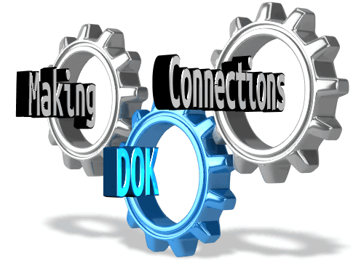
Notes:
Depth of Knowledge is about making connections and transferring learning.

Slide 3
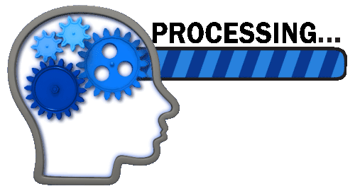
INB Table of Contents
Left Side
Right Side
Page 74
DOK-2 Conclusion
Page 75
Objective
From Knowledge to Concept
INB
Notes:
INB Set-Up

Slide 4
Knowledge
Notes:
A story about Knowledge…

Slide 5
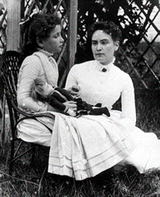
1888
Helen Keller
DOK-1
Recall and Reproduce
Sullivan spelled words into Helen’s hand and tried to help the girl connect letters and words with objects’ names. At first, Helen thought her teacher was just playing a game. Helen memorized the words.
SHOW ME
TELL ME
DOK-1 | Provides or shows information
Notes:
Helen Keller was deaf and blind after the age of two. Her story was remarkable. Her parents had no way to communicate with her.
Anne Sullivan was hired to teach Helen and was referred to as Teacher. Teacher taught Helen many words for objects by spelling them into her hand, and used
and later used sign language for Helen to feel the words being spelled. Helen was able to spell objects but she never asked Teacher “What is it?”
The knowledge was there – the recall to show Teacher she could spell words. This reminds me of students who can spell and read anything you give them.
And then BREAKTHROUGH!

Slide 6
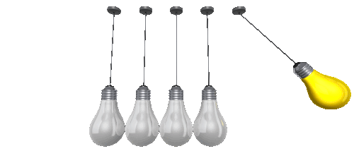
Concept
Notes:
Helen began to make connections between the words Annie was spelling in her hand and what they actually mean.

Slide 7
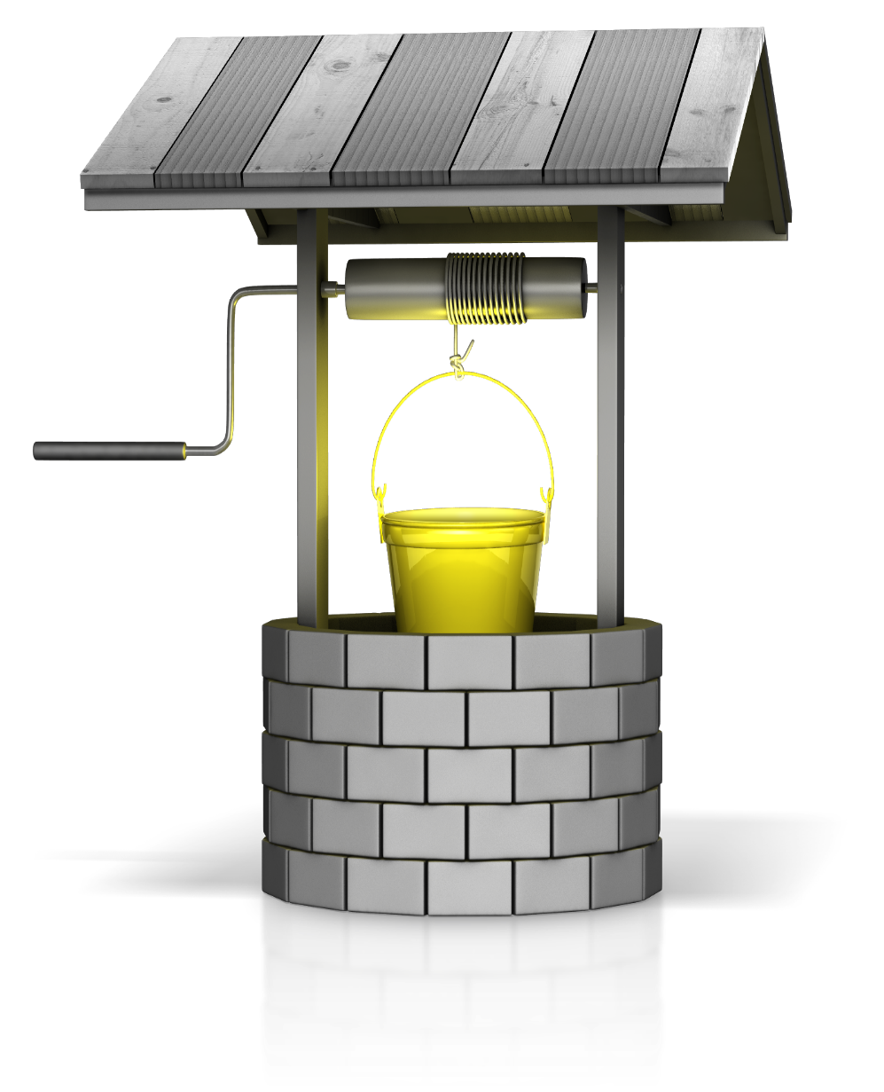
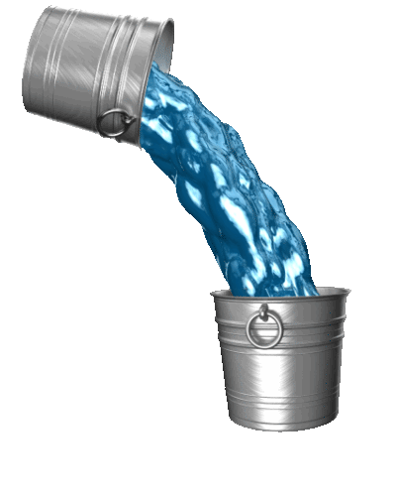
Keller later wrote in her autobiography, “As the cool stream gushed over one hand she spelled into the other the word water, first slowly, then rapidly.
I stood still, my whole attention fixed upon the motions of her fingers. Suddenly I felt a misty consciousness as of something forgotten–-a thrill of returning thought; and somehow the mystery of language was revealed to me. I knew then that ‘w-a-t-e-r’ meant the wonderful cool something that was flowing over my hand.
That living word awakened my soul, gave it light, hope, joy, set it free! There were barriers still, it is true, but barriers that could in time be swept away.”
Notes:
So…what happened? Turn and share. Yes…she did realize that the word water, meant water . But how would you generalize that? Go deeper.
She understood that EVERYTHING HAS A NAME. She began to use the knowledge of words spelled into her hand and moved that knowledge to a new
Context - and began to ask WHAT IS IT? When she began to ask what things were, Annie knew she had conceptualized that EVERYTHING HAD A NAME!
When knowledge is moved and used in a new context accurately it is called conceptualization.

Slide 8
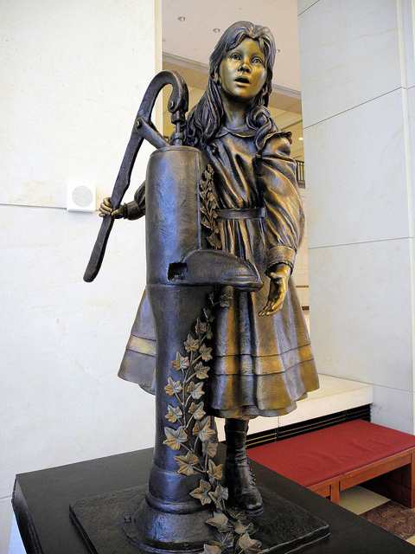
April 5, 1887
DOK-2
Skills and Concepts
DOK-2
Skills and Concepts
I can LOCATE and
SELECT
Information or details…
In order to…
IDENTIFY and
VERIFY
a new concept.
DOK-2 | Locates-Selects relevant information
DOK-2 | To Identify and Verify a specific concept or criteria.
Notes:
Alabama US Capitol Visitor Center
So now Helen has taken previous inert knowledge of letters and words
And moved it to conceptualizing that EVERYTHING HAS A NAME. DOK-2: Helen selected the correct words to identify what objects around her were.
She used her prior knowledge (words and spellings of words) in order to Identify that the words meant the names of objects.

Slide 9
Embedded PowerPoint Video
Making the Connection
From Knowledge
To
Conceptualization
All Things Have a Name
Notes:
Helen’s learning transferred making more and more connections between words and now understanding that words have meaning and ALL THINGS HAVE A NAME!
The Breakthrough! Conceptualization always leads to connections and transfer of learning. The BIG IDEA for Helen – ALL THINGS HAVE A NAME….opened unlimited connections!

Slide 10
Right Side INB p. 75
Locate and Select (Prior Knowledge Needed) 1. What prior knowledge did Helen need to conceptualize?
Helen needed to conceptualize (make a connection) that the words she had learned to spell meant that EVERYTHING HAS A NAME.
Identify and Verify the Concept (show understanding) 2. How did she demonstrate the conceptualization?
She demonstrated that she understood that EVERYTHING HAD A NAME, when she began to ask “What is it” and connected back to the words she had previously learned applying them a new way.
Think About this…..
How was the new context in which Helen used words different than the previous?
What decision did Helen have to make?
Notes:
Let’s review the story of Helen up to the Water Well. Have learners discuss each question before clicking on the answer slides.
Open discussion and sharing.

Slide 11
Right Side INB p. 75
Read each task. Underline what prior knowledge the learner has to conceptualize. Circle how the learner will show that conceptualization has taken place.
Explain the difference between addition and subtraction.
Summarize the author’s point of view.
Explain the steps you would follow to determine the age of a tree.
Based on the text, what does the phrase flew off the handle mean?
Create a glyph for your classmates to complete.
Write one paragraph describing what you learned about birds from the text.
Identify the genre of the two texts based on their text features.
Make a graphic organizer to show student birthdays in this class.
Write a sentence using each part of speech as shown in the chart.
Graph the data from the table to show the information in a new way. What decision must the learner make in each instance? Which tasks do not overtly articulate the prior knowledge?
Notes:
1. Model the first sentence:
What is the intended outcome? (Explaining the differences between + and - ) This is the conceptualization taking place.
What prior knowledge did the learner first need before conceptualizing? (the meaning of addition and subtraction).

Slide 12
Read each task. Underline the prior knowledge the learner has to conceptualize. Circle how the learner will demonstrate that conceptualization has taken place.
Explain the difference between addition and subtraction.
Summarize the author’s point of view.
Explain the steps you would follow to determine the age of a tree.
Based on the text, what does the phrase flew off the handle mean?
Create a glyph for your classmates to complete.
Write one paragraph describing what you learned about birds from the text.
Identify the genre of the two texts based on their text features.
Make a graphic organizer to show student birthdays in this class.
Write a sentence using each part of speech as shown in the chart.
Graph the data from the table to show the information in a new way. What decision must the learner make in each instance? Which tasks do not overtly articulate the prior knowledge?
Notes:
Answers - some can vary.
#4, 5 and 8 – the prior knowledge is not specifically stated. Many questions and tasks students encounter do not state or hint at prior learning.
#10 Optional ideas
In DOK-2 the learner has to make TWO DECISIONS
What prior knowledge do I need in order to answer or complete the task.
How will I complete the task (conceptualize meaning).

Slide 13
Left Side INB p. 74
What conclusion can you make about DOK-2?

