Slide 1

References Links
Common Core State Standards
http://www.corestandards.org/ELA-Literacy/RL/4
Smarter Balanced Assessment Consortium (SBAC)
http://www.smarterbalanced.org/
SBAC ELA/Literacy Content Specifications, ODE
http://www.ode.state.or.us/wma/teachlearn/commoncore/sbac_ela_literacycontentspecifications.pdf
D.O.K.
An Introduction
Depth of Knowledge
Bridging Assessment and Instruction
Connecting to the…
CCSS
Learning Progressions Framework
http://www.naacpartners.org/publications/ELA_LPF_12.2011_final.pdf
References Books
Quality Performance Assessment: A Guide for Schools and Districts by Center for Collaborative Education (2012)
Critical and Formative Thinking Assessments
Moore, Betsy & Stanley, Todd (2010)
EMBEDDED Formative Assessment - William, Dylan (2011)
The task examples in this booklet were taken from SBAC, ELA Literacy Content Specifications from the Oregon Department of Education web site as Cognitive Rigor Matrix (Depth of Knowledge). Tasks are not all-inclusive. http://www.ocde.us/CommonCoreCA/Documents/MathCogRigorMatrix.pdf
Everything School Leaders Need to Know About ASSESSMENT
Popham, James W. (2010)

Slide 2
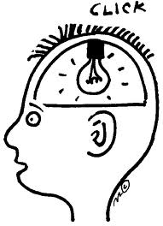
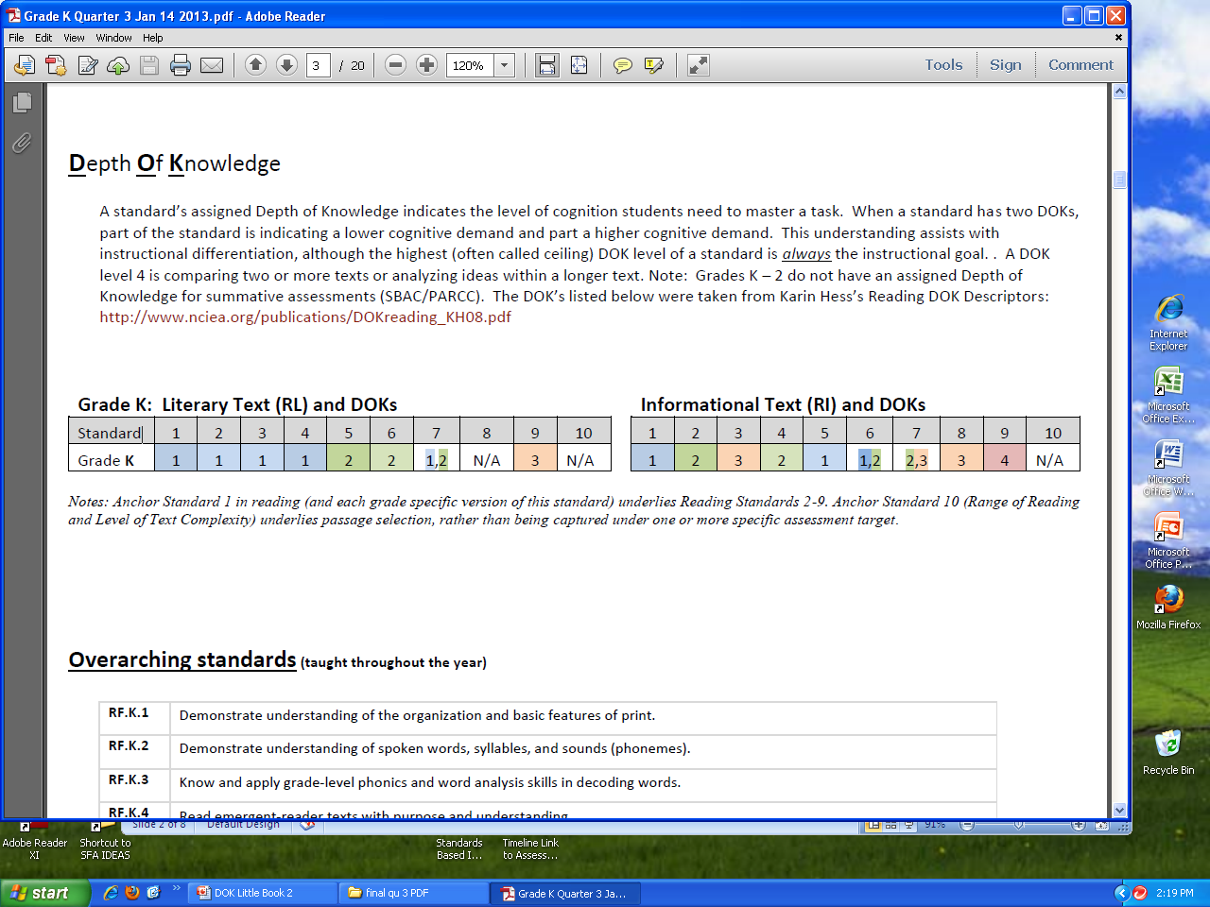
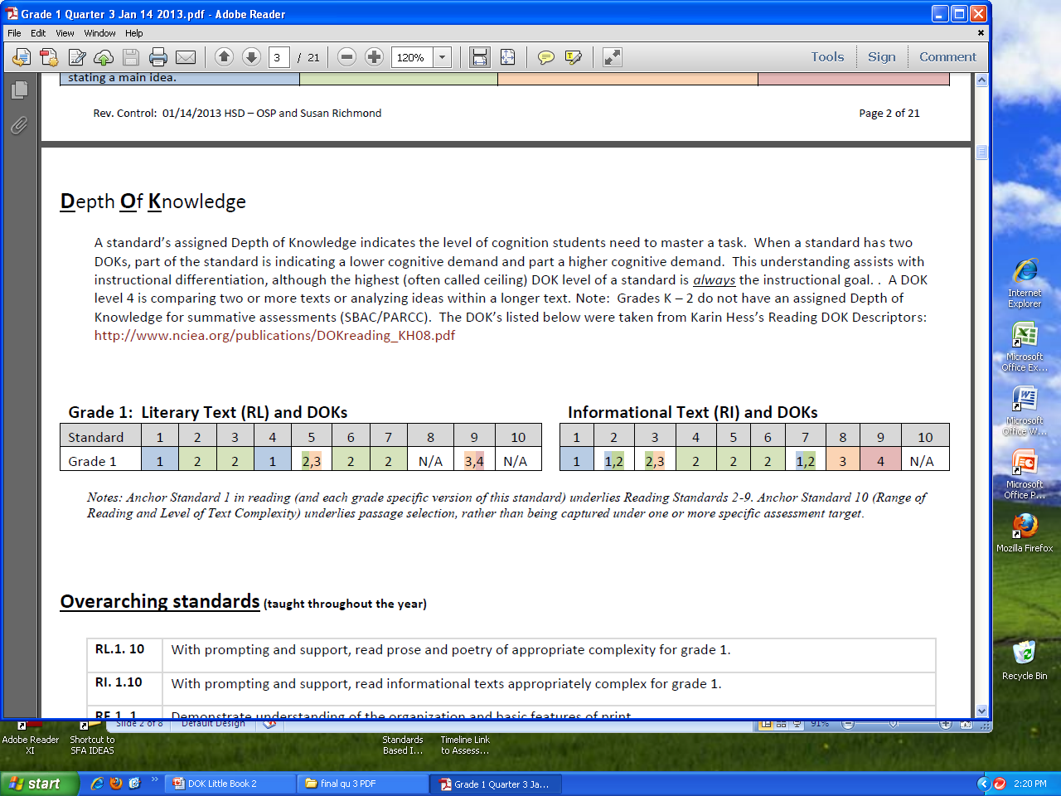
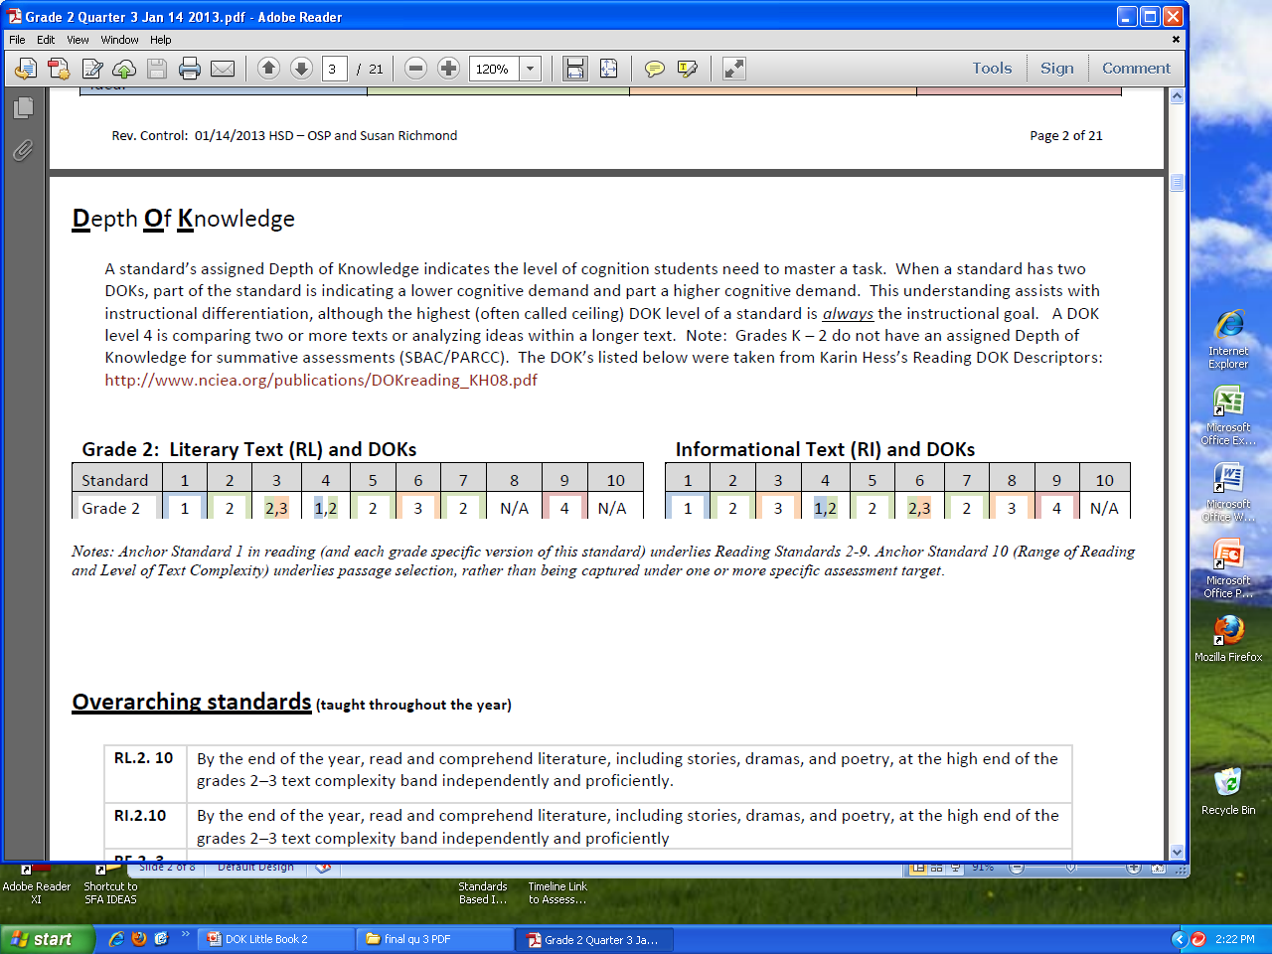
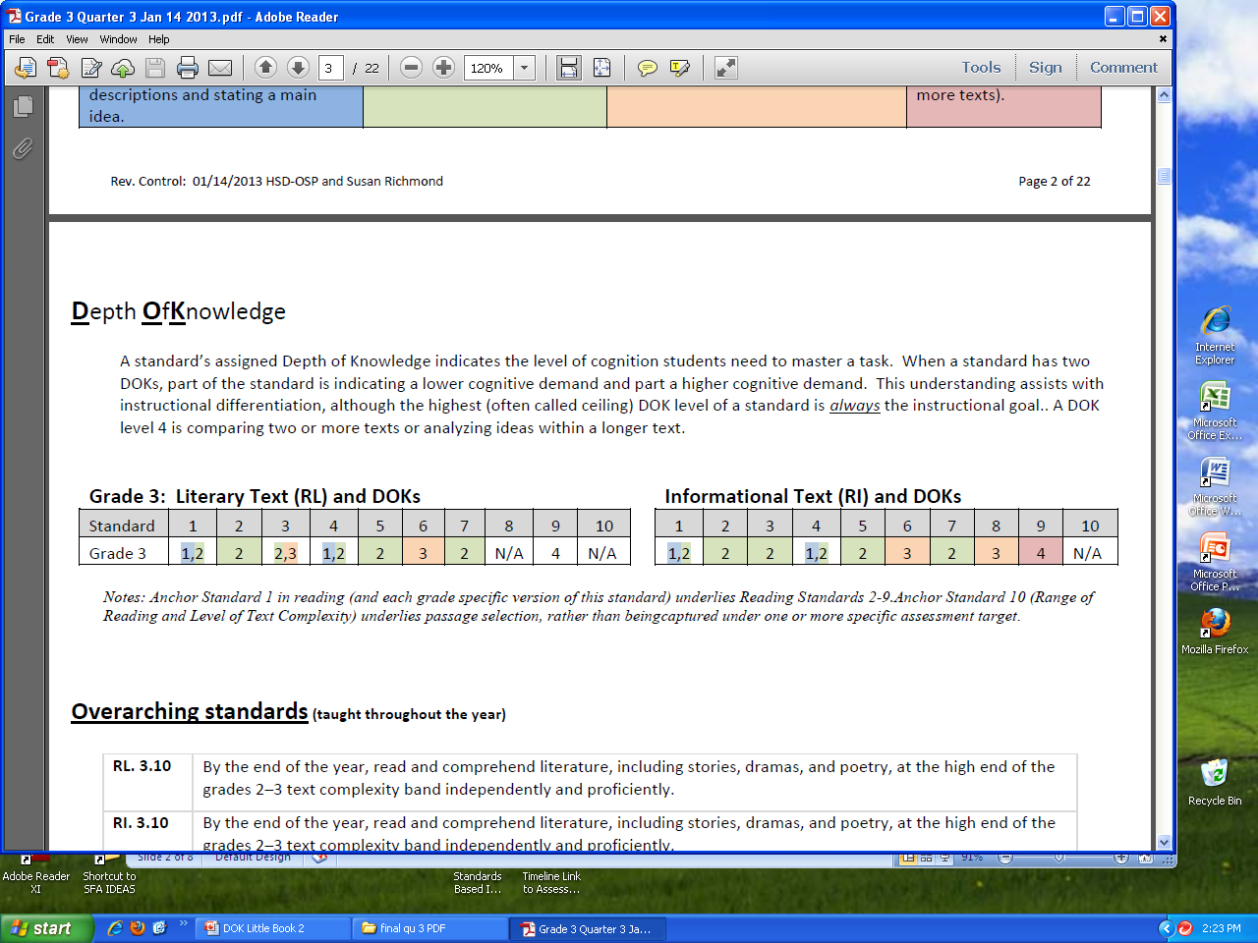
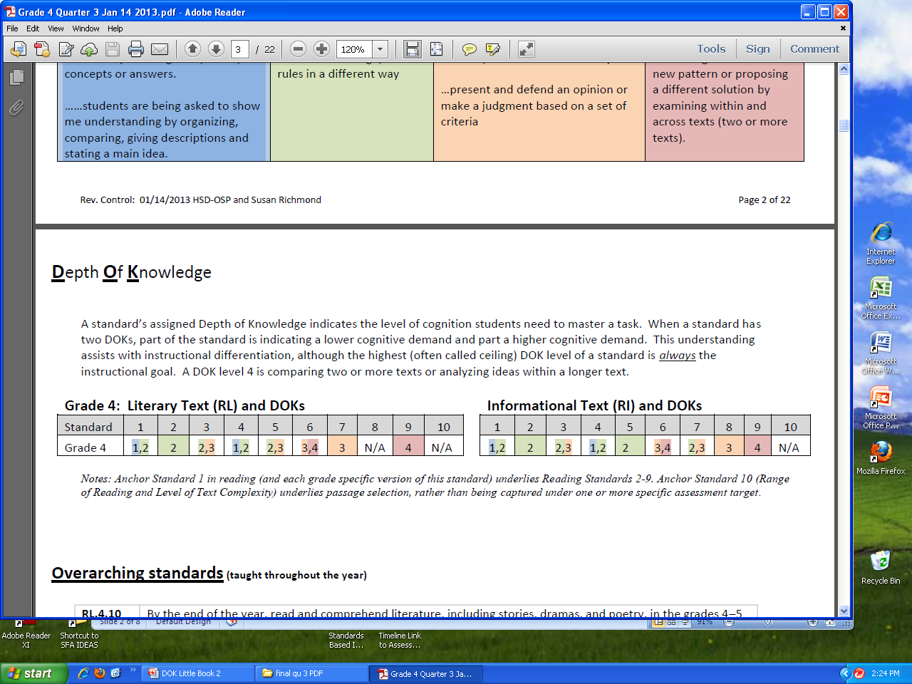
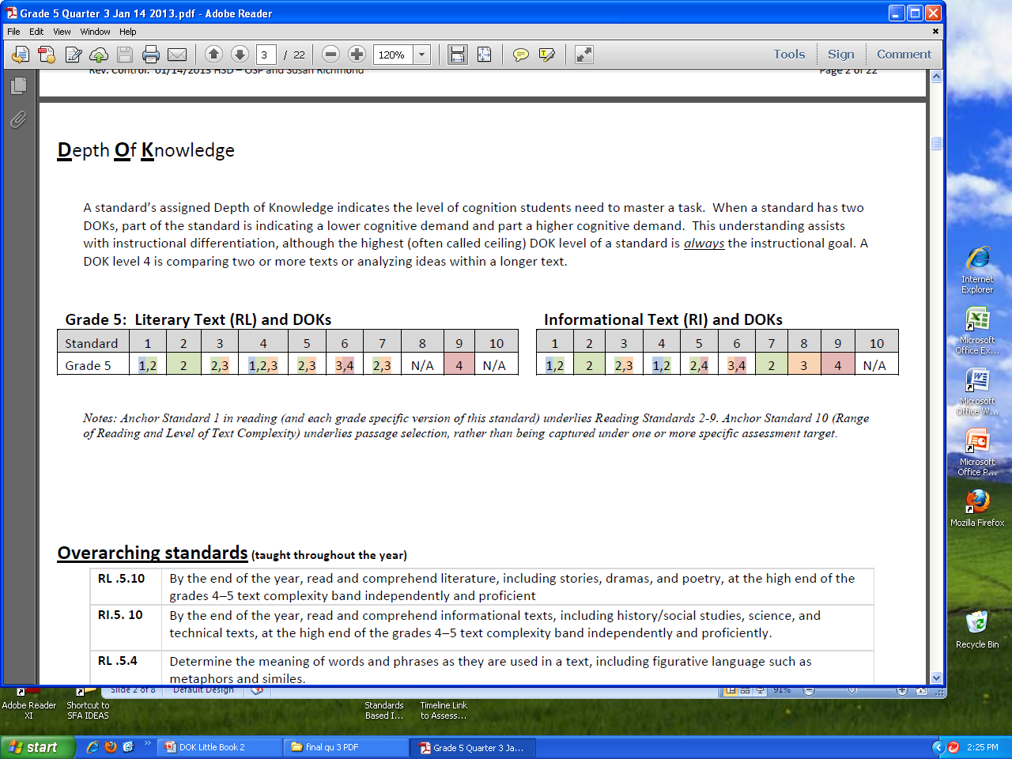
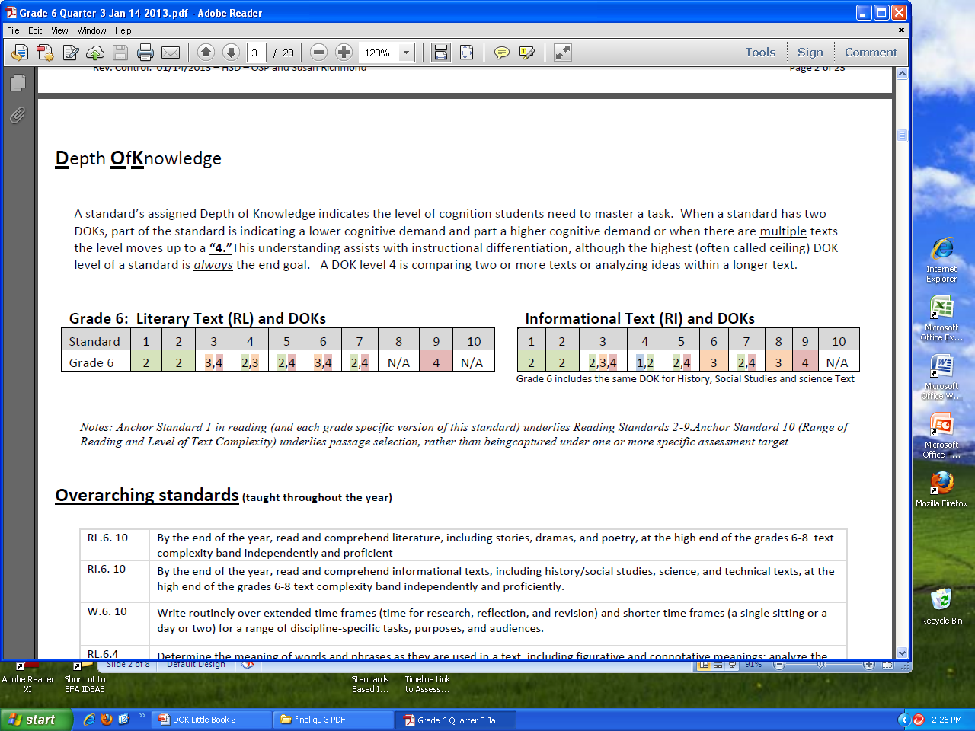
Reading DOK Levels K – 6
Grades K – 2 do not have an assigned Depth of Knowledge for summative assessments (SBAC/PARCC). The DOK’s l for K – 2 listed below were taken from Karin Hess’s Reading DOK Descriptors: http://www.nciea.org/publications/DOKreading_KH08.pdf
What is DOK?
Norman Webb (1997) developed a process and criteria for aligning standards and standardized assessments and curricular alignment based upon the cognitive demands or depth of knowledge required to complete a task. Webb’s identified Cognitive Demands are the four Depths of Knowledge Levels (DOK). DOK levels are determined by task complexity.
DOK | Description
1 | Recall and Reproduction Requires recall of information, such as a fact, definition, term, or performance of a simple process or procedure.
2 | Skills and Concepts Use information or conceptual knowledge, two or more steps.
3 | Reasoning and Thinking Requires deep understanding exhibited through planning, using evidence, and more demanding cognitive reasoning.
4 | Extended Thinking Requires connections and extensions, high cognitive demands and complex reasoning .
Norman L. Webb, senior research scientist with the Wisconsin Center for Education.
When a standard has two DOKs the highest DOK level of a standard is always the end goal. A DOK level 4 is comparing two or more texts or analyzing ideas within a longer text.
Quality Performance Assessment: A Guide for Schools and Districts by Center for Collaborative Education (2012)
Page 1
Page 14

Slide 3
Scaffolding and Differentiating Standard Instruction
Following the DOK Matrix, teachers can scaffold sequential tasks that progress from and to a standard’s highest required Depth of Knowledge.
What is Bloom’s Taxonomy?
Educators use Bloom’s Taxonomy (a classification or hierarchy (taxonomy) developed in 1956 by Benjamin Bloom) to develop questions of higher rigor.
Bloom's organizes how students think and learn, with an emphasis on reaching the highest thinking level possible. Bloom’s taxonomy difficulty level is determined by verbs.
Example (not a completed table)
Reading Literature RL.5.5 DOK - 3
Learning Progression Tasks for RL.5.5 (Measure with Informal Formative Assessments)
Reading Literature RL.5.5 Explain how a series of chapters, scenes, or stanzas fits together to provide the overall structure of a particular story, drama, or poem. |  | Path of DOK - 1 | a. Students can define chapter, scene, stanza, story, drama and poem. | b. Student can match or select appropriate words to define meaning (definitions), (refer to DOK-1 words). | Path to DOK -2 | c. Students can give examples of chapters, scenes and stanzas. | f. Students can explain the function of a chapter, scene and stanza (providing structure). | h. Students obtain and interpret information within a chapter, scene and stanza.
Student NAME
1 |  | 1 |  |  | 2
2 |  | 1 |  |  | 2
3 |  | 1 |  |  | 2
Levels of Thinking | Examples of Bloom’s Levels Verbs | At What Level am I Asking My Students to Think?
6 CREATING | Compose, Construct, Create, Design, Develop, Integrate, Invent, Make | I am asking my students to put information together in a different way.
5 EVALUATING | Appraise, Argue, Assess, Choose, Conclude, Critic, Decide, Evaluate | I am asking my students to present and defend.
4 ANALYZING | Analyze, Classify, Compare, Contrast, Deduce, Differentiate, Discriminate | I am asking my students to examine and break apart information.
3 APPLYING | Apply, Change, Choose, Compute, Dramatize, Interview, Prepare, Produce, Obtain | I am asking my students to solve problems for new situations.
2 UNDERSTANDING | Conclude, Demonstrate, Discuss, Explain, Generalize, Identify, Interpret, Paraphrase, Predict, Summarize, Tell | I am asking my students to show me understanding.
1 REMEMBERING | Define, Describe, Find, Identify, Label, List, Name, Quote, Recall, Recite, Sequence, Tell, | I am asking my students to remember previously learned material.
Pre-Requisites to DOK-3
Example (not a completed table)
Literature Reading Literature RL.2.5 DOK-2 Learning Progressions Tasks for RL.2.5
Reading Literature RL.2.5 Describe the overall structure of a story, including describing how the beginning introduces the story and the ending concludes the action |  | Path of DOK - 1 | a. Student can define the terms: story, beginning, introduction, ending conclusion and action. | b. Student can match the terms to their (definitions), (refer to DOK-1 words).
Student NAME
1 |  | 1
2 |  | 1
3 |  | 1
4 |  | 1
5 |  | 1
Pre-Requisites to DOK-2
Moore, Betsy & Stanley, Todd (2010) Critical and Formative Thinking Assessments p. 138
Page 13
Page 2

Slide 4
The DOK Matrix and CCSS
Common Core State Standard Assessments were developed using Webb's Depth of Knowledge (cognitive matrix) to determine the cognitive complexity of each standard.
Bloom’s connects with the DOK as a “springboard” or starting point (the verb). What comes after the verb is more important than the verb itself.
Task Examples for Depth of Knowledge
Level 4
(not a complete list)
The tasks in the red box have been identified as sequential, developmental learning tasks that progress from a DOK-1 and to a Depth of Knowledge 4.
Webb’s DOK Measures Cognitive Task Complexity
1 Recall and Reproduction |  | 2 Skills and Concepts | 3 Short term Reasoning -Thinking |  | 4 Extended Thinking
New Bloom’s Taxonomy Measures Difficulty of Thinking
Remember | Understand | Apply | Analyze | Evaluate | Create
Example
RI.5.9 Integrate information from several texts on the same topic in order to write or speak about the subject knowledgeably. DOK - 4
What recall (DOK-1) assessment tasks demonstrate evidence of synthesizing? | c Students develop a complex approach of gathering information about the same topic from several texts. d Students develop an alternative solution about a topic using several texts as references.
a Students brainstorm ideas, concepts, problems about the same topic from several texts. | What extended thinking (DOK-4) assessment tasks demonstrate evidence of understanding?
What skills and concepts (DOK-2) assessment tasks demonstrate evidence of synthesizing? | e Students explain how concepts or ideas about the same topic specifically relate to other content domains/concepts.
b Students generate conjectures or hypotheses about one topic based on several texts. | What extended thinking (DOK-4) assessment tasks demonstrate evidence of applying?
What thinking and reasoning (DOK-3) assessment tasks demonstrate evidence of synthesizing? | f Students devise an approach among many texts to research the same topic.
Assessment writers for CCSS use the DOK Matrix (combining Blooms and Depth of Knowledge) to close the gap between how we expect students to think (Bloom’s) and the evidence of that thinking (Webb’s).
Complexity Level |  | DOK Evidence of Tasks – what comes after the verb
2 Skills and Concepts |  | Obtain information using text features/references.
Thinking Level |  | Verb Examples of Apply
Bloom’s | Apply | Apply, Change, Choose, Compute, Dramatize, Interview, Prepare, Obtain
Page 3
Page 12

Slide 5

Tasks for Depth of Knowledge
Level 4
Each Standard has a DOK Level
DOK Blooms | DOK LEVEL 1 Recall and Reproduction | DOK LEVEL 2 Skills and Concepts | DOK LEVEL 3 Reasoning and Thinking | DOK LEVEL 4 Extended Thinking
Under-stand |  |  |  | e Explain how concepts or ideas specifically relate to other content domains/concepts.
Apply |  |  |  | f Devise an approach among many alternatives to research a novel problem.
Analyze |  |  |  | g Analyze multiple sources or multiple text. H Analyze complex abstract themes.
Evaluate |  |  |  | h Evaluate relevancy, accuracy and completeness of information across texts or sources
Create | a Brainstorm ideas, concepts, problems, or perspectives related to a topic or concept. | b Generate conjectures or hypotheses based on observations or prior knowledge and experience | c Develop a complex model or approach for a given situation. d Develop an alternative solution. | J Synthesize information across multiple sources or texts. K Articulate a new voice, theme, knowledge or perspective.
The Smarter Balance Assessment Consortium (SBAC) has “assigned” a Depth of Knowledge to each of the Reading Common Core State Standards.
Example: Grade 3 Standard 1
RL.3.1 Ask and answer questions to demonstrate understanding of a text, referring explicitly to the text as the basis for the answers.
#Depth of Knowledge level (DOK) 1, 2
DOK | Description
1 | Recall and Reproduction Requires recall of information, such as a fact, definition, term, or performance of a simple process or procedure.
2 | Skills and Concepts Use information or conceptual knowledge, two or more steps.
SBAC Content Specifications for the Summative Assessment of the Common Core State Standards for English Language Arts and Literacy in History/Social Studies,, Science & Technical Subjects 2011
Page 11
Page 4

Slide 6
How are Assessment Tasks Determined by DOK?
The Common Core State Standards require high-level cognitive demand. For each CCSS Summative Assessment Target , the “depth(s) of knowledge” that student needs to bring to the item/task” has been identified, using the Cognitive Rigor Matrix or DOK Matrix.
This matrix draws from two widely accepted measures to describe cognitive rigor: Bloom's (revised) Taxonomy of Educational Objectives and Webb’s Depth-of-Knowledge Levels.
Task Examples for Depth of Knowledge
Level 3
(not a complete list)
The tasks in the orange box have been identified as sequential, developmental learning tasks that progress from a DOK-1 and to a Depth of Knowledge 3.
Depth of Knowledge Reading Matrix… Sequential Tasks
Example
Depth of Knowledge (Webb) Task Complexity | DOK LEVEL 1 Recall and Reproduction | DOK LEVEL 2 Basic Skills and Concepts | DOK LEVEL 3 Strategic Thinking and Reasoning | DOK LEVEL 4 Extended Thinking
Blooms (Task Difficulty)
Remember (Knowledge) | -Recall, locate basic facts, definitions, details and events
Understand (Comprehend) | -Select appropriate words for use when intended meaning is clearly evident. | -Specify, explain relationships -Summarize -Identify central ideas | -Explain, generalize or connect ideas using supporting evidence (quote, text, evidence, example…). | -Explain how concepts or ideas specifically relate to other content domains/concepts.
Apply | -Use language structure(pre/suffix) or word relationships (synonyms/antonym) to determine meaning. | -Use context to identify word meanings -Obtain and interpret information using text features. | -Use concepts to solve non-routine problems. | -Devise an approach among many alternatives to research a novel problem.
Analyze | - Identify the kind of information contained in a graphic, table, visual, etc. | -Compare literary elements, facts, terms and events. -Analyze format, organization and text structures. | -Analyze or interpret author’s craft (e.g., literary devices, viewpoint, or potential bias) to critique a text. | -Analyze multiple sources or multiple text. -Analyze complex abstract themes.
Evaluate |  |  | -Cite evidence and develop a logical argument for conjectures based on one text or problem. | -Evaluate relevancy, accuracy and completeness of information across texts or sources
Create (Synthesize) | -Brainstorm ideas, concepts, problems, or perspectives related to a topic or concept. | -Generate conjectures or hypotheses based on observations or prior knowledge and experience. | -Develop a complex model or approach for a given situation. -Develop an alternative solution. | -Synthesize information across multiple sources or texts. -Articulate a new voice, theme, knowledge or perspective.
RL.4.5 Explain major differences between poems, drama, and prose, and refer to the structural elements of poems (e.g., verse, rhythm, meter) and drama (e.g., casts of characters, settings, descriptions, dialogue, stage directions) when writing or speaking about a text. DOK - 3
What recall (DOK-1) assessment tasks demonstrate evidence of remembering? | d. Students use evidence (quotes, text examples) to generalize or connect major differences between poems, drama and prose.
a. Student finds definitions or can define: poem, drama, prose, verse, rhythm, meter, casts of characters, setting, description, | What thinking and reasoning (DOK-3) assessment tasks demonstrate evidence of applying?
What skills and concepts (DOK-2) assessment tasks demonstrate evidence of understanding? | e. Student can use knowledge of structural elements of poems, drama or prose to solve a problem (i.e., how to write a poem, etc…)
b. Students can give examples of poems, dramas and prose. c. Student obtains/interprets information relating to structures of poems, drama and prose. | What thinking and reasoning (DOK-3) assessment tasks demonstrate evidence of analyzing?
 | f Students analyze a poem, drama or prose text in order to critique the use of literary elements to create a viewpoint or bias.
What thinking and reasoning (DOK-3) assessment tasks demonstrate evidence of understanding?
DOK 1 Progression
DOK 2 Progression
DOK 3 Progression
DOK 4 Progression
DOK 3 Progression
DOK 4 Progression
The National Center for the Improvement of Educational Assessment, Inc. in conjunction with SBAC.
Page 5
Page 10

Slide 7

Tasks for Depth of Knowledge
Level 3
Instructional Benefits of using the DOK Matrix
What is the standard really asking a student to do? How will the assessment task look?
Depth of Knowledge matches the standard to an assessment task. Bloom’s matches the type of thinking needed in order for students to do an assessment task.
Analyze Instruction
Is my instruction rigorous?
Lesson Planning
Do my lessons match the cognitive demand needed?
Design Assessment Items and Tasks
What tasks match the level of demand?
What formative assessments should I use?
Scaffolding and Differentiation
What pre-assessments and tasks or activities do I
use for varying student levels of cognition?
How do I move students toward the needed
cognitive demand of a standard?
Depth of Knowledge (Webb) Task Complexity | DOK LEVEL 1 Recall and Reproduction | DOK LEVEL 2 Basic Skills and Concepts | DOK LEVEL 3 Strategic Thinking and Reasoning
Blooms (Task Difficulty)
Understand |  |  | d Explain, generalize or connect ideas using supporting evidence (quote, text, evidence, example…).
Apply |  |  | e Use concepts to solve non-routine problems.
Analyze | a. - Identify the kind of information contained in a graphic, table, visual, etc. | b Compare literary elements, facts, terms and events. c Analyze format, organization and text structures. | f Analyze or interpret author’s craft (e.g., literary devices, viewpoint, or potential bias) to critique a text.
Evaluate |  |  | g Cite evidence and develop a logical argument for conjectures based on one text or problem.
DOK 3 Progression
DOK 3 Progression
Permission to use the cognitive rigor matrix for reproduction is given when authorship is fully cited: Karen K Hess Cognitive Rigor Matrix 2009, www.nciea.org
Page 9
Page 6

Slide 8
Tasks for Depth of Knowledge
Levels 1 and 2.
Task Examples for Depth of Knowledge
Levels 1 and 2.
Depth of Knowledge (Webb) Task Complexity | DOK LEVEL 1 Recall and Reproduction | DOK LEVEL 2 Basic Skills and Concepts
Blooms
Recall | a. -Recall, locate basic facts, definitions, details and events
Understand | b. -Select appropriate words for use when intended meaning is clearly evident. | d. -Specify, explain relationships e. -Summarize f. -Identify central ideas
Apply | c. -Use language structure(pre/suffix) or word relationships (synonyms/antonym) to determine meaning. | g. -Use context to identify word meanings h. -Obtain and interpret information using text features.
There are no CCSS Reading Standards listed as having only a DOK of 1. Standards with a DOK of 1 are listed as DOK 1,2. The highest level of cognitive demand for those standards would be considered a “2.”
Teaching sequentially to reach a DOK of 2, scaffolding would start with the DOK 1 tasks and move upward. The grade level standard would dictate what tasks to select from the DOK Matrix.
DOK 1 Progression
Example
RL.3.1
Ask and answer questions to demonstrate understanding of a text, referring explicitly to the text as the basis for the answers.
Depth of Knowledge level (DOK) 1, 2
DOK 2 Progression
What recall (DOK-1) assessment tasks demonstrate evidence of remembering? | What skills and concepts (DOK-2) assessment tasks demonstrate evidence of understanding?
a. Recall, locate answers to questions about facts, definitions, details or events. | d. Be able to explain relationships (cause and effect) referring to the text.
identify or describe characters, setting and sequence. | e. Summarize events using explicit text references.
describe or explain who, what, where, when or how | f. Identify Main Idea using text as a reference.
b – c Not Applicable | Not Applicable Obtain information using text features/references.
The Tasks in the blue box have been identified as sequential learning tasks of a Depth of Knowledge 1.
The Tasks in the Green boxes have been identified as sequential developmental learning tasks that progress from DOK-1 and to a Depth of Knowledge 2.
Heritage, Kim, Vendlinski, and Herman (2009) explain that learning progressions are important to the development of progressive sophistication in skills within a domain.
Page 7
Page 8

