Slide 1
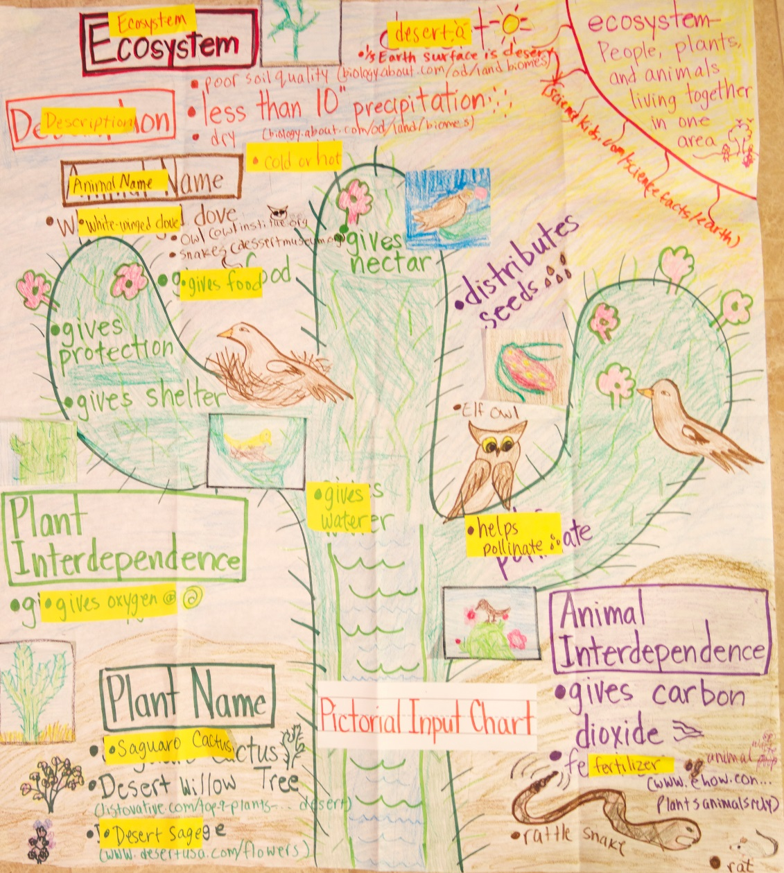

Slide 2
About this Document
Guided Language Acquisition or GLAD is “Guided.” This necessitates a Depth of Knowledge (DOK) of 1. Because a task is a DOK-1 doesn’t mean it’s easy. Memorizing an encyclopedia is not easy but it is still a DOK-1 because it is recall. Learning a new language is not easy!
Researchers from Education Northwest are rigorously conducting a 4 year experimental study of Project GLAD. Initial results are showing that GLAD’s most positive impact on English Language Learners (ELLs) are strongest with those at the intermediate levels of English proficiency. GLAD Research The impact on non-ELL students was slightly negative in the second year of study in relationship to vocabulary growth.
These findings suggest that GLAD as a form of sheltered English instruction benefits students who have acquired some English but does not replace English Language Development which supports all ELLS at their individual levels of proficiency. This study further suggests that students above an intermediate level of proficiency are perhaps not challenged enough with GLAD or when GLAD replaces other vocabulary instruction.
WHAT THIS DOCUMENT IS NOT
This document IS NOT a training manual for how to teach GLAD strategies. However, this document should only be used by educators trained in GLAD. Those trained in GLAD will recognize the brief outline of each of the specific GLAD strategies. GLAD Training This document also IS NOT an extension of GLAD. GLAD is for language acquisition. Once you transfer learning to the Extending Complexity Tasks, you have left GLAD. The two are very distinctly different. The Extending Complexity Tasks should not be confused with helping students acquire English proficiency!
WHAT THIS DOCUMENT IS
This document IS a possible instructional tool for transference, scaffolding and differentiation moving away from a particular GLAD strategy toward more cognitively demanding tasks. Students who have not mastered a GLAD strategy as it is originally intended, will need appropriate scaffolds for these tasks. Students who have mastered the GLAD strategy or beyond may benefit from the Extending Complexity Tasks. The tasks must be completed independently to truly be at the DOK level indicated.
The tasks are adapted from Karin Hess’s Cognitive Rigor Matrix. Karin Hess It is very important to recognize that the tasks MOVE AWAY from language acquisition instruction and are not to be considered GLAD strategies or part of instruction for acquiring language.
The illustrations are from the Pasco School District’s G.L.A.D. Website.
The GLAD inquiry charts are similar to Hoffman’s I-Charts (the first creator of I-Charts). Many of the tasks are aligned to his charts. Hoffman, J. (1992). "Critical Reading/Thinking Across the Curriculum: Using I-Charts to Support Learning." Language Arts, 69(2), 121-127.

Slide 3
Table of Contents
Imbedding Vocabulary and Concepts
Cognitive Content Dictionary……………………………………………….
Teacher Made Big Books………………………………………………………
Inquiry Charts
Exploration Reports……………………………………………………………… 4
Observation Chart………………………………………………………………… 5
Inquiry Chart………………………………………………………………………... 6
Input Charts
Pictorial Input Chart…………………………………………………………….. 7
Comparative Input Chart……………………………………………………… 8
Narrative Input Chart…………………………………………………………… 9
Oral Practice
Chants…………………………………………………………………………………. 10
Sentence Pattern Chart…………………………………………………........ 11
Reading and Writing
Cooperative Strip Paragraph……………………………………………….. 12
Process Grid………………………………………………………………………… 13
Story Maps………………………………………………………………………….. 14

Slide 4
A. Imbedding Vocabulary and Concepts
Cognitive Content Dictionary
Language Functions: Describe/Express/Predict/Define/Explain
CCSS L.4, L.5 - Purpose: The Cognitive Content or Picture Dictionary helps students build content vocabulary which aids in text comprehension.
Basic G.L.A.D Strategy Teacher Guided with whole class, team or individual
1. | New Word The teacher selects a word (becomes a daily-weekly signal word) later students vote on a word.
DOK-1 Knowledge Tasks: Recall – Read - Define
2. | Predictions (clues) Students predict meaning of selected word. The teacher writes or sketches something that will help students remember the meaning of each word.
DOK- 1 Knowledge: Define
3. | Final Meaning Students use the word in a sentence as the teacher writes the sentence(s).
BEYOND GLAD Extending Complexity After students have gone through the Basic GLAD Strategy, they may use the Cognitive Content Dictionary as a reference to answer the extended DOK level prompts as indicated. Each task must be completed by students independently.
CCSS L.4 - DOK-2 Comprehension Prompt: give non-examples -examples Prompt: Select a word from the chart. Give a non-example of the word and explain why it is a non-example
Teacher: Students will need a short text related to the topic of study, with one underlined new vocabulary word. CCSS L.4 - DOK-2 Application Prompt: Use context to identify word meanings. Prompt: Write a definition for the underlined word based on how it is used in the text

Slide 5
2. Teacher Made Big Books
Language Functions: Retell/Relate/Describe/Explain
CCSS L.1, L.6 - Purpose: Teacher-Made Big Books focus on content standards while imbedding concepts and vocabulary. Big- Books make expository/informational text comprehensible (by using frames and patterns) and allow reading access for all students.
Basic G.L.A.D Strategy
DOK-1 Knowledge – Recall - Read
1. | The teacher selects and presents key concepts and vocabulary writing them in familiar pattern or rhythm (such as Brown Bear, Brown Bear) or a frame (first, next last). Using real pictures and photos, the teacher creates the Big-Book.
BEYOND GLAD Extending Complexity After students have gone through the Basic GLAD Strategy, they may use the Big Book as a reference to answer the extended DOK level prompts as indicated. Each task must be completed by students independently.
CCSS RL-RI.1 - DOK-1 Comprehension Prompt: describe/explain who, what, where, when, or how Who or what is the Big Book about? Where does the story/event take place? When did ___ happen? (Students can tell, write or draw their answers).
CCSS RI/RL.1 - DOK-2 Application Prompt: Obtain and interpret information using text features. Prompt: Select and draw an illustration from the Big Book. Write facts from the Big Book that tell about the illustration.
Teacher: Students should have had some practice with generalizations before doing this task. CCSS RI.3 - DOK-2 Synthesis Prompt: Generate conjectures /hypotheses based on observations-prior knowledge and experience. Prompts: Complete the following generalization about teacher fill in (topic). Based on teacher fill in , what can you generalize that most teacher fill in can/do/are?

Slide 6
B. Inquiry Charts
Exploration Reports
Language Functions: Explain/Describe/Ask Questions/Predict
CCSS SL.1 -Purpose: The Exploration Report is a type of inquiry chart that gives the teacher an understanding of students’ background knowledge about a topic. It provides a basis for scaffolding vocabulary and content knowledge throughout a unit of study. Exploration Reports teach the differences between predicting (hypothesis), observing and questioning.
Basic G.L.A.D Strategy
1. | DOK-1 Knowledge – Recall – Recognize Basic Facts The teacher selects 2-3 colored high interest photos for each team. Each team then decides on one photo and states an observation, a prediction and a question which the teacher records on the Exploration Report Chart.
2. | Scaffolding The teacher uses the Exploration Report Chart to monitor understanding of the topic. As the unit progresses and information is learned, the chart can be revisited and extended to include new observations, wonderings or predictions.
BEYOND GLAD Extending Complexity After students have gone through the Basic GLAD Strategy, they may use the Exploration Report to a reference to answer the extended DOK level prompts as indicated. Each task must be completed by students independently.
CCSS L.3 - DOK-1 Analysis Prompt: identify whether specific information is contained in graphic representations. Prompt: List three new observations you could add to the Exploration Report Chart and where each can be found in the text.
CCSS RI.1, RI.3 - DOK-2 Analysis Prompt: Distinguish: relevant-irrelevant information; fact/opinion. Prompt: Choose a wondering question from the Exploration Report Chart. Answer the question with relevant facts, details or examples from the text.

Slide 7
2. Observation Chart
Language Functions: Describe/ Narrate/Ask/Recall
CCSS SL.1, SL.6 - Purpose: Teacher guided as a team activity for introducing a new unit of study/topic, an Observation Chart is a type of inquiry chart that engages student curiosity and is also a tool to assess background knowledge. Ms. Tores, Progressive History Teacher states,” 1 this is done as a frontloading exercise—creates a visual background to knowledge.”
Basic G.L.A.D Strategy
DOK-1 Knowledge – Recall - Basic Facts
1. | The teacher selects real photos in color and attaches them to white paper. Students work in teams or pairs to discuss each photo. Students write an observation, a question and a comment under each photo.
2. | Scaffolding The teacher uses the Observation Chart to monitor understanding of the topic. As the unit progresses and information is learned, the chart can be revisited and extended to include new observations, questions and comments.
BEYOND GLAD Extending Complexity After students have gone through the Basic GLAD Strategy, they may use the Observation Chart as a reference to answer the extended DOK level prompts as indicated. Each task must be completed by students independently.
CCSS SL.2 - DOK-2 Analysis Prompt: categorize/compare literary elements, terms, facts, details, events Prompt: Group similar observations students wrote on the Observation Chart. Give each new group a title.
CCSS RI.3 - DOK-3 Application Prompt: use concepts to solve non-routine problems Teacher: Fill in the blanks before presenting the prompts to students. Prompt: Write an informational text to show what you have learned about _______ (Observation Chart topic). In your text explain how your ideas have changed about _______ (topic) and why. Support your reasons with facts, details or examples from a primary source.

Slide 8
Inquiry Chart
Language Functions: Predict/Statement/Question
CCSS L.3 - Purpose: Inquiry charts set a purpose for learning. James Hoffman is accredited with I (inquiry)) Charts in 1982 as a strategy to plan, interact and integrate to and with information.2 The GLAD Inquiry Chart is similar, but based on the scientific method of: think – predict and hypothesize (the predecessor of the K.W.L.). This strategy helps access students’ background knowledge, address misconceptions and revise learning.
Basic G.L.A.D Strategy
DOK-1 Knowledge – Recall - Basic Facts
1. | Select a topic. Record student’s comments in each column: What I Know and What I Want to Know.
DOK-1 Comprehension – describe or explain who, what, when, where, how
2. | Revisit Revisit the topic often asking students to site sources of new information and answering prior questions.
BEYOND GLAD Extending Complexity After students have gone through the Basic GLAD Strategy, they may use the Inquiry Chart as a reference to answer the extended DOK level prompts as indicated. Each task must be completed by students independently.
CCSS SL.2, RI.6 - DOK-2 Comprehension: summarize results, concepts, ideas. Teacher: Fill in the blanks before presenting the prompt. Prompt: In one or two paragraphs, summarize what you learned about _______ (topic). Use facts, details or examples from the text and the Inquiry Chart in your summary.
CCSS SL.3, DOK-2 Analysis: distinguish: relevant-irrelevant information; fact/opinion. Teacher: Fill in the blanks before presenting the prompt. Prompt: Which facts, details or examples from the text and Inquiry Chart were not relevant to your summary? Explain why.
CCSS SL.4, W.1, RI.8 - DOK – 3 Evaluate: Cite evidence and develop a logical argument for conjectures. Teacher: Fill in the blanks before presenting the prompt. Prompt: State an opinion about ______ (topic based from Inquiry Chart and text(s)) citing facts, details or examples to support a logical reason for your opinion.

Slide 9
C. Input Charts
Pictorial Input Chart
Language Functions: Analyze, Compare/Contrast, Express/Explain/Describe
CCSS L.1, L.5 - Purpose: The Pictorial Input Chart makes vocabulary and concepts comprehensible. Organizing information as students watch imprints or inputs a visual mind map that students can refer to throughout a unit of study and becomes a valuable resource for students.
Basic G.L.A.D Strategy
1. | Before Beginning, Enlarge a picture and trace on butcher paper in light pencil, include vocabulary and notes about the picture. Then, while students are watching trace over the entire drawing, providing verbal input for student understanding. Chunk or classify information in different colors.
DOK-1 Knowledge: Recall – Retell – Facts - Read
2. | CCSS RI.7 - Revisit Revisit the topic often, asking students to site sources of new information.
BEYOND GLAD Extending Complexity After students have gone through the Basic GLAD Strategy, they may use the Pictorial Input Chart as a reference to answer the extended DOK level prompts as indicated. Students will also need texts that support the topic! Each task must be completed by students independently.
Teacher: Based on the Pictorial Input Chart, fill in the blank of the prompt. CCSS L.4, RI.2, and RI.4 - DOK-1 Analysis: Identify whether specific information is contained in graphic representations. Prompt: Does the information in the Pictorial Input Chart explain _________? If yes, describe where.
Teacher: Based on the Pictorial Input Chart, fill in the blank of the prompt. CCSS L.4, RI.2, and RI.7 - DOK-2 Comprehension: Locate information to support explicit-implicit central ideas. Prompt: What information in the Pictorial Input Chart most supports the central idea that _______?
CCSS L.5.2, RI.7 - DOK – 3 Synthesis: Develop an alternative solution. Teacher: Fill in the blanks before presenting the prompt. Create a Pictorial Input chart that organizes the same information as the class Pictorial Input chart, but in a different and better way. Then answer the following questions: Why did you arrange your chart in the way you did? How is it different? How is it better? What conclusion did you reach when you created your chart?

Slide 10
2. Comparative Input Chart
Language Functions: Analyze, Compare/Contrast, Express/Explain/Describe
Purpose: The Comparative Input Chart is a variation of the pictorial Venn diagram, comparing and contrasting two objects, animals or people. Information and content is presented with the comparative, taken to a Venn and finally to writing step by step.
Basic G.L.A.D Strategy
1. | Before Beginning, Enlarge and trace on butcher paper two objects, animals or characters that lend themselves to compare/contrast in light pencil, include vocabulary and notes about the picture. Then, while students are watching trace over the entire drawing, providing verbal input for student understanding. Chunk or classify information in different colors.
DOK-1 Knowledge: Recall – Retell – Facts - Read
2. | CCSS L.4 - Revisit Revisit to add new information on word cards and review prior information.
BEYOND GLAD Extending Complexity After students have gone through the Basic GLAD Strategy, they may use the Comparative Input Chart as a reference to answer the extended DOK level prompts as indicated. Each task must be completed by students independently.
CCSS L.3, RI.2 - DOK-2 Analysis: categorize/compare literary elements, terms, facts, details, events Prompt: Record the key points of the Comparative Input Chart onto a Venn Diagram.
CCSS RI.1, RI.2 - DOK-2 Comprehension: Locate information to support explicit-implicit central ideas. Prompt: Summarize the main ideas of each side of the Comparative Input Chart.
CCSS L4, RI.6, RI.9 - DOK – 3 Application: Apply a concept in a new context. Teacher: Fill in the blanks before presenting the prompt. Prompt: Write a comparative writing piece about ______ (topic on Comparative Input Chart). Use the Comparative Input Chart and your Venn Diagram as a resource for writing. Your writing piece should have the following: Introduction Similarities and Differences Conclusion

Slide 11
2. Narrative Input Chart
Language Functions: Ask/Narrate/Retell/Sequence/Predict
Purpose: The Narrative Input Chart exposes students to narrative text formats. It allows for increased comprehension of academic language and concepts but within a narrative format. The chart provides a visual retelling of the story step-by-step
Basic G.L.A.D Strategy
1. | Create a story or use a Read Aloud that emphasizes standards-based concepts and vocabulary you would like to present in a narrative format. Before beginning draw or copy pictures to represent each part of the story and attach the text to the back of each picture. Create a background for the narrative. As you tell the story, place the pictures on the background.
DOK-1 Knowledge: Recall, recognize, or locate basic facts, details, events, or ideas explicit in texts.
2. | CCSS L.4 - Revisit Revisit to add word cards and/or speech bubbles.
BEYOND GLAD Extending Complexity After students have gone through the Basic GLAD Strategy, they may use the Pictorial Input Chart as a reference to answer the extended DOK level prompts as indicated. Each task must be completed by students independently.
CCSS SL.2, RL.1 - DOK-1 Comprehension: describe/explain who, what, where, when, or how Teacher: Fill in the blanks before presenting the prompt. Prompt: Who is the story about? What was the problem? What was the solution? What happened before/after ___? Where was the setting? How did ___ (character), respond to ____?
CCSS SL.3, RL.2 - DOK-2 Comprehension: Take notes; organize ideas/data Prompt: What is the moral or lesson of the story? Support your answer with examples from the text.
CCSS RL.5, RL.7 - DOK–2 Application: Apply simple organizational structures (paragraph, sentence types) in writing. Prompt: Write one sentence for each illustration/photo. Each sentence should describe how the illustration contributes to the story.

Slide 12
D. Oral Practice
Chants
Language Functions:
CCSS L.3, L.5 - Purpose: Chants imbed concepts and vocabulary using auditory and visual language patterns. Students access academic language in a low-pressured environments
Basic G.L.A.D Strategy
1. | Choose key concepts and vocabulary to imbed in chants within a frame or existing song. Chants should emphasize the rhythm and language patterns first and then focus on concepts and vocabulary.
DOK-1 Knowledge: Recall – Read
2. | CCSS L.4 - Revisit Revisit the chants to add scientific, historic or other interesting words.
BEYOND GLAD Extending Complexity After students have gone through the Basic GLAD Strategy, they may use the Chant Chart as a reference to answer the extended DOK level prompts as indicated. Each task must be completed by students independently.
CCSS SL.6, RL.1 DOK-1 Comprehension: Identify or describe literary elements (characters, setting, sequence,) or the sequence of how information is presented in expository chants. Prompt: Draw, write or tell the sequence of events in the Chant Chart.
CCSS L.5, W.1, W.2 - DOK-2 Analysis: Categorize or compare terms, facts, details or events. Prompt: On paper, draw or write to group similar details, descriptions, definitions or facts about the topic of the chant. Give each group a title.

Slide 13
2. Sentence Pattern Chart
Language Functions: Syntax, complex, simple sentence, forms, functions, verbs
CCSS L.1- Purpose: The Sentence Patterning Chart is a very powerful strategy to teach parts of speech, and complex sentence formation using student’s own words.
Basic G.L.A.D Strategy
1. | Choose a key plural noun from a unit of study that can produce action. Color code the headings of each part of speech on the chart (Adjectives-red, Nouns-black, Verbs-green, Adverbs-blue, Prepositional phrases-orange) Create and label the grid and headings in front of students.
2. | Students brainstorm words for each section using resources in the room if needed (pictorial charts, etc.).
3. | Select 2—3 adjectives from the students’ list of words, and one word from each of the other categories (mark these with post-it notes).
4. | Students sing/chant to the tune of “The Farmer-in-the Dell,” each posted word.
DOK-1 Knowledge: Recall – Read
Revisit Revisit the chants to add scientific, historic or other interesting words.
BEYOND GLAD Extending Complexity After students have gone through the Basic GLAD Strategy, they may use the Sentence Patterning Chart as a reference to answer the extended DOK level prompts as indicated. Each task must be completed by students independently.
CCSS L.1 - DOK-2 Application: Use context to identify word meaning. Teacher: Write 3-4 sentences with simple parts of speech they have learned but in a different order than the chart. Prompt: Use words they have not seen on a Sentence Patterning Chart. Underline each part of speech in the sentences with the correct color.
CCSS L.1, L.3, RL/RI.4 - DOK-2 Analysis: Distinguish/Identify language features. Teacher: Write 3-4 patterns of parts of speech on the board (N/V/N, N.Adj/V, Pr/N/Adj/V) Prompt: Write a sentence for each Parts of Speech pattern on the board.

Slide 14
E. Reading and Writing Process Grid Language Functions: Categorize/Classify/List/Summarize
CCSS W.1-2a - Purpose: The Process Grid assists students in processing, organizing and categorizing content and important concepts (much as a mind map). It can be used to teach writing of expository paragraphs.
Basic GLAD Strategy
DOK – 1 Comprehension: Select appropriate words/information when meaning is clearly evident. In the first row list one important Main Topic (i.e. career). Continue across first row & list sub-topics of the Main Topic (i.e., work place, vehicles, etc.) Invest time teaching and giving input about each of the sub-topics across the first row. Students provide information /examples randomly under any sub-topic, creating a matrix. Use the Process Grid to write the Cooperative Strip paragraphs.
BEYOND GLAD Extending Complexity After students have gone through the Basic GLAD Strategy, they may use the Process Grid as a reference to answer the extended DOK level prompts as indicated. Each task must be completed by students independently.
CCSS RI.9, W.1-2b - DOK-2 Analysis: Categorize, compare terms, facts, details, events. Teacher: Provide students with a new Process Grid with only the top row completed AFTER input and instruction about the Topic and Sub-Topics across the first row. Prompt: Fill in the Process Grid using information you have learned about _________.
CCSS RI.1 - DOK-3 Comprehension: Make inferences about explicit/implicit themes. Teacher: This task requires a class -completed Process Grid. Prompt: Select an example under the Main Topic (e.g., Teacher) from the Process Grid. What inferences can you make about your word/phrase ? Explain your reasons using sub-topic examples from the Process Grid.
CCSS RI.3, W.5, W.9a, DOK –3 Synthesis: Synthesize information within one source… Teacher: This task requires a class -completed Process Grid. Prompt: Select two examples under the Main Topic (e.g. Teacher-Doctor) from the Process Grid. Write 3-4 paragraphs comparing the similarities and differences between the two examples. Use sub-topic examples from the grid. Your writing should include: An Introduction A Similarities Paragraph A Differences Paragraph A Conclusion

Slide 15
2. Cooperative Strip Paragraph Language Functions: compare – contrast – describe – narrate – retell - sequence
CCSS W.5 - Purpose: The Cooperative Strip Paragraph teaches the writing process – read – write – respond – revise and edit, as a whole class activity. A grade-level text is written about a topic the students have studied.
Basic GLAD Strategy
DOK - 1 Knowledge: Recall – Read DOK – 1 Comprehension: Describe/Explain who, what, where, when or how Create a topic sentence (pre-written) about a class topic. Ask teams to use the process grid or other graphics in the room to write a supporting sentence for the Topic Sentence (main idea). Monitor to make sure the sentences are factual and not repeated. Place each sentence on a sentence strip & place into a pocket chart. Group strips to look like a paragraph (tear off extra space on strips). The class reads the paragraph as the teacher solicits revisions. Revise one skill at a time.
Variation Use group frames for emerging writers who cannot write sentences yet. Start with one paragraph, move to multi-paragraph..
BEYOND GLAD Extending Complexity After students have gone through the Basic GLAD Strategy, they may use the Cooperative Strip Paragraph as a reference to answer the extended DOK level prompts as indicated. Each task must be completed by students independently.
CCSS L.3,4,6 - DOK-2 Application: Use context to identify word meaning. Teacher: Post three-four key words from the Cooperative Strip Paragraph . Prompt: Write a new sentence for each of the key words. Do not use the sentences on the Cooperative Strip Chart.
CCSS W.1-3c - DOK-2 Analysis: Analyze the organization of a text. Teacher: Write a new paragraph with 6-7 sentences using key words students know about a familiar topic. Arrange the sentences in a nonsensical order. Use signal words as often as possible. Prompt: This is a paragraph that needs to be reordered. Number the sentences in the order they should be in. Then rewrite the paragraph in the correct order.
CCSS W.1-3a, DOK –3 Comprehension: Connect Ideas using supporting evidence. Teacher: Students should know that a written piece has an introduction, a body and a conclusion before starting. Write a NEW short text (or take one from a source) about a familiar topic. Be sure students have not seen it before. Remove the introduction and present students with only the texts’ body and conclusion. Prompt: Read the text. It does not have an introduction. Write an introduction for the text. Your introduction needs a Topic Sentence and some background information.

Slide 16
Story Map Language Functions: Retell/Sequence/Narrate/ Describe
CCSS RL.5, Purpose: Story Maps promote sequencing and comprehension. Students are exposed to the elements of narratives. Story Maps can be used with Narrative Input charts.
Basic GLAD Strategy
CCSS RL.1, RL.3 DOK-1 Knowledge: Recall – Read Choose a story with a clear problem and solution. After reading the narrative, students work with you to complete the parts of the story on the story map. Teams can complete more and more of the story map as proficiency allows. For primary grades: Cut the story map apart and use it for sequencing.
Revisit CCSS RL.2-5, W.3a DOK-1 Comprehension: Identify or describe literary elements After students are proficient at filling in story maps, they can use the story map to plan their own stories.
Extending Complexity After students have gone through the Basic GLAD Strategy, they may use the Story Map as a reference to answer the extended DOK level prompts as indicated. Each task must be completed by students independently.
CCSS RL.1, RL.3 DOK-2 Comprehension: Specify, explain, cause-effect Prompt: What caused the problem in the story? Explain the effects of the problem. Use examples from the text.
CCSS RL.3, DOK-2 Analysis: Identify use of literary devices (i.e., literary elements or techniques) Teacher: When presenting the prompt, be sur to fill in the blanks beforehand. Prompt: Imagine the story _____ took place in a different setting. Would the events have been the same? Why or why not? Give an example.
CCSS W.3 DOK-3 Evaluate: Describe, compare solution methods Teacher: When presenting the prompt, be sur to fill in the blanks beforehand. Prompt: What would have happened if ________ had _______? Not done

