Slide 1
Claim #2
Students can produce effective and well grounded writing for a range of purposes and audiences.
Assessed Writing Forms
Writing Targets for Claim 2
Assessed Writing |  | Opinion | Informational | Narrative
Full-Writes | DOK-4 | Target 7 | Target 4 | Target 2
Write a Brief Text | DOK-3 | Target 6a | Target 3a | Target 1a
Revise a Brief Text | DOK-2 | Target 6b | Target 3b | Target 1b
Language-Vocabulary | DOK-1, 2 | Target 8
Edit and Clarify | DOK-1, 2 | Target 9
Technology | DOK-1 | Target 10
Note: Target 5 is not listed in the above chart. Target 5 is Use Text Features in informational writing but is not assessed in the summative assessment.
Full Writes
1
2
ELA Claims-Targets-Standards
Write a Brief Text
Revise a Brief Text
3
Language and Vocabulary
4
Edit and Clarify
5

Slide 2
Full Writes
Instructing and Assessing
Writing a Full-Write (composition) Standards W.1-2-3-4-5-9
Provide students with opportunities to write full compositions .The writing forms of Editing, Language, Revising and Writing Brief Texts are scaffolds to help students accomplish this task. This is DOK-4 writing task.
Full-Write scaffolds have been taught as a focused and systematic whole or small group mini lessons in each area of the Writing Type Rubrics (opinion, informational and narrative). Students now need practice of completing each of the separate writing practice forms into a full composition or Full-Write.
Full-Writes assess all categories: Statement of Purpose/Focus and Organization and Elaboration of Evidence and Language and Vocabulary (under the Development Category) as well as Conventions.
Full-Writes are the product outcome of a Performance Task (PT). A performance task is a lengthy task that involves the integration of the ELA Claims (Reading, Writing or Speaking & Listening and Research).
Students synthesize information from multiple sources to complete a real-to-life task (producing a brochure, writing an essay) that is more complex than the other forms of writing.
Writing is assessed at the completion of the task following a complete writing rubrics and any specified criteria of the Performance Task Prompt.
SBAC Performance Task Specifications
There are 3 Types of Full Writes
Opinion/Argument Writing
Informational/Explanatory Writing
Narrative Writing
Each Full Write has a rubric.
18

Slide 3
Instructing and Assessing
Revising a Brief Text Standards W.1 – 2 – 3 a-e
Provide students with opportunities to revise short pieces of writing ( 1-3 paragraphs). They need to practice recognizing what should be added, deleted or changed about a text. This is DOK-2 writing task.
Revising Brief Texts can be taught as a focused and systematic whole or small group mini lesson and assessed for understanding during instruction. Mini Lessons either focus on Organization or Elaboration, but not both simultaneously. A more formal assessment should be selected response.
Revising a Brief Text can also be assessed as part of a Full-Write composition using the rubrics for narrative, informational or opinion/argument writing. When assessed in this way (as part of a total score) it is assessed as Statement of Purpose/Focus and Organization and Elaboration of Evidence (under the Development Category).
Instructing and Assessing
Writing a Brief Text Standards W.1-2-3 a-e
Provide students with opportunities to complete in some way short pieces of writing ( 1-3 paragraphs), based on the standard focus. Students practice writing an additional sentence or paragraph to complete a pre-written piece of writing (i.e., write a conclusion, write an introduction). This is a DOK-3 Writing Task.
Writing Brief Texts can be taught as a focused and systematic whole or small group mini lesson and assessed for understanding during instruction. Mini Lessons either focus on Organization or Elaboration, but not both simultaneously. A more formal assessment should be constructed response measured against a CR Rubric.
Writing a Brief Text can also be assessed as part of a Full-Write composition using the rubrics for narrative, informational or opinion/argument writing. When assessed in this way (as part of a total score) it is assessed as Statement of Purpose/Focus and Organization and Elaboration of Evidence (under the Development Category).
Full Write SBAC Sample Exemplar Opinion Rubric Grade 3 - 5
Statement of Purpose/Focus and Organization |  | Development: Language and Elaboration of Evidence |  | Conventions
Statement of Purpose/Focus | Organization | Elaboration of Evidence | Language and Vocabulary
The response is fully sustained and consistently and purposefully focused: opinion is clearly stated, focused, and strongly maintained opinion is communicated clearly within the context | The response has a clear and effective organizational structure creating unity and completeness: effective, consistent use of a variety of transitional strategies logical progression of ideas from beginning to end effective introduction and conclusion for audience and purpose | The response provides thorough and convincing support/evidence for the writer’s opinion that includes the effective use of sources, facts, and details: use of evidence from sources is smoothly integrated, comprehensive, and relevant effective use of a variety of elaborative techniques | The response clearly and effectively expresses ideas, using precise language: use of academic and domain-specific vocabulary is clearly appropriate for the audience and purpose | The response demonstrates a strong command of conventions: few, if any, errors in usage and sentence formation e effective and consistent use of punctuation, capitalization, and spelling
A Full-Write is part of a Performance Task and assesses mastery of reading, writing and language standards. The writing portion is assessed using a complete narrative, opinion or informational rubric.
Grade 5 Performance Task Sample
17

Slide 4
Each category is assessed in a Full-Write Rubric…
Statement of purpose/focus and organization,
Elaboration of Evidence and Language and Vocabulary
Conventions
Instructing and Assessing
Edit and Clarify Standards L.1 and L.2
Provide students with opportunities to edit grammar use and punctuation. This is a DOK-1 or DOK-2 writing task.
Editing and Clarifying can be taught as a focused and systematic whole or small group mini lesson and assessed for understanding during instruction. A more formal assessment should be selected response.
Editing and Clarifying can also be assessed as part of a Full-Write composition using the rubrics for narrative, informational or opinion/argument writing. When assessed in this way (as part of a total score) it is assessed as Conventions.
Editing and Clarifying should not be assessed as or with revising or writing a brief text.
Instructing and Assessing
Language and Vocabulary Use Standards L.3 - L.6
Provide students with opportunities to correct Language and Vocabulary Use. This is a DOK-1 or DOK-2 writing task.
Language/Vocabulary Use can be taught as a focused and systematic whole or small group mini lesson and assessed for understanding during instruction. A more formal assessment should be selected response.
Language and Vocabulary Use can also be assessed as part of a Full-Write composition using the rubrics for narrative, informational or opinion/argument writing. When assessed in this way (as part of a total score) it is assessed as Language and Vocabulary (under the Development Category on the Rubric)
Language and Vocabulary should not be assessed as or with revising or writing a brief text.
Statement of Purpose/Focus and Organization |  | Development: Language and Elaboration of Evidence |  | Conventions
Statement of Purpose/Focus | Organization | Elaboration of Evidence | Language and Vocabulary
Prompts for Full-Writes (full compositions) are complex . Students find evidence from multiple sources to complete the prompt.
Grade 5 Sample of a Full-Write Prompt
The legislature has passed a new law that allows only service dogs to go with their owners into public places. You are working on the school newsletter, and you have been asked to write a multi-paragraph article giving your opinion on the new law. In your article, you will take a side as to whether you think allowing only service dogs in public places is a good law or whether other service animals should also be permitted. Your article will be read by the teachers and students at your school. In your article, clearly state your opinion and support your opinion with reasons that are thoroughly developed using information from what you have read and viewed.
16

Slide 5
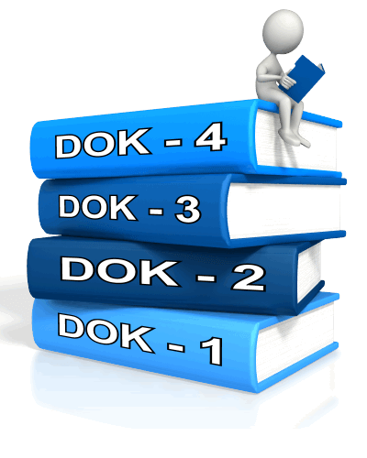
Edit and Clarify …
Brief-Writes
Grade 6 Sample Edit and Clarify Target Question:
Item Stem:
Select the correct way to revise the highlighted sentence (followed by a selected passage and a portion highlighted)
Options:
A. He lived in Troy, New York, in the early 1800s. There he had
ran a business that delivered meat to the United States Army.
B. He lived in Troy, New York, in the early 1800s he ran a
business that delivers meat to the United States Army.
C. He lived in Troy, New York in the early 1800s, and he ran a
business that delivered meat to the United States Army.
D. In the early 1800s, Sam Wills on lived in Troy, New York, and
ran a business that delivered meat to the United States Army.
The Distractor Analysis gives insight into possible student misconceptions and in that light can guide instruction
Distractor Analysis:
This option uses an incorrect/nonstandard verb tense (“had ran”).
This option has a comma splice (“New York, in”).
This option requires a second comma to set off a parenthetical element (“New York”).
D. Correct: This revision has correct grammar and punctuation.
Brief Writes assess a portion of The 3 Types of Writing
Opinion/Argument Writing
Informational/Explanatory Writing
Narrative Writing
Each type of Brief Write has a rubric.
Students could be asked to read an opinion piece of writing and create an introductory paragraph to set up the claim. They could be asked to write an ending for a narrative story. They could be asked to more clearly write a conclusion for an informational piece of writing. This is a focused form of writing.
15

Slide 6
Brief Writes Develops a Piece of Writing
A Brief-Write is one to three paragraphs.
Edit and Clarify:
Apply or edit grade-appropriate grammar
usage and mechanics to clarify a
message and edit narrative,
Informational and
opinion/argument texts.
Grade 5 Sample Edit and Clarify Target Question:
The author of “Election of the President” wants to add to the first paragraph a sentence that identifies the four stages of a presidential election. Read this sentence: The election of the president covers four stages: primaries and caucuses a national convention a general election and Electoral College voting.
What is the correct position of commas in the underlined section of the sentence?
Options:
A. primaries, and caucuses a national convention a general election, and Electoral College voting.
B. primaries and caucuses, a national convention, a general election, and Electoral College voting.
C. primaries and caucuses a national, convention a general, election and Electoral, College voting.
D. primaries and, caucuses a national convention a general election and, Electoral College voting.
Distractor Analysis:
A. Commas are incorrectly placed only before the two instances of the
conjunction ‘and.’
B. Correct: commas are placed to separate the items into a list
C. Commas are incorrectly placed in phrases, separating the adjectives from their nouns.
D. Commas are incorrectly placed after the two instances of the conjunction ‘and.’
Brief Write SBAC Narrative Brief Write Example Rubric
14

Slide 7
The first two categories are assessed in Brief-Writes:
Statement of purpose/focus and organization,
Elaboration of Evidence and Language and Vocabulary
Conventions
Edit and Clarify assessed apart from a full or brief write are selected response questions and are Conventions of Writing (grammar, spelling, punctuation, etc.…).
Statement of Purpose/Focus and Organization |  | Development: Language and Elaboration of Evidence |  | Conventions
Statement of Purpose/Focus | Organization | Elaboration of Evidence | Language and Vocabulary
Grade 3 Sample of a Brief Write
A student is writing an opinion essay for class about serving flavored milk in school cafeterias. Read the paragraph from the essay and complete the task that follows. Some people believe that schools should not serve flavored milk at lunch. According to them, students get too much sugar. It is true that flavored milk has more sugar than plain milk, but some students just will not drink plain milk. If that happens, they will not get the necessary calcium, vitamins, and other nutrients. That can’t be good. Drinking flavored milk is certainly healthier than not drinking any milk at all. Question: The beginning of the student’s essay does not state his/her opinion.
Write an opening paragraph that states the opinion and explains what the topic is about.
Edit and Clarify
Conventions
The response demonstrates a strong command of conventions: few, if any, errors in usage and sentence formation effective and consistent use of punctuation, capitalization, and spelling
13

Slide 8
Language and Vocabulary assessed apart from a full or brief write are selected response questions.
Revise a Brief Text
Grade 5 Sample of a Language and Vocabulary Target question.
Read the sentence in Paragraph 5 and complete the task that follows it.
Scientists pick individual animals and fit them with lightweight,
comfortable radio transmitters.
Which set of words has the same meanings as the underlined
words in the sentence in the box?
Options:
A. select, equip
B. claim , connect
C. examine, link
D. determine , tame
Distractor Analysis:
A. Correct: “Select” is a synonym for “pick”; “equip with” is a synonym of “fit with.”
B. Although scientists may possibly “claim” the individual animals, in this context this is unlikely. The phrase, “connect them to lightweight” does show something scientists could do after the animals have been selected and fitted with a tracking device.
C. The scientists are able to “examine” the migratory path of an animal. But in this context scientists must select them first and then possibly examine them. The word “link” is to connect one part to another as a bond or tie. In this case there is no bond as the scientists want to attach a transmitter without the animals knowing it is there.
D. The animal does not need to be “tamed” in order for it to be fitted with a tracking device.
Revise a Brief Text assesses a portion of The 3 Types of Writing
Opinion/Argument Writing
Informational/Explanatory Writing
Narrative Writing
Each type of Brief Write has a rubric.
12

Slide 9
Students use precise Language and Vocabulary and style appropriate to the audience.
Academic Vocabulary
Domain-Specific Vocabulary
Figurative Language
Revising a Brief-Write means adding, deleting or changing a developed piece of writing. These are selected response questions.
Grade 3 Sample of a Language and Vocabulary Target question:
Stimulus Text:
Birds Make Good Pets There are many reasons why people keep birds as pets. Canaries sing beautiful songs. Parakeets will sit on your shoulder. Parrots can talk to you. Birds fly outdoors. Pet birds can be fun.
Item Stem:
A student is revising this paragraph and needs to take out information that does not support why birds make good pets. Which of the following sentences does not support why birds make good pets?
Options:
A. “Canaries sing beautiful songs.”
B. “Parakeets will sit on your shoulder.”
C. “Parrots can talk to you.”
D. “Birds fly outdoors.”
The Distractor Analysis gives insight into possible student misconceptions and in that light can guide instruction.
Distractor Analysis:
A. Incorrect:
This sentence gives a reason why someone might want a bird as a pet.
B. Incorrect:
This sentence gives a reason why someone might want a bird as a pet.
C. Incorrect:
This sentence gives a reason why someone might want a bird as a pet.
D. Correct:
This sentence states a fact about birds. It does not give a reason why someone would want a bird as a pet.
Grade 3 Sample of Language and Vocabulary:
Read this sentence from Paragraph 1.
You could really do some damage if you didn’t know that law and started driving on the wrong side of the road! Which phrase would replace the words “really do some damage” with more specific language?
Options:
drive poorly
create confusion
injure people
get in the way
The Distractor Analysis gives insight into possible student misconceptions and in that light can guide instruction.
Distractor Analysis:
A. Although a driver on the wrong side of the road is an example of driving poorly, the phrase is not specific enough to be the best replacement for “really do some damage.”
B. Although a driver on the wrong side of the road could cause confusion, the phrase “create confusion” does not create the same impact as “really do some damage,” nor is it specific.
C. CORRECT: The phrase “injure people” is a more specific replacement for the words “really do some damage” because it indicates the kinds of damage a driver who doesn’t know
the law could cause by driving on the wrong side of the road.
D. Although a driver on the wrong side of the road could “get in the way” of other drivers, this phrase does not have the same meaning as “really do some damage.”
11

Slide 10
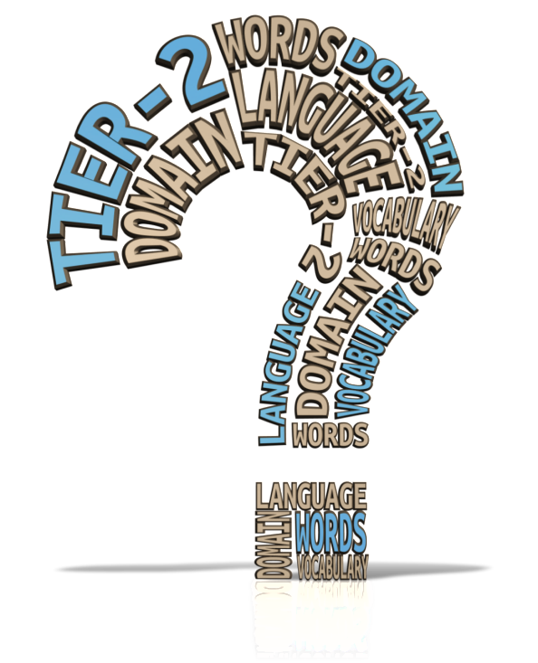
Revising a Brief Text is adding, deleting or changing a piece of Writing
The first two categories are assessed in Revising a Brief Write.
Statement of purpose/focus and organization,
Elaboration of Evidence and Language and Vocabulary
Conventions
Language and Vocabulary
The 4th form of assessed writing is LANGUAGE AND VOCABULARY USE Students will use language and vocabulary accurately including tier 2 academic and domain-specific vocabulary appropriate to the purpose and audience.
Statement of Purpose/Focus and Organization |  | Development: Language and Elaboration of Evidence |  | Conventions
Statement of Purpose/Focus | Organization | Elaboration of Evidence | Language and Vocabulary
Grade 6 Sample of Revise a Brief Write
Select the group of sentences that would follow the given passage most logically.
Read the following passage and then answer the question.
By the time we reached the zoo, Jimmy and I were out of breath. Sweat was trickling into my eyes and soaking my Tshirt. “Where . . . is . . . she?” he asked in short gasps as we looked around the main entrance. I was dizzy from running so hard, so I didn’t notice her until she gave a little wave. There she was, in a short-sleeved green uniform, smiling warmly under the shade of a big oak tree. She looked just like her picture on the website. Her white curls were peeking out from under a straw hat.
Options:
A. It was always nice to see my grandma. “We’re worn out,” I said. “Can you please buy us some lemonade?”
B. “Are you Ms. Jackson?” I asked nervously. “My name is Javier, and this is my friend, Jimmy. Sorry we’re late.”
C. Jimmy and I strolled over to her. “Excuse me,” I said. “Would you mind telling us where the penguins are?”
D. “We’ve got to get out of here,” said Jimmy, and I agreed. Even though I was desperate to get indoors to warm up, I followed him back to the sidewalk.
This is a word/language choice target. This target focuses on word choice and calls for replacing a grade-appropriate word or phrase.
10

