Slide 1
CCSS Student Writing Exemplars
Scored Using the SBAC Writing Rubric
Source: This collection of K-6 student papers were taken from Appendix C: Samples of Student Writing of the Common Core State Standards (CCSS) in English Language Arts and Literacy.
Evaluation Tool: SBAC Writing Rubric
http://www.corestandards.org/assets/Appendix_C.pdf
Score | Statement of Purpose/Focus and Organization |  | Development: Language and Elaboration of Evidence |  | Conventions Standard L 1-2
 | Statement of Purpose/Focus | Organization | Elaboration of Evidence | Language and Vocabulary

Slide 2
Opinion Exemplar Pieces

Slide 3
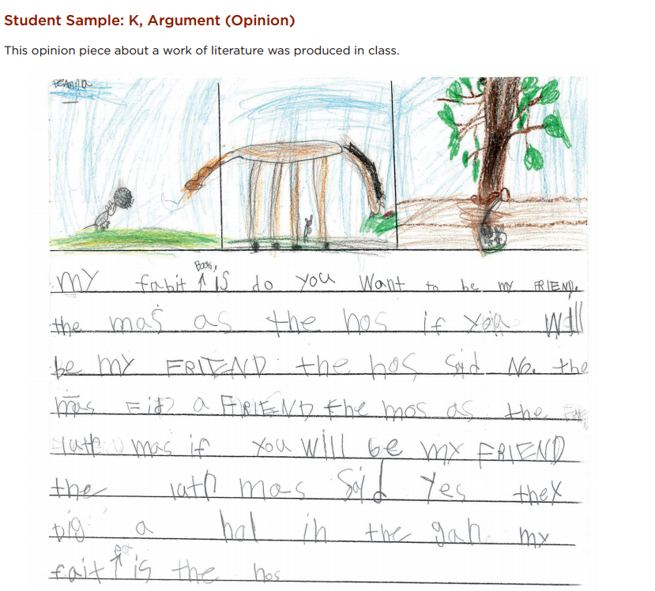

Slide 4
CCSS.ELA-LITERACY.W.K.1 Use a combination of drawing, dictating, and writing to compose opinion pieces in which they tell a reader the topic or the name of the book they are writing about and state an opinion or preference about the topic or book (e.g., My favorite book is...).
K-2 SBAC 4 Point Opinion Rubric
Score | Statement of Purpose/Focus and Organization |  | Development: Language and Elaboration of Evidence |  | Conventions Standard L 1-2
 | Statement of Purpose/Focus | Organization | Elaboration of Evidence | Language and Vocabulary
4 Exemplary | Uses a combination of drawing, dictation, & writing (K) to compose Explains something more about the topic OR A connection is made between topic & broader idea(s) | Intro, body, and conclusion support focus and reason(s) Uses several transitions appropriately (e.g., because, since, and, also, for example, since) to connect ideas | Elaborates using a variety of relevant details, examples, quotes, etc. to support focus (opinion) or explain reasons May use figurative language (e.g., imagery, simile, exaggeration) | Chooses words and phrases for effect (e.g., precise, concrete, or sensory vocabulary) Uses variety of sentences (simple, compound, with prepositional phrases) | Edits with support/ Resources Has few or no errors in grammar, word usage, or mechanics as appropriate to grade
Exemplar Example for Grade K
4 Exemplary | tells the reader the name of the book (in the title of the paper). . . . my fait (favorite) pot (part) is the hos (horse) Uses a combination of drawing and writing to support topic | states an opinion or preference about the book. Structure is easy to follow /sequence in order Pictures support the text Tells the reader the name of the book (in the title of the paper) My fabit (favorite) Book is do you Want to be my FRIEND | Drawings include descriptive details but don’t support opinion. Details to support opinion lacking. Score: 2 | Appropriate use of vocabulary Writes simple, complete sentences with some variety (in beginnings). Score: 3 | Uses grade mechanics and word use with some errors: -Mixing of upper and lower case letters -Missing capitals at the beginning of sentences Score: 2
Any text in red is a skill that isn’t part of this grade level’s Writing standard. However, a score is given to support the teaching of that skill.

Slide 5
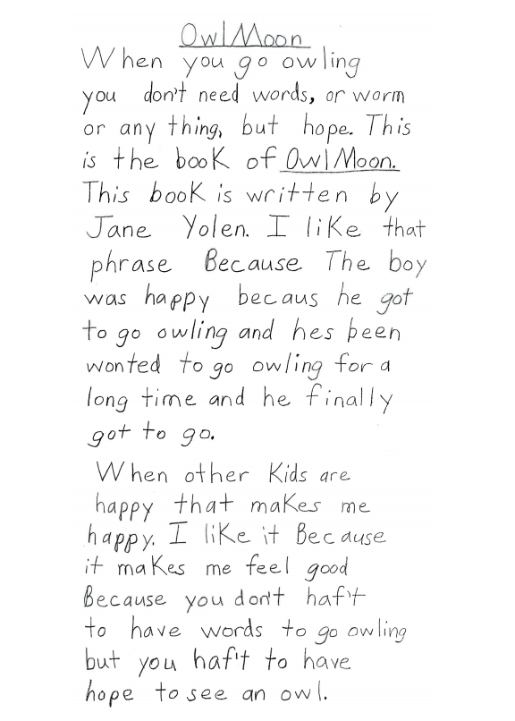


Slide 6
CCSS.ELA-LITERACY W.2.1 Write opinion pieces in which they introduce the topic or book they are writing about, state an opinion, supply reasons that support the opinion, use linking words (e.g. because, and, also) to connect opinion and reasons, and provide a concluding statement or section.
K-2 SBAC 4 Point Opinion Rubric
Score | Statement of Purpose/Focus and Organization |  | Development: Language and Elaboration of Evidence |  | Conventions
 | Statement of Purpose/Focus | Organization | Elaboration of Evidence | Language and Vocabulary
4 Exemplary | Uses a combination of drawing, dictation, & writing (K) to compose Explains something more about the topic OR A connection is made between topic & broader idea(s) | Intro, body, and conclusion support focus and reason(s) Uses several transitions appropriately (e.g., because, since, and, also, for example, since) to connect ideas | Elaborates using a variety of relevant details, examples, quotes, etc. to support focus (opinion) or explain reasons May use figurative language (e.g., imagery, simile, exaggeration) | Chooses words and phrases for effect (e.g., precise, concrete, or sensory vocabulary) Uses variety of sentences (simple, compound, with prepositional phrases) | Edits with support/ resources Has few or no errors in grammar, word usage, or mechanics as appropriate to grade
Exemplar Example for Grade 2
4 Exemplary | Clearly identifies the opinion topic (with some words from the book) and the title. When you go owling you don’t need words, or worm (warm) or any thing. but hope. This is (from) the book of Owl Moon. A connection is made between topic & broader ideas. When other kids are happy that makes me happy. | Provides a concluding statement which supports opinion. I like it Because it makes me feel good Because you don’t haf’t (have) to have words to go owling but you haf’t to have hope to see an owl. States one or more reasons for opinion. Uses transitions – linking words- to connect ideas. I like it Because it makes me feel good Because you don’t haf’t (have) to have words to go owling but you haf’t to have hope to see an owl. | Elaborates using relevant details. States an opinion about the book and supplies reasons to support the opinion. like that phrase Because The boy was happy because (because) he got to go owling and hes (he’s) been wonted (wanting) to go owling for a long time and he finally got to go. When other kids are happy that makes me happy | Appropriate use of vocabulary. Uses a variety of sentence (simple and compound). | Demonstrates growing command of the conventions of standard written English: Capital letters are used in a title. r The pronoun I is capitalized. All sentences begin with a capital letter. The title of the book is underlined. Most words are spelled correctly. The use of the comma and the apostrophe is not consistent, but all sentences end with periods.
Any text in red is a skill that isn’t part of this grade level’s Writing standard. However, a score is given to support the teaching of that skill.

Slide 7
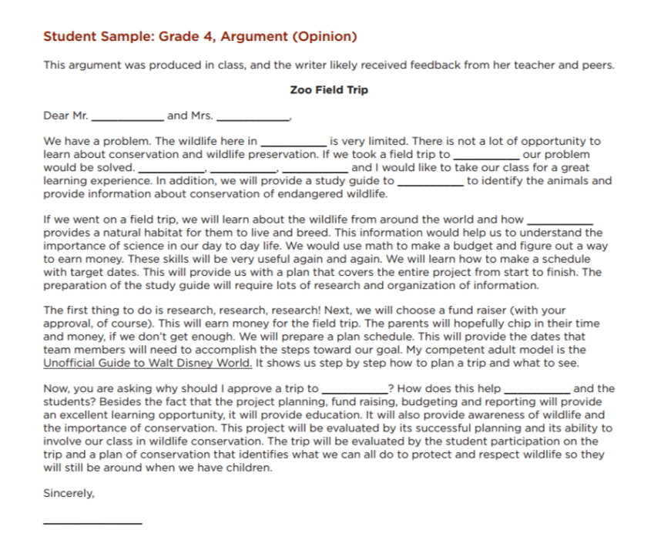

Slide 8
CCSS.ELA-Literacy.W.4.1.a Introduce a topic or text clearly, state an opinion, and create an organizational structure in which related ideas are grouped to support the writer's purpose. CCSS.ELA-Literacy.W.4.1.b Provide reasons that are supported by facts and details. |  |  |  | CCSS.ELA-Literacy.W.4.1.a Introduce a topic or text clearly, state an opinion, and create an organizational structure in which related ideas are grouped to support the writer's purpose. CCSS.ELA-Literacy.W.4.1.b Provide reasons that are supported by facts and details.
3-5 SBAC 4 Point Opinion Rubric
Score | Statement of Purpose/Focus and Organization |  | Development: Language and Elaboration of Evidence |  |  | Conventions
 | Statement of Purpose/Focus | Organization | Elaboration of Evidence |  | Language and Vocabulary
4 Exemplary | The response is fully sustained and consistently and purposefully focused: opinion is clearly stated, focused, and strongly maintained opinion is communicated clearly within the context | The response has a clear and effective organizational structure creating unity and completeness: effective, consistent use of a variety of transitional strategies logical progression of ideas from beginning to end effective introduction and conclusion for audience and purpose | The response provides thorough and convincing support/evidence for the writer’s opinion that includes the effective use of sources, facts, and details: use of evidence from sources is smoothly integrated, comprehensive, and relevant effective use of a variety of elaborative techniques |  | The response clearly and effectively expresses ideas, using precise language: use of academic and domain-specific vocabulary is clearly appropriate for the audience and purpose | The response demonstrates a strong command of conventions: few, if any, errors in usage and sentence formation e effective and consistent use of punctuation, capitalization, and spelling
Exemplar Example for Grade 4
4 Exemplary | The response is fully sustained and consistently and purposefully focused. We have a problem. The wildlife here in ___ is very limited. There is not a lot of opportunity to learn about conservation and wildlife preservation. If we took a field trip to ___ our problem would be solved. ___, ___, ___ and I would like to take our class for a great learning experience. | Effective use of a variety of transitional strategies. The first thing to do . . . Next . . Now, you are asking . . . Besides the fact . . . Logical progression of ideas from beginning to end. Effective introduction and conclusion for purpose (the final paragraph details possible objections to the field trip and argues against each one.). Now, you are asking why should I approve a trip to ___?. . . Besides the fact that the project planning, fund raising, budgeting and reporting will provide an excellent learning opportunity, it will provide education. It will also provide awareness of wildlife and the importance of conservation. | The response provides thorough and convincing support for opinion, is smoothly integrated, and relevant. This information would help us to understand the importance of science in our day to day life. We would use math to make a budget and figure out a way to earn money. We will learn how to make a schedule with target dates. The preparation of the study guide will require lots of research and organization of information. |  | Clearly and effectively expresses ideas, using appropriate academic and domain specific vocabulary. conservation, wildlife preservation, natural habitat, endangered...budget, competent, schedule, accomplish, awareness, evaluated, opportunity. | Strong command of conventions; few errors in usage and sentence formation. Sentence formation is appropriate for a letter. Effective and consistent use of punctuation, capitalization, and spelling throughout the letter.

Slide 9
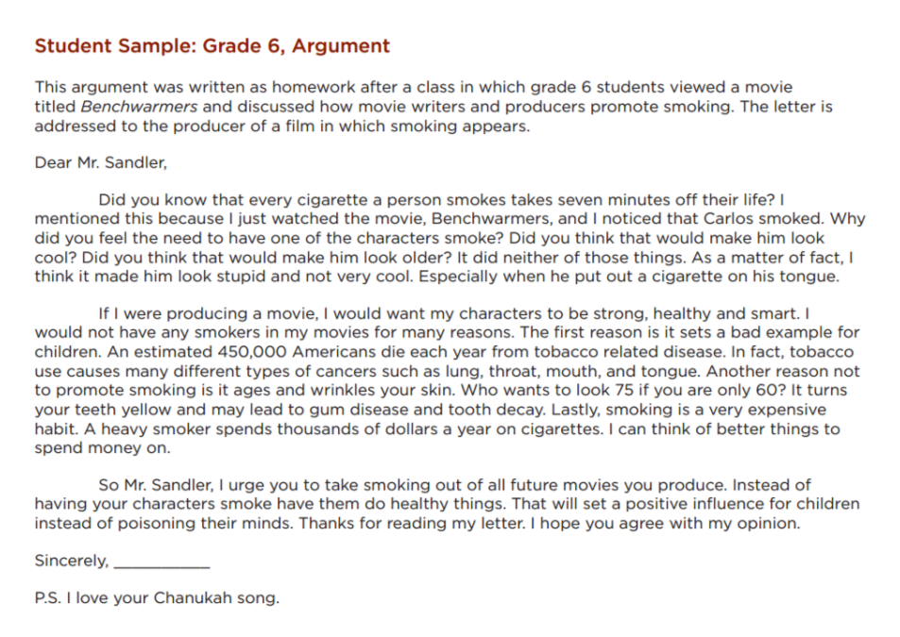

Slide 10
CCSS.ELA-Literacy.W.6.1.a Introduce claim(s) and organize the reasons and evidence clearly. CCSS.ELA-Literacy.W.6.1.b Support claim(s) with clear reasons and relevant evidence, using credible sources and demonstrating an understanding of the topic or text. |  |  |  | CCSS.ELA-Literacy.W.6.1.c Use words, phrases, and clauses to clarify the relationships among claim(s) and reasons. CCSS.ELA-Literacy.W.6.1.d Establish and maintain a formal style. CCSS.ELA-Literacy.W.6.1.e Provide a concluding statement or section that follows from the argument presented
6-8 SBAC 4 Point Opinion Rubric
Score | Statement of Purpose/Focus and Organization |  | Development: Language and Elaboration of Evidence |  |  | Conventions
 | Statement of Purpose/Focus | Organization | Elaboration of Evidence |  | Language and Vocabulary
4 Exemplary | The response is fully sustained and consistently and purposefully focused: claim is clearly stated, focused and strongly maintained alternate or opposing claims are clearly addressed* claim is introduced and communicated clearly within the context | The response has a clear and effective organizational structure creating unity and completeness: effective, consistent use of a variety of transitional strategies logical progression of ideas from beginning to end effective introduction and conclusion for audience and purpose strong connections among ideas, with some syntactic variety | The response provides thorough and convincing support/evidence for the writer’s claim that includes the effective use of sources, facts, and details. The response achieves substantial depth that is specific and relevant: use of evidence from sources is smoothly integrated, comprehensive, relevant, and concrete effective use of a variety of elaborative |  | The response clearly and effectively expresses ideas, using precise language: use of academic and domain-specific vocabulary is clearly appropriate for the audience and purpose | The response demonstrates a strong command of conventions: few, if any, errors are present in usage and sentence formation effective and consistent use of punctuation, capitalization, and spelling
Exemplar Example for Grade 6
4 Exemplary | Claim is clearly stated, focused and strongly maintained. I would not have any smokers in my movies for many reasons. Alternate or opposing claims addressed. Did you think that would make him look cool? Did you think that would make him look older? | Clear and effective organizational structure. The first reason is it sets a bad example for children. Another reason not to promote smoking is it ages and wrinkles your skin. It turns your teeth yellow and may lead to gum disease and tooth decay. Lastly, smoking is a very expensive habit. Effective use of transitional strategies. The first reason, Another reason, Lastly | Provides thorough and convincing support/ evidence; effective use of facts: -Every cigarette a person smokes takes seven minutes off their life. -About 450,000 Americans die each year from tobacco related disease. -Tobacco use causes many different types of cancers such as lung, throat, mouth, and tongue. -A heavy smoker spends thousands of dollars a year on cigarettes. |  | Adequately expresses ideas, using a mix of precise and general language. producing, disease, influence, urge, poisoning...stupid, smart | Strong command of conventions; few errors in usage and sentence formation. Sentence formation is appropriate for a letter. Effective and consistent use of punctuation, capitalization, and spelling throughout the letter.

Slide 11
SBAC Full Composition
Opinion Rubrics

Slide 12
Grades K - 2: Generic 4-Point Opinion Writing Rubric
Score | Statement of Purpose/Focus and Organization |  | Development: Language and Elaboration of Evidence |  | Conventions
 | Statement of Purpose/Focus | Organization | Elaboration of Evidence | Language and Vocabulary
4 Exemplary | Uses a combination of drawing, dictation, & writing (K) to compose Explains something more about the topic OR A connection is made between topic & broader idea(s) | Intro, body, and conclusion support focus and reason(s) Uses several transitions appropriately (e.g., because, since, and, also, for example, since) to connect ideas | Elaborates using a variety of relevant details, examples, quotes, etc. to support focus (opinion) or explain reasons May use figurative language (e.g., imagery, simile, exaggeration) | Chooses words and phrases for effect (e.g., precise, concrete, or sensory vocabulary) Uses variety of sentences (simple, compound, with prepositional phrases) | Edits with support/ resources Has few or no errors in grammar, word usage, or mechanics as appropriate to grade
3 Proficient | Uses a combination of drawing, dictation, & writing (K) to compose Clearly identifies topic (gr K-3) Focus (opinion) about topic is clearly stated (gr K-3 | Has intro, body, and concluding statement or section (gr 1-3) that support focus (opinion) States one or more reasons for opinion (gr 1-3) Uses transitions (e.g., because, and) to connect ideas (gr 2-3) | Drawings or writing include relevant and descriptive details, labels/captions, facts, or elaboration that support the opinion or reasons Details are explained, not simply listed | Appropriate use of vocabulary (nouns, verbs, plurals, adjectives, etc.) Uses some variety of sentence types (statement, question, exclamation) Uses adult/peer feedback to revise | Edits with support from peers, adults, resources (gr 2-3) Minor errors do not interfere with reader’s understanding
2 Developing | Uses a combination of drawing, dictation, & writing (K) to compose Has topic and attempts a focus (opinion), but focus may shift or not be relevant to the topic chosen | Introduction, body, and conclusion are evident, but may lack clarity or coherence (e.g., attempts to connect opinion to a reason, but reason may not make sense) | Some elaboration strategies are evident in drawings or writing (gr K-3), or added with support/ questioning from peers or adults Ideas may not be fully elaborated or details may be insufficient to support opinion | Vocabulary use has minor errors Dictates, writes, and expands simple complete sentences Uses adult/peer feedback to revise | Edits with support from peers or adults (gr 2-3) Uses grade-appropriate basic mechanics and word use with some errors
1 Emerging | Uses a combination of drawing, dictation, & writing (K) to compose Attempts to identify a topic, but lacks a focus (opinion) or may have more than one topic or confusing topic as stated | Attempts introduction, body, and conclusion, but one or more parts are missing | No details provided or attempts to add details to drawings or writing which may be random, inaccurate, or irrelevant | Generally uses basic, incorrect, or below grade level vocabulary when dictating (K) or writing Uses adult/peer feedback to revise | Edits with support from peers or adults (gr 2-3) Uses below grade-level basic mechanics with frequent errors
0 | A response gets no credit if it provides no evidence of the ability to [fill in with key language from the intended target].

Slide 13
Grades 3 - 5: Generic 4-Point Opinion Writing Rubric
Score | Statement of Purpose/Focus and Organization |  | Development: Language and Elaboration of Evidence |  | Conventions
 | Statement of Purpose/Focus | Organization | Elaboration of Evidence | Language and Vocabulary
4 Exemplary | The response is fully sustained and consistently and purposefully focused: opinion is clearly stated, focused, and strongly maintained opinion is communicated clearly within the context | The response has a clear and effective organizational structure creating unity and completeness: effective, consistent use of a variety of transitional strategies logical progression of ideas from beginning to end effective introduction and conclusion for audience and purpose | The response provides thorough and convincing support/evidence for the writer’s opinion that includes the effective use of sources, facts, and details: use of evidence from sources is smoothly integrated, comprehensive, and relevant effective use of a variety of elaborative techniques | The response clearly and effectively expresses ideas, using precise language: use of academic and domain-specific vocabulary is clearly appropriate for the audience and purpose | The response demonstrates a strong command of conventions: few, if any, errors in usage and sentence formation e effective and consistent use of punctuation, capitalization, and spelling
3 Proficient | The response is adequately sustained and generally focused: opinion is clear and for the most part maintained, though some loosely related material may be present context provided for the claim is adequate | The response has an recognizable organizational structure, though there may be minor flaws and some ideas may be loosely connected: adequate use of transitional strategies with some variety adequate progression of ideas from beginning to end adequate introduction and conclusion | The response provides adequate support/evidence for the writer’s opinion that includes the use of sources, facts, and details: some evidence from sources is integrated, though citations may be general or imprecise adequate use of some elaborative techniques | The response adequately expresses ideas, employing a mix of precise with more general language: use of domain-specific vocabulary is generally appropriate for the audience and purpose | The response demonstrates an adequate command of conventions: some errors in usage and sentence formation are present, but no systematic pattern of errors is displayed adequate use of punctuation, capitalization, and spelling
2 Developing | The response is somewhat sustained with some extraneous material or a minor drift in focus: may be clearly focused on the opinion but is insufficiently sustained opinion on the issue may be unclear and unfocused | The response has an inconsistent organizational structure, and flaws are evident: inconsistent use of transitional strategies with little variety uneven progression of ideas from beginning to end conclusion and introduction, if present, are weak | The response provides uneven, cursory support/evidence for the writer’s opinion that includes partial or uneven use of sources, facts, and details: evidence from sources is weakly integrated, and citations, if present, are uneven weak or uneven use of elaborative techniques | The response expresses ideas unevenly, using simplistic language: use of domain-specific vocabulary that may at times be inappropriate for the audience and purpose | The response expresses ideas unevenly, using simplistic language: use of domain-specific vocabulary that may at times be inappropriate for the audience and purpose
1 Emerging | The response may be related to the purpose but may offer little or no focus: may be very brief may have a major drift opinion may be confusing or ambiguous | The response has little or no discernible organizational structure: few or no transitional strategies are evident frequent extraneous ideas may intrude | The response provides minimal support/evidence for the writer’s opinion that includes little or no use of sources, facts, and details: use of evidence from sources is minimal, absent, in error, or irrelevant | The response expression of ideas is vague, lacks clarity, or is confusing: uses limited language or domain-specific vocabulary may have little sense of audience and purpose | The response demonstrates a lack of command of conventions: errors are frequent and severe and meaning is often obscured
0 | A response gets no credit if it provides no evidence of the ability to [fill in with key language from the intended target].

Slide 14
Grades 6 - 8: Generic 4-Point Opinion Writing Rubric
Score | Statement of Purpose/Focus and Organization |  | Development: Language and Elaboration of Evidence |  | Conventions
 | Statement of Purpose/Focus | Organization | Elaboration of Evidence | Language and Vocabulary
4 Exemplary | The response is fully sustained and consistently and purposefully focused: claim is clearly stated, focused and strongly maintained alternate or opposing claims are clearly addressed* claim is introduced and communicated clearly within the context | The response has a clear and effective organizational structure creating unity and completeness: effective, consistent use of a variety of transitional strategies logical progression of ideas from beginning to end effective introduction and conclusion for audience and purpose strong connections among ideas, with some syntactic variety | The response provides thorough and convincing support/evidence for the writer’s claim that includes the effective use of sources, facts, and details. The response achieves substantial depth that is specific and relevant: use of evidence from sources is smoothly integrated, comprehensive, relevant, and concrete effective use of a variety of elaborative | The response clearly and effectively expresses ideas, using precise language: use of academic and domain-specific vocabulary is clearly appropriate for the audience and purpose | The response demonstrates a strong command of conventions: few, if any, errors are present in usage and sentence formation effective and consistent use of punctuation, capitalization, and spelling
3 Proficient | The response is adequately sustained and generally focused: claim is clear and for the most part maintained, though some loosely related material may be present context provided for the claim is adequate | The response has an evident organizational structure and a sense of completeness, though there may be minor flaws and some ideas may be loosely connected: adequate use of transitional strategies with some variety adequate progression of ideas from beginning to end adequate introduction and conclusion adequate, if slightly inconsistent, connection among ideas | The response provides adequate support/evidence for writer’s claim that includes the use of sources, facts, and details. The response achieves some depth and specificity but is predominantly general: some evidence from sources is integrated, though citations may be general or imprecise adequate use of some elaborative techniques | The response adequately expresses ideas, employing a mix of precise with more general language: use of domain-specific vocabulary is generally appropriate for the audience and purpose | The response demonstrates an adequate command of conventions: some errors in usage and sentence formation may be present, but no systematic pattern of errors is displayed adequate use of punctuation, capitalization, and spelling
2 Developing | The response is somewhat sustained and may have a minor drift in focus: may be clearly focused on the claim but is insufficiently sustained claim on the issue may be somewhat unclear and unfocused | The response has an inconsistent organizational structure, and flaws are evident: inconsistent use of basic transitional strategies with little variety uneven progression of ideas from beginning to end conclusion and introduction, if present, are weak weak connection among ideas | The response provides uneven, cursory support/evidence for the writer’s claim that includes partial or uneven use of sources, facts, and details, and achieves little depth: evidence from sources is weakly integrated, and citations, if present, are uneven weak or uneven use of elaborative techniques | The response expresses ideas unevenly, using simplistic language: use of domain-specific vocabulary may at times be inappropriate for the audience and purpose | The response demonstrates a partial command of conventions: frequent errors in usage may obscure meaning inconsistent use of punctuation, capitalization, and spelling
1 Merging | The response may be related to the purpose but may offer little relevant detail: may be very brief may have a major drift claim may be confusing or ambiguous | The response has little or no discernible organizational structure: few or no transitional strategies are evident frequent extraneous ideas may intrude | The response provides minimal support/evidence for the writer’s claim that includes little or no use of sources, facts, and details: use of evidence from sources is minimal, absent, in error, or irrelevant | The response expression of ideas is vague, lacks clarity, or is confusing: uses limited language or domain-specific vocabulary may have little sense of audience and purpose | The response demonstrates a lack of command of conventions: errors are frequent and severe and meaning is often obscure
0 | A response gets no credit if it provides no evidence of the ability to [fill in with key language from the intended target].
Working Drafts of ELA rubrics for assessing CCSS writing standards --- © (2010) Karin Hess, National Center for Assessment [khess@nciea.org

Slide 15
Informative/Explanatory Exemplar Pieces

Slide 16
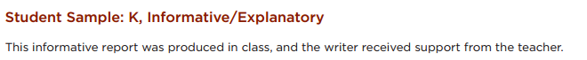
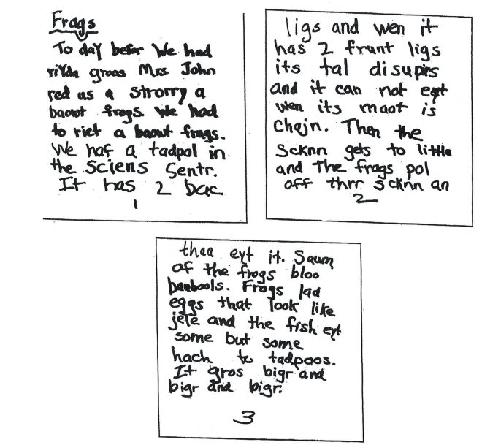
(K Informative/Explanatory story)

Slide 17
CCSS.ELA-LITERACY.W.K.2 Use a combination of drawing, dictating, and writing to compose informative/explanatory texts in which they name what they are writing about and supply some information about the topic.
K-2 SBAC 4 Point Informative/Explanatory Rubric
Score | Statement of Purpose/Focus and Organization |  | Development: Language and Elaboration of Evidence |  | Conventions Standard L 1-2
 | Statement of Purpose/Focus | Organization | Elaboration of Evidence | Language and Vocabulary
4 Exemplary | -Uses a combination of drawing, dictation, & writing (K) to compose. -Explains something more about the topic OR a connection is made between topic & broader idea(s). -Clearly presents the topic and focus/controlling idea | -Intro, body, and conclusion support focus -Uses several transitions appropriately (e.g., because, since, and, but, also, for example, since) to connect or group ideas | -Has a depth of information; insightful -Elaborates, using a variety of relevant details, definitions, examples, quotes, text evidence to support focus/concepts | -Maintains voice/tone of knowledgeable person conveying information. -Knows when to use formal-informal language. -Uses effective, precise vocabulary and variety of sentence structures | -Edits with support / resources -Has few or no errors in grammar, word usage, or mechanics as appropriate to grade
Exemplar Example for Grade K
4 Exemplary | establishes the topic in a title: …Mrs. ___ red (read) us a strorry (story) a baowt (about) frogs. supplies some focused ideas about the topic: It has 2 bac (back) ligs (legs) and wen (when) it has 2 frunt (front) ligs (legs) its tal (tail)disupirs (disappears) . . . Then the scknn (skin) gets to (too) little and the frags pol (pull) off thrr (their) scknn (skin) . . . o Frogs lad (laid) eggs that look like jele (jelly) . . | provides a n introduction and a sense of closure: - To day befor (before) We had riyda (writing) groos (groups) Mrs. _____ red (read) us a strorry (story) a baowt (about) frogs. -It gros (grows) bigr (bigger) and bigr and bigr. uses transitions and linking words: . . . and wen (when) . . . Then . . . but . . . | Some authentic details: It has 2 bac ligs and wen it has 2 frunt ligs its tal disupirs and it can not eyt wen its maot is chajn…Then the scknn gets to little and the frogs pol off thrr scknn an thaa yet it. Score: 3 | Produces complete simple sentences. Appropriate use of Vocabulary. Score: 3 | Has few or no errors in grammar and word usage, but mechanics errors in spelling above grade level words. Score: 3 (As a kindergartener, the writer demonstrates remarkable control of the conventions of standard written English. As this was a process piece, it is reasonable to assume that the writer received feedback to correct possible errors with capital letters and periods).
Any text in red is a skill that isn’t part of this grade level’s Writing standard. However, a score is given to support the teaching of that skill.

Slide 18
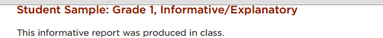
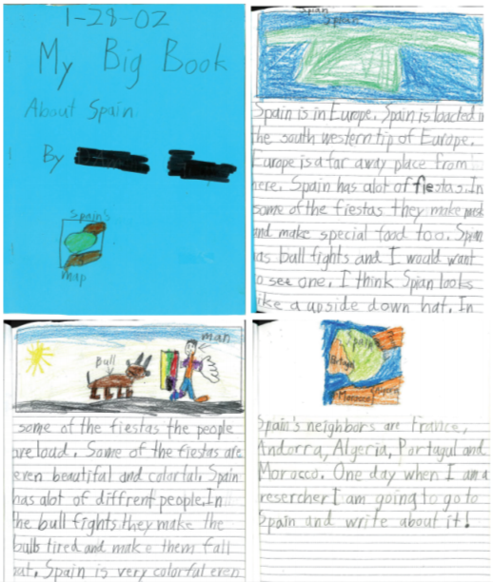
(1st Informative/Explanatory story)

Slide 19
CCSS.ELA-LITERACY.W.1.2 Write informative/explanatory texts in which they name a topic, supply some facts about the topic, and provide some sense of closure.
K-2 SBAC 4 Point Informative/Explanatory Rubric
Score | Statement of Purpose/Focus and Organization |  | Development: Language and Elaboration of Evidence |  | Conventions Standard L 1-2
 | Statement of Purpose/Focus | Organization | Elaboration of Evidence | Language and Vocabulary
4 Exemplary | -Uses a combination of drawing, dictation, & writing (K) to compose. -Explains something more about the topic OR a connection is made between topic & broader idea(s). -Clearly presents the topic and focus/controlling idea | -Intro, body, and conclusion support focus -Uses several transitions appropriately (e.g., because, since, and, but, also, for example, since) to connect or group ideas | -Has a depth of information; insightful -Elaborates, using a variety of relevant details, definitions, examples, quotes, text evidence to support focus/concepts | -Maintains voice/tone of knowledgeable person conveying information. -Knows when to use formal-informal language. -Uses effective, precise vocabulary and variety of sentence structures | -Edits with support / resources -Has few or no errors in grammar, word usage, or mechanics as appropriate to grade
Exemplar Example for Grade 1
4 Exemplary | names the topic (in the title): My Big Book About Spain • supplies some facts about the topic: -Spain is loacted (located) in the south western tip of Europe. -Spain has alot of fiestas. -Spian . . . has bull fights. -Spain’s neighbors are France, Andorra, Algeria, Portugal and Morocco. Uses a combination of drawing and writing to support topic | provides some sense of closure. One day when I am a researcher I am going to go to Spain and write about it! | Elaborates, using relevant details to support focus: -In some of the fiestas they make mask and make special food too…people are loud….even beautiful and colorful. -In the bull fights they make the bulls tired and make them fall out. Score: 4 | Appropriate use of vocabulary Writes simple, complete sentences with some variety (in beginnings). Score: 3 | demonstrates command of some of the conventions of standard written English: -awareness of beginning-of-sentence capitalization -awareness of end-of-sentence punctuation -awareness of the use of capital letters for proper nouns Score: 3
Any text in red is a skill that isn’t part of this grade level’s Writing standard. However, a score is given to support the teaching of that skill.

Slide 20
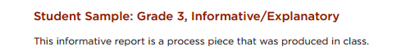
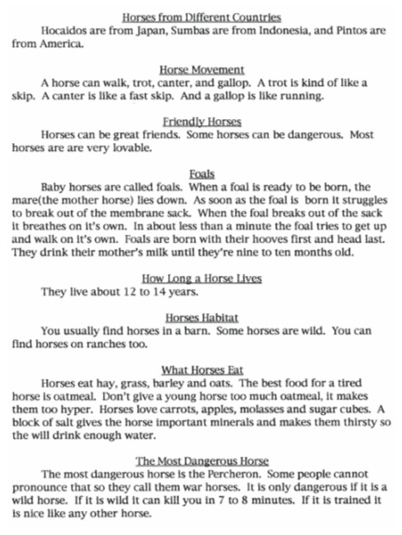
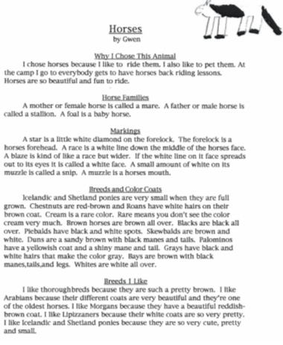
(3rd Informative/Explanatory story)

Slide 21
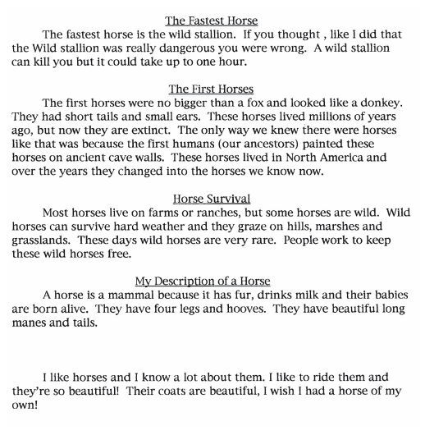
(3rd Informative/Explanatory story)

Slide 22
CCSS.ELA-Literacy.W.3.2.a Introduce a topic and group related information together; include illustrations when useful to aiding comprehension. CCSS.ELA-Literacy.W.3.2.b Develop the topic with facts, definitions, and details. |  |  |  | CCSS.ELA-Literacy.W.3.2.c Use linking words and phrases (e.g., also, another, and, more, but) to connect ideas within categories of information. CCSS.ELA-Literacy.W.3.2.d Provide a concluding statement or section.
3-5 SBAC 4 Point Informative/Explanatory Rubric
Score | Statement of Purpose/Focus and Organization |  | Development: Language and Elaboration of Evidence |  |  | Conventions
 | Statement of Purpose/Focus | Organization | Elaboration of Evidence |  | Language and Vocabulary
4 Exemplary | The response is fully sustained and consistently and purposefully focused: controlling idea or main idea of a topic is focused, clearly stated, and strongly maintained. controlling idea or main idea of a topic is introduced and communicated clearly within the context . | The response has a clear and effective organizational structure creating unity and completeness: use of a variety of transitional strategies logical progression of ideas from beginning to end. effective introduction and conclusion for audience and purpose. | The response provides thorough and convincing support/evidence for the controlling idea or main idea that includes the effective use of sources, facts, and details: use of evidence from sources is smoothly integrated comprehensive, and relevant . effective use of a variety of elaborative techniques . |  | The response clearly and effectively expresses ideas, using precise language: use of academic and domain-specific vocabulary is clearly appropriate for the audience and purpose. | The response demonstrates a strong command of conventions: few, if any, errors are present in usage and sentence formation. effective and consistent use of punctuation, capitalization, and spelling.
Exemplar Example for Grade 3
4 Exemplary | introduces a topic and maintains it through piece: I chose horses because I like to ride them. . . . Horses are so beautiful and fun to ride. Idea is communicated clearly within the context. -the writer gives clear descriptions of many horses and their beauty. | Effective use of introduction and conclusion: -Why I Chose This Animal -I like horses and I know a lot about them. I like to ride them and they’re so beautiful! Their coats are beautiful, I wish I had a horse of my own! Transitional strategy; creates an organizational structure (using headers) that groups related information together. -Horse Families; Markings; Breeds and Color Coats; Horses from Different Countries | The response provides thorough, convincing , and comprehensive evidence of knowledge about horses: Examples: -The forelock is a horses forehead…A muzzle is a horses mouth. -A trot is kind of like a skip. A canter is like a fast skip. And a gallop is like running. -When a foal is ready to be born, the mare (the mother horse) lies down…it struggles out of the membrane sack…it breathes on it’s own. -The most dangerous horse is the Percheron…cannot pronounce the name so they call them war horses…kill you in 7 to 8 minutes. |  | Clearly and effectively expresses ideas, using appropriate academic and domain specific vocabulary: -spreads, amount, yellowish, shiny, struggles, pronounce, extinct, ancestors, membrane -Stallion, forelock, chestnuts, piebalds, skewbalds, Palominos, Duns, Bays, thoroughbreds, minerals | Strong command of conventions; few errors in usage and sentence formation. Effective and consistent use of punctuation, capitalization, and spelling throughout the piece. - Occasional errors do not interfere with the underlying message of the piece.

Slide 23
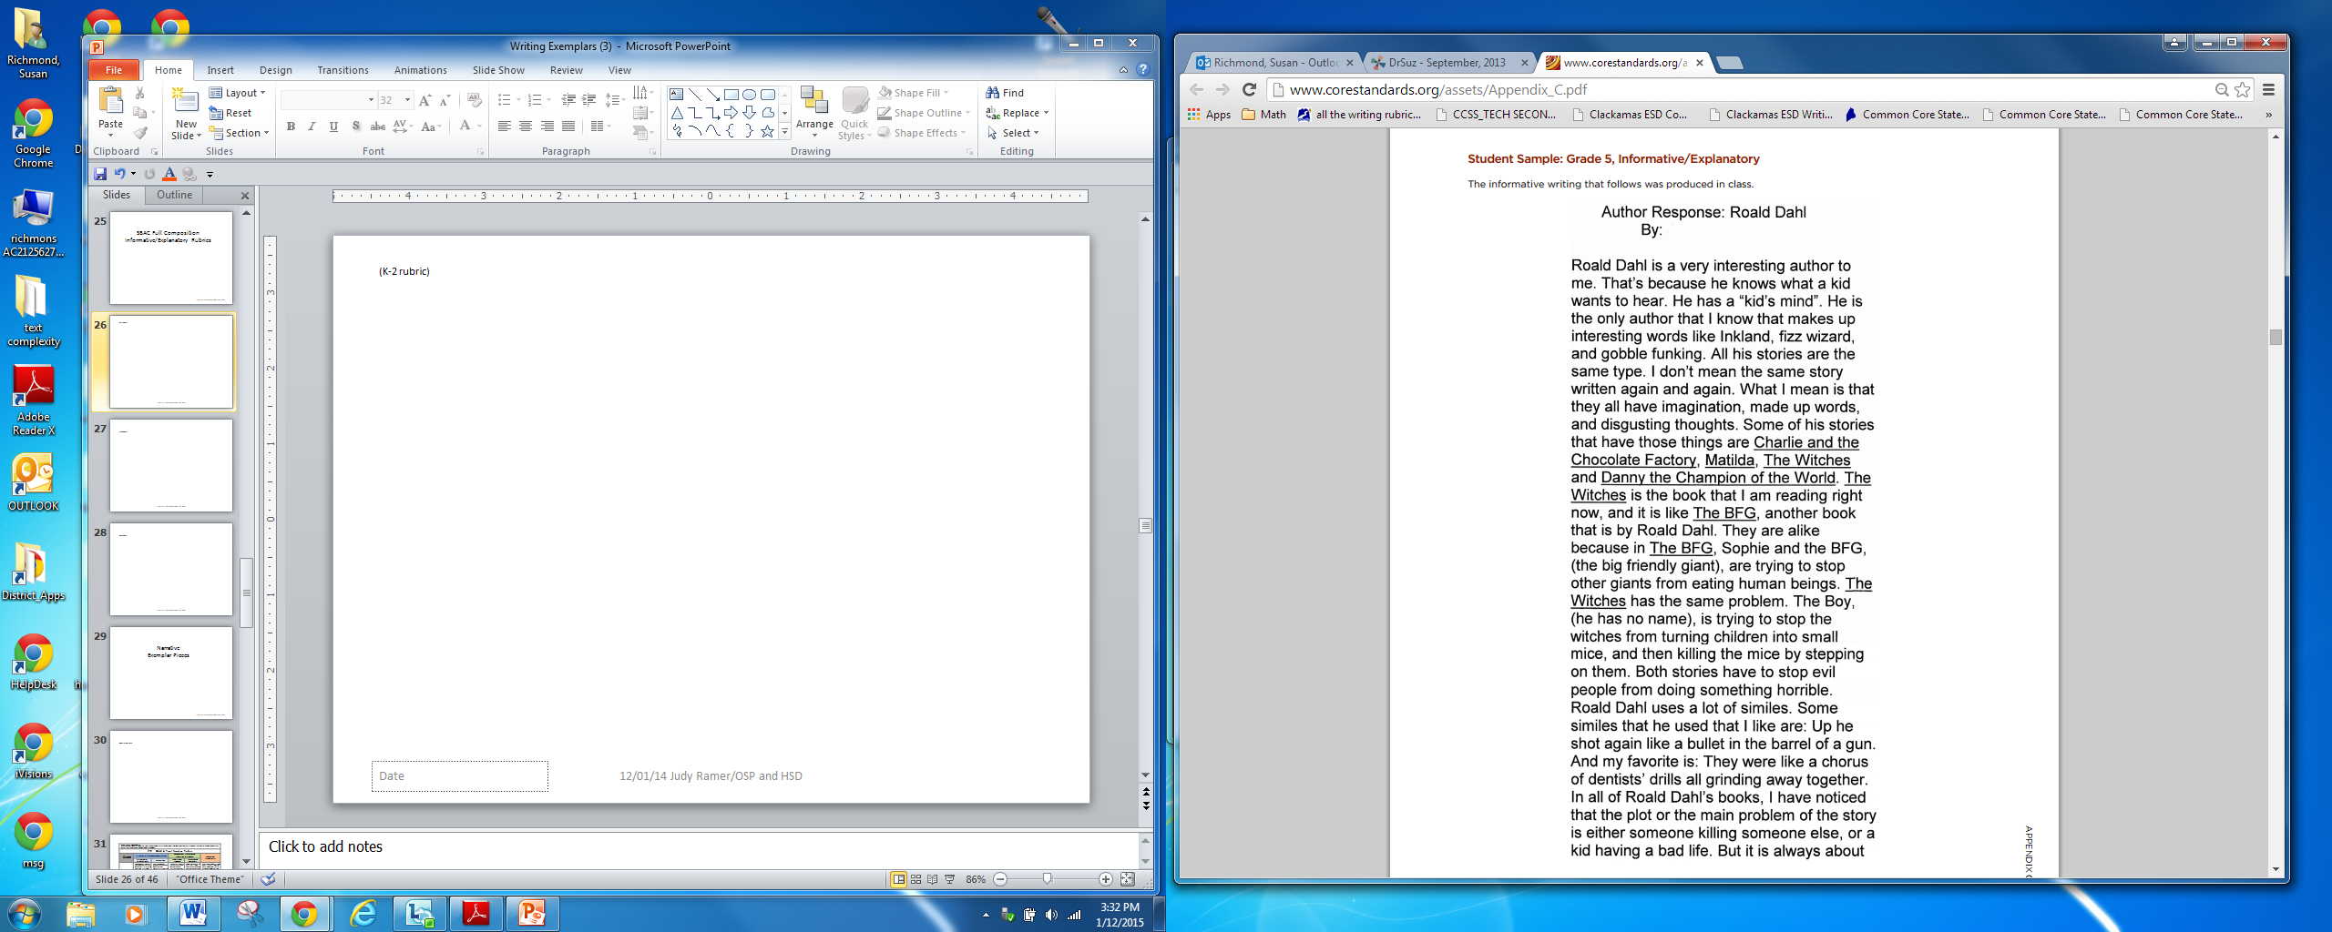
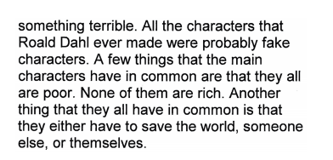
(5th Informative/Explanatory story)

Slide 24
CCSS.ELA-Literacy.W.5.2.a: Introduce a topic clearly, provide a general observation and focus, and group related information logically; include formatting (e.g., headings), illustrations, and multimedia when useful to aiding comprehension. CCSS.ELA-Literacy.W.5.2.b: Develop the topic with facts, definitions, concrete details, quotations, or other information and examples related to the topic. |  |  |  | CCSS.ELA-Literacy.W.5.2.c: Link ideas within and across categories of information using words, phrases, and clauses (e.g., in contrast, especially).. CCSS.ELA-Literacy.W.5.2.d: Use precise language and domain-specific vocabulary to inform about or explain the topic. CCSS.ELA-Literacy.W.5.2.e: Provide a concluding statement or section related to the information or explanation presented.
3-5 SBAC 4 Point Informative/Explanatory Rubric
Score | Statement of Purpose/Focus and Organization |  | Development: Language and Elaboration of Evidence |  |  | Conventions
 | Statement of Purpose/Focus | Organization | Elaboration of Evidence |  | Language and Vocabulary
4 Exemplary | The response is fully sustained and consistently and purposefully focused: controlling idea or main idea of a topic is focused, clearly stated, and strongly maintained. controlling idea or main idea of a topic is introduced and communicated clearly within the context . | The response has a clear and effective organizational structure creating unity and completeness: use of a variety of transitional strategies logical progression of ideas from beginning to end. effective introduction and conclusion for audience and purpose. | The response provides thorough and convincing support/evidence for the controlling idea or main idea that includes the effective use of sources, facts, and details: use of evidence from sources is smoothly integrated comprehensive, and relevant . effective use of a variety of elaborative techniques . |  | The response clearly and effectively expresses ideas, using precise language: use of academic and domain-specific vocabulary is clearly appropriate for the audience and purpose. | The response demonstrates a strong command of conventions: few, if any, errors are present in usage and sentence formation. effective and consistent use of punctuation, capitalization, and spelling.
Exemplar Example for Grade 5
4 Exemplary | introduces the topic clearly, provides a general observation and focus: Roald Dahl is a very interesting author to me. That’s because he knows what a kid wants to hear. Main idea (interesting author…what a kid wants to hear) is clearly communicated within the context: …makes up interesting words…they all have imagination and disgusting thoughts…stop evil people from doing something horrible. None of them (characters) are rich…save the world. | effective introduction for purpose (but lacking a conclusion): Roald Dahl is a very interesting author to me. That’s because he knows what a kid wants to hear. adequate use of transitional strategies with some variety Both stories…I have noticed… But… A few things… Another adequate progression of ideas from beginning to end (Score: 3; Proficient) | develops the topic with facts, definitions, concrete details, quotations, or other information and examples related to the topic: -He is the only author that I know that makes up interesting words like Inkland, fizz wizard, and gobble funking. -Roald Dahl uses a lot of similes. Some similes that he used that I like are: Up he shot again like a bullet in the barrel of a gun. And my favorite is: They were like a chorus of dentists’ drills all grinding away together. -In all of Roald Dahl’s books, I have noticed that the plot or the main problem of the story is either someone killing someone else, or a kid having a bad life. |  | Clearly and effectively expresses ideas, using appropriate academic and domain specific Vocabulary: -Roald Dahl uses a lot of similes. -I have noticed that the plot or the main problem of the story . . . -All the characters . . . Imagination, disgusting, horrible, noticed, terrible | Strong command of conventions; few errors in usage and sentence formation. Effective and consistent use of punctuation, capitalization, and spelling throughout the piece.

Slide 25
SBAC Full Composition
Informative/Explanatory Rubrics

Slide 26
Grades K - 2: Generic 4-Point Informational/Explanatory Writing Rubric
Score | Statement of Purpose/Focus and Organization |  | Development: Language and Elaboration of Evidence |  | Conventions
 | Statement of Purpose/Focus | Organization | Elaboration of Evidence | Language and Vocabulary
4 Exemplary | Uses a combination of drawing, dictation, & writing (K) to compose Explains something more about the topic OR a connection is made between topic & broader idea(s) Clearly presents the topic and focus/controlling idea | Intro, body, and conclusion support focus Uses several transitions appropriately (e.g., because, since, and, but, also, for example, since) to connect or group ideas | Has a depth of information; insightful Elaborates using a variety of relevant details, definitions, examples, quotes, text evidence to support focus/concepts | Maintains voice/tone of knowledgeable person conveying information – knows when to use formal-informal language Uses effective, precise vocabulary and variety of sentence structures | Edits with support /resources Has few or no errors in grammar, word usage, or mechanics as appropriate to grade
3 Proficient | Uses a combination of drawing, dictation, & writing (K) to compose Topic (context) and focus/controlling idea are clearly stated (gr K-3) | Has overall coherence (K-3); Provides a concluding statement or section (gr, 1, 2, 3) Groups related ideas (gr3) that support the focus Uses transitions to connect ideas (gr3) | Some authentic details, definitions, facts, text evidence support focus Adds labels or captions to illustration, drawing, visuals, charts/tables, or diagram to enhance details, facts, and ideas | Produces complete simple (K), compound (g, 1- 3), complex (gr3) sentences Appropriate use of vocabulary (nouns, plurals, verbs, pronouns, adjectives, adverb, content-specific) Uses adult/peer feedback to Revise | Edits with support /resources (gr 2-3) Minor errors do not interfere with reader understanding (e.g., capitalization, punctuation; spelling)
2 Developing | Uses a combination of drawing, dictation, & writing (K) to compose Has topic and attempts a focus/information, but focus may shift or not be relevant to the topic chosen | Introduction, body, and conclusion are evident, but may lack clarity or Coherence (e.g., attempts to connect ideas, but may not be logical or make sense) | Some elaboration strategies are evident in drawings or writing (gr K-3), or with support/ questioning from peers or adults (gr K -1) Ideas may not be fully elaborated or details may be insufficient to support topic | Vocabulary use has minor errors Dictates, writes, and expands simple complete sentences Uses adult/peer feedback to revise | Edits with support from peers or adults (gr 2-3) Uses grade-appropriate basic mechanics and word use with some errors
1 Emerging | Uses a combination of drawing, dictation, & writing (K) to compose Attempts to identify a topic but lacks a focus or may have more than one topic or confusing topic as stated | Attempts introduction, body, and conclusion, but one or more parts are missing | No details provided or attempts to add details to drawings or writing which may be random, inaccurate, or irrelevant | Generally uses basic, incorrect, or below grade level vocabulary when dictating (K) or writing Uses adult/peer feedback to revise | Edits with support from peers or adults (gr 2-3) Uses below grade-level basic mechanics with frequent errors
0 | A response gets no credit if it provides no evidence of the ability to [fill in with key language from the intended target].
Working Drafts of ELA rubrics for assessing CCSS writing standards --- © (2010) Karin Hess, National Center for Assessment [khess@nciea.org

Slide 27
Grades 3 - 5: Generic 4-Point Informational/Explanatory Writing Rubric
Score | Statement of Purpose/Focus and Organization |  | Development: Language and Elaboration of Evidence |  | Conventions
 | Statement of Purpose/Focus | Organization | Elaboration of Evidence | Language and Vocabulary
4 Exemplary | The response is fully sustained and consistently and purposefully focused: controlling idea or main idea of a topic is focused, clearly stated, and strongly maintained. controlling idea or main idea of a topic is introduced and communicated clearly within the context . | The response has a clear and effective organizational structure creating unity and completeness: use of a variety of transitional strategies logical progression of ideas from beginning to end. effective introduction and conclusion for audience and purpose. | The response provides thorough and convincing support/evidence for the controlling idea or main idea that includes the effective use of sources, facts, and details: use of evidence from sources is smoothly integrated comprehensive, and relevant . effective use of a variety of elaborative techniques . | The response clearly and effectively expresses ideas, using precise language: use of academic and domain-specific vocabulary is clearly appropriate for the audience and purpose. | The response demonstrates a strong command of conventions: few, if any, errors are present in usage and sentence formation. effective and consistent use of punctuation, capitalization, and spelling.
3 Proficient | The response is adequately sustained and generally focused: focus is clear and for the most part maintained, though some loosely related material may be present. some context for the controlling idea or main idea of the topic is adequate. | The response has an evident organizational structure and a sense of completeness, though there may be minor flaws and some ideas may be loosely connected: adequate use of transitional strategies with some variety adequate progression of ideas from beginning to end. adequate introduction and conclusion | The response provides adequate support/evidence for the controlling idea or main idea that includes the use of sources, facts, and details: some evidence from sources is integrated, though citations may be general or imprecise . adequate use of some elaborative techniques . | The response adequately expresses ideas, employing a mix of precise with more general language. Use of domain-specific vocabulary is generally appropriate for the audience and purpose. | The response demonstrates an adequate command of conventions: some errors in usage and sentence formation may be present, but no systematic pattern of errors is displayed. adequate use of punctuation, capitalization, and spelling.
2 Developing | The response is somewhat sustained and may have a minor drift in focus: may be clearly focused on the controlling or main idea, but is insufficiently sustained. controlling idea or main idea may be unclear and somewhat unfocused . | The response has an inconsistent organizational structure, and flaws are evident: inconsistent use of transitional strategies with little variety uneven progression of ideas from beginning to end. conclusion and introduction, if present, are weak. | The response provides uneven, cursory support/evidence for the controlling idea or main idea that includes partial or uneven use of sources, facts, and details: evidence from sources is weakly integrated, and citations, if present, are uneven. weak or uneven use of elaborative techniques | The response expresses ideas unevenly, using simplistic language: use of domain-specific vocabulary that may at times be inappropriate for the audience and purpose. | The response demonstrates a partial command of conventions: frequent errors in usage may obscure meaning. inconsistent use of punctuation, capitalization, and spelling.
1 Emerging | The response may be related to the topic but may provide little or no focus: may be very brief may have a major drift focus. may be confusing or ambiguous . | The response has little or no discernible organizational structure: few or no transitional strategies are evident . frequent extraneous ideas may intrude . | The response provides minimal support/evidence for the controlling idea or main idea that includes little or no use of sources, facts, and details: use of evidence from the source material is minimal, absent, in error, or irrelevant . | The response expression of ideas is vague, lacks clarity, or is confusing: uses limited language or domain-specific vocabulary. may have little sense of audience and purpose . | The response demonstrates a lack of command of conventions: errors are frequent and severe. meaning is often obscure.
0 | A response gets no credit if it provides no evidence of the ability to [fill in with key language from the intended target].

Slide 28
Grades 6 - 12: Generic 4-Point Informational/Explanatory Writing Rubric
Score | Statement of Purpose/Focus and Organization |  | Development: Language and Elaboration of Evidence |  | Conventions
 | Statement of Purpose/Focus | Organization | Elaboration of Evidence | Language and Vocabulary
4 Exemplary | The response is fully sustained and consistently and purposefully focused: controlling idea or main idea of a topic is focused, clearly stated, and strongly maintained. controlling idea or main idea of a topic is introduced and communicated clearly within the context . | The response has a clear and effective organizational structure creating unity and completeness: use of a variety of transitional strategies logical progression of ideas from beginning to end. effective introduction and conclusion for audience and purpose. strong connections among ideas, with some syntactic variety. | The response provides thorough and convincing support/evidence for the controlling idea or main idea that includes the effective use of sources, facts, and details. The response achieves substantial depth that is specific and relevant: use of evidence from sources is smoothly integrated, comprehensive, and concrete effective use of a variety of elaborative techniques. | The response clearly and effectively expresses ideas, using precise language: use of academic and domain-specific vocabulary is clearly appropriate for the audience and purpose. | The response demonstrates a strong command of conventions: few, if any, errors are present in usage and sentence formation. effective and consistent use of punctuation, capitalization, and spelling.
3 Proficient | The response is adequately sustained and generally focused: focus is clear and for the most part maintained, though some loosely related material may be present. some context for the controlling idea or main idea of the topic is adequate. | The response has an evident organizational structure and a sense of completeness, though there may be minor flaws and some ideas may be loosely connected: adequate use of transitional strategies with some variety adequate progression of ideas from beginning to end. adequate introduction and conclusion adequate, if slightly inconsistent, connection among ideas. | The response provides adequate support/evidence for the controlling idea or main idea that includes the use of sources, facts, and details: some evidence from sources is integrated, though citations may be general or imprecise. adequate use of some elaborative techniques. | The response adequately expresses ideas, employing a mix of precise with more general language: use of domain-specific vocabulary is generally appropriate for the audience and purpose. | The response demonstrates an adequate command of conventions: some errors in usage and sentence formation may be present, but no systematic pattern of errors is displayed. adequate use of punctuation, capitalization, and spelling
2 Developing | The response is somewhat sustained and may have a minor drift in focus: may be clearly focused on the controlling or main idea, but is insufficiently sustained controlling idea or main idea may be unclear and somewhat unfocused | The response has an inconsistent organizational structure, and flaws are evident: inconsistent use of transitional strategies with little variety uneven progression of ideas from beginning to end conclusion and introduction, if present, are weak weak connection among ideas | The response provides uneven, cursory support/evidence for the controlling idea or main idea that includes partial or uneven use of sources, facts, and details: evidence from sources is weakly integrated, and citations, if present, are uneven weak or uneven use of elaborative techniques | The response expresses ideas unevenly, using simplistic language: use of domain-specific vocabulary that may at times be inappropriate for the audience and purpose | The response demonstrates a partial command of conventions: frequent errors in usage may obscure meaning inconsistent use of punctuation, capitalization, and spelling
1 Emerging | The response may be related to the topic but may provide little or no focus: may be very brief may have a major drift focus. may be confusing or ambiguous. | The response has little or no discernible organizational structure: few or no transitional strategies are evident. frequent extraneous ideas may intrude. | The response provides minimal support/evidence for the controlling idea or main idea that includes little or no use of sources, facts, and details: use of evidence from the source material is minimal, absent, in error, or irrelevant | The response expression of ideas is vague, lacks clarity, or is confusing: uses limited language or domain-specific vocabulary may have little sense of audience and purpose | The response demonstrates a lack of command of conventions: errors are frequent and severe and meaning is often obscure.
0 | A response gets no credit if it provides no evidence of the ability to [fill in with key language from the intended target].

Slide 29
Narrative
Exemplar Pieces

Slide 30
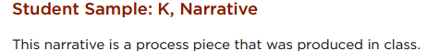
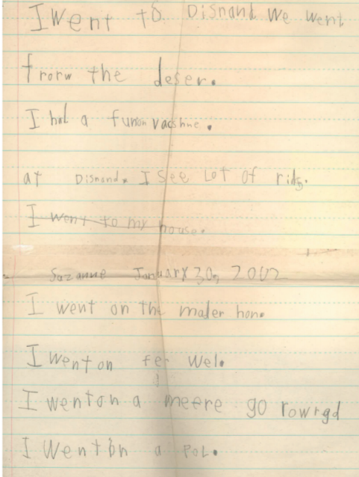
(K Narrative story)

Slide 31
CCSS.ELA-LITERACY.W.K.3 Use a combination of drawing, dictating, and writing to narrate a single event or several loosely linked events, tell about the events in the order in which they occurred, and provide a reaction to what happened.
K-2 SBAC 4 Point Narrative Rubric
Score | Statement of Purpose/Focus and Organization |  | Development: Language and Elaboration of Evidence |  | Conventions Standard L 1-2
 | Statement of Purpose/Focus | Organization | Elaboration of Evidence | Language and Vocabulary
4 Exemplary | -Beginning establishes engaging context for story line/events (e.g., asks a question; starts with action or feelings) -Effectively presents and maintains focus (controlling idea) of story line | -Has a beginning, middle, and an ending with a sense of closure(e.g., a lesson learned –next time…; he never did that again) -Variety of transitions used appropriately -Chronology is logical | -Relevant, concrete details create vivid images or ideas -Effective use of dialogue, sensory and concrete details, strong verbs to advance the action; or to how characters’ motivation, development, growth, or change | -Maintains consistent narrator’s voice -Uses precise language and sentence variety (simple, compound, with phrases) -May use figurative language (e.g., imagery) | -Edits with support from peers, adults, resources -Has few or no errors in grammar, word usage, mechanics as appropriate to grade (e.g., uses conventional spelling for words with common patterns)
Exemplar Example for Grade K
4 Exemplary | establishes a situation by naming a place: Disnand (Disneyland) Effectively maintains focus with every sentence being about the trip to Disneyland. | recounts several loosely linked events and the order in which they occurred. o I had a fun on vacshne (vacation). . . . I see lot (lots) of rids (rides). I went on the mader hon (Matterhorn). . . . I went my house. | provides a reaction to what happened. I had a fun on vacshne (vacation). Score: 3 | Produces complete simple sentences. Appropriate use of Most Vocabulary. Score: 3 | demonstrates command of some of the conventions of standard written English: -This piece illustrates consistent control of beginning-of-sentence capitalization and end of sentence punctuation. The writer also uses capital letters appropriately in the title of the piece. Score: 3
Any text in red is a skill that isn’t part of this grade level’s Writing standard. However, a score is given to support the teaching of that skill.

Slide 32
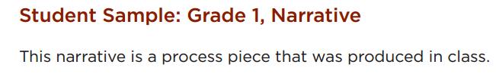
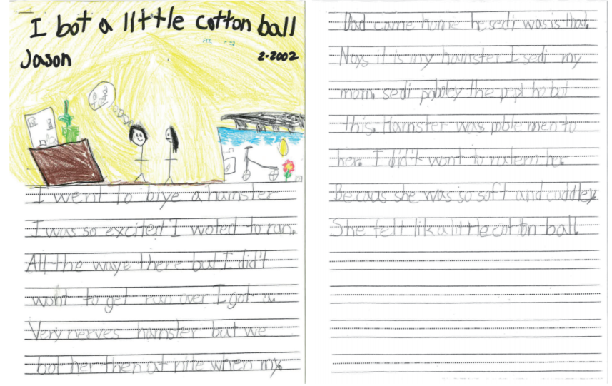
(1st Narrative story)

Slide 33
CCSS.ELA-LITERACY.W.1.3 Write narratives in which they recount two or more appropriately sequenced events, include some details regarding what happened, use temporal words to signal event order, and provide some sense of closure.
K-2 SBAC 4 Point Narrative Rubric
Score | Statement of Purpose/Focus and Organization |  | Development: Language and Elaboration of Evidence |  | Conventions Standard L 1-2
 | Statement of Purpose/Focus | Organization | Elaboration of Evidence | Language and Vocabulary
4 Exemplary | -Beginning establishes engaging context for story line/events (e.g., asks a question; starts with action or feelings) -Effectively presents and maintains focus (controlling idea) of story line | -Has a beginning, middle, and an ending with a sense of closure(e.g., a lesson learned –next time…; he never did that again) -Variety of transitions used appropriately -Chronology is logical | -Relevant, concrete details create vivid images or ideas -Effective use of dialogue, sensory and concrete details, strong verbs to advance the action; or to how characters’ motivation, development, growth, or change | -Maintains consistent narrator’s voice -Uses precise language and sentence variety (simple, compound, with phrases) -May use figurative language (e.g., imagery) | -Edits with support from peers, adults, resources -Has few or no errors in grammar, word usage, mechanics as appropriate to grade (e.g., uses conventional spelling for words with common patterns)
Exemplar Example for Grade 1
4 Exemplary | establishes the situation with the opening sentence. -I went to biye (buy) a hamster . . . Supplies some focused ideas about the main idea: -I got a. Very nerves (nervous) hamster . . . then at nite (night) when my. Dad came home. | provides a n introduction and a sense of closure: -I went to biye (buy) a hamster . . . -I Did’t (didn’t) wont (want) to ratern (return) her. Becaus she was so soft and cuddley (cuddly). She felt lik (like) a little cotton ball. uses transitions and linking words to suggest event order: -then at nite (night) when my. Dad came home he sedi (said) was (what) is that. Noys (noise) . . . | includes some detail regarding what happened. -I was so excited I woted (wanted) to run. All the waye (way) there . . . Score: 3 | Produces complete simple sentences. Appropriate use of Vocabulary. Score: 3 | Uses grade-appropriate basic mechanics and word use with some Errors: -Capital/period error usage causes some lack of understanding of ideas. Score: 2
Any text in red is a skill that isn’t part of this grade level’s Writing standard. However, a score is given to support the teaching of that skill.

Slide 34
(2nd Narrative story)
Student Sample: Grade 2, Narrative
This narrative was produced in class, and the writer likely received support from the teacher.
My first tooth is gone
I recall one winter night. I was four. My sister and I were running down the hall and something happend.
It was my sister and I had run right into each other. Boy! did we cry. But not only did I cry, my tooth was
bleeding. Then it felt funny. Then plop! There it was lying in my hand. So that night I put it under my
pillow and in the morning I found something. It was not my tooth it was two dollars. So I ran down the
hall, like I wasen’t supposed to, and showed my mom and dad. They were suprised because when they
lost teeth the only thing they got is 50¢.

Slide 35
CCSS.ELA-LITERACY.W.2.3 Write narratives in which they recount a well-elaborated event or short sequence of events, include details to describe actions, thoughts, and feelings, use temporal words to signal event order, and provide a sense of closure.
K-2 SBAC 4 Point Narrative Rubric
Score | Statement of Purpose/Focus and Organization |  | Development: Language and Elaboration of Evidence |  | Conventions Standard L 1-2
 | Statement of Purpose/Focus | Organization | Elaboration of Evidence | Language and Vocabulary
4 Exemplary | -Beginning establishes engaging context for story line/events (e.g., asks a question; starts with action or feelings) -Effectively presents and maintains focus (controlling idea) of story line | -Has a beginning, middle, and an ending with a sense of closure(e.g., a lesson learned –next time…; he never did that again) -Variety of transitions used appropriately -Chronology is logical | -Relevant, concrete details create vivid images or ideas -Effective use of dialogue, sensory and concrete details, strong verbs to advance the action; or to how characters’ motivation, development, growth, or change | -Maintains consistent narrator’s voice -Uses precise language and sentence variety (simple, compound, with phrases) -May use figurative language (e.g., imagery) | -Edits with support from peers, adults, resources -Has few or no errors in grammar, word usage, mechanics as appropriate to grade (e.g., uses conventional spelling for words with common patterns)
Exemplar Example for Grade 2
4 Exemplary | Effectively presents and maintains main idea: -Gives title; My first tooth is gone -My sister and I were running down the hall and something happend. . . . But not only did I cry . . . Then it felt funny. Then plop! There it was lying in my hand. establishes engaging context for the story line: -I recall one winter night. I was four. My sister and I were running down the hall and something happend. | provides a n intro. and a sense of closure: -I recall one winter night. I was four. My sister and I were running down the hall and something happend. -They were suprised because when they lost teeth the only thing they got is 50¢. recounts a sequence of events using transition words to signal event order. -My sister and I were running down the hall and something happend. . . . But not only did I cry . . . Then it felt funny. Then plop! There it was lying in my hand. | includes details to describe actions, thoughts, and feelings. -Boy! did we cry. -Then it felt funny. -So I ran down the hall, like I wasen’t supposed to, and showed my mom and dad Score: 4 | Produces a variety of complete sentences, both simple and compound. Maintains consistent narrator’s voice: -I recall…Boy! did we cry…like I wasen’t supposed to… Use of descriptive and figurative language: -winter night… Boy!...Then plop! Score: 4 | demonstrates growing command of the conventions of standard written English. -This piece illustrates the writer’s largely consistent use of beginning-of-sentence capitalization and end-of-sentence punctuation (both periods and exclamation points). -The pronoun I is also capitalized consistently, and almost all the words are spelled correctly. -The writer sets off a parenthetical element with commas and uses an apostrophe correctly. Score: 3
Any text in red is a skill that isn’t part of this grade level’s Writing standard. However, a score is given to support the teaching of that skill.

Slide 36
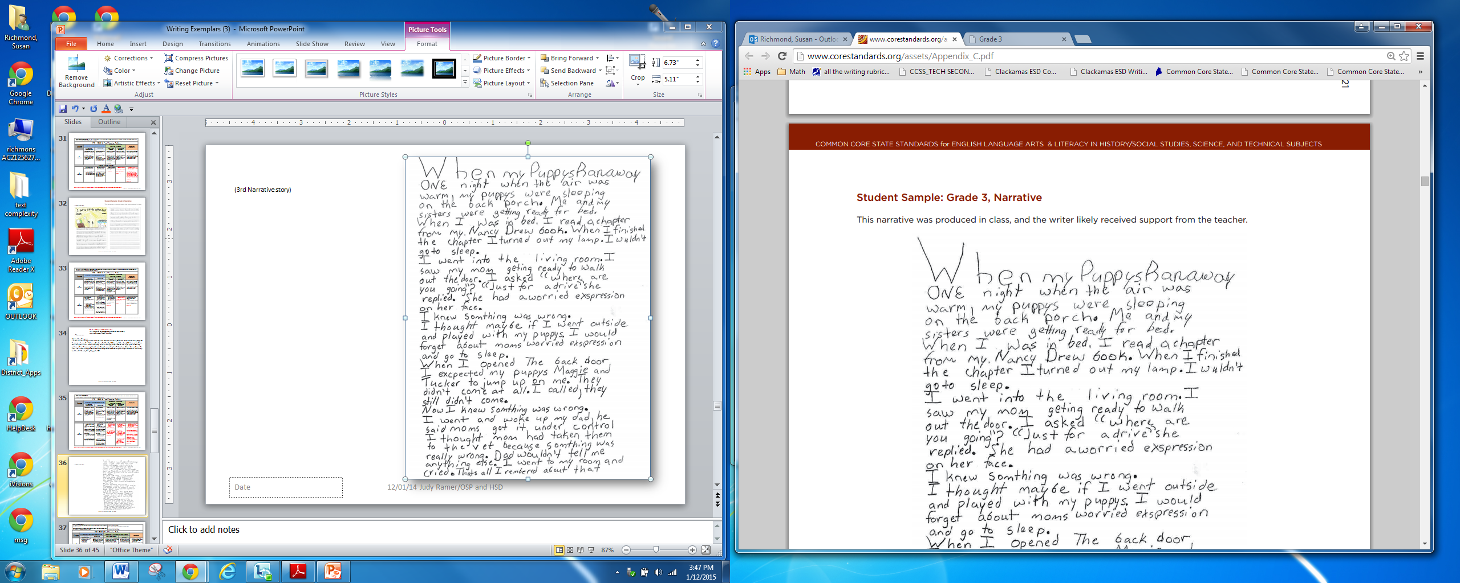
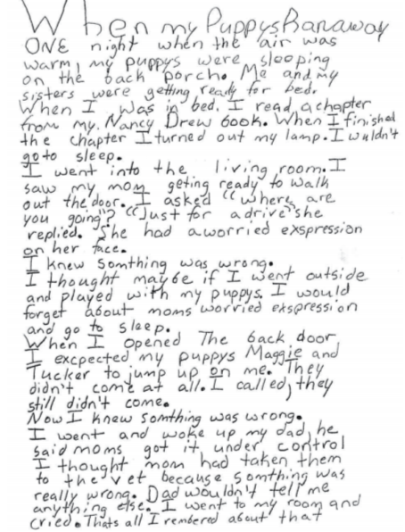
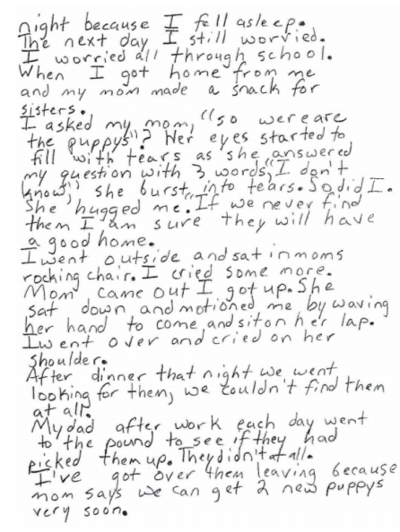
(3rd Narrative story)

Slide 37
CCSS.ELA-Literacy.W.3.3.a: Establish a situation and introduce a narrator and/or characters; organize an event sequence that unfolds naturally. CCSS.ELA-Literacy.W.3.3.b: Use dialogue and descriptions of actions, thoughts, and feelings to develop experiences and events or show the response of characters to situations. |  |  |  | CCSS.ELA-Literacy.W.3.3.c: Use temporal words and phrases to signal event order. CCSS.ELA-Literacy.W.3.3.d: Provide a sense of closure.
3-8 SBAC 4 Point Narrative Rubric
Score | Statement of Purpose/Focus and Organization |  | Development: Language and Elaboration of Evidence |  |  | Conventions
 | Statement of Purpose/Focus | Organization | Elaboration of Evidence |  | Language and Vocabulary
4 Exemplary | The narrative, real or imagined, is clearly focused and maintained throughout: -effectively establishes a setting, narrator and/or characters, and point of view | The narrative, real or imagined, has an effective plot helping create unity and completeness: -effective, consistent use of a variety of transitional strategies -logical sequence of events from beginning to end -effective opening and closure for audience and purpose | The narrative, real or imagined, provides thorough and effective elaboration using details, dialogue, and description: -effective use of a variety of narrative techniques that advance the story or illustrate the experience |  | The narrative, real or imagined, clearly and effectively expresses experiences or events: -effective use of sensory, concrete, and figurative language clearly advance the purpose | The narrative, real or imagined, demonstrates a strong command of conventions: -few, if any, errors in usage and sentence formation -effective and consistent use of punctuation, capitalization, and spelling
Exemplar Example for Grade 3
4 Exemplary | establishes a situation and introduces the narrator. -ONE night when the air was warm, my puppys were sleeping on the back porch. . . . I turned out my lamp. I wuldn’t go to sleep. . . . I saw my mom geting ready to walk out the door. . . . She had a worried exspression on her face. I knew somthing was wrong. Narrative is clearly focused and maintained throughout the piece. | effective opening and closure for purpose: -. . . She had a worried exspression on her face. I knew somthing was wrong. -I’ve got over them leaving because mom says we can get 2 new puppys very soon. organizes an event sequence that unfolds naturally and uses transition words and phrases to signal event order. -When I opened The back door I excpected my puppys Maggie and Tucker to jump up on me. They didn’t come at all. I called, they still didn’t come. Now I knew something was Wrong. | uses dialogue and description of characters’ actions, thoughts, and feelings to develop experiences and events or show the response of characters to situations. -I asked “where are you going”? “Just for a drive” she replied. She had a worried exspression on her face. -I knew somthing was wrong. -I went to my room and cried. -The next day I still worried. I worried all through school. -Her eyes started to fill with tears as she answered my question with 3 words, “I don’t know,” she burst into tears. So did I. She hugged me. -I went outside and sat in moms rocking chair. I cried some more. -I’ve got over them leaving because mom says we can get 2 new puppys very soon. |  | Effective use of sensory, concrete, and figurative language: -replied…worried exspression…I called….under control…eyes started to fill with tears…burst into tears…motioned me…cried on her shoulder… | Strong command of conventions; few errors in usage and sentence formation. Effective and consistent use of punctuation, capitalization, and spelling throughout the piece. Occasional errors do not interfere materially with the underlying message.

Slide 38
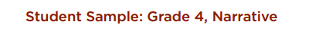
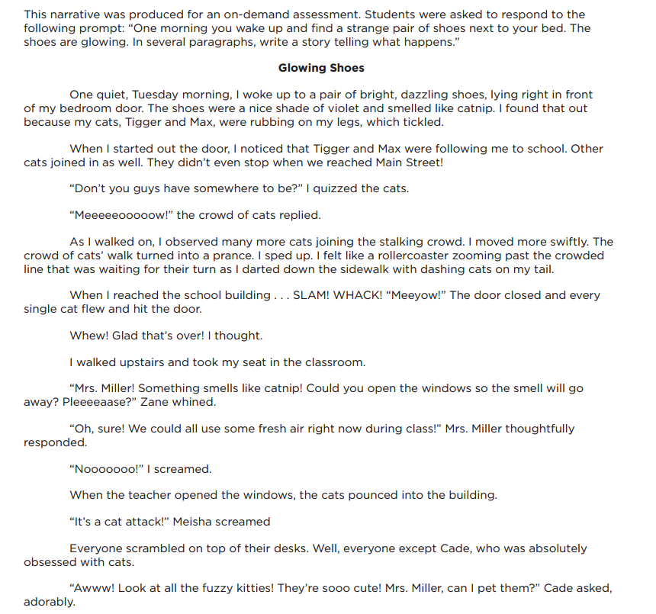
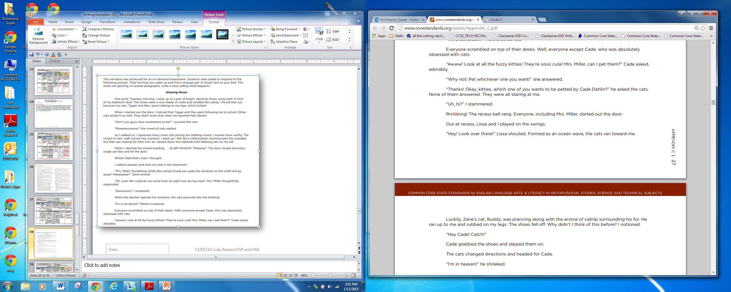
(4th Narrative story)

Slide 39
CCSS.ELA-Literacy.W.4.3.a: Orient the reader by establishing a situation and introducing a narrator and/or characters; organize an event sequence that unfolds naturally. CCSS.ELA-Literacy.W.4.3.b: Use dialogue and descriptions of actions, thoughts, and feelings to develop experiences and events or show the response of characters to situations. |  |  |  | CCSS.ELA-Literacy.W.4.3.c: Use a variety of transitional words and phrases to manage the sequence of events. CCSS.ELA-Literacy.W.4.3.d: Use concrete words and phrases and sensory details to convey experiences and events precisely. CCSS.ELA-Literacy.W.4.3.e: Provide a conclusion that follows from the narrated experiences or events.
3-8 SBAC 4 Point Narrative Rubric
Score | Statement of Purpose/Focus and Organization |  | Development: Language and Elaboration of Evidence |  |  | Conventions
 | Statement of Purpose/Focus | Organization | Elaboration of Evidence |  | Language and Vocabulary
4 Exemplary | The narrative, real or imagined, is clearly focused and maintained throughout: -effectively establishes a setting, narrator and/or characters, and point of view | The narrative, real or imagined, has an effective plot helping create unity and completeness: -effective, consistent use of a variety of transitional strategies -logical sequence of events from beginning to end -effective opening and closure for audience and purpose | The narrative, real or imagined, provides thorough and effective elaboration using details, dialogue, and description: -effective use of a variety of narrative techniques that advance the story or illustrate the experience |  | The narrative, real or imagined, clearly and effectively expresses experiences or events: -effective use of sensory, concrete, and figurative language clearly advance the purpose | The narrative, real or imagined, demonstrates a strong command of conventions: -few, if any, errors in usage and sentence formation -effective and consistent use of punctuation, capitalization, and spelling
Exemplar Example for Grade 4
4 Exemplary | orients the reader by establishing a situation and introducing the narrator and characters: -One quiet, Tuesday morning, I woke up to a pair of bright, dazzling shoes, lying right in front of my bedroom door. | • organizes an event sequence that unfolds naturally: -The teacher opens the window; cats come into the classroom; at recess the cats surge toward the narrator; her shoes fall off; another student (one who loves cats) picks up the narrator’s shoes; the cats move toward him; he is delighted. uses a variety of transitional words and phrases to manage the sequence of events. -When I started out the door . . . As I walked on . . . When I reached the school building . . . provides a conclusion that follows from the narrated experiences or events. -The narrator describes Cade earlier in the piece as a student obsessed with cats. The story concludes logically because such a character would likely be pleased with the effects of wearing catnip-scented shoes. | uses dialogue and description to develop experiences and events or show the responses of characters to situations: -I felt like a rollercoaster zooming past the crowded line that was waiting for their turn . . . -Whew! Glad that’s over! I thought. -“Awww! Look at all the fuzzy kitties! They’re sooo cute! Mrs. Miller, can I pet them? Cade asked, adorably. |  | uses concrete words and phrases , sensory details , and figurative language to convey experiences and events precisely: -The shoes were a nice shade of violet and smelled like catnip. .. rubbing on my legs, which tickled. -“Awww! Look at all the fuzzy kitties! They’re sooo cute! . . . -I felt like a rollercoaster zooming past the crowded line…darted down the sidewalk with dashing cats on my tail. -stalking crowd, swiftly, prancing, aroma | demonstrates an exemplary command of the conventions of standard written English.

Slide 40
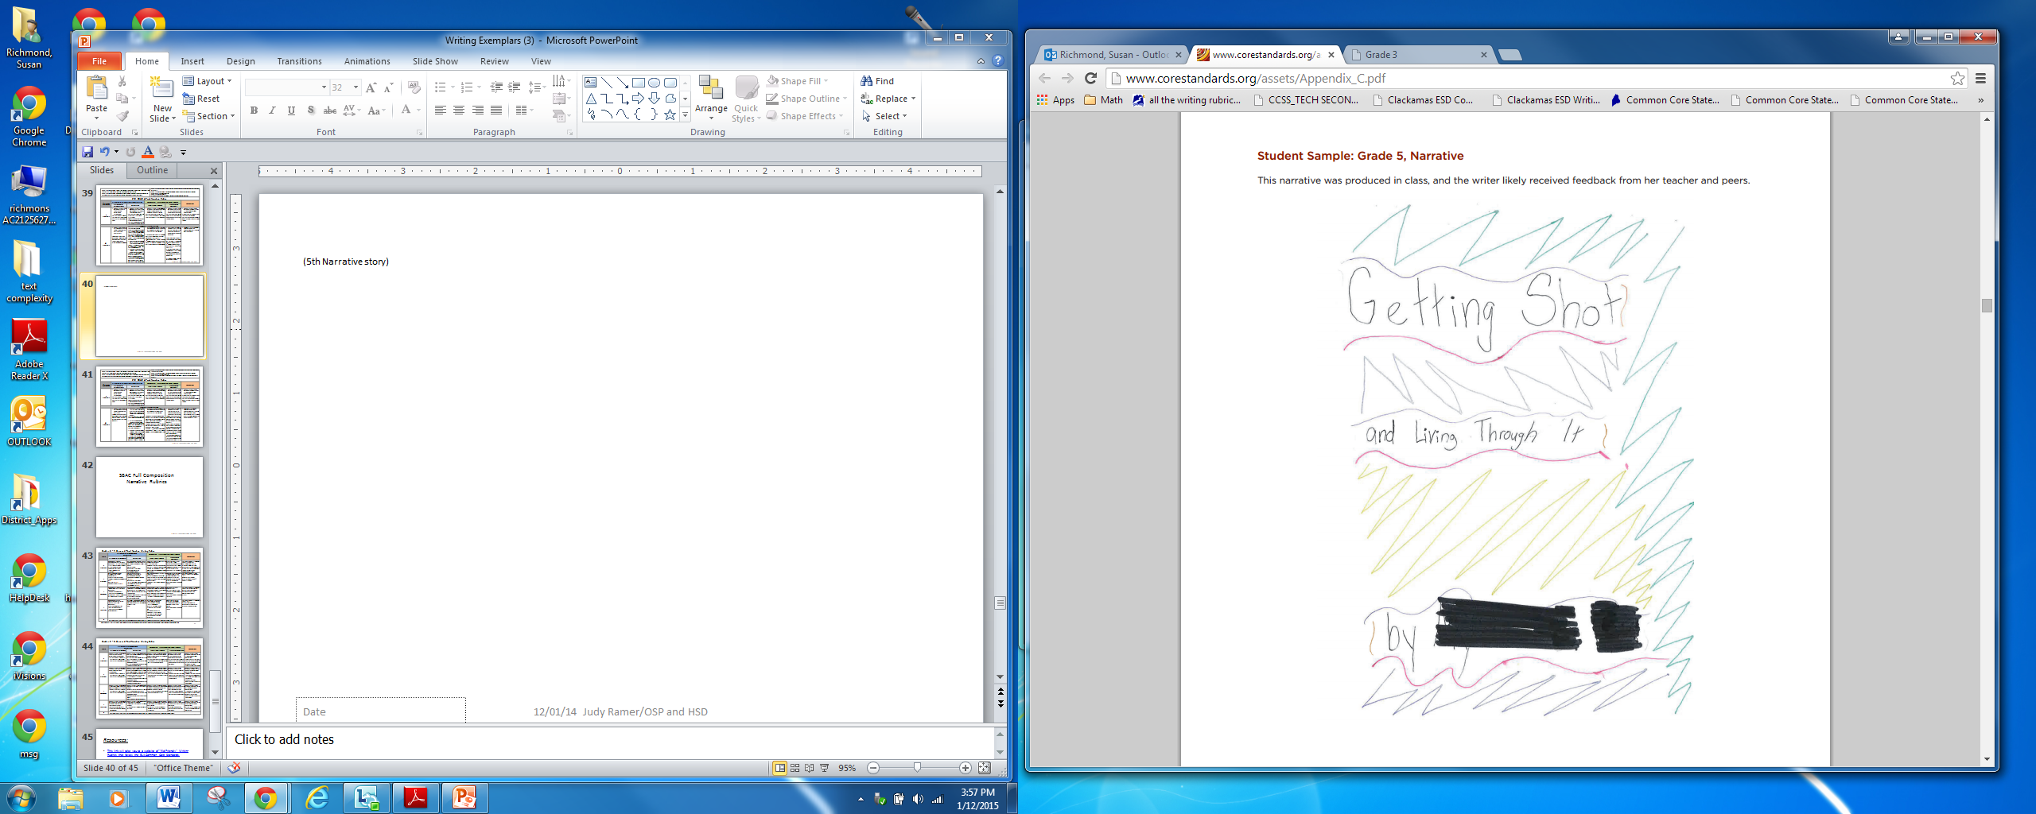
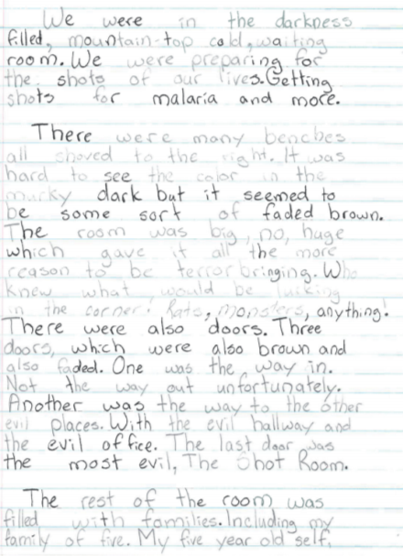
(5th Narrative story)

Slide 41
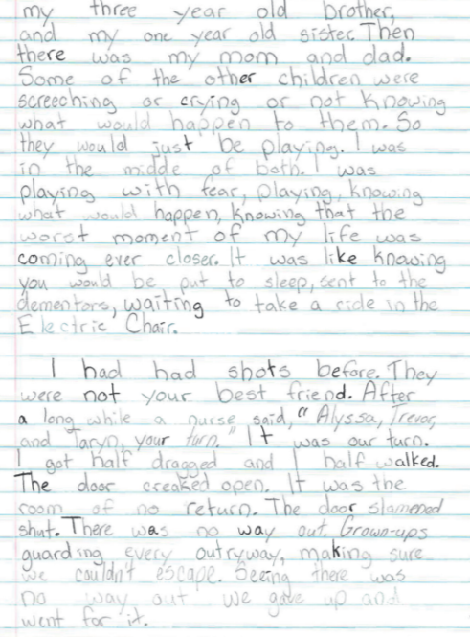
(5th Narrative story)

Slide 42
CCSS.ELA-Literacy.W.5.3.a: Orient the reader by establishing a situation and introducing a narrator and/or characters; organize an event sequence that unfolds naturally. CCSS.ELA-Literacy.W.5.3.b: Use narrative techniques, such as dialogue, description, and pacing, to develop experiences and events or show the responses of characters to situations. |  |  |  | CCSS.ELA-Literacy.W.5.3.c: Use a variety of transitional words, phrases, and clauses to manage the sequence of events. CCSS.ELA-Literacy.W.5.3.d: Use concrete words and phrases and sensory details to convey experiences and events precisely. CCSS.ELA-Literacy.W.5.3.e: Provide a conclusion that follows from the narrated experiences or events.
3-8 SBAC 4 Point Narrative Rubric
Score | Statement of Purpose/Focus and Organization |  | Development: Language and Elaboration of Evidence |  |  | Conventions
 | Statement of Purpose/Focus | Organization | Elaboration of Evidence |  | Language and Vocabulary
4 Exemplary | The narrative, real or imagined, is clearly focused and maintained throughout: -effectively establishes a setting, narrator and/or characters, and point of view | The narrative, real or imagined, has an effective plot helping create unity and completeness: -effective, consistent use of a variety of transitional strategies -logical sequence of events from beginning to end -effective opening and closure for audience and purpose | The narrative, real or imagined, provides thorough and effective elaboration using details, dialogue, and description: -effective use of a variety of narrative techniques that advance the story or illustrate the experience |  | The narrative, real or imagined, clearly and effectively expresses experiences or events: -effective use of sensory, concrete, and figurative language clearly advance the purpose | The narrative, real or imagined, demonstrates a strong command of conventions: -few, if any, errors in usage and sentence formation -effective and consistent use of punctuation, capitalization, and spelling
Exemplar Example for Grade 5
4 Exemplary | orients the reader by establishing a situation and introducing the narrator. -We were in the darkness filled, mountain-top cold, waiting room. We were preparing for the shots of our lives. | organizes an event sequence that unfolds naturally and uses a variety of transitional words, phrases, and clauses to manage the sequence of events: -Trevor went first…It was my turn… When Taryn had her turn… effective opening for audience and purpose: -We were in the darkness filled, mountain-top cold, waiting room. We were preparing for the shots of our lives. provides a conclusion that follows from the narrated experiences or events (emphasizing closure by the use of sentence fragments). -We opened the door and the sparkling sun blinded our eyes. It was over. All over. Finally. | uses narrative techniques to develop experiences and events or show the responses of characters to situations: -Humor through exaggeration: Before the shot was even touching him he was already howling. When it did hit him he was yelling loud enough to deafen you. -Reporting a character’s thoughts: I was paralyzed with fear, I was death-defyed, I was scared. -Pacing: It touched, entered my flesh, and fufilled it’s job. I started with a whimper then, BOOM! full blast cry. |  | uses concrete words and phrases and sensory details to convey experiences and events precisely. -We were in the darkness filled, mountain-top cold, waiting room. We were preparing for the shots of our lives. -There were also doors. Three doors, which were also brown and also faded. One was the way in. Not the way out unfortunately. -The rest of the room was filled with families. Including my family of five. My five year old self, my three year old bother, and my one year old sister. | demonstrates good command of the conventions of standard written English (with occasional errors that do not interfere materially with the underlying message).

Slide 43
SBAC Full Composition
Narrative Rubrics

Slide 44
Grades K - 2: Generic 4-Point Narrative Writing Rubric
Score | Statement of Purpose/Focus and Organization |  | Development: Language and Elaboration of Evidence |  | Conventions
 | Statement of Purpose/Focus | Organization | Elaboration of Evidence | Language and Vocabulary
4 Exemplary | Beginning establishes engaging context for story line/events (e.g., asks a question; starts with action or feelings) Effectively presents and maintains focus (controlling idea) of story line | Has a beginning, middle, and an ending with a sense of closure(e.g., a lesson learned –next time…; he never did that again) Variety of transitions used appropriately Chronology is logical | Relevant, concrete details create vivid images or ideas Effective use of dialogue, sensory and concrete details, strong verbs to advance the action; or to how characters’ motivation, development, growth, or change | Maintains consistent narrator’s voice Uses precise language and sentence variety (simple, compound, with phrases) May use figurative language (e.g., imagery) | Edits with support from peers, adults, resources Has few or no errors in grammar, word usage, mechanics as appropriate to grade (e.g., uses conventional spelling for words with common patterns)
3 Proficient | Uses a combination of drawings, dictation, and writing (K) Event/ series of events is supported with key elements (gr K-2) Has title (gr 1-2) and clear focus (gr K-2) | Clear order of events; provides a reaction (K) Has beginning, middle, and end or problem solution (gr 1-2) Uses basic transitions (e.g., before, after, then, next, later) to show event order or chronology (gr 1-2) | Details include nouns, verbs, and adjectives May use dialogue, sensory or concrete details for effect (gr 1-2) Elaborates on actions, reactions, motivations, thoughts, or feelings orally or in writing | Appropriate use of words (singular-plural) and prepositional phrases Produces variety of complete sentences – orally (K) or in writing Uses adult/peer feedback to revise | Edits with support from peers, adults, or resources (gr 2) Minor errors do not interfere with reader’s understanding
2 Developing | Beginning has some context (when, why, etc.) for story line/events Includes key elements (characters, problem or main event) and attempts to establish a central focus | Has beginning, middle, and end, but some parts need work or need more clarity (e.g., may have digressions or gaps in the story; sequence or connection of events is not clear) Transitions are lacking or cause confusion | Some elaboration strategies are evident in drawings or writing, or added with support/questioning from peers or adults Uses some details or dialogue to elaborate on images or ideas (actions, thoughts, feelings) | Vocabulary use has minor errors Dictates, writes, and expands simple complete sentences Uses adult/peer feedback torevise | Edits with support from peers, adults, or resources (gr 2) Uses grade-appropriate basic mechanics and word use with some errors
1 Emerging | Beginning may have confusing context or no context for story line/events Lacks key elements of the story line/events (character(s), problem, or main event) | Attempts a beginning, middle, and end, but one or more parts are missing or generic (e.g., once upon a time…; the end) | Attempts to add details to drawings or writing are random, generic (e.g., good, nice, pretty), or may seem irrelevant to story line OR May identify literary elements (characters, setting, action) without any added description or details | Generally uses basic, incorrect, or below grade level vocabulary when dictating (K) or writing Uses adult/peer feedback to revise | Edits with support from peers or adults(gr 2) Grade-appropriate mechanics are not used or have frequent errors
0 | A response gets no credit if it provides no evidence of the ability to [fill in with key language from the intended target].
Working Drafts of ELA rubrics for assessing CCSS writing standards --- © (2010) Karin Hess, National Center for Assessment [khess@nciea.org

Slide 45
Grades 3 - 8: Generic 4-Point Narrative Writing Rubric
Score | Statement of Purpose/Focus and Organization |  | Development: Language and Elaboration of Evidence |  | Conventions
 | Statement of Purpose/Focus | Organization | Elaboration of Evidence | Language and Vocabulary
4 Exemplary | The narrative, real or imagined, is clearly focused and maintained throughout: effectively establishes a setting, narrator and/or characters, and point of view* | The narrative, real or imagined, has an effective plot helping create unity and completeness: effective, consistent use of a variety of transitional strategies logical sequence of events from beginning to end effective opening and closure for audience and purpose | The narrative, real or imagined, provides thorough and effective elaboration using details, dialogue, and description: effective use of a variety of narrative techniques that advance the story or illustrate the experience | The narrative, real or imagined, clearly and effectively expresses experiences or events: effective use of sensory, concrete, and figurative language clearly advance the purpose | The narrative, real or imagined, demonstrates a strong command of conventions: few, if any, errors in usage and sentence formation effective and consistent use of punctuation, capitalization, and spelling
3 Proficient | The narrative, real or imagined, is adequately focused and generally maintained throughout: adequately establishes a setting, narrator and/or characters, and point of view* | The narrative, real or imagined, has an evident plot helping create a sense of unity and completeness, though there may be minor flaws and some ideas may be loosely connected: adequate use of a variety of transitional strategies adequate sequence of events from beginning to end adequate opening and closure for audience and purpose | The narrative, real or imagined, provides adequate elaboration using details, dialogue, and description: adequate use of a variety of narrative techniques that generally advance the story or illustrate the experience | The narrative, real or imagined, adequately expresses experiences or events: adequate use of sensory, concrete, and figurative language generally advance the purpose | The narrative, real or imagined, demonstrates an adequate command of conventions: some errors in usage and sentence formation but no systematic pattern of errors is displayed adequate use of punctuation, capitalization, and spelling
2 Developing | The narrative, real or imagined, is somewhat maintained and may have a minor drift in focus: inconsistently establishes a setting, narrator and/or characters, and point of view | The narrative, real or imagined, has an inconsistent plot, and flaws are evident: inconsistent use of basic transitional strategies with little variety uneven sequence of events from beginning to end opening and closure, if present, are weak weak connection among ideas | The narrative, real or imagined, provides uneven, cursory elaboration using partial and uneven details, dialogue, and description: narrative techniques, if present, are uneven and inconsistent | The narrative, real or imagined, unevenly expresses experiences or events: partial or weak use of sensory, concrete, and figurative language that may not advance the purpose | The narrative, real or imagined, demonstrates a partial command of conventions: frequent errors in usage may obscure meaning inconsistent use of punctuation, capitalization, and spelling
1 Emerging | The narrative, real or imagined, may be maintained but may provide little or no focus: may be very brief may have a major drift focus may be confusing or ambiguous | The narrative, real or imagined, has little or no discernible plot: few or no transitional strategies are evident frequent extraneous ideas may intrude | The narrative, real or imagined, provides minimal elaboration using little or no details, dialogue, and description: use of narrative techniques is minimal, absent, in error, or irrelevant | The narrative, real or imagined, expression of ideas is vague, lacks clarity, or is confusing: uses limited language may have little sense of purpose | The narrative, real or imagined, demonstrates a lack of command of conventions: errors are frequent and severe and meaning is often obscured
0 | A response gets no credit if it provides no evidence of the ability to [fill in with key language from the intended target].

Slide 46
Resources:
This link will take you to a website of "Kid Friendly" Writing Rubrics that follow the ELA Common Core Standards.

