Slide 1
BUILDING KNOWLEDGE
CLOSING THE GAP
by BUILDING
KNOWLEDGE
THEME
TOPIC
Struggling students with deeper knowledge can out perform high achieving students with less knowledge.

Slide 2
BUILDING KNOWLEDGE
Which yields the highest result for building knowledge?
THEME
or
TOPIC
The message the author wants to convey is the theme. Themes are broad ideas.
The subject is the topic. Topics are more specific in nature.

Slide 3
BUILDING KNOWLEDGE
Students who read or listen to connected texts by topic yield as much as 4 times vocabulary growth.
More vocabulary and background knowledge about a topic means exceeding over students with great reading skills but little background knowledge.
40%
“Knowing lots of strategies cannot fully compensate for lack of background knowledge.” Fisher & Frey, 2009

Slide 4
BUILDING KNOWLEDGE
“So, if we systematically build
knowledge by topic our students will…
Develop their Academic Vocabulary
and Build their
Background
knowledge.

Slide 5
BUILDING KNOWLEDGE
“It is widely accepted among researchers that the difference in students’ vocabulary levels is a key factor in disparities in academic achievement… but that vocabulary instruction has been neither frequent nor systematic in most schools.”
(Appendix A of Common Core State Standards for ELA)

Slide 6
BUILDING KNOWLEDGE
Narrow from Theme to Topic…
THEME
POLLUTION IS HARMFUL
Narrow to a more specific topic
Water Pollution
Narrow to an even more
specific topic
Groundwater Pollution
Pesticides in Our Water
Narrow to an even more specific topic
Pesticides Effect on Human Health
Build knowledge systematically and the vocabulary follows.

Slide 7
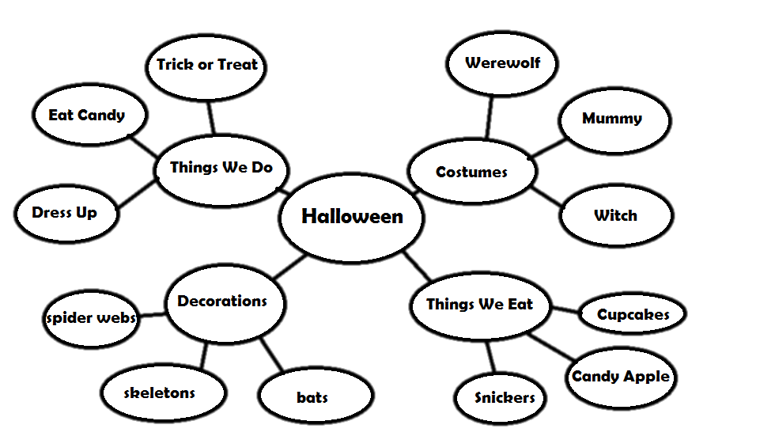
BUILDING KNOWLEDGE
Building topic knowledge systematically grade by grade, gives students the platform of understanding they need to achieve higher level tasks.
species
exposure
bacteria
harmful
organisms
poisoning
parasites
Pesticides and Health
contaminate
illnesses
vulnerable
rashes
released
infants
neurological
nitrates
hazard

Slide 8
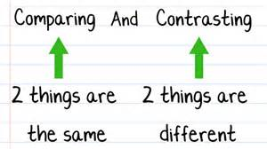
Teaching strategies without prior background knowledge will not build a platform of understanding.

Slide 9
BUILDING KNOWLEDGE
How can we increase the volume of reading students do on a day to day basis about a topic?
more pages
texts at different levels of complexity
student or teacher choice of text
build knowledge of words and the world
light support
guided or independent reading
build a love of reading

Slide 10
BUILDING KNOWLEDGE
Getting Ready….

Slide 11
BUILDING KNOWLEDGE
We Must Build Topic Knowledge not only systematically grade by grade but must follow through with….
Re-evaluating
And
Adjusting
tracking
Monitoring
scaffolds

Slide 12
BUILDING KNOWLEDGE
Go Team! Build
Knowledge!

