Slide 1
Writing Questions for Paired Passages
This activity can be used for Professional Development or during a PLC. This is an activity to be done by teachers (not students).
This activity is time consuming but extremely valuable for understanding how questions in paired passages support
a final performance task (PT) and how to write those questions.
Questions should be pre-written before instruction.
Performance Tasks can involve several sources (more than the two provided in this example). This is a simplified version to focus on writing questions.
This model insures text-dependent questions for standards RL and RI.1.
Other standards should be addressed if understanding the passages selected require the skills and knowledge of specific standards.

Slide 2
Paired Passages Supporting a Performance Task
Find two passages you feel have a connection. Read both paired passages.
How do the passages connect? It could be content (about the same topic), context (they both share similar situations) or concept (they both support a concept such as; “How to People Handle Challenge?”)
Write a Central Insight Statement that show how the passages connect
a. example: The Soldiers in the American Revolution had to find New Ways to Fight.
“Morph” the Central Insight Statement into a Deep Understanding or shared Insight that can reach across content.
b. example: When People are in Difficult Situations They Must Make Hard Choices.
Now use the Deep Understanding to write a Performance Task with an authentic purpose that includes the content topic:
c. example: You are writing an informational report how the soldiers in the American Revolution handled difficult situations. What hard choices did they have to make? Use details from the text to support your report.

Slide 3
Paired Passages Supporting a Performance Task
After you have written your Performance Task, re-read each passage by paragraph or section. After each section write a Major Point Statement. This statement is the main idea of the paragraph. Do this for each paragraph or section.
The Major Point Statements must support or enhance the Performance Task.
After you have written a Major Point (main idea) Statement for each paragraph or section, go back and write 2-3 key details that support each Major Point Statement.
You are ready now to write selected and constructed response questions that will support a Performance Task. Students can use their responses as sources to complete the final Performance Task, because each response supports the Performance Task.
Central Insight Statement: Main Idea – Morphs into a Deep Understanding which helps you create a Performance Task that is supported by all questions.
Major Point Statements: Main Idea of each paragraph or section. These can be used to write constructed responses.
Key Details: Support each paragraph’s main idea. These can be used to write selected responses.

Slide 4
Creating Text Dependent Questions for Paired Texts Text 1 – |  | Creating Text Dependent Questions for Paired Texts Text 2 –
Shared Central Insight Statement: What is the common central insight from both texts?
Deep Understanding: What understanding move across content?
Final Performance Task (authentic task):
Major Points: What major points in each section of the texts (or various stimuli) support the central insight? Number each section of each text.
Section 1 Major Point Statement | Section 1 Major Point Statement
Key Details: What key details support the Major Point Statement? | Key Details: What key details support the Major Point Statement?
Section 2 Major Point Statement | Section 2 Major Point Statement
Key Details: What key details support the Major Point Statement? | Key Details: What key details support the Major Point Statement?
Section 3 Major Point Statement | Section 3 Major Point Statement
Key Details: What key details support the Major Point Statement? | Key Details: What key details support the Major Point Statement?
Section 4 Major Point Statement | Section 4 Major Point Statement
Key Details: What key details support the Major Point Statement? | Key Details: What key details support the Major Point Statement?
Section 5 Major Point Statement | Section 5 Major Point Statement
Key Details: What key details support the Major Point Statement? | Key Details: What key details support the Major Point Statement?

Slide 5
The following example has:
two paired passages
a completed Pairing Passages for Questions template.

Slide 6
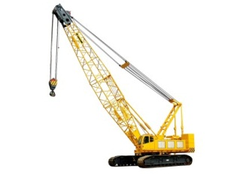
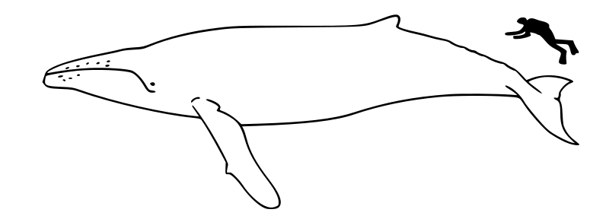
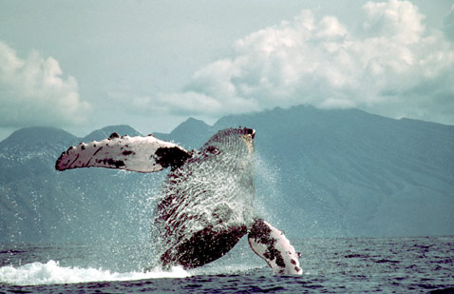
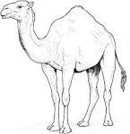
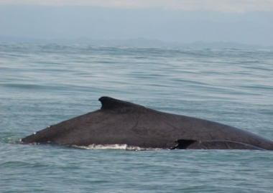
Grade Equivalence 3.9
The Humpback Whale (Text 1)
Section 1
What weighs about the same as a 50 ton crane?
The humpback whale!
The humpback whale is easy to spot. It is the longest of all whales. Humpback whales can be 40 to 50 feet long and weigh up to 50 tons!
Section 2
Some people say the humpback whale has wings like a bird!
But, they are really large flippers. They are the largest flippers of any whale.
Section 3
Do humpback whales really have a hump on their back like a camel?
When a humpback whale gets ready to dive under the water, it arches its body.
It only looks like a hump coming out of the water.

Slide 7
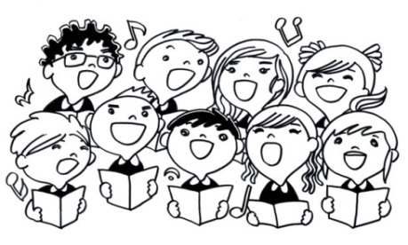
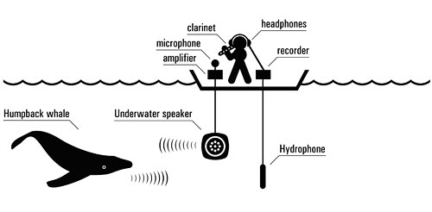
The Humpback Whale
Section 4
Does a humpback whale have fingerprints like people do?
The humpback whale has a tail with a deep notch. Underneath the tail there are white patches called flukes. Each whale’s fluke is different than any other whales, just like our fingerprints are different than anyone's. Scientists can recognize different humpback whales by their flukes.
Section 5
Humpback whales can sing beautiful songs, but not like we do!
The male humpback whale sings the songs. All of the songs have meaning and are very complex. Because the songs are complex scientists, believe that humpback whales are very intelligent. Graphic courtesy David Rothenberg

Slide 8
Grade Equivalence 3.5
Facts about Humpback Whales – Text 2
Section 1
Description
The humpback whale is an easy whale to spot. Not only is it huge (40-50 tons) but it is 40 to 50 feet long! 50 feet is about as tall as a five story building.
Many people say the humpback whale has a hump on its back! But when the humpback dives under the water he arches his back. It only looks like a hump.
Humpback whales have large flippers. Their flippers are a third of their body size. The scientific name for humpback whales is Megaptera which means “huge-wings.”
Humpback whales can be gray to black. They have white markings under their tails called flukes. These markings are unique to each whale and help scientists identify them. The humpback’s tail is about 12 feet wide. Humpbacks stick their tail out of the water, swing it around and slap the water. This is called lobtailing. The reason they lobtail is not known.
Section 2
Behavior
Humpback whales are known for their complex whale songs. Scientists have been studying these songs for many years. Only males have been found to sing. The songs all have a reason and are very complex. This makes scientists believe that whales are very intelligent.
Humpback whales are famous for leaping out of the water. They use their strong tails to slap the water. Their tails help propel them all the way out of the ocean.
Humpbacks hunt in groups in very clever ways. The hunting members make a circle under the water. Then, all of the whales blow bubbles at the same time. The wall of bubbles traps small fish for the humpbacks to eat. This is called bubble-net feeding.
Section 3
One of a Kind
Humpback whales are “one of a kind” for many reasons. They are the largest whale. They are the only whale that sings. They work in hunting teams and use clever ways to catch food. They are the acrobats of the ocean and are known as very intelligent.

Slide 9
Creating Text Dependent Questions for Paired Texts Text 1 – The Humpback Whale |  | Creating Text Dependent Questions for Paired Texts Text 2 – Facts About Humpback Whales
What is the common central insight from both texts? Shared Central Insight Statement: Humpback Whales are unique.
Based on the shared central insight statement, what deep understanding moves across content and domains? Animals can have unique qualities or features that allow them to survive or to be recognized.
Final Performance Task (authentic task): A company gives people tours to see the humpback whale on their boats. You have been asked to design a brochure describing what the people can expect to see. In your brochure use details and examples from both texts in your description of the humpback whale.
Major Points: What major points in each section of the texts (or various stimuli) support the central insight? Number each section
Section 1 Major Point Statement The humpback whale is easy to spot | Section 1 Major Point Statement The humpback whale is easy to recognize.
Key Details: What key details support the Major Point Statement? It weighs 50 tons. It is about 40- 50 feet long. | Key Details: What key details support the Major Point Statement? It weighs 50 tons. It is about 40- 50 feet long. It arches it back when it dives under water which makes it look like a hump. It has the largest flippers of any whale. Some people think the flippers look like wings. The flippers are a third of its body size. Humpback whales have markings on their flukes different than other whales. Flukes are like fingerprints. The humpback’s tail is 12 feet wide. Humpbacks slap their tails against the water or “lobtail
Section 2 Major Point Statement The humpback whale looks like it has wings. | Section 2 Major Point Statement Humpback whales behave in specific ways.
Key Details: What key details support the Major Point Statement? Its flippers look like large wings | Key Details: What key details support the Major Point Statement? Key Details: What key details support the Major Point Statement? Humpbacks make beautiful and complex whale songs. Only males make the whale songs. The whale songs are very complex. Humpbacks leap out of the ocean. Humpbacks are called the oceans acrobats. Humpbacks hunt in groups. Humpbacks have clever ways to hunt. Humpbacks bubble-net to catch small fish to ear.
Section 3 Major Point Statement Does a humpback whale really have a hump on its back? | Section 3 Major Point Statement Humpbacks are different than other whales in some ways.
Key Details: What key details support the Major Point Statement? The whale arches it back when it dives under water. This looks like a humped back. | Key Details: What key details support the Major Point Statement? Key Details: What key details support the Major Point Statement? They are the largest whale. They are the only whale that sings. They hunt in teams in clever ways. They are the only whale that is called the ocean’s acrobat. Humpbacks are thought of as the most intelligent whale.
Section 4 Major Point Statement Scientists can identify different humpback whales. | Section 4 Major Point Statement
Key Details: What key details support the Major Point Statement? Humpback whales have flukes underneath their tails. Each whale’s fluke is different than any others. This means the fluke could be called a humpback’s “fingerprint.” | Key Details: What key details support the Major Point Statement?
Section 5 Major Point Statement Humpback whales can sing. | Section 5 Major Point Statement
Key Details: What key details support the Major Point Statement? Male humpback whales sing songs. The whales’ songs are complex. Scientists think whales are intelligent because of their complex songs All of the songs have meaning. | Key Details: What key details support the Major Point Statement?
Key Details could be used for DOK-1-2 Selected Response Questions.
Performance Tasks are a DOK-4 Question.
Major Point statements could be used for 3 Constructed Response Questions.

