Slide 1

Grade
Grade
K
Quarter 4 Pre-Assessment
Teacher Directions
Sequential Steps toward Standard Mastery
Reading
12 Selected-Response Items
Research
2 Constructed-Response
Writing
1 Brief Write
1 Write to Revise
1 Full Composition (Optional Performance Task)
Writing w/ Integrated Language as Part of the Performance Task
Language/Vocabulary
Edit/Clarify
Performance Task
at Grade Level

Slide 2
Grade
K
Quarter Four
Pre-Assessment
Reading: Literature
Targets |  | Standards | DOK
3 | Reasoning and Evidence | RL.3 | 1-2
6 | Reasoning and Evidence | RL.6 | 2
5 | Analysis Within and Across Texts | RL.9 | 4
Reading: Informational
Targets |  | Standards | DOK
11 | Reasoning and Evidence | RI.3 | 1-2
11 | Reasoning and Evidence | RI.6 | 3-4
12 | Analysis Within and Across Texts | RI.9 | 2-3-4
Note: There may be more than one standard per target. Standards can have different DOKs per target.
Actual writing standards assessed are boxed.
Opinion Writing and Language
Targets |  | Standards | DOK
1a | Brief Opinion Write | W.1a, W.1b, W.1c, W.1d | 3
1b | Write-Revise Opinion | W.1a, W.1b, W.1c, W.3d | 2
2 | Full Opinion Composition | W-1a, W-1b, W-1c, W-1d | 4
8 | Language-Vocabulary Use | L.K.6 | 1-2
9 | Edit and Clarify | L.K.1.a | 1-2

Slide 3

All elementary ELA assessments were reviewed and revised in June of 2015 by the following amazing and dedicated HSD K-6th grade teachers.
Deborah Alvarado Lincoln Street | Ko Kagawa Minter Bridge
Linda Benson West Union | Jamie Lentz Mooberry
Anne Berg Eastwood | Sandra Maines Quatama
Aliceson Brandt Eastwood | Gina McLain TOSA
Sharon Carlson Minter Bridge | Teresa Portinga Patterson
Deborah Deplanche Patterson | Judy Ramer Consultant
Alicia Glasscock Imlay | Sara Retzlaff McKinney
Sonja Grabel Patterson | Jami Rider Free Orchard
Megan Harding Orenco | Kelly Rooke Free Orchards
Renae Iversen TOSA | Angela Walsh Witch Hazel
Ginger Jay Witch Hazel

Slide 4
Note:
During kindergarten students are not normally reading. Read the stories to the students and ask the questions as Listening Comprehension questions. Most students should be able to point to pictures and answer questions with support and prompting. Please tell students what the pictures show if students aren’t clear about the image.
Recommendation: The literary section can be assessed at a different time than the informational section. The informational section includes two passages as required by standard RI.K.9 and may require more time.
Listening comprehension prepares students for the kind of questions that are higher level questions (rather than decodable text which is not conducive to higher level questioning).
Kindergarten Directions:
Teachers will need:
1. Teacher Directions Section
2. Literature and Informational texts. Read each to your class 2-3 times. Discuss the story so that students are clear about language and vocabulary terms. Some teachers choose to project these onto an overhead screen.
For Assessing Students Individually (if you assess in small groups you may want to make more than one copy of the following):
3. A copy of the Literature and Informational Stories
4. A copy of the Picture Prompts
Students will need:
1. The Student Assessment Copy
This includes:
a. Student Record Form (for teacher to mark)
b. Constructed Response Answer Sheets
c. Student Check-List (optional use)
Performance Task Optional (after the assessment):
If desired, the performance task is at grade level and can be used as an Opinion pre-test for writing at the beginning of this quarter. The end quarter CFA can be used as a post-test.
Performance Task Possible Pre-Classroom Activity
Attached - Optional

Slide 5
Using Key Details Classroom Activity for Performance Task
This classroom pre-activity follows the Smarter Balanced Assessment Consortium general design of contextual elements, resources, learning goals, key terms and purpose [http://oaksportal.org/resources/]
The content within each of these was written by Jamie Lentz.
The Classroom Activity introduces students to the context of a performance task, so they are not disadvantaged in demonstrating the skills the task intends to assess.
Contextual elements include:
an understanding of the setting or situation in which the task is placed
potentially unfamiliar concepts that are associated with the scenario
key terms or vocabulary students will need to understand in order to meaningfully engage with and complete the performance task
The Classroom Activity is also intended to generate student interest in further exploration of the key idea(s). The Classroom Activity should be easy to implement with clear instructions.
Please read through the entire Classroom Activity before beginning the activity with students to ensure any classroom preparation can be completed in advance. Throughout the activity, it is permissible to pause and ask students if they have any questions.
Resources needed:
1 copy of Text #1 and Text #2 from the ancillary materials
White chart paper (you will model writing your opinion piece on this)
Chart paper marker
Learning Goals:
Students will understand the context of the key concepts related to the topic:
using key details from the text in our opinion writing
Students will understand the key terms:
Note: Definitions are provided here for the convenience of facilitators. Students are expected to understand these key terms in the context of the task, not memorize the definitions.
Key details- important pieces of information from the text that need to be in our writing
Opinion- what someone thinks about something
Evidence- pieces of information that show something is true or right
[Purpose: The facilitator’s goal is to help students understand that key details from texts need to be included when writing and opinion piece. The key details are pieces of evidence to support their opinion.]
*Facilitators can decide whether they want to display ancillary materials using an overhead projector or computer/Smartboard, or whether they want to produce them as a handout for students.

Slide 6
Using Key Details Classroom Activity
Discussion questions:
What is an opinion?
What are key details? (this should be a review from the interim classroom activity)
What is evidence?
Facilitator says: “Today we will be getting ready for the Seasons Performance Task. We are going to talk about including key details from texts that we read into our writing. We have already learned about key details, so I’m going to give you a minute to talk to your partner about what key details are. Key details are….”
Possible student responses (unscripted):
Important things from the story
The important parts
Stuff we have to put in our writing
Facilitator says: “Let’s see what you remember about key details. __________ what did you and _______ talk about? (Call on several students and provide the definition if needed before moving on).”
Facilitator says: “Today I am going to write an opinion piece about soccer. An opinion is what someone thinks about something. I think soccer is a great sport, so my opinion writing is going to be telling why soccer is a great sport. What is your opinion about soccer? Do you think soccer is fun, boring, hard, easy. Turn and tell your partner your opinion about soccer. I think soccer is ….. (give your class “go” signal).”
Student responses (unscripted):
Fun and you have to run a lot
I think soccer is fun.
I play soccer!
Facilitator says: “Before I begin writing my opinion piece, I need to do some reading to get more information about soccer. Let’s read these two texts. (Read Text #1 and Text #2 from the ancillary materials).”
Facilitator says: “Now I know more about soccer and I can use the key details from the texts in my opinion writing. I can use this information as evidence. Evidence shows why my opinion is right or correct.”
(Begin writing on the chart paper as you continue through the next section).

Slide 7
Facilitator says: “Let’s see I am going to start with my opinion… Soccer is a great sport! Hmm… why do I think soccer is so great? I’m going to look back at the first text for some key details. I’m going to write this part about scoring a goal and this first part where the text says that everyone can play…. Everyone can play soccer and score a goal. Alright now I’m going to look for some key details to use from the second text. I need to make sure they are evidence, or show that my opinion is right. Sofia loved scoring goals… turn to your partner and talk about whether or not I should add that to my opinion writing (give class “go” signal).”
Possible student responses (unscripted):
Yes she should
She should say she loves scoring goals because it makes soccer great
Yes
No
Facilitator says: “_______ what do you and your partner think? Should I add that key detail? (call on a few students and clarify why you would/wouldn’t use it- it is evidence that soccer is great but would be repetitive).“
(Continue modeling with as many key details as needed).
Facilitator says: “In your performance task, you will be learning more about opinion writing. The partner work you did today should help prepare you for the research and writing you will be doing in the performance task.”
Note: Facilitator should collect student notes from this activity.

Slide 8
Ancillary Materials
Soccer
Soccer is a fun sport that everyone can play. There are eleven players on each team. Most of the time players kick the ball but sometimes they use their heads too! Each team tries to get the soccer ball into the other team’s net and score a goal!
Sofia the Soccer Star
Sofia loved playing soccer! She played on a team with boys and girls from school every Saturday. Sofia loved running and scoring goals. Her favorite part about playing soccer was having fun with her friends. One Saturday they even won a trophy!

Slide 9
Pre-Assessment and Learning Progressions
The pre-assessments are unique.
They measure progress toward a standard.
Unlike the Common Formative Assessments which measure standard mastery, the pre-assessments are more like a base-line picture of a student’s strengths and gaps, measuring skills and concepts students need “along the way,” in order to achieve standard mastery.
So what about a “post-assessment?” There is not a standardized post-assessment.
The true measure of how students are doing “along the way,” is assessed in the classroom during instruction and classroom formative assessment. For this reason The CFA’s are not called “post-assessments.” The CFAs measure the “end goal,” or standard mastery. However, without the pre-assessments, how will we know what our instruction should focus on throughout each quarter?
Learning Progressions: are the predicted set of skills needed to be able to complete the required task demand of each standard. The learning progressions were aligned to Hess’ Cognitive Rigor Matrix.
The pre-assessments measure student proficiency indicated on the boxes in purple (adjustment points). These points are tasks that allow us to adjust instruction based on performance. For instance, if a student has difficulty on the first “purple” adjustment point (DOK-1, Cf) the teacher will need to go back to the tasks prior to DOK-1 Cf and scaffold instruction to close the gap, continually moving forward to the end of the learning progression.
There is a Reading Learning Progression checklist for each standard in each grade that can be used to monitor progress. It is available at:
Beg. of QTR
CFA
RL.2.1 grade-level standard assessment.
END of QTR
Example of a Learning Progression for RL.2.1
Pre-Assessments Measure Adjustment Points (in purple)
Throughout the QTR
After the pre-assessment is given, Learning Progressions provide informal formative assessment below and near grade-level “tasks” throughout each quarter.
DOK 1 - Ka | DOK - Kc | DOK 1 - Cd | DOK 1 - Cf | DOK 2 - Ch | DOK 2 - Ck | DOK 2 -Cl | Standard Mastery
Recall who, what, where, when, why and how about a story read and discussed in class. | Use and define Standard Academic Language: who, what, where, when, why, and how; ask, answer, questions, key details | Connect the terms who to characters; where and when to setting; what and how to sequence of events. | Ask and answer who, what, where, when, why and how questions about key details in a text. | Concept Development Student understands that key details help tell who, what, where, when, why and how. | Uses key details to identify who, what, where, when, why and how about a story not read in class. | Finds information using key details to answer specific questions about a new story. | RL.2.1 Ask and answer such questions as who, what, where, when, why, and how to demonstrate understanding of key details in a text
http://sresource.homestead.com/Grade-2.html

Slide 10
Quarter Four Reading Literature Learning Progressions.
The indicated boxes highlighted before the standard, are assessed on this pre-assessment. The standard itself is assessed on the Common Formative Assessment (CFA) at the end of each quarter.
DOK 1 - Ka | DOK 1 - Kc | DOK 1 - Cd | DOK 1 - Cf | DOK 2 - Ch | Standard DOK-2 APn
Recall characters, setting beginning, middle and ending events in a story read and discussed in class. | Define the terms (know the meanings of) Standard Academic Language: story, character, setting , major and event. | Identify specific characters, setting and event sequences in a new- (i.e., not a well-known traditional story), (read and discussed in class). NOT ASSESSED | Answer describing questions about characters, setting or events in a story read and discussed in class. SELECTED RESPONSE | Connects story events to a specific character or setting. SELECTED RESPONSE | RL.K.3 With prompting and support, identify characters, settings, and major events in a story (read but not discussed in class)
DOK 1- Ka | DOK 1 - Kc | DOK 1 - Cf | DOK 2 - Ch | DOK 2 - Ci | Standard
Retells the name of an author or illustrator in texts read and discussed in class. | Define and be able to use Standard Academic Language: author, illustrator, story, role, telling and name. | Answers questions that require explaining what an author and illustrator’s roles are in a story. NOT ASSESSED | Concept Development Explain who the author is and his/her role. Explain who the illustrator is and his/her role. | Locate information from an illustration or in the text to answer questions about the text. SELECTED RESPONSE | RL.K.6 With prompting and support, name the author and illustrator of a story and define the role of each in telling the story
DOK 1 - Ka | DOK 1 - Kc | DOK 1 - Cf | DOK 2 - Ch | DOK 2 - Ci | DOK 2 - Cl | DOK 3 - ANp | DOK 3 - Cu | DOK 3 - ANz | Standard DOK 4 – SYV
Locate specific characters in a story. | Understand and be able to use Standard Academic Language: characters, story, compare, contrast, same, different, adventures familiar and experiences. | Answers basic questions (no inference) about characters and their experiences or adventures. NOT ASSESSED | Concept Development: Understands what an adventure is. Understands what an experience is. | Can sequence the events of an adventure or experience (beginning, middle and ending) in a few sentences (orally). SELECTED RESPONSE | Refers to the correct part of a text when asked about a specific event within a sequence of an adventure or experience. | Lists adventures or experiences of characters in two separate lists or columns. SELECTED RESPONSE | Explains or shows how one characters adventures or experiences are the same or different than another (prompt with descriptive adjectives). | Analyzes the adventure or experiences between two characters with a prompt(s), (i.e., which character showed/had___ during his/her adventure?) CONSTRUCTED RESPONSE | RL.K.9 With prompting and support, compare and contrast the adventures and experiences of characters in familiar stories.

Slide 11
Quarter Four Reading Informational Learning Progressions.
The indicated boxes highlighted before the standard, are assessed on this pre-assessment. The standard itself is assessed on the Common Formative Assessment (CFA) at the end of each quarter.
DOK 1 - Ka | DOK 1 - Kc | DOK 1 - Cf | DOK 2 – Ch – Concept Development |  |  | DOK 3 - ANp | Standard DOK 3 – Cu
Answers describing questions about individuals, events or ideas read to and discussed in text (rote memory). | Define the terms understand and use Standard Academic Language: events, ideas, information, between, connect, individuals and text. | Answers questions about individuals, events or ideas read to and discussed in class (requires more than memory). NOT ASSESSED | Explains connections between time and events, individuals, ideas or information. | Explains connections between sequence of events, ideas or information. | Explains connections between cause and effect of events. SELECTED RESPONSE | Organizes (categorizes) on a graphic organizer (draws or glues pictures) of when events happened (timeline), or how two individuals/ideas are the same or different (venn). SELECTED RESPONSE | RI.K.3 With prompting and support, describe the connection between two individuals, events, ideas, or pieces of information in a text.
DOK 1- Ka | DOK 1 - Kc | DOK 1 - Cf | DOK 2 - Ch | DOK 2 - Cl |  | Standard
Retells the name of an author or illustrator in texts read and discussed in class. | Define and be able to use Standard Academic Language: author, illustrator, story, role, telling and name. | Answers questions that require explaining what an author and illustrator’s roles are in a story. NOT ASSESSED | Concept Development Explain who the author is and his/her role. Explain who the illustrator is and his/her role. | Locate information or ideas presented in the text by the illustrator. SELECTED RESPONSE | Locate information or ideas presented in the text by the author. SELECTED RESPONSE | RI.K.6 Name the author and illustrator of a text and define the role of each in presenting the ideas or information in a text.
DOK 1 - Ka | DOK 1 - Kc | DOK 1 - Cf | DOK 2 - Ch | DOK 2 - Ck | DOK 3 - ANP | DOK 3- APx | DOK 2 - SYG | DOK 4 - SYU | Standard
Recall details about specific illustrations, descriptions or procedures from a text read and discussed in class. | Understand and use Standard Academic Language: similarities and differences, texts, illustrations, descriptions, procedures and topic. | Answer what, who, when and where questions about illustrations, descriptions, and procedures in a read/discussed text. NOT ASSESSED | Concept Development: Student understands that two texts about the same topic can have similar or different illustrations, descriptions and procedures. | Make generalizations between two texts on the same topic (how they are generally the same/different) about specific illustrations, descriptions or procedures. SELECTED RESPONSE | Gather, analyze, and organize illustrations, descriptions or procedures from two texts on the same topic (able to organize by lists or columns). | Understands the concept of identifying similarities and differences between two texts (can explain or show without much prompting). SELECTED RESPONSE | Gather (to synthesize) information within one source – finds all of the attributes about a topic that support___ (requires knowing similarities and differences). | Gather (to synthesize) information within two sources – finds all of the attributes about a topic from both sources that support ___. CONSTRUCTED RESPONSE | RI.K.9 With prompting and support, identify basic similarities in and differences between two texts on the same topic (e.g., in illustrations, descriptions, or procedures

Slide 12
A Note about constructed responses: Constructed response answers are not written “in stone.” There is no perfect way a student should respond. Look for the general intent of the prompt and student response and follow the rubric below as much as possible. Use your best judgment. Unlike DOK-1 questions where there is one right and wrong answer, constructed responses are more difficult to assess. Overall consistency of intent based on most of your student responses can guide you.
Quarter 4 Pre-Assessment Constructed Response Key
Literary Passages: Pedro’s Pet and James and Baby Bird
RLK.9 Prompt: Draw, write or tell about what made Pedro and James happy at the end of each story.
Constructed Response Research Rubrics Target 2
Locate, Select, Interpret and Integrate Information.
Constructed Response Research Rubrics Target 2
Locate, Select, Interpret and Integrate Information
The response gives sufficient evidence of the ability to locate and select information that shows or tells what made Pedro and James happy at the end of each story. Students should be able to write or draw about what made Pedro happy at the end of the story Pedro’s Pet. Students could include details that (1) Pedro bought a new pet – a mouse, (2) and would keep it in his room. Students should be able to write or draw about what made James happy at the end of the story James and Baby Bird. Students could include that at the end of the story (1) James had to set the baby bird free, and (2) may explain why or that it was happier being free. The response gives sufficient evidence of the ability to interpret and integrate information to draw or write about how both stories ended, using sufficient details to demonstrate that the student understood the beginning and endings in both texts ( words, letters or pictures).
2 | Student draws or writes with sufficient details to show what made Pedro and James happy at the end of each story. Student writes or draws 2 details about what made Pedro happy. Student writes or draws 2 details about what made James happy.
1 | Student draws or writes with partial details to show some understanding of what made Pedro and James happy at the end of each story. Student writes or draws 1 detail about what made Pedro happy. Student writes or draws 1 detail about what made James happy.
0 | Student does not show understanding of what made either James or Pedro happy. The student response is not consistent with the prompt.
Toward RL.K.9 DOK 3 - ANz
Analyzes the adventure or experiences between two characters with a prompt(s), (i.e., which character showed/had___ during his/her adventure?)

Slide 13
Constructed Response Answer Key
Informational Passages: What Do Animals Need? and Rocks Help This Animal Eat
14. Write and draw about what animals need in their habitat so
they can eat.
1
What does a giraffe need to eat?
2
How does a lion find its food?
Giraffes need the leaves from the acacia trees. Student may say tall trees or give information about how tall a giraffe is and that is needs to eat from tall trees.
Lions find their food by hunting or that lions hunt for other animals to eat.
_______________
_______________
_______________
_______________
_______________
_______________
3
What does a bear need so it can find its food?
4
What does an otter need so it can eat?
Bears need plenty of room
to roam to find food.
Students may refer to
needing a lot of space to
look for food. (Bears do
not need a den to find
food).
Otters need a rock so it can break open its food. Students may also say that otters eat crabs or animals that live in hard shells or that otters break open hard shells with rocks to get the food out.
_______________
_______________
_______________
_______________
_______________
_______________
Student Response Examples
2 | #1- Giraffes need tall or acacia trees. #2- Lions need to hunt or eat other animals. #3 – Bears need room to find food. #4 – Otters need a rock to break open shells.
1 | #1 - #4 2 answers have partial information. 2 answers are complete.
0 | None or very few of the pictures or words show an understanding of the prompts
Toward RI.K.9 DOK 4 - SYU
Gather (to synthesize) information within two sources – finds all of the attributes about a topic from both sources that support ___.

Slide 14
Questions #15 and #16 address language standards that are assessed on SBAC as part of Claim #2 – Writing. These two questions are not on the student Listening Comprehension answer key and recording sheet, but may be used for instructional guidance in language and writing as desired. Questions #15 and #16 are combined as a two-part question.
15. Write letters, words or pictures to tell what animal you liked best in the stories. Give your words and pictures a title. Write a Brief Text, W.K.1b State Topic, Target 6a
Title ________________
Circle the words or pictures you made that show what you liked best about the animal you chose. Revise a Text, W.K.1b support with reasons, Writing Target 6b
2 | The response states a topic by giving the words or pictures a title and has circled the reasons that support what animal he or she liked best. Student writes, draws and/or tells about the animal he or she liked best and then gives the pictures and/or words a logical title (states the topic). The student has circled sufficient words or pictures that explain most why he or she liked the animal best (supports the topic with reasons).
1 | The response states a topic by giving the words or pictures a title, but may only be partially accurate or logical, with some or a few words or pictures representing why he or she liked the animal the best (needs more supportive reasoning). Student writes, draws and/or tells about the animal he or she liked best and then gives the pictures and/or words a title that is partially representative of the student’s words and/or pictures. The student has circled some of the words or pictures that explain most why he or she liked the animal best (supports the topic with reasons) or there may be few detailed reasons in the student’s writing/drawing.
0 | The response does not state a title that is logical for what the student has written or drawn. There are minimal or very few details in words or pictures that support what animal he or she liked best. Student does not write or draw in a logical way about what animal he or she likes best.

Slide 15
Performance Task Answer Key
CCSS.ELA-Literacy.W.K.1
Use a combination of drawing, dictating, and writing to compose opinion pieces in which they tell a reader the topic or the name of the book they are writing about and state an opinion or preference about the topic or book (e.g., My favorite book is...).
Question #17 (Performance Task) is optional. If scoring, language standards L.K.6 (using words learned in the texts) and L.K.1a (capitals and lower case letters) as listed on the cover sheet of this assessment, are integrated in the scoring key below. In grades 1 – 6 language and vocabulary, and edit and clarify are assessed separately.
17. Task: Pretend you help make habitats at a zoo. Select an animal. What is the best habitat for it? Draw and write to show why you think it is the best habitat for your animal.
My Zoo Animal
The Best Habitat for My Animal
Students receive three scores, one for each criterion. In kindergarten, use your judgment along with the writing rubric (below) to decide how the final product best supports each of these three areas.
Purpose and Organization (4) Uses drawing and writing to compose. Explains more about the topic (animal). Connects the topic of the animal to words or pictures that show the best habitat for it. |  |  |  | Language -Elaboration of Evidence (4) Uses relevant details or examples to support the opinion of the best habitat for his/her animal. Uses vocabulary learned from the passages. (L.6) Uses complete sentences when sharing. L.K.1f |  |  |  | Conventions (4) Uses words or letters appropriate for age especially capitals and lower case letters. L.K.1a. If sharing, uses grammar appropriate for age as well as any plural pronouns. L.K.1c
1 | 2 | 3 | 4 | 1 | 2 | 3 | 4 | 1 | 2 | 3 | 4
Total Score /12

Slide 16
Performance Task
(Optional!)
The following pages support a student performance task.
In kindergarten a performance task is more of an instructional lesson and has much support. If you choose to do a performance task as part of your instruction you can break this down into several days. This should be done after you have given the entire assessment (both literary and informational sections).
Directions:
Re- Read the Passages and model how to take notes - (a teacher note-taking form with instructions and a student form that can be used for modeling, are included). Kindergarten students are not expected to take notes independently.
Have students share their two completed constructed response questions from this assessment (these are research questions).
The Performance Task
Classroom Activity:
Review any vocabulary students may struggle with.
Task:
You help make habitats at a zoo. Select an animal. What is the best habitat for it? Draw and write to show why you think it is the best habitat for your animal.

Slide 17
Grade K
Name_____________________
What is the text mostly about? This is the main topic.
Draw a main topic picture.
1
Read the text with the students. Ask the students if the text is about (use irrelevant examples – a french-fry?, a hair?).
This will help students understand that when you ask what a text is mostly about you are referring to the subject or what is called a main topic.
Ask students to draw a picture of the main topic.
Remember students will need to have a note-taking form for each passage.
Use letters, words or pictures. Tell more about the main topic.
Ask students to explain more about the main topic.
Tell students, “When we want to explain more about (name the main topic), we can look to see what else happened. We are looking for ideas and details.”
Ask students, “What ideas or details can you find and tell about?”
2
Differentiation:
Students who need more pages – print as needed. In kindergarten you can scaffold students to start with illustrating the main topic, then move to details and ideas in another lesson. Students who would benefit from enrichment can continue on with more specific details or a new text.
Students who need more direct instruction – teach each part in mini lessons. These concepts can be taught separately:
Main Topic
Ideas
Details
ELL Students may need each part taught using language (sentence) frames emphasizing transitional words.

Slide 18
Grade K
Name_____________________
What is the text mostly about? This is the main topic.
Draw a main topic picture.
Use letters, words or pictures. Tell more about the main topic.

Slide 19
Grades K - 2: Generic 4-Point Opinion Writing Rubric
Score | Statement of Purpose/Focus and Organization |  | Development: Language and Elaboration of Evidence |  | Conventions CCSS and Report Card Alignment Conventions: Kinder-L.K.1a, L.K.2a, & L.K.2d 1st-L.1.1a, L.1.2 2nd-L.2.2
 | Statement of Purpose/Focus CCSS and Report Card Alignment Text Types & Purposes: Kinder-W.K.1 1st-W.1.1.1-4 2nd-W.2.1.1-4 | Organization CCSS and Report Card Alignment Text Types & Purposes: Kinder-none 1st-W.1.1.5 2nd-W.2.1.4-5 | Elaboration of Evidence CCSS and Report Card Alignment Text Types & Purposes/Production and Distribution of Writing: Kinder-W.K.1.3 1st-W.1.1.4 & W.1.5.2 2nd-W.2.1.4 | Language and Vocabulary CCSS and Report Card Alignment Conventions & Vocab. Acquisition: Kinder-L.K.1b-f & L.K.6 1st-L.1.1b-j & L.1.6 2nd-L.2.1 & L.2.6
4 Exemplary (E) | Uses a combination of drawing, dictation, & writing (K) to compose Explains something more about the topic OR A connection is made between topic & broader idea(s) | Intro, body, and conclusion support focus and reason(s) Uses several transitions appropriately (e.g., because, since, and, also, for example, since) to connect ideas | Elaborates using a variety of relevant details, examples, quotes, etc. to support focus (opinion) or explain reasons May use figurative language (e.g., imagery, simile, exaggeration) | Chooses words and phrases for effect (e.g., precise, concrete, or sensory vocabulary) Uses variety of sentences (simple, compound, with prepositional phrases) | Edits with support/ resources Has few or no errors in grammar, word usage, or mechanics as appropriate to grade
3 Proficient (M) | Uses a combination of drawing, dictation, & writing (K) to compose Clearly identifies topic (gr K-3) Focus (opinion) about topic is clearly stated (gr K-3 | Has intro, body, and concluding statement or section (gr 1-3) that support focus (opinion) States one or more reasons for opinion (gr 1-3) Uses transitions (e.g., because, and) to connect ideas (gr 2-3) | Drawings or writing include relevant and descriptive details, labels/captions, facts, or elaboration that support the opinion or reasons Details are explained, not simply listed | Appropriate use of vocabulary (nouns, verbs, plurals, adjectives, etc.) Uses some variety of sentence types (statement, question, exclamation) Uses adult/peer feedback to revise | Edits with support from peers, adults, resources (gr 2-3) Minor errors do not interfere with reader’s understanding
2 Developing (NM) | Uses a combination of drawing, dictation, & writing (K) to compose Has topic and attempts a focus (opinion), but focus may shift or not be relevant to the topic chosen | Introduction, body, and conclusion are evident, but may lack clarity or coherence (e.g., attempts to connect opinion to a reason, but reason may not make sense) | Some elaboration strategies are evident in drawings or writing (gr K-3), or added with support/ questioning from peers or adults Ideas may not be fully elaborated or details may be insufficient to support opinion | Vocabulary use has minor errors Dictates, writes, and expands simple complete sentences Uses adult/peer feedback to revise | Edits with support from peers or adults (gr 2-3) Uses grade-appropriate basic mechanics and word use with some errors
1 Merging (NY) | Uses a combination of drawing, dictation, & writing (K) to compose Attempts to identify a topic, but lacks a focus (opinion) or may have more than one topic or confusing topic as stated | Attempts introduction, body, and conclusion, but one or more parts are missing | No details provided or attempts to add details to drawings or writing which may be random, inaccurate, or irrelevant | Generally uses basic, incorrect, or below grade level vocabulary when dictating (K) or writing Uses adult/peer feedback to revise | Edits with support from peers or adults (gr 2-3) Uses below grade-level basic mechanics with frequent errors
0 | A response gets no credit if it provides no evidence of the ability to [fill in with key language from the intended target].

Slide 20
ELP Kindergarten Standards Organized by Modality
Receptive modalities*: Ways in which students receive communications from others (e.g., listening, reading, viewing). Instruction and assessment of receptive modalities focus on students’ communication of their understanding of the meaning of communications from others. | Listening & Reading | 9 - create clear and coherent grade-appropriate speech and text | 10 - make accurate use of standard English to communicate in grade-appropriate speech and writing | 1 | construct meaning from oral presentations and literary and informational text through grade-appropriate listening, reading, and viewing
 |  |  |  | 8 | determine the meaning of words and phrases in oral presentations and literary and informational text
Productive modalities*: Ways in which students communicate to others (e.g., speaking, writing, and drawing). Instruction and assessment of productive modalities focus on students’ communication of their own understanding or interpretation. | Speaking & Writing |  |  | 3 | speak and write about grade-appropriate complex literary and informational texts and topics
 |  |  |  | 4 | construct grade-appropriate oral and written claims and support them with reasoning and evidence
 |  |  |  | 7 | adapt language choices to purpose, task, and audience when speaking and writing
Interactive modalities*: Collaborative use of receptive and productive modalities as “students engage in conversations, provide and obtain information, express feelings and emotions, and exchange opinions” (Phillips, 2008, p. 3). | Listening, Speaking, Reading, and Writing |  |  | 2 | participate in grade-appropriate oral and written exchanges of information, ideas, and analyses, responding to peer, audience, or reader comments and questions
 |  |  |  | 5 | conduct research and evaluate and communicate findings to answer questions or solve problems
 |  |  |  | 6 | analyze and critique the arguments of others orally and in writing
Standard | An ELL can… | By the end of an English language proficiency level, an ELL Kindergarten can . . .
4 Productive (S & W) | …construct grade-appropriate oral & written claims & support them with reasoning & evidence. | 1 | 2 | 3 | 4 | 5
 |  | …express a feeling or opinion about a familiar topic. | …express an opinion or preference about a familiar topic | …express an opinion or preference about a familiar topic or story. | …express an opinion or preference about a variety of topics or stories. | …express an opinion or preference about a variety of topics or stories.
This performance task is based on writing. As an option if you’d like to monitor growth for ELP as a second goal, teachers can choose to assess ELP standard 4 because it aligns with this specific performance task. Your student’s full composition can be analyzed to identify English language proficiency levels. It is evident that students will be navigating through the modalities to get to the end product. However, it is important to keep in mind what the full opinion writing performance task is assessing and how deeply the student understands class content and language. The ELP growth goal is to provide the “just-right scaffolds” for students to demonstrate their understanding in order for them to move from one proficiency level to the next.

Slide 21
Opinion Writing Pre-Assessment Performance Task
Student and Class Scoring: |  |  | School Year: |  | Grade:
 |  | Teachers Name:
 |  | School:
Student Name: |  |  | Focus and Organization | Elaboration and Evidence | Conventions | Student Total | ELP Score
 |  |  | Score | Score | Score
1.
2.
3.
4.
5 |  |  |  |  |  | 0
6 |  |  |  |  |  | 0
7 |  |  |  |  |  | 0
8 |  |  |  |  |  | 0
9 |  |  |  |  |  | 0
10 |  |  |  |  |  | 0
11 |  |  |  |  |  | 0
12 |  |  |  |  |  | 0
13 |  |  |  |  |  | 0
14 |  |  |  |  |  | 0
15 |  |  |  |  |  | 0
16 |  |  |  |  |  | 0
17 |  |  |  |  |  | 0
18 |  |  |  |  |  | 0
19 |  |  |  |  |  | 0
20 |  |  |  |  |  | 0
21 |  |  |  |  |  | 0
22 |  |  |  |  |  | 0
23 |  |  |  |  |  | 0
24 |  |  |  |  |  | 0
25 |  |  |  |  |  | 0
26 |  |  |  |  |  | 0
27 |  |  |  |  |  | 0
28 |  |  |  |  |  | 0
29 |  |  |  |  |  | 0
30 |  |  |  |  |  | 0
31 |  |  |  |  |  | 0
32 |  |  |  |  |  | 0
33 |  |  |  |  |  | 0
34 |  |  |  |  |  | 0
35 |  |  |  |  |  | 0
Scoring Key:
Total # Correct
1
= Emerging
0 - 4
2
= Developing
5 - 7
3
= Proficient
8 - 10
4
= Exemplary
11 - 12

Slide 22
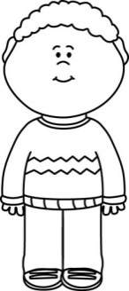

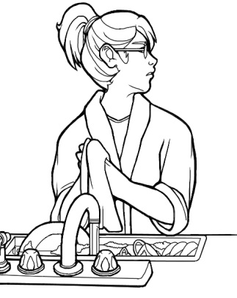
Pedro’s Pet
Ginger Jay
Pedro wanted a pet. Most of his friends had pets. Some had big pets and some had small pets. One of the kids at school even had a snake! Pedro wanted a dog or cat. One morning he asked his mom if he could have a pet. He knew she would she would say no. They lived in a small house with no yard. There was no room for a dog or cat. But still, Pedro wanted a pet.
No, Pedro we don’t have room!

Slide 23
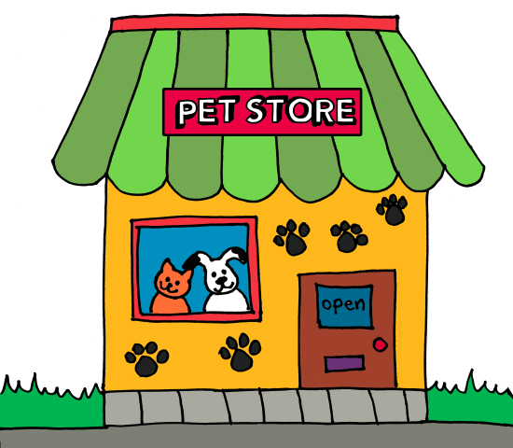
Pedro told his mom that if she would let him have a pet it would be small. He told her it would be quiet. He told her it could live in his room and he would take care of it. His mom said they could go to the pet store. Pedro was happy!

Slide 24



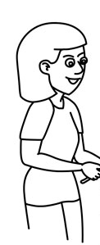

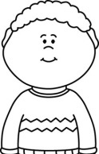


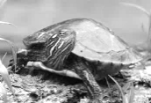
At the pet store, Pedro saw so many pets! He saw dogs and cats. He saw fish and turtles. Pedro did not know which pet to get. Then his mom showed him a gray mouse. The mouse was small and quiet. It could live in his room and he would take care of it. Now Pedro has the perfect pet!

Slide 25
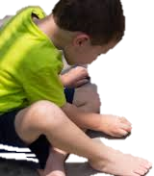
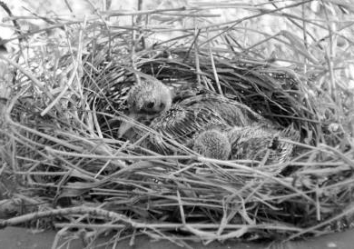
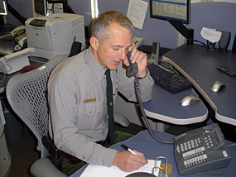
James and Baby Bird
Ginger Jay
James was walking in his yard one day. All of a
sudden he saw a little bird's nest. It was on the
ground. James knew that nests belonged in trees,
not on the ground. He went inside to find his mom.
His mom came out and saw the nest. She saw a tiny
baby bird inside the nest. The baby bird was chirping
and chirping. It seemed hungry but there was no momma bird close by.
James' mom carried the baby bird and the nest over to the porch. She carefully placed it in a small box. She poked some holes in the top of the box. This way the baby bird would have air but still stay safe. She told James they would call someone to help. She called a park ranger from their city park. He told them what to do.

Slide 26
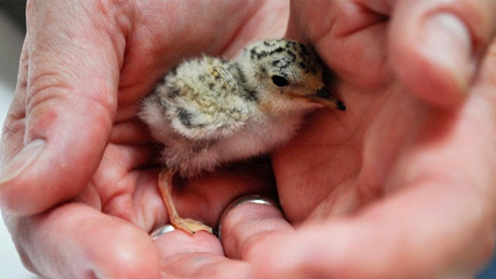
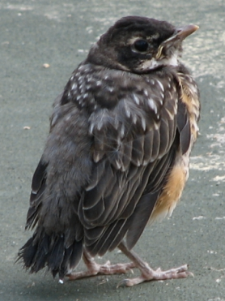
James helped his mom take care of the baby bird. He helped her find small worms in the yard and feed them to the bird. He helped her change the bird's water and keep the box clean. He was very careful not to touch the
baby bird or take him out of the box. One day his
mom said it was time to set the bird free.
James was sad. He wanted to keep the baby bird. He wanted to buy a cage and keep him for a pet.
James' mom told him this kind of bird was not a pet.
She said he would not want to live in a cage. She
suggested they take him outside and let him go
near the trees in their yard. James was still sad,
but when he saw the bird fly free he was happy.

Slide 27




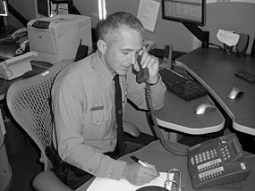
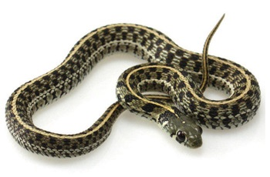
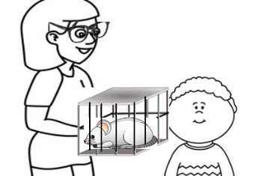


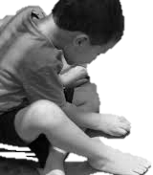
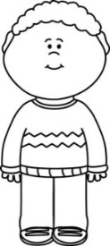
Selected Response Picture Prompts
Literary Passage: Pedro’s Pet
1.
2.
3.
4.
5.
6.

Slide 28
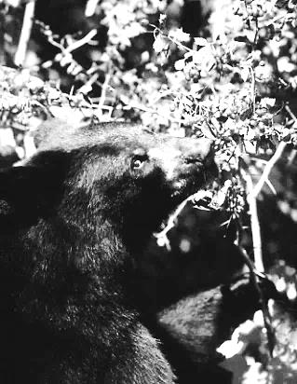
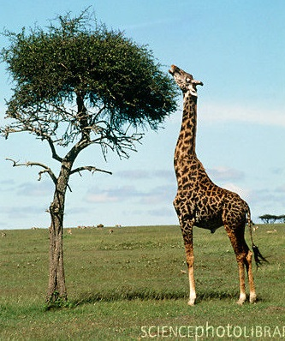
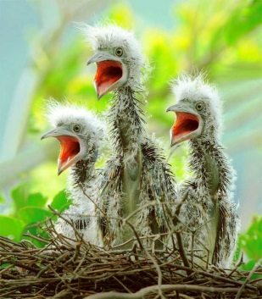
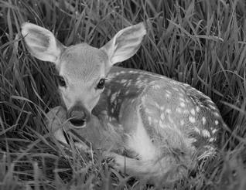
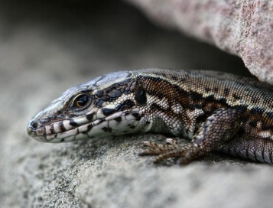
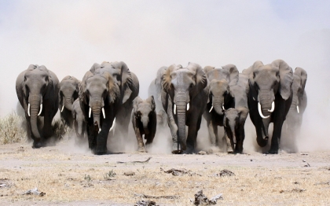
What do Animals Need?
By Elizabeth Yeo
An animal’s habitat is all around it. What can animals find in their habitats that they need?
Animals Need Food and Water
Animals find food and water in their habitat.
A lion hunts other animals for its food.
A giraffe eats the leaves of an acacia tree for its food.
Bears need to roam a large area to find enough food.
Animals Need a Home
Animals find homes in their habitats.
Beavers need trees to cut down to build their homes.
Birds need a nest to hold their young.
Bears need a den for their home.
Fawns find a soft place in the woods to live.
Animals Need to be Safe
An animal’s home can protect it.
There are other ways animals keep safe from danger.
A lizard hides under rocks to protect itself from hungry birds.
Some animals use camouflage.
Some animals have sharp teeth.
Large groups, called herds, give animals a safe place to hide.

Slide 29
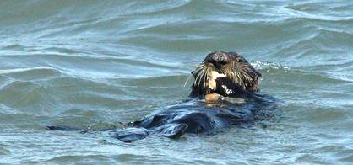
Rocks Help This Animal Eat
By Kate Paixão
What can you do with rocks? A sea otter uses them to help it eat!
Sea otters live in the ocean. They eat crabs and other animals with hard shells. Here is how rocks help the sea otter eat a meal.
First the sea otter catches its food. Next it swims to the top of the water. Then the sea otter floats on its back. It puts the hard shell on its belly. Bam! The otter hits the shell with a rock. The shell breaks. The otter eats what is inside.

Slide 30
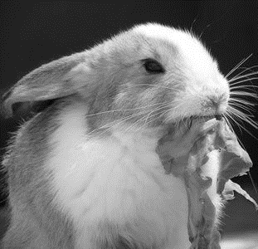
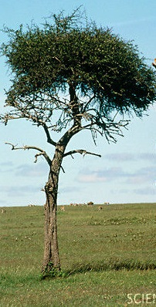
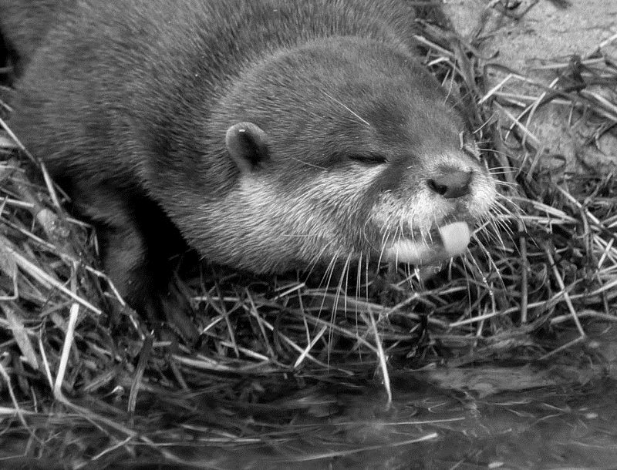
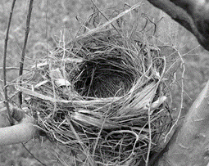
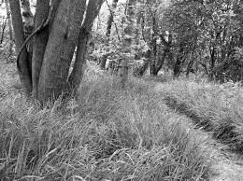

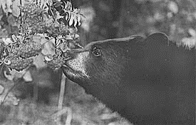
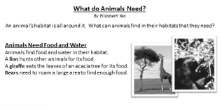
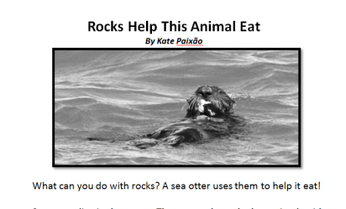
Selected Response Picture Prompts
Informational Passages: What Do Animals Need? and Rocks Help This Animal Eat
8.
9. How do lizards and elephants protect themselves differently?
10.
11.
12..
13. Look at the two texts above. How are they the same? How are they different?
food and water
acacia trees
In a nest
a soft place in the woods
to climb trees
to find enough food

Slide 31


Grade
K
Student QTR 4 Pre-Assessment
Listening Comprehension
Name________________________

Slide 32
Kindergarten Reading Informational and Literary Text Quarter 4 Pre-Assessment Record Form Selected Response Directions: Read each question and the answer choices to the student. Show student the answer-choice prompt for the literary and the informational passages. Check the answer the student gives. Correct answers are highlighted in bold.
Literary Passages: Pedro’s Pet and James and Baby Bird
1 | Identify specific characters, setting and event sequences. Toward RL.K.3 DOK-1 Cd Prompt: Who wanted a pet? mom________ Pedro_______ friends _______
2 | Answer describing questions about characters, setting or events in a story read and discussed in class Toward RL.K.3 DOK-1 Cf Prompt: What kind of house did Pedro live in? Small house with no yard______ small house with a yard_____
3 | Connects story events to a specific character or setting Toward RL.K.3 DOK-2 Ch Prompt: How did James and his mom know how to take care of the bird? They read a book_____ They called a park ranger_______
4 | Locate information from an illustration or in the text to answer questions about the text. Toward RL.K.6 DOK-2 Ci Prompt: What is an animal Pedro saw at the pet store? fish_______ snake ________
5 | Can sequence the events of an adventure or experience (beginning and ending). Toward RL.K.9 DOK-2 Ci Prompt: Which pictures show what happened first? At the pet shop_____ Asking for a pet______
6 | Lists adventures or experiences of characters ( classroom activity: in two separate lists or columns). Toward RL.K.9 DOK-3 Anp Prompt: Which character gets a new pet? James ______ Pedro_____
7 | Constructed Response Prompt RL.K.9 Analyzes the adventure or experiences between two characters. Toward RL.K.9 DOK-3 Anz Prompt: Draw, write or tell about what made Pedro and James happy at the end of each story. Points: 2___ 1____ 0_____
Informational Passages: What Do Animals Eat? and Rocks Help This Animal Eat
8 | Explains connections between cause and effect of events. Toward RI.K.3 DOK-2 Ch Prompt: What is something all animals need in their habitat? Food and water____ acacia trees_____
9 | …or how two individuals/ideas are the same or different … Toward Rl.K.3 DOK-3 Anp Prompt: Teacher: “How do lizards and elephants protect themselves differently?” (i.e. A lizard hides under rocks to protect itself from hungry birds and Elephants have herds). Students must have both correct.
10 | Locate information or ideas presented in the text by the illustrator. Toward RI.K.6 DOK-2 Cl Prompt: Where is the best habitat for a fawn? In a nest ________ a soft place in the woods_____
11 | Locate information or ideas presented in the text by the author. Toward RI.K.6 DOK-2 Cl Prompt: Why do bears need a large area to roam in? to climb trees____ to find enough food___
12 | Make generalizations between two texts on the same topic (how they are generally the same/different) about specific illustrations, descriptions or procedures. Toward RI.K.9 DOK-2 Ck Prompt: Which story tells about the most animals? What do Animals Need?_______ Rocks help this animal eat_______
13 | Understands the concept of identifying similarities and differences between two texts (can explain or show without much prompting). Toward RI.K.9 DOK-3 APx Prompt: Look at the two texts above. How are they the same? How are they different? Write student response: Similarities – both have animals and/or both show what animals need. Differences one is about an otter and the other tells about many kinds of animals. Student must have an example of a similarity and a difference. Any are acceptable if they are taken from text based information and are logical.
14 | Constructed Response RI.K.9 Gather (to Synthesize) information within two sources – finds all of the attributes about a topic from both sources that support that different animals need different things in their habitat for different reasons. Toward RI.K.9 DOK-4 Syu Prompt: Write and draw about what animals need in their habitat so they can eat. Points: 2___ 1____ 0___
Each correct selected response is one point.
1 | 2 | 3 | 4 | 5 | 6 | 7 | 8 | 9 | 10 | 11 | 12 | 13 | 14
/1 | /1 | /1 | /1 | /1 | /1 | /2 | /1 | /1 | /1 | /1 | /1 | /1 | /2
Total Listening Comprehension _____/ 16 For students needing support with any one standard, please refer to your grade-level Reading Learning Progressions for instructional tasks and differentiation.

Slide 33
Toward RL.K.9 DOK 3 - ANz
Analyzes the adventure or experiences between two characters with a prompt(s), (i.e., which character showed/had___ during his/her adventure?)
Draw, write or tell about what made Pedro and James happy at the end of each story.
Pedro’s Pet
What made Pedro happy at the end of the story?
James and Baby Bird
What made James happy at the end of the story?

Slide 34
Toward RI.K.9 DOK 4 - SYU
Gather (to Synthesize) information within two sources – finds all of the attributes about a topic from both sources that support ___.
14. Write and draw about what animals need in their habitat so they can eat.
1
What does a giraffe need to eat?
2
How does a lion find its food?
________________________________________________
________________________________________________
3
What does a bear need so it can find food?
4
What does an otter need so it can eat?
________________________________________________
________________________________________________

Slide 35
#15 - #16 Writing Practice SBAC Assessed brief writes and revised writes. The below activity is a prelude to this concept at a kindergarten level.
15. Write letters, words or pictures to tell what animal you liked best in the stories. Give your words and pictures a title. Write a Brief Text, W.K.1b State Topic, Target 6a
Title ________________
Circle the words or pictures you made that show what you liked best about the animal you chose. Revise a Text, W.K.1b support with reasons, Writing Target 6b

Slide 36
Performance Task (Optional)
17. Pretend you help make habitats at a zoo. Select an animal. What is the best habitat for it? Draw and write to show why you think it is the best habitat for your animal.
My Zoo Animal
The Best Habitat for My Zoo Animal

Slide 37

STOP
Close your books and wait for instructions!

Slide 38
Color the box green if your answer was correct. Color the box red if your answer was not correct.
Literary Text
1 | I can identify the character, setting or an event .Toward RL.K.3
2 | I can answer describing questions about a story. Toward RL.K.3
3 | I can tell what a character did or where. Toward RL.K.3
4 | I can find information from pictures or words to answer questions about the text. RL.K.6
5 | I can sequence the events by beginning, middle and ending in a story. Toward RL.K.9
6 | I can tell about the adventures of different characters in a story. Toward RL.K.9
7 | I can compare the adventures of different characters in a story. Toward RL.K.9 | 2 | 1 | 0
Informational Text
8 | I can tell what caused something to happen (connecting ideas) Toward RI.K.3
9 | I can group together “when” things in a story happened. Toward RI.K.3
10 | I know what an author does. I know what an illustrator does. Toward RI.K.6
11 | I can look at pictures in a book to find information or ideas. Toward RI.K.6
12 | I can explain how some things are the same or different in two texts about the same topic. Toward RI.K.9
13 | I can tell what pictures or words show similarities or differences in two texts. Toward RI.K.9
14 | I can tell how information is the same or different in two different texts about the same topic. Toward RI.K.9 | 2 | 1 | 0
Writing
15 | I can draw and write to tell about a topic and give my opinion about it. W.K.1b (Brief Write) | 2 | 1 | 0
16 | I can tell what I liked best to give my opinion. Revise a Brief Text W.K.1a | 2 | 1 | 0

