Slide 1

Grade
K
Quarter 2 Pre-Assessment
Listening Comprehension
Teacher Directions
Sequential Steps toward Standard Mastery
Reading
12 Selected-Response Items
Research
2 Constructed-Response Items (2 point items)
Writing
O Brief Write
0 Write to Revise
1 Full Informational Composition (as part of an optional performance task).
Writing w/Integrated Language as Part of the Performance Task
Language/Vocabulary
Edit/Clarify
Performance Task
at Grade Level

Slide 2
Grade
K
Quarter Two Pre-Assessment
Reading: Literature
Targets |  | Standards | DOK
4 | Reasoning & Evaluation | RL.6 | 3-4
5 | Analysis Within or Across Texts | RL.6, RL.7 | 3-4
6 | Text Structures/Features | RL.5 | 2-3
Reading: Informational
Targets |  | Standards | DOK
4 | Reasoning & Evaluation | RI.6 | 3-4
5 | Analysis Within or Across Texts | RI.7 | 2-3
6 | Text Structures/Features | Rl.5, RI.7 | 2
Note: There may be more standards per target. Actual standards assessed are boxed.
Informational Writing and Language
Targets |  | Standards | DOK
Optional Performance Task
4 | Full Informational Composition | W-2a, W-2b, W-2c, W-3b, W-5, W-9 | 4

Slide 3

All elementary ELA assessments were reviewed and revised in June of 2015 by the following amazing and dedicated HSD K-6th grade teachers.
Deborah Alvarado Lincoln Street | Ko Kagawa Minter Bridge
Linda Benson West Union | Jamie Lentz Mooberry
Anne Berg Eastwood | Sandra Maines Quatama
Aliceson Brandt Eastwood | Gina McLain TOSA
Sharon Carlson Minter Bridge | Teresa Portinga Patterson
Deborah Deplanche Patterson | Judy Ramer Consultant
Alicia Glasscock Imlay | Sara Retzlaff McKinney
Sonja Grabel Patterson | Jami Rider Free Orchard
Megan Harding Orenco | Kelly Rooke Free Orchards
Renae Iversen Teacher Mentor | Angela Walsh Witch Hazel
Ginger Jay Witch Hazel
Performance Task Classroom Activities for K – 6 were written by Jamie Lentz, Gina McLain, Hayley Heider, Anna Wooley, Gretchen Erlandsen, Deborah Deplanche, Connie Briceno, Judy Ramer, Carrie Ellis, Sandra Maines, Renae Iversen, Anne Berg, Aliceson Brandt and Ko Kagawa.

Slide 4
Note:
During kindergarten students are normally not reading. Read the stories to the students and ask the questions as Listening Comprehension questions. Most students should be able to point to pictures and answer questions with support and prompting. Please DO tell students what the pictures show if students aren’t clear about the image. The literary section can be assessed at a different time than the informational section.
Listening comprehension prepares students for the kind of questions that are higher leveled questions (rather than decodable text which is not conducive to higher leveled questioning).
Kindergarten Directions:
Teachers will need:
1. Teacher Directions Section
Literature and Informational texts. Read each to your class 2-3 times. Discuss the story so that students are clear about language and vocabulary terms.
For Assessing Students
3. 1-2 copies of Literature and Informational Stories
4. 1-2 copies of the Picture Prompts
Students will need:
The Student Assessment Copy
This includes:
a. Student Record Form (for teacher to mark)
b. Constructed Response Answer Sheets
c. Student Check-List (optional use)

Slide 5
Pre-Assessment and Learning Progressions
The pre-assessments are unique.
They measure progress toward a standard.
Unlike the Common Formative Assessments which measure standard mastery, the pre-assessments are more like a base-line picture of a student’s strengths and gaps, measuring skills and concepts students need “along the way,” in order to achieve standard mastery.
So what about a “post-assessment?” There is not a standardized post-assessment.
The true measure of how students are doing “along the way,” is assessed in the classroom during instruction and classroom formative assessment. For this reason The CFA’s are not called “post-assessments.” The CFAs measure the “end goal,” or standard mastery. However, without the pre-assessments, how will we know what our instruction should focus on throughout each quarter?
Learning Progressions: are the predicted set of skills needed to be able to complete the required task demand of each standard. The learning progressions were aligned to Hess’ Cognitive Rigor Matrix.
The pre-assessments measure student proficiency indicated on the boxes in purple (adjustment points). These points are tasks that allow us to adjust instruction based on performance. For instance, if a student has difficulty on the first “purple” adjustment point (DOK-1, Cf) the teacher will need to go back to the tasks prior to DOK-1 Cf and scaffold instruction to close the gap, continually moving forward to the end of the learning progression.
There is a Reading Learning Progression checklist for each standard in each grade that can be used to monitor progress. It is available at:
END of QTR
Beg. of QTR
Example of a Learning Progression for RL.2.1
Pre-Assessments Measure Adjustment Points (in purple)
CFA
RL.2.1 grade-level standard assessment.
After the pre-assessment is given, Learning Progressions provide informal formative assessment below and near grade-level “tasks” throughout each quarter.
Throughout the QTR
DOK 1 - Ka | DOK - Kc | DOK 1 - Cd | DOK 1 - Cf | DOK 2 - Ch | DOK 2 - Ck | DOK 2 -Cl | Standard Mastery
Recall who, what, where, when, why and how about a story read and discussed in class. | Use and define Standard Academic Language: who, what, where, when, why, and how; ask, answer, questions, key details | Connect the terms who to characters; where and when to setting; what and how to sequence of events. | Ask and answer who, what, where, when, why and how questions about key details in a text. | Concept Development Student understands that key details help tell who, what, where, when, why and how. | Uses key details to identify who, what, where, when, why and how about a story not read in class. | Finds information using key details to answer specific questions about a new story. | RL.2.1 Ask and answer such questions as who, what, where, when, why, and how to demonstrate understanding of key details in a text
http://sresource.homestead.com/Grade-2.html

Slide 6
Quarter Two Reading Literature Learning Progressions.
The indicated boxes highlighted before the standard, are assessed on this pre-assessment. The standard itself is assessed on the Common Formative Assessment (CFA) at the end of each quarter.
DOK 1 - Ka | DOK1 - Kc | DOK 1 - Cd | DOK 1- Cf | DOK 2 - Ch | DOK 2 - Cl | DOK 2 - APn | Standard
Locate different kinds of common text that have been read and discussed in class. | Define and be able to use Standard Academic Language: texts, types, storybooks, poems, etc... | Use the correct terms for different kinds of text when referring to a text (storybook, poem, fairytale, etc...). | Answers questions about details or literary elements in various types of texts. SELECTED RESPONSE | Concept Development Understands that there are different kinds of text types (poems, stories- fable, folktale, and/or myth). | Is able to identify and locate features that are specific to different text types. SELECTED RESPONSE | Is able to use text types (features) to locate specific information. SELECTED RESPONSE | RL.K.5 Recognize common types of texts (e.g., storybooks, poems).
DOK 1- Ka | DOK 1 - Kc | DOK 1 - Cf | DOK 2 - Ch | DOK 2 - Cl | Standard
Retells the name of an author or illustrator in texts read and discussed in class. | Define and be able to use Standard Academic Language: author, illustrator, story, role, telling and name. | Answers questions that require explaining what an author and illustrator’s roles are in a story. SELECTED RESPONSE | Concept Development Explain who the author is and his/her role. Explain who the illustrator is and his/her role. | Locate information from an illustration or in the text to answer questions about the text. CONSTRUCTED RESPONSE | RL.K.6 With prompting and support, name the author and illustrator of a story and define the role of each in telling the story
DOK 1 - Ka | DOK 1 - Kc | DOK – 1 Cf | DOK – 2 Ch | DOK 2 - Ch | Standard DOK 2 – Cl
Locate illustrations in a story. Recall specific points in the story. Read and discussed. | Define and be able to use Standard Academic Language: describe, relationship, between, appear illustration, story, moment, part of a story and depict. | Answer questions that require students describing specific parts of the story that have illustrations (Point and show). SELECTED RESPONSE | Student understands that illustrations tell about specific parts of a story. | Explain what is happening in the story by doing a picture walk. Specify which illustrations show details about specific moments in a story. SELECTED RESPONSE | RL.K.7 With prompting and support, describe the relationship between illustrations and the story in which they appear (e.g., what moment in a story an illustration depicts).

Slide 7
Quarter Two Reading Informational Learning Progressions.
The indicated boxes highlighted before the standard, are assessed on this pre-assessment. The standard itself is assessed on the Common Formative Assessment (CFA) at the end of each quarter.
DOK 1 - Ka | DOK 1 - Kc | DOK 1 - Cf | Standard
Locate the front cover, back cover, and title page of a book that has been demonstrated in class (for each concept). SELECTED RESPONSE | Define and be able to use Standard Academic Language: front cover, back cover, and title page. | Answers questions that require students to look at the front and back covers, the title and specific pages in a book. CONSTRUCTED RESPONSE | RI.K.5 Identify the front cover, back cover, and title page of a book.
DOK 1- Ka | DOK 1 - Kc | DOK 1 - Cf | DOK 2 - Ch | DOK 2 - Cl |  | Standard
Retells the name of an author or illustrator in texts read and discussed in class. | Define and be able to use Standard Academic Language: author, illustrator, story, role, telling and name. | Answers questions that require explaining what an author and illustrator’s roles are in a story. SELECTED RESPONSE | Concept Development Explain who the author is and his/her role. Explain who the illustrator is and his/her role. | Locate information or ideas presented in the text by the illustrator. SELECTED RESPONSE | Locate information or ideas presented in the text by the author. | RI.K.6 Name the author and illustrator of a text and define the role of each in presenting the ideas or information in a text.
DOK 1 - Ka | DOK 1 - Kc | DOK – 1 Cf | DOK 2 - Ch | DOK 2 - APn | DOK 3 - Cu | Standard
Locate illustrations in a text. Recall specific points in the text. Locate specific people, places or things in a text. | Define and be able to use Standard Academic Language: illustration depicts, role, describe, relationship between, person, place, thing, idea, text, appears and part of a text. | Answers questions about a person, place, thing or idea by referring to the illustrations in a text. SELECTED RESPONSE | Concept Development Understands that illustrations represent the text parts of a story to help describe person, place, thing or idea. | Uses information from illustration to explain and interpret more about the details (person, place, thing or idea) of a text. SELECTED RESPONSE | Using supporting evidence from a text explains the relationships between the illustrations and the read part of a story (i.e., the story said ___ and the illustrations tell me that ___). CONSTRUCTED RESPONSE | RI.K.7 With prompting and support, describe the relationship between illustrations and the text in which they appear (e.g., what person, place, thing, or idea in the text an illustration depicts).

Slide 8
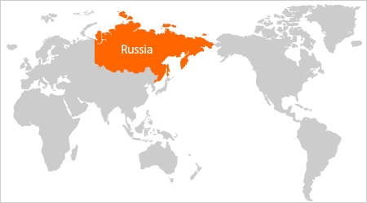
Jamie’s Russian Birthday
(considered a realistic-literary fiction)
In our classroom we celebrate birthdays.
Today is Jamie’s birthday. She is six years old.
Jamie was born in the United States, but Jamie’s parents were born in Russia. Russia is far away from the United States. Jamie’s parents asked our teacher to help give Jamie a Russian birthday.
USA

Slide 9

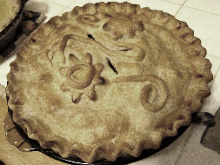
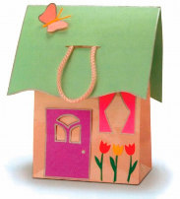
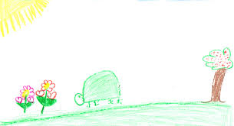
In Russia, children get a present at school. On a student’s birthday in Russia the teacher gives pencils or books to celebrate. The students give a small handmade gift.
Russian children get a birthday pie with a greeting carved into the crust, instead of a cake.
Everyone in our class made Jamie a handmade present just like they do in Russia. I made her a picture. Jill made Jamie a bow out of ribbon and Jose made her a paper house!

Slide 10
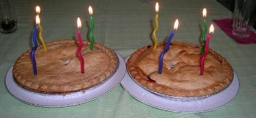
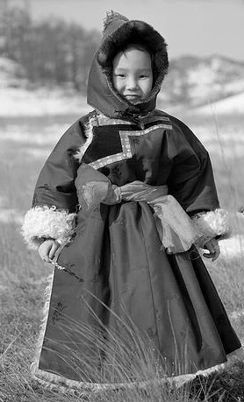
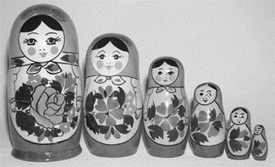
When Jamie’s parents came to our classroom we all sang Happy Birthday. Jamie blew out the candles on the Russian pie. Then, our teacher gave Jamie two new pencils. Jamie loved the presents all of us made.
Jamie’s parents showed us a picture of Jamie in Russian clothes. Then they gave her a set of Russian nesting dolls. Each doll fit inside the next biggest doll until they were all inside.
Russian birthdays are great!

Slide 11
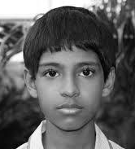
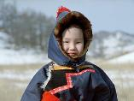
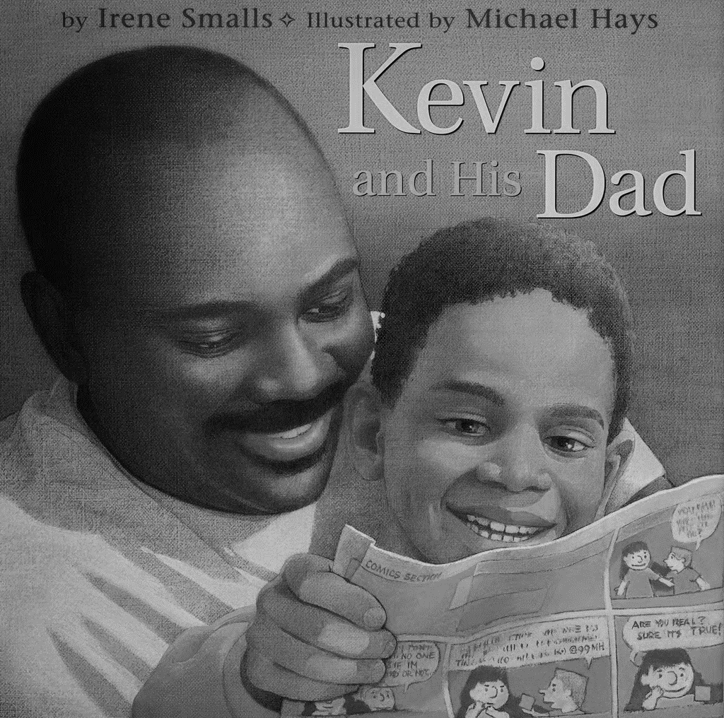


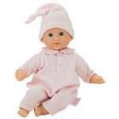
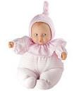

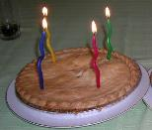
Selected Response Picture Prompt
Literary Passage: Jamie’s Russian Birthday
1.
2.
3.
4. This is the story of Jamie’s Russian Birthday. Which part shows what an author did?
5.
6. What does the story say about the nesting dolls?

Slide 12
A Note about constructed responses: Constructed response answers are not written “in stone.” There is no perfect way a student should respond. Look for the general intent of the prompt and student response and follow the rubric below as much as possible. Use your best judgment. Unlike DOK-1 questions where there is one right and wrong answer, constructed responses are more difficult to assess. Overall consistency of intent based on most of your student responses can guide you.
Quarter 2 Pre-Assessment Constructed Response Key
Literary Passage: Jamie’s Russian Birthday
7. RI.K.6 Prompt: Tell what a Russian birthday party is like. What did you learn from the story and the pictures?
Constructed Response Research Rubrics Target 2
Locate, Select, Interpret and Integrate Information.
The response gives sufficient evidence of the ability to locate and select information what a Russian birthday party is like. Information that supports what a Russian party is like in words or pictures could include (1) getting a present at school, (2) teacher gifts, (3) students giving gifts, (4) any description of a birthday pie.
The response gives sufficient evidence of the ability to interpret and integrate information to draw or write about what a Russian birthday party is like would be a cohesive picture or words that tell about or show characters, what they are doing and some of the details mentioned above.
Constructed Response Research Rubrics Target 2
Locate, Select, Interpret and Integrate Information.
2 | Student draws or writes about a Russian birthday party to include: 1 or more characters What the characters are doing 3 or more details that are specifically about a Russian birthday party.
1 | Student draws or writes about a Russian birthday party to include: At least 1 character. 1-2 details that are specifically about a Russian birthday party.
0 | Student drawing or writing may have 1 details about the party but does not connect it with a character and may have other information unrelated to the actual story.
Toward RI.K.6 DOK 2 - Cl
Locate information from an illustration or in the text to answer questions about the text.

Slide 13
Teachers: Read the story below to your students, modeling with an informational book of your choice as you read.
Parts of a Book
There are different parts of a book. The outside part of a book is called the cover.
The Front Cover
The front cover of a book has a title or the name of the book. The cover of a book names the author and the illustrator. The author is the person who wrote the book. The illustrator is the person who made the pictures in the book.
The Back Cover
The back cover of a book tells us it is the end of the book. Sometimes it also tells you what the book is about.
The Title Page
Open the front cover of a book and you will see the title page. The title page shows the author, illustrator and the title of the book again. The title page may have the publisher and the year it was made. It may also have a dedication. A dedication is a way to remember or thank someone.

Slide 14
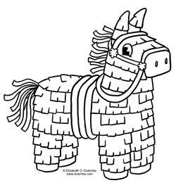
Teachers: Read the story below to your students. If you’d like a larger image you could use the overhead screen.
A Piñata
By Cindy Tess
A piñata is something filled with candy. A piñata can be in the shape of an animal, a car or anything!

Slide 15

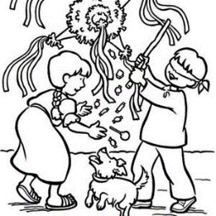
Some children have a piñata to celebrate their birthdays.
The piñata is hung from a high place. Then boys and girls are blindfolded.
They try to hit the piñata with a stick or bat. If it is hit hard, enough it breaks open and the candy falls out.

Slide 16


Did you know that you can MAKE your own piñata?
1
FIRST
You need glue, flour, and water. You mix it together in a bowl. It is very sticky!

Slide 17

2
SECOND
You need a lot of paper cut into strips. You will also need a balloon.

Slide 18
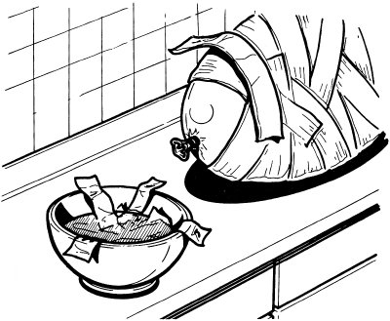
3
THIRD
Dip each strip of paper into the sticky mix. Then, put the strips of paper on the balloon.

Slide 19
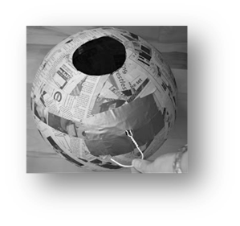
4
FOURTH
When the balloon is covered with paper, let it dry. Then, put a hole in the bottom.

Slide 20


FIFTH
When you are done, paint and decorate your piñata. Then, you put candy in the hole.

Slide 21


Now it’s time to hit the piñata!

Slide 22

Selected Response Question Prompt for Question 9
Informational Passages: Parts of a Book and A Piñata

Slide 23

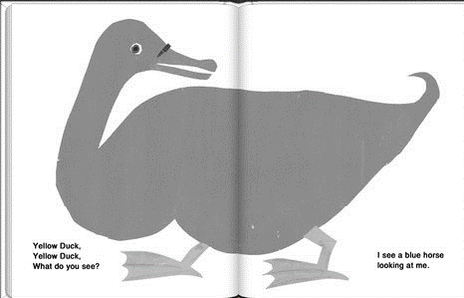



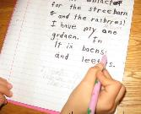
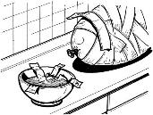
Selected Response Picture Prompt for…
Informational Passages: Parts of a Book and A Piñata
8.
9.
10.
11.
12.
13.
What does the illustrator do to tell about piñatas?
Show student story: A Piñata
Why is there a hole in this piñata?

Slide 24
A Note about constructed responses: Constructed response answers are not written “in stone.” There is no perfect way a student should respond. Look for the general intent of the prompt and student response and follow the rubric below as much as possible. Use your best judgment. Unlike DOK-1 questions where there is one right and wrong answer, constructed responses are more difficult to assess. Overall consistency of intent based on most of your student responses can guide you.
Quarter 2 Pre-Assessment Constructed Response Key
Informational Passage: A Piñata
RI.K.7 Prompt: Draw and write about three things you learned about making piñatas in the story and in the illustrations.
Constructed Response Research Rubrics Target 3
Evidence of the ability to distinguish relevant from irrelevant information such as fact from opinion.
Note: In the text A Piñata – the captions under each picture are considered to be “part of the text.” You may call these captions.
The response: gives sufficient evidence of the ability to distinguish relevant from irrelevant information by identifying specifically how a picture from A Piñata, connects to how a piñata is made.
This is a DOK-3 connection so support may be needed to help students understand that pictures or illustrations give more meaning to the text/captions.
Relevant information must come from the text and illustrations. Relevant information about how the pictures help understand the text/captions better should include the following information:
2 | Student draws and/or writes three details that are supported by the text and/or illustrations.
1 | Student draws and/or writes one-to-two details supported by the text and/or illustrations.
0 | Student does not draw or write details supported by the text.
Toward RI.K.7 DOK 3 - Cu
Using supporting evidence from a text explains the relationships between the illustrations and part of a story.

Slide 25
Performance Task
(Optional!)
The following pages support a student performance task.
In kindergarten a performance task is more of an instructional lesson and has much support. If you choose to do a performance task as part of your instruction you can break this down into several days.
Part 1:
A Classroom Activity
Re- Read the Passages
Model how to take notes to class.
2 Research Questions - have students share their comprehension questions from this assessment (these
are research questions)
Review any vocabulary students may struggle with.
Part 2:
The Performance Task
Describe a piñata you would like to make.
What do you need to make the piñata?
What would you do with it?

Slide 26
Party Games Classroom Activity for Performance Task
This classroom pre-activity follows the Smarter Balanced Assessment Consortium general design of contextual elements, resources, learning goals, key terms and purpose [http://oaksportal.org/resources/] The classroom activity was written by Jamie Lentz.
The Classroom Activity introduces students to the context of a performance task, so they are not disadvantaged in demonstrating the skills the task intends to assess.
Contextual elements include:
an understanding of the setting or situation in which the task is placed
potentially unfamiliar concepts that are associated with the scenario
key terms or vocabulary students will need to understand in order to meaningfully engage with and complete the performance task
The Classroom Activity is also intended to generate student interest in further exploration of the key idea(s). The Classroom Activity should be easy to implement with clear instructions.
Please read through the entire Classroom Activity before beginning the activity with students to ensure any classroom preparation can be completed in advance. Throughout the activity, it is permissible to pause and ask students if they have any questions.
Resources needed:
Color copy of the classroom activity ancillary materials (cut out)
Computer with YouTube videos on task bar
Learning Goals:
Students will understand the context of the key concepts related to the topic:
games are played at parties
party games can be made at home
Students will understand the key terms:
Note: Definitions are provided here for the convenience of facilitators. Students are expected to understand these key terms in the context of the task, not memorize the definitions.
Party Games- fun and silly games that are played with friends at parties
Hang/hung- to put on the wall or on a string coming down from the ceiling
Blindfold – to cover up a person’s eyes, usually for a game
Fill – to add something all the way to the top (add water to the top of a balloon)
[Purpose: The facilitator’s goal is to help students understand games are played at parties and that they can be made at home.]
*Facilitators can decide whether they want to display ancillary materials using an overhead projector or computer/Smartboard, or whether they want to produce them as a handout for students.

Slide 27
Party Games Classroom Activity
Discussion question:
What party games have you played?
Have you ever made a game for a party?
How did you make that party game? What materials did you use?
Facilitator says: “Today we get to talk about party games! We will get ready for the Piñata Performance Task. Party games are fun and silly games that we play with our friends at parties. First I am going to show you a few pictures of different party games.”
(Show students picture A and B located in the ancillary materials.)
Facilitator says: “I want you to think of a game that you’ve played at a party and get ready to share with your partner. (Model thinking for students using your classroom signal/routine for thinking. Give appropriate wait time and then signal students to begin discussing with their partner). I’ve played ….”
Facilitator says: “Ok boys and girls, let’s hear what party games you have played. ______ what did your partner share with you? (continue calling on students until a variety of games have been shared. If your students are struggling to come up with games, you may consider showing the following clips: Duck, Duck, Goose: https://www.youtube.com/watch?v=1G656BZsWoE 0:15-1:15; Musical Chairs: https://www.youtube.com/watch?v=bCS-H1uYfT8 0:00-1:15).
Possible student responses (unscripted):
Pin the tail on the donkey
Piñatas
Water balloons
Musical chairs
Duck, duck, goose
Face painting
Hide and seek
Facilitator says: “Did you know that many party games can be MADE AT HOME? You can fill water balloons at home. Fill means to add something all the way to the top. To fill water balloons means the water has to be added all the way to the top of the balloon! Think of a party game that you have made at home to share with your partner. If you haven’t made a party game, you can describe water balloons just like I did. (Model thinking for students using your classroom signal/routine for thinking. Give appropriate wait time, then signal students to begin discussing with their partner). I’ve made…”
Facilitator says: “Let’s hear about some party games you have made! (Call on a few students to share how they made their party game.)

Slide 28
Possible student responses (unscripted):
Colored pictures/signs
Filled up water balloons
Made a piñata
Facilitator says: “Wow, I heard some great discussions. (if your class is struggling to share you might say “It sounds like we might need more examples. Let’s watch this video on how to make your own fishing game.” (Go to https://www.youtube.com/watch?v=zNdTnAywCBI).
Facilitator says: “Next let’s talk about materials. When you make a party game you will need lots of different things. If you are hanging something on the wall or from above such as the ceiling or a tree, you will need tape or string. Here is a picture of two games that were hung (show picture C from the ancillary materials). To hang something means to put it on a wall or on a string coming down from the ceiling. (Point to the corresponding types of hangings). Think about the materials you would need to make this game (show picture D from the ancillary materials). Share your ideas with your partner (give signal and listen to student responses). I would need…”
Facilitator says: “Alright, let’s see what you and your partner came up with. _____ what materials did you and your partner come up with?” (Continue calling on students until all materials have been shared- give students any materials they have forgotten. Use this time to explain what a blindfold is).
Possible student responses (unscripted):
Mask (blindfold)
Paper
Donkey
Tail
Crayons
Facilitator says: “In your performance task, you will be learning more about a party game and how to make it at home. The partner work you did today should help prepare you for the research and writing you will be doing in the performance task.”
Note: Facilitator should collect student notes from this activity.

Slide 29
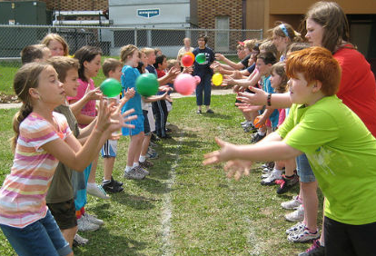
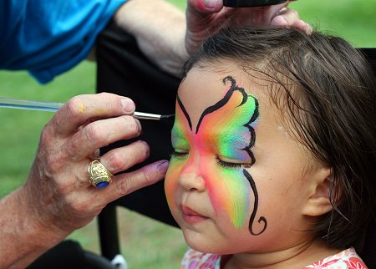
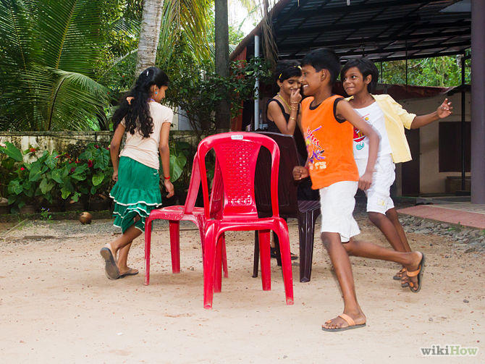
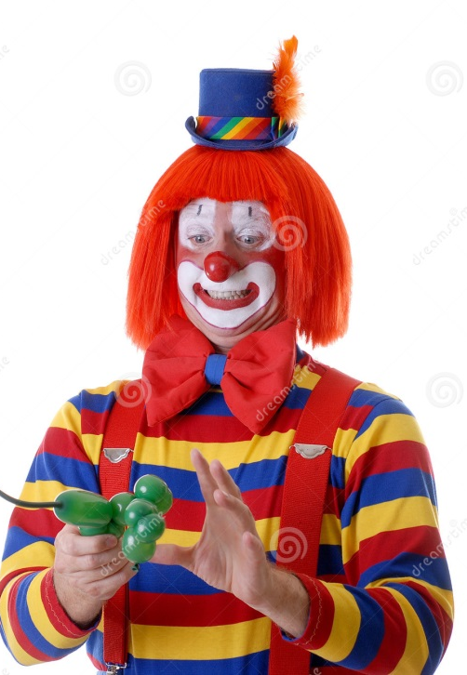
Ancillary Materials
Picture A
Picture B

Slide 30
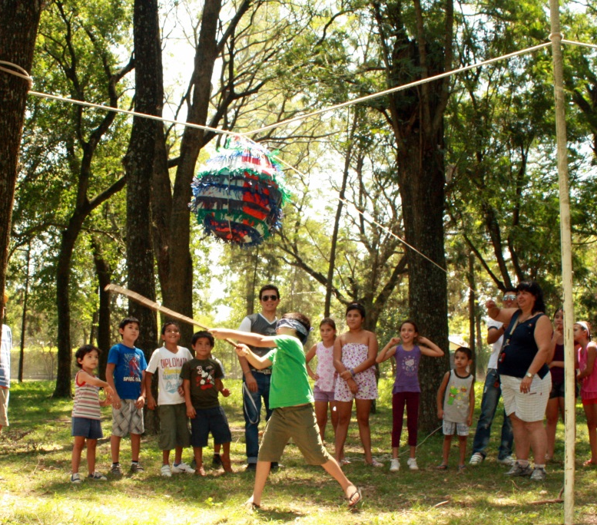
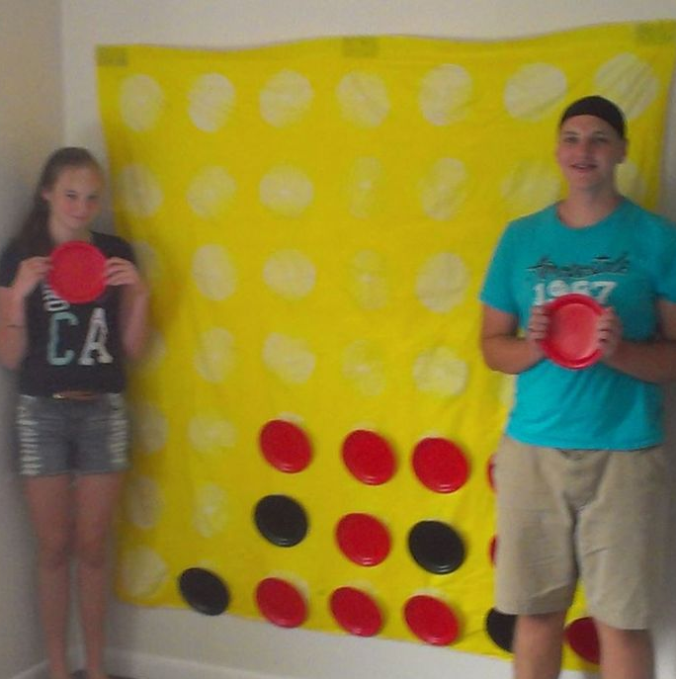
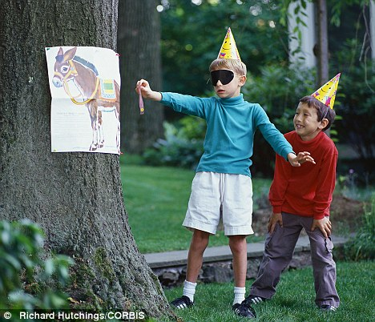
Ancillary Materials
Picture C
Picture D- Pin the Tail on the Donkey

Slide 31
Grade K
Name_____________________
What is the text mostly about? This is the main topic.
Draw a main topic picture.
1
Read the text with the students. Ask the students if the text is about (use irrelevant examples – a french-fry?, a hair?).
This will help students understand that when you ask what a text is mostly about you are referring to the subject or what is called a main topic.
Ask students to draw a picture of the main topic.
Remember students will need to have a note-taking form for each passage.
Use letters, words or pictures. Tell more about the main topic.
Ask students to look explain more about the main topic.
Tell students, “When we want to explain more about (name the main topic), we can look to see what else happened. We are looking for ideas and details.”
Ask students, “What ideas or details can you find and tell about?”
2
Differentiation:
Students who need more pages – print as needed. In kindergarten you can scaffold students to start with illustrating the main topic, then move to details and ideas in another lesson. Students who would benefit from enrichment can continue on with more specific details or a new text.
Students who need more direct instruction – teach each part in mini lessons. These concepts can be taught separately:
Main Topic
Ideas
Details
ELL Students may need each part taught using language (sentence) frames emphasizing transitional words.

Slide 32
Grade K
Name_____________________
What is the text mostly about? This is the main topic.
Draw a main topic picture.
Use letters, words or pictures. Tell more about the main topic.

Slide 33
Grade K
15. Performance Task Answer Key: Task: Describe a piñata you would like to make.
A Piñata I Would Make | What I Need to Make a Piñata
What I Would Do With It
Students receive three scores, one for each criterion. In kindergarten, use your judgment along with the writing rubric to decide how the final product best supports each of these three areas.
Purpose and Organization (4) Explains more about a Piñata he/she would like to make Connects it to personal use Groups or connects ideas |  |  |  | Language -Elaboration of Evidence (4) Uses relevant details or examples of Piñata Uses vocabulary learned from the passage If sharing, makes good sense. |  |  |  | Conventions (4) Uses words or letters appropriate for age If sharing, uses grammar appropriate for age
1 | 2 | 3 | 4 | 1 | 2 | 3 | 4 | 1 | 2 | 3 | 4
Total Score /12

Slide 34
Grades K - 2: Generic 4-Point Informational/Explanatory Writing Rubric
Score | Statement of Purpose/Focus and Organization |  | Development: Language and Elaboration of Evidence |  | Conventions CCSS and Report Card Alignment Conventions: Kinder-L.K.1a, L.K.2a, & L.K.2d 1st-L.1.1a, L.1.2 2nd-L.2.2
 | Statement of Purpose/Focus CCSS and Report Card Alignment Text Types & Purposes: Kinder-W.K.2 1st-W.1.2.1-3 2nd-W.2.2.1-3 | Organization CCSS and Report Card Alignment Text Types & Purposes: Kinder-none 1st-W.1.2.4 2nd-W.2.2.4 | Elaboration of Evidence CCSS and Report Card Alignment Text Types & Purposes/Production and Distribution of Writing: Kinder-W.K.2.3 & L.K.6 1st-W.1.5.2 2nd-W.2.2.3 | Language and Vocabulary CCSS and Report Card Alignment Conventions & Vocab. Acquisition: Kinder-L.K.1b-f & L.K.6 1st-L.1.1b-j & L.1.6 2nd-L.2.1 & L.2.6
4 Exemplary (E) | Uses a combination of drawing, dictation, & writing (K) to compose Explains something more about the topic OR a connection is made between topic & broader idea(s) Clearly presents the topic and focus/controlling idea | Intro, body, and conclusion support focus Uses several transitions appropriately (e.g., because, since, and, but, also, for example, since) to connect or group ideas | Has a depth of information; insightful Elaborates using a variety of relevant details, definitions, examples, quotes, text evidence to support focus/concepts | Maintains voice/tone of knowledgeable person conveying information – knows when to use formal-informal language Uses effective, precise vocabulary and variety of sentence structures | Edits with support /resources Has few or no errors in grammar, word usage, or mechanics as appropriate to grade
3 Proficient (M) | Uses a combination of drawing, dictation, & writing (K) to compose Topic (context) and focus/controlling idea are clearly stated (gr K-3) | Has overall coherence (K-3); Provides a concluding statement or section (gr, 1, 2, 3) Groups related ideas (gr3) that support the focus Uses transitions to connect ideas (gr3) | Some authentic details, definitions, facts, text evidence support focus Adds labels or captions to illustration, drawing, visuals, charts/tables, or diagram to enhance details, facts, and ideas | Produces complete simple (K), compound (g, 1- 3), complex (gr3) sentences Appropriate use of vocabulary (nouns, plurals, verbs, pronouns, adjectives, adverb, content-specific) Uses adult/peer feedback to Revise | Edits with support /resources (gr 2-3) Minor errors do not interfere with reader understanding (e.g., capitalization, punctuation; spelling)
2 Developing (NM) | Uses a combination of drawing, dictation, & writing (K) to compose Has topic and attempts a focus/information, but focus may shift or not be relevant to the topic chosen | Introduction, body, and conclusion are evident, but may lack clarity or Coherence (e.g., attempts to connect ideas, but may not be logical or make sense) | Some elaboration strategies are evident in drawings or writing (gr K-3), or with support/ questioning from peers or adults (gr K -1) Ideas may not be fully elaborated or details may be insufficient to support topic | Vocabulary use has minor errors Dictates, writes, and expands simple complete sentences Uses adult/peer feedback to revise | Edits with support from peers or adults (gr 2-3) Uses grade-appropriate basic mechanics and word use with some errors
1 Merging (NY) | Uses a combination of drawing, dictation, & writing (K) to compose Attempts to identify a topic but lacks a focus or may have more than one topic or confusing topic as stated | Attempts introduction, body, and conclusion, but one or more parts are missing | No details provided or attempts to add details to drawings or writing which may be random, inaccurate, or irrelevant | Generally uses basic, incorrect, or below grade level vocabulary when dictating (K) or writing Uses adult/peer feedback to revise | Edits with support from peers or adults (gr 2-3) Uses below grade-level basic mechanics with frequent errors
0 | A response gets no credit if it provides no evidence of the ability to [fill in with key language from the intended target].
Working Drafts of ELA rubrics for assessing CCSS writing standards --- © (2010) Karin Hess, National Center for Assessment [khess@nciea.org

Slide 35
ELP Kindergarten Standards Organized by Modality
Receptive modalities*: Ways in which students receive communications from others (e.g., listening, reading, viewing). Instruction and assessment of receptive modalities focus on students’ communication of their understanding of the meaning of communications from others. | Listening & Reading | 9 - create clear and coherent grade-appropriate speech and text | 10 - make accurate use of standard English to communicate in grade-appropriate speech and writing | 1 | construct meaning from oral presentations and literary and informational text through grade-appropriate listening, reading, and viewing
 |  |  |  | 8 | determine the meaning of words and phrases in oral presentations and literary and informational text
Productive modalities*: Ways in which students communicate to others (e.g., speaking, writing, and drawing). Instruction and assessment of productive modalities focus on students’ communication of their own understanding or interpretation. | Speaking & Writing |  |  | 3 | speak and write about grade-appropriate complex literary and informational texts and topics
 |  |  |  | 4 | construct grade-appropriate oral and written claims and support them with reasoning and evidence
 |  |  |  | 7 | adapt language choices to purpose, task, and audience when speaking and writing
Interactive modalities*: Collaborative use of receptive and productive modalities as “students engage in conversations, provide and obtain information, express feelings and emotions, and exchange opinions” (Phillips, 2008, p. 3). | Listening, Speaking, Reading, and Writing |  |  | 2 | participate in grade-appropriate oral and written exchanges of information, ideas, and analyses, responding to peer, audience, or reader comments and questions
 |  |  |  | 5 | conduct research and evaluate and communicate findings to answer questions or solve problems
 |  |  |  | 6 | analyze and critique the arguments of others orally and in writing
Standard | An ELL can… | By the end of an English language proficiency level, an ELL Kindergarten can . . .
4 Productive (S & W) | …construct grade-appropriate oral & written claims & support them with reasoning & evidence. | 1 | 2 | 3 | 4 | 5
 |  | …express a feeling or opinion about a familiar topic. | …express an opinion or preference about a familiar topic | …express an opinion or preference about a familiar topic or story. | …express an opinion or preference about a variety of topics or stories. | …express an opinion or preference about a variety of topics or stories.
This performance task is based on writing. As an option if you’d like to monitor growth for ELP as a second goal, teachers can choose to assess ELP standard 4 because it aligns with this specific performance task. Your student’s full composition can be analyzed to identify English language proficiency levels. It is evident that students will be navigating through the modalities to get to the end product. However, it is important to keep in mind what the full opinion writing performance task is assessing and how deeply the student understands class content and language. The ELP growth goal is to provide the “just-right scaffolds” for students to demonstrate their understanding in order for them to move from one proficiency level to the next.

Slide 36
Informational Writing Pre-Assessment
Student and Class Scoring: |  |  | School Year: |  | Grade:
 |  | Teachers Name:
 |  | School:
Student Name: |  |  | Focus and Organization | Elaboration and Evidence | Conventions | Student Total | ELP Score
 |  |  | Score | Score | Score
 |  |  |  |  |  | 0
 |  |  |  |  |  | 0
 |  |  |  |  |  | 0
 |  |  |  |  |  | 0
 |  |  |  |  |  | 0
 |  |  |  |  |  | 0
 |  |  |  |  |  | 0
 |  |  |  |  |  | 0
 |  |  |  |  |  | 0
 |  |  |  |  |  | 0
 |  |  |  |  |  | 0
 |  |  |  |  |  | 0
 |  |  |  |  |  | 0
 |  |  |  |  |  | 0
 |  |  |  |  |  | 0
 |  |  |  |  |  | 0
 |  |  |  |  |  | 0
 |  |  |  |  |  | 0
 |  |  |  |  |  | 0
 |  |  |  |  |  | 0
 |  |  |  |  |  | 0
 |  |  |  |  |  | 0
 |  |  |  |  |  | 0
 |  |  |  |  |  | 0
 |  |  |  |  |  | 0
 |  |  |  |  |  | 0
 |  |  |  |  |  | 0
 |  |  |  |  |  | 0
 |  |  |  |  |  | 0
 |  |  |  |  |  | 0
 |  |  |  |  |  | 0
Scoring Key:
Total # Correct
1
= Emerging
0 - 4
2
= Developing
5 - 7
3
= Proficient
8 - 10
4
= Exemplary
11 - 12

Slide 37
Grade
K
Student QTR 2 Pre-Assessment
Listening Comprehension
Name________________________

Slide 38
Kindergarten Reading Informational and Literary Text Quarter 2 CFA Record Form Selected Response Directions: Read each question to the student. Show student the answer-choice prompt for the literary and the informational passages. Check the answer the student gives. Correct answers are highlighted in bold.
Literary Passage: Jamie’s Russian Birthday
1 | Who is the story about? DOK-1 Cf RL.K.5 Prompt: a boy_________ Jamie________
2 | Is able to identify and locate features that are specific to different text types. DOK-2 Cl RL.K.5 Prompt: Which book is most like Jamie’s Russian Birthday? Kevin and his Dad_________ The Duckling …________
3 | Is able to use text types (features) to locate specific information. DOK-2 APn RL.K.5 Prompt: Which is a picture of nesting dolls? Girl nesting dolls____ a regular doll _____
4 | Answers questions that require explaining what an author and illustrator’s roles are in a story. DOK-1 cF RL.K.6 Prompt: This is the story of Jamie’s Russian Birthday (show student one page). Which part shows what the author did? words____ picture(s)_____
5 | Answer questions that require students describing specific parts of the story that have illustrations (Point and show). DOK-1 Cf RL.K.7 Prompt: Which picture goes with Jamie’s birthday pie? Traditional cake______ Russian Pie________
6 | Explain what is happening by doing a picture walk. Specify which illustrations show details about specific moments in a story. DOK-2 Ch RL.K.7 Prompt: What does the story say about the nesting dolls? They fit inside each other.
7 | Constructed Response DOK-2 Cl RI.K.6 Prompt: Tell what a Russian birthday party is like. What did you learn from the story and the pictures? Points: 2___ 1____ 0_____
Informational Passages: Parts of a Book and A Piñata
8 | PASSAGE: PARTS OF A BOOK #8 - 10 Locate the front cover, back cover, and title page of a book that has been demonstrated in class (for each concept). DOK-1 Ka RI.K.5 Prompt: Circle the picture that shows the back cover of a book. back cover of book_______ open book________
9 | Answers questions that require students to look at the front and back covers, the title and specific pages in a book. DOK-1 Cf RI.K.6 Prompt: What does this book cover tell us the book will be about? penguin _____ dolphin_____
10 | Answers questions that require explaining what an author and illustrator’s roles are in a story. DOK-1 Cf RI.K.6 Prompt: Circle the picture that shows what an author does. child coloring _____ child writing _______
11 | PASSAGE: A PINATA # 11 - 14 Locate information or ideas presented in the text by the illustrator. DOK-2 Cl RI.K.6 Prompt: What does the illustrator do to tell about piñatas? Answer should include information from an illustration.
12 | Answers questions about a person, place, thing or idea by referring to the illustrations in a text. DOK- 1 Cf RI.K.7 Prompt: Which illustration shows how to make the sticky mix? mixing bowl ______ strips of paper_______
13 | Uses information from the illustration to explain and interpret more about the details (person, place, thing or idea) of a text. DOK-1 Apn RI.K.7 Prompt: Why is there a hole in the balloon? Answer should be something about candy
14 | Constructed Response DOK-3 Cu RI.K.7 Prompt: Draw and write about three things you learned about making piñatas in the story and in the illustrations. Points: 2___ 1____ 0_____
Each correct selected response is one point.
1 | 2 | 3 | 4 | 5 | 6 | 7 | 8 | 9 | 10 | 11 | 12 | 13 | 14
/1 | /1 | /1 | /1 | /1 | /1 | /2 | /1 | /1 | /1 | /1 | /1 | /1 | /2
Total Listening Comprehension _____/ 16 For students needing support with any one standard, please refer to your grade-level Reading Learning Progressions for instructional tasks and differentiation.

Slide 39
Toward RL.K.6 DOK 2 - Cl
Locate information from an illustration or in the text to answer questions about the text.
7. Tell what a Russian birthday party is like. What did you
learn from the story and the pictures?

Slide 40
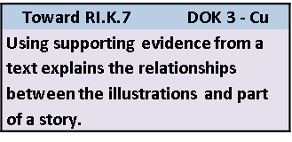
Draw and write about three things you learned about making piñatas in the story and in the illustrations.

Slide 41
15. Performance Task
A Piñata I Would Make | What I Need to Make a Piñata
What I Would Do With It

Slide 42
This self-reflection sheet is applicable for grades 1 – 6. In kindergarten it can be used for teacher-student reflection, parent conferencing, an assessment record or whichever way is most applicable to the teacher.
Literary Text
1 | I can answer questions from different kinds of books. RL.K.5
2 | I can find parts of a book that show words and pictures. RL.K.5
3 | I can use pictures to locate information. RL.K.5
4 | I can answers questions about what an author and illustrator do. RL.K.6
5 | I can answer questions to describe parts of the story that have illustrations . RL.K.7
6 | I can look inside a book and tell which pictures go with which parts of the story. RL.K.7
7 | I can find information from pictures or words answer questions about the text. RL.K.6 | 2 | 1 | 0
Informational Text
8 | I can find the front and back cover of a book. I can find the title page. RI.K.5
9 | I can look at the front and back cover of a book to find answers. RI.K.5
10 | I know what an author does. I know what an illustrator does. RI.K.6
11 | I can look at pictures in a book to find information or ideas. RI.K.6
12 | I can find answers to questions about a person, place, thing or idea in the pictures of a book. RI.K.7
13 | I can explain about a person, place, thing or idea by looking at pictures in a book. RI.K.7
14 | I can explain how the pictures help me understand parts of a story. RI.K.7 | 2 | 1 | 0

