Slide 1
Grade
3rd
Teacher Directions
Quarter 2 Pre-Assessment
Literary & Informational
Reading
12 Selected-Response Items
1 Constructed Response
Research
3 Constructed-Response
Writing
1 Full Composition (Performance Task)
1 Brief Write
1 Write to Revise
Writing w/ Integrated Language
1 Language/Vocabulary
1 Edit/Clarify
Sequential Steps toward Standard Mastery
Performance Task
at Grade Level

Slide 2
3rd
Quarter Two Pre-Assessment
Reading: Literature
Targets |  | Standards | DOK
4 | Reasoning & Evaluation | RL.6 | 3-4
5 | Analysis Within or Across Texts | RL.6, RL.7 | 3-4
6 | Text Structures/Features | RL.5 | 2-3
Reading: Informational
Targets |  | Standards | DOK
4 | Reasoning & Evaluation | RI.6 | 3-4
5 | Analysis Within or Across Texts | RI.7 | 2-3
6 | Text Structures/Features | Rl.5, RI.7 | 2
Note: There may be more standards per target. Writing standards assessed in this assessment are boxed.
Informational Writing and Language
Targets |  | Standards | DOK
3a | Brief Informational Write | W.2a, W.2b, W.2d, W.2d, W.2e and/or W.9 | 3
3b | Write-Revise Informational | W.2a, W.2b, W.2d, W.2d, W.2e and/or W.9 | 2
4 | Full Informational Composition | W-2a, W-2b, W-2c, W-2d, W-2e, W-3b, W-4, W-5, W-8, W-9 | 4
8 | Language-Vocabulary Use | W.2d, L.3a | 1-2
9 | Edit and Clarify | L..2a | 1-2

Slide 3
All elementary ELA assessments were reviewed and revised in June of 2015 by the following amazing and dedicated HSD K-6th grade teachers.
Deborah Alvarado Lincoln Street | Ko Kagawa Minter Bridge
Linda Benson West Union | Jamie Lentz Mooberry
Anne Berg Eastwood | Sandra Maines Quatama
Aliceson Brandt Eastwood | Gina McLain TOSA
Sharon Carlson Minter Bridge | Teresa Portinga Patterson
Deborah Deplanche Patterson | Judy Ramer Consultant
Alicia Glasscock Imlay | Sara Retzlaff McKinney
Sonja Grabel Patterson | Jami Rider Free Orchard
Megan Harding Orenco | Kelly Rooke Free Orchards
Renae Iversen Teacher Mentor | Angela Walsh Witch Hazel
Ginger Jay Witch Hazel
Performance Task Classroom Activities for K – 6 were written by Jamie Lentz, Gina McLain, Hayley Heider, Anna Wooley, Gretchen Erlandsen, Deborah Deplanche, Connie Briceno, Judy Ramer, Carrie Ellis, Sandra Maines, Renae Iversen, Anne Berg, Aliceson Brandt and Ko Kagawa.

Slide 4
Background
This is a pre-assessment to measure the task of writing an informational article. Full compositions are always part of a Performance Task (PT). A complete performance task would have:
Part 1
A classroom activity (30 minutes)
(35 minutes – Independent work)
Passages or stimuli to read
3 research questions
There may be other constructed response questions.
Part 2
A full-composition (70 minutes)
Students should have access to spell-check resources but no grammar-check resources. Students can refer back to their passages, notes and 3 research questions and any other constructed responses, as often as they’d like.
Directions
30 minutes
You may wish to have a 30 minute classroom activity. The purpose of a PT activity is to
ensure that all students are familiar with the concepts of the topic and know and
understand key terms (vocabulary) that are at the upper end of their grade level (words
they would not normally know or are unfamiliar with their background or culture).
The classroom activity DOES NOT pre-teach any of the content that will be assessed!
35 minutes
Students read the passages independently. If you have students who can not read
the passages you may read them to those students but please make note of the
accommodation. Remind students to take notes as they read. During an actual SBAC assessment students are allowed to keep their notes as a reference.
Students answer the 3 research questions or other constructed response questions. Students should also refer to their answers when writing their full informational article.
15 minute break
70 Minutes
4. Students write their full composition (informational article).
SCORING
An Informational Rubric is provided. Students receive three scores:
Organization and Purpose
Evidence and Elaboration
Conventions

Slide 5
Order at HSD Print Shop…
http://www.hsd.k12.or.us/Departments/PrintShop/WebSubmissionForms.aspx
Directions
The HSD Elementary Assessments are neither scripted nor timed assessments. They are a tool to inform instructional decision making. It is not the intent of these assessments to have students “guess and check” answers for the sake of finishing an assessment.
All students should “move toward” taking the assessments independently but many will need scaffolding strategies. If students are not reading at grade level and can’t read the text, please read the stories to the students and ask the questions. Allow students to read the parts of the text that they can. Please note the level of differentiation a student needed.
About this Assessment
This assessment includes: Selected-Response (SR), Constructed-Response (CR), and a Performance Task (PT).
Types of SBAC Constructed Response Rubrics in this Assessment http://www.livebinders.com/play/play?id=774846
Reading 2 Point Short Response 3 Point Extended Response | Writing 4 Point Full Composition Rubric (Performance Task) 2-3 Point Brief Write (1-2 Paragraphs) Rubric 2-3 Point Write to Revise Rubrics as needed | Research 2 Point Rubrics Measuring Research Skill Use
Quarter 2 Performance Task The underlined sections are those scored on SBAC. Please take 2 days to complete performance tasks.
Part 1 | Part 2
Classroom activity if desired/needed Read two paired passages Take notes while reading (note-taking) Answer SR and CR research questions about sources Components of Part 1 Note-Taking: Students take notes as they read passages to gather information about their sources. Students are allowed to use their notes to later write a full composition (essay). Note-taking strategies should be taught as structured lessons throughout the school year in grades K – 6. A teacher’s note-taking form with directions and a note-taking form for your students to use for this assessment is provided, or you may use whatever formats you’ve had past success with. Please have students practice using the note-taking page in this document before the actual assessment if you choose to use it. Research: In Part 1 of a performance task students answer constructed response questions written to measure a student’s ability to use research skills needed to complete a performance task. These CR questions are scored using the SBAC Research Rubrics rather than reading response rubrics. | Plan your essay (brainstorming/pre-writing) Write, revise and edit (W.5) Write a full composition or speech Components of Part 2 Planning: Students review notes and sources and plan their composition. Write, Revise and Edit: Students draft, write, revise and edit their writing. Word processing tools should be available for spell check (but no grammar check). Full Written Informational Composition: introduction (identifies the topic and provides a focus) organization (definition, classification, comparison/contrast, etc.), development (with facts, concrete details, quotations, other information) transitions (linking ideas) precise language and domain‐specific vocabulary conclusion (closure) Conventions of Standard English.
There are NO Technology-enhanced Items/Tasks (TE) Note: It is highly recommended that students have experiences with the following types of tasks from various on-line instructional practice sites, as they are not on the HSD Elementary Assessments: reordering text, selecting and changing text, selecting text, and selecting from drop-down menu

Slide 6
The Food We Eat Performance Task Classroom Activity
This classroom pre-activity follows the Smarter Balanced Assessment Consortium general design of contextual elements, resources, learning goals, key terms and purpose [http://oaksportal.org/resources/]
The classroom activity was written by Connie Briceno and Deborah Delplanche.
The Classroom Activity introduces students to the context of a performance task, so they are not disadvantaged in demonstrating the skills the task intends to assess.
Contextual elements include:
an understanding of the setting or situation in which the task is placed
potentially unfamiliar concepts that are associated with the scenario
key terms or vocabulary students will need to understand in order to meaningfully engage with and complete the performance task
The Classroom Activity is also intended to generate student interest in further exploration of the key idea(s). The Classroom Activity should be easy to implement with clear instructions.
Please read through the entire Classroom Activity before beginning the activity with students to ensure any classroom preparation can be completed in advance. Throughout the activity, it is permissible to pause and ask students if they have any questions.
Resources needed:
Chart paper
Markers and crayons
Elmo for displaying ancillary materials
Learning Goals:
Students will
learn about the different food groups
categorize and discuss foods based on: availability, location and nutritional value
Students will understand the key terms:
Note: Definitions are provided here for the convenience of facilitators. Students are expected to understand these key terms in the context of the task, not memorize the definitions.
Access/Availability- at hand, present and ready to be used
Nutrients- a healthy ingredient found in food (minerals, vitamins, etc.)
Healthy- in good, desirable condition
Processed- changed or prepared by special treatment
Village- a small, rural community
Location- a place where a certain thing can be found
*Facilitators can decide whether they want to display ancillary materials using an overhead projector or computer/Smartboard, or whether they want to produce them as a handout for students.

Slide 7
Title The Food We Eat Classroom Activity
[Purpose: The facilitator’s goal is to help students understand how food consumption is based on location, availability and nutritional value. This activity will allow students to become familiar with a variety of food groups and the reasons associated with how and why people choose to eat the food they do.]
Divide the class into the following 6 groups: fruits, vegetables, protein, grains, dairy and junk food.
Facilitator says: “Today, we will get ready for The Food We Eat Performance Task. Your group is going to be given a piece of butcher paper with the name of the food group. Your task is to list as many foods that fit in that category as possible in the next three minutes.
[Pass out paper and let the groups work for three minutes. Be sure to give extra support to the grains/cereals group as barley is a vocabulary word they need to know.]
Facilitator says: “Let’s see what each group has come up with. When I call on your group, please have one person hold the poster while another person reads the list.”
[Give the students one minute to share their poster with the class. Display figures 2 and 3 for reference during the group discussion so students can see what could be added or deleted from their lists.]
Discussion question: “Why do we eat all of these different kinds of foods?”
[Give the groups one to two minutes to discuss. Share out when done.]
Possible student responses:
They help us grow
They taste good
They are healthy
It’s what’s in my fridge
Facilitator says : “How is junk food made?”
[Give students time to share their ideas in their group.]
Facilitator says: “Many natural foods have valuable nutrients in them that are healthy for our body. When food is processed, those nutrients are stripped away, or removed. Food is processed to increase the shelf-life, or the amount of time the food can stay fresh in the store.

Slide 8
[https://www.youtube.com/watch?v=PdyDlMqcRUs] – this 4 minute video is extra support and shows how potato chips are processed.
Facilitator says: “We eat different foods for many reasons. One of the reasons is that people will eat food they have access to or that is available to them based on where they live. From the list you have created, which foods do you think are grown in Oregon that you have access to? Circle those food items with a blue crayon.”
[Give them one minute to circle their choices. Have each group share three items from their poster that are found in Oregon.]
Facilitator says: “Which foods have you seen in the grocery store that you think are not grown in Oregon? Share in your group some of these foods.”
[Give students one minute to brainstorm some foods.]
Facilitator says: “Grocery stores give us access to food grown both in and outside of our state. We can even buy food grown in different countries. Many of these foods are processed in factories and packaged to be shipped to the grocery stores. This allows these foods to be stored safely so they can be eaten at a later date. Now we are going to look at a completely different location.”
[Show Figure 1 of a village in South Africa.]
Discussion question: “This is a picture of a small village located in South Africa . It is near the coast. What do you notice about the village? What food do you think they eat there and why?
[Have students turn and talk with a partner to share their observations.]
Possible student responses:
There are no roads or stores
There is no electricity
They can raise some farm animals for meat
It’s near the coast so maybe they can eat fish
Facilitator says: “In your performance task, you will be learning more about how and why people choose to eat different foods. The group work you did today should help prepare you for the research and writing you will be doing in the performance task.”
Note: Facilitator should collect student notes from this activity.

Slide 9
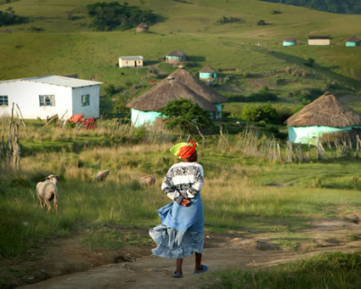
Ancillary Materials
Figure 1
Xhosa Village in South Africa, near the coast

Slide 10
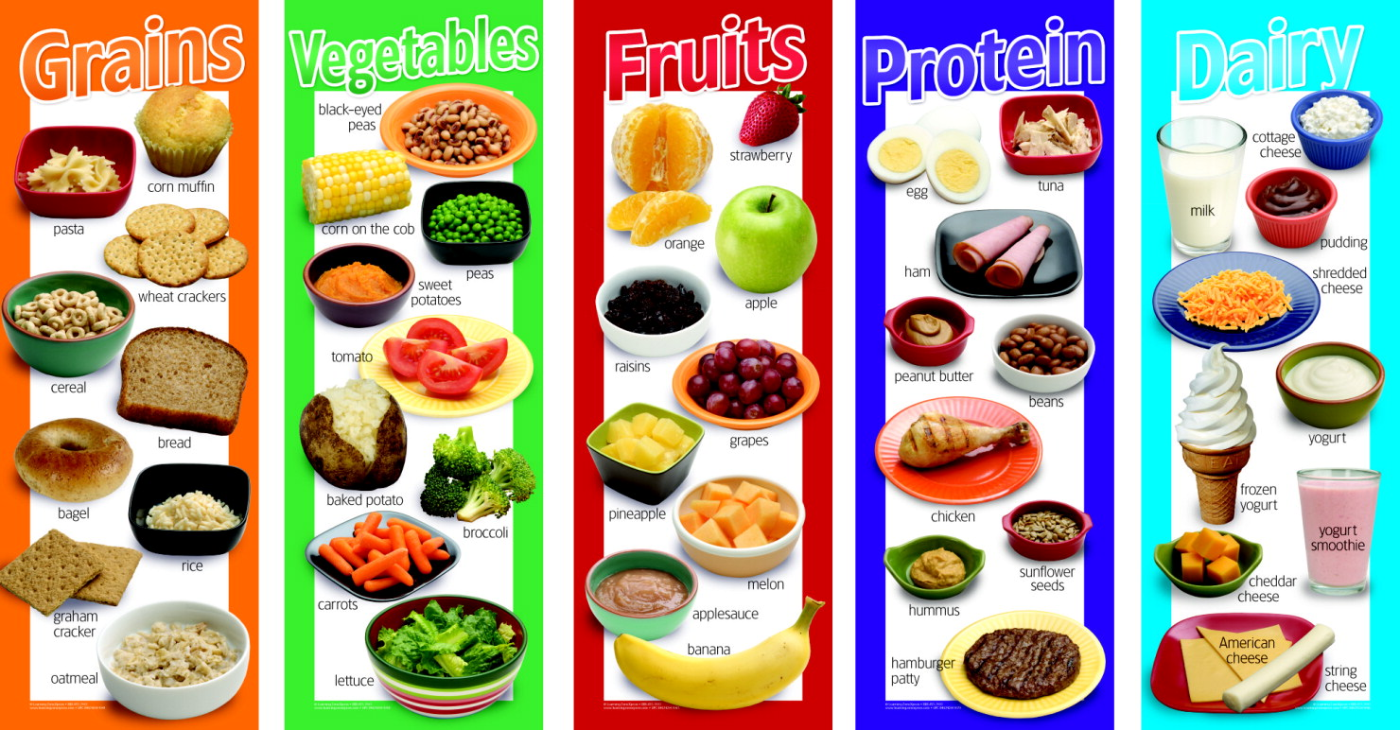
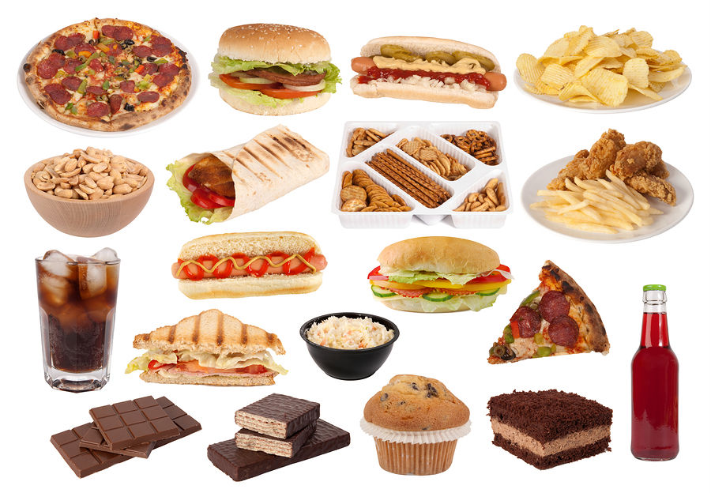
Ancillary Materials
Figure 2 Food Groups
Figure 3 Junk Food

Slide 11
Pre-Assessment and Learning Progressions
The pre-assessments are unique.
They measure progress toward a standard.
Unlike the Common Formative Assessments which measure standard mastery, the pre-assessments are more like a base-line picture of a student’s strengths and gaps, measuring skills and concepts students need “along the way,” in order to achieve standard mastery.
So what about a “post-assessment?” There is not a standardized post-assessment.
The true measure of how students are doing “along the way,” is assessed in the classroom during instruction and classroom formative assessment. For this reason The CFA’s are not called “post-assessments.” The CFAs measure the “end goal,” or standard mastery. However, without the pre-assessments, how will we know what our instruction should focus on throughout each quarter?
Learning Progressions: are the predicted set of skills needed to be able to complete the required task demand of each standard. The learning progressions were aligned to Hess’ Cognitive Rigor Matrix.
The pre-assessments measure student proficiency indicated in the boxes in purple (adjustment points). These points are tasks that allow us to adjust instruction based on performance. For instance, if a student has difficulty on the first “purple” adjustment point (DOK-1, Cf) the teacher will need to go back to the tasks prior to DOK-1 Cf and scaffold instruction to close the gap, continually moving forward to the end of the learning progression.
There is a Reading Learning Progression checklist for each standard in each grade that can be used to monitor progress. It is available at:
END of QTR
Beg. of QTR
Example of a Learning Progression for RL.2.1
Pre-Assessments Measure Adjustment Points (in purple)
CFA
RL.2.1 grade-level standard assessment.
After the pre-assessment is given, Learning Progressions provide informal formative assessment below and near grade-level “tasks” throughout each quarter.
DOK 1 - Ka | DOK - Kc | DOK 1 - Cd | DOK 1 - Cf | DOK 2 - Ch | DOK 2 - Ck | DOK 2 -Cl | Standard Mastery
Recall who, what, where, when, why and how about a story read and discussed in class. | Use and define Standard Academic Language: who, what, where, when, why, and how; ask, answer, questions, key details | Connect the terms who to characters; where and when to setting; what and how to sequence of events. | Ask and answer who, what, where, when, why and how questions about key details in a text. | Concept Development Student understands that key details help tell who, what, where, when, why and how. | Uses key details to identify who, what, where, when, why and how about a story not read in class. | Finds information using key details to answer specific questions about a new story. | RL.2.1 Ask and answer such questions as who, what, where, when, why, and how to demonstrate understanding of key details in a text
Throughout the QTR
http://sresource.homestead.com/Grade-3.html

Slide 12
Quarter Two Reading Literature Learning Progressions.
The indicated boxes highlighted before the standard, are assessed on this pre-assessment. The standard itself is assessed on the Common Formative Assessment (CFA) at the end of each quarter.
Path to DOK - 1 |  |  |  |  | Path to DOK - 2
 |  |  |  |  |  |  |  | End Goal
DOK 1 - Ka | DOK 1 - Kc | DOK 1 - Cd | DOK 1 - Cf | DOK 2 - Ch |  | DOK 2 - Cl | DOK 2 - APn | Standard
Retell facts and details about a chapter, scene or stanza in a story, drama or poem (read and discussed in class). | Define (understand and use) Standard Academic Language: refer, dramas, poems, stories, describe, earlier, sections, builds, chapter, scene, and stanza. | Describe the specific literary elements of a story, drama or poem. | Answers who, what when, where and how questions about a story, drama or poem by locating information from chapters, scenes or stanzas ( read but not discussed in class). | Concept Development Understands that each part of a stanza (in a poem), a chapter (in a story) and a scene (in a drama) builds on earlier sections and gives an example. |  | Identify a main idea in, or a generalization about a chapter, scene or stanza with supporting details. SELECTED RESPONSE | Use the unique text features of chapters, scenes and stanzas to locate specific information about a story, drama or poem (which stanza refers to....). SELECTED RESPONSE | RL.3.5 Refer to parts of stories, dramas, and poems when writing or speaking about a text, using terms such as chapter, scene, and stanza; describe how each successive part builds on earlier sections.
Not Assessed
Path to DOK - 1 |  |  |  | DOK - 2 |  | Path to DOK - 3
 |  |  |  |  |  |  |  |  |  |  | End Goal
DOK 1 - Ka | DOK 1 - Kc | DOK 1 - Cd | DOK 1 - Cf |  | DOK 2 - Ch |  | DOK 2 - ANq | DOK 3 - Cu | DOK 3 - Cw | DOK 3 - ANA | Standard
Recall what specific characters in a text said about an event (read and discussed in class). | Define (understand and use) Standard Academic Language: point of view, distinguish, narrator, characters and phrase “from that of...”. | Identifies the narrator of a text. Identifies characters in a text. | Describe or explain specific parts of a text that give understanding to what a character or narrator said. SELECTED RESPONSE |  | Concept Development Understands that points of view vary and are reflected in words or actions and gives an example of own point of view. |  | Identifies and compares the different points of view in a text. | Explain a character’s point of view using supporting evidence from the text. SELECTED RESPONSE | Describe how a narrator’s or character’s point of view may affect the reader’s own point of view. | Analyze how a character or narrator’s point of view is different than your own. CONSTRUCTED RESPONSE | RL.3.6 Distinguish their own point of view from that of the narrator or those of the characters.
DOK 1 - Ka | DOK 1 - Kc | DOK 1 - Cd | DOK 1 - Cf | DOK 2 - Ch | DOK 2 - Cl | DOK 2 – Apn | Standard
Tell about or locate illustrations in a text read and discussed in class. | Define (understand and use) Standard Academic Language: explain, aspects, specific, illustrations, contribute, conveyed, create, mood, emphasize, characters, aspects and setting. | Identify or describe specific illustrations that create mood, emphasize aspects of a character or setting. SELECTED RESPONSE | Answer questions explaining how or in what way illustrations contribute to a specific part of a text. SELECTED RESPONSE | Concept Development Understands that a text’s illustrations can contribute to the message the story is telling. | Locate information within the text that is conveyed by specific aspects of the text’s illustrations. CONSTRUCTED RESPONSE | RL.3.7 Explain how specific aspects of a text’s illustrations contribute to what is conveyed by the words in a story (e.g., create mood, emphasize aspects of a character or setting).

Slide 13
Quarter Two Reading Informational Learning Progressions.
The indicated boxes highlighted before the standard, are assessed on this pre-assessment. The standard itself is assessed on the Common Formative Assessment (CFA) at the end of each quarter.
DOK 1 - Ka | DOK 1 - Kc | DOK 1 - Cf | DOK 2 - Ch | DOK 2 - Cl | DOK 2 - APn | Standard
Locate specific text features (i.e., key words, sidebars, hyperlinks) from a text read and discussed in class. | Define (understand and use) Standard Academic Language: key words, sidebars, hyperlinks, relevant, efficiently, topic and text features/tools. | Answers questions about the purpose of different text features and search tools. | Concept Development Understands that search or text features (tools) can provide information about a text or topic. | Locate information using key words, sidebars or hyperlinks (and other search tools/text features) relevant to a topic. SELECTED RESPONSE | Obtain and Interpret information using key words, sidebars or hyperlinks relevant to a topic. SELECTED REPSONSE | RI.3.5 Use text features and search tools (e.g., key words, sidebars, hyperlinks) to locate information relevant to a given topic efficiently.
Not Assessed
DOK 1 - Ka | DOK 1 - Kc | DOK 1 - Cf | DOK 2 - Ch | DOK 2 - ANq | DOK 3 - Cu | DOK 3 - Cw | DOK 3 - ANA | Standard
Recall what an author conveys in a text about an event (read and discussed in class). | Define (understand and use) Standard Academic Language: point of view, distinguish, author, and phrase “from that of...”. | Describe or explain specific parts of a text that give understanding to an author’s point of view. | Concept Development Understands that an author’s point of view is reflected in words and gives an example of his/her own point of view. | Identifies and lists the author’s points of views within a text. Compares an author’s point of view with their own. SELECTED RESPONSE | Explain an author’s point of view using supporting evidence from the text. SELECTED RESPONSE | Describe how an author’s point of view may affect the reader’s own point of view. | Analyze how an author’s point of view is different than your own. CONSTRUCTED RESPONSE | RI.3.6 Distinguish their own point of view from that of the author of a text.
Not Assessed
DOK 1 - Ka | DOK 1 - Kc | DOK 1 - Cf | DOK 1 - Ch | DOK 2 - Cl | DOK 2 - Cl | DOK 2 - APn | Standard
Locate or recall specific illustrations (maps, photographs) or specific words from a text read and discussed in class (rote memory). | Define (understand and use) Standard Academic Language: illustrations, maps and photographs, the phrase “gained from”, demonstrate, key events and occur. | Answers questions using illustrations as well as words in a text. SELECTED RESPONSE | Concept Development Understands that words of a text and illustrations (maps or photographs) are informational sources. | Identifies a main idea or generalization(s) about how or why key events occur (using illustrations or text). SELECTED REPONSE | Locates specific illustrations or text information as evidence to support a central idea. | Obtain and interpret information based on the illustrations and the words in the text to demonstrate understanding. CONSTRUCTED RESPONSE | RI.3.7 Use information gained from illustrations (e.g., maps, photographs) and the words in a text to demonstrate understanding of the text (e.g., where, when, why, and how key events occur).

Slide 14
Grade 3
Research Notes
Teacher Guide
Key Idea
Write one new key idea about the main idea
____________________________________________________________________________
____________________________________________________________________________
Key Details
Explain more about the new key idea. Write two key details from the section or paragraph that support the key idea.
Key Detail __________________________________________________________________
__________________________________________________________________________
Key Detail _________________________________________________________________
_________________________________________________________________________
Again and Again
What words or phrases does the author use again and again? Write them here. Think about why the author keeps using them again and again.
Write one conclusion sentence that tells the most about the new key idea and key details.
Use some of the again and again words if you can.
____________________________________________________________________________
_____________________________________________________________________________
Instruct students to re-read a paragraph or section of the text they liked or you’ve chosen.
Ask, “Does the section or paragraph state something new about the main idea?”
This is a key idea about the main idea (be sure students know what the main idea is).
Have students write ONE brief sentence about the new key idea .
1
Ask students to look for key details that explain more about the new key idea.
Key details are reasons that support a key idea. Instruct students to write 2 brief key details that support the key idea.
Example: If the main idea is about dogs and..
“The dog likes to play,” (is the key Idea),
Then some key details might be:
the dog likes to play fetch.
the dog likes to play with the ball.
Remember students will need to have a note-taking form for each passage.
2
Have students re-read the paragraph or section they wrote about and write words or ideas they see Again and Again, in the box.
Explain, “When authors use the same words, phrases or ideas Again and Again ask yourself “why?”. It means something is important.”
3
Instruct students to look at the again and again words or phrases, ask “Do you see some of the again and again words or ideas in the key ideas or key details sentences you wrote? Can the words help you write one conclusion sentence that tell the most about the key idea you chose?”
Summarizing is a big part of writing conclusions. It is an extremely important strategy for students to learn in order to use research skills effectively.
4
Differentiation:
Students who need more pages – print as many as needed. Students who would benefit from enrichment can continue on with more sections or paragraphs. Students who need more direct instruction – teach each part as a
mini lesson. These concepts can be taught separately:
Main Idea
Key Idea
Key Details
Again and Again
Conclusions - Summarizing
ELL Students may need each part taught using language (sentence) frames emphasizing transitional words.

Slide 15
Grade 3
R E- read | S | E | A | R | C | H
 | SOMETHING NEW | EXPLAIN MORE | AGAIN and AGAIN | RELEVANT OR NOT? | CONCLUDE | HAVE EVIDENCE
Research Notes
Name_________________ Passage_______________ Main Idea ____________
Key Idea
Write one new key idea about the main idea
____________________________________________________________________________
____________________________________________________________________________
Key Details
Explain more about the new key idea. Write two key details from the paragraph or section that support the new key idea.
Key Detail _________________________________________________________________________
__________________________________________________________________________
Key Detail
_________________________________________________________________________
_________________________________________________________________________
Again and Again
What words or phrases does the author use again and again? Write them here.
Think about why the author keeps using them again and again.
Write one conclusion sentence that tells the most about the new key idea and key details.
Use some of the again and again words if you can.
____________________________________________________________________________
____________________________________________________________________________

Slide 16
Determining Grade Level Text
Grade level text is determined by using a combination of both the CCSS new quantitative ranges and qualitative measures.
Example: If the grade equivalent for a text is 6.8 and has a lexile of 970, quantitative data shows that placement should be between grades 4 and 8.
Four qualitative measures can be looked at from the lower grade band of grade 4 to the higher grade band of grade 8 to determine a grade level readability.
The combination of the quantitative ranges and qualitative measures for this particular text shows that grade 6 would be the best readability level for this text.
Common Core Band | Flesch-Kincaid® | The Lexile Framework®
2nd - 3rd | 1.98 - 5.34 | 420 - 820
4th - 5rd | 4.51 - 7.73 | 740 - 1010
6th – 8th | 6.51 - 10.34 | 925 - 1185
9th – 10th | 8.32 - 12.12 | 10.50 - 1335
11th - CCR | 10.34 - 14.20 | 11.85 - 1385
4 Qualitative Factors | Rate your text from easiest to most difficult between bands.
 | Beginning of lower (band) grade | End of lower (band) grade | Beginning of higher (band) to mid | End of higher (band) grade | Not suited to band
Purpose/Meaning
Structure
Language Clarity
Language
Overall Placement
To see more details about each of the qualitative measures please go to slide 6 of: http://www.corestandards.org/assets/Appendix_A.pdf

Slide 17
Grades 3 - 5: Generic 4-Point Informational/Explanatory Writing Rubric
Score | Statement of Purpose/Focus and Organization |  | Development: Language and Elaboration of Evidence |  | Conventions CCSS and Report Card Alignment Conventions: 3rd-L.3.2 4th-L.4.2, L.4.3b 5th-L.5.2
 | Statement of Purpose/Focus CCSS and Report Card Alignment Text Types & Purposes: 3rd-W.3.2a-b 4th-W.4.2a-b 5th-W.5.2a-b | Organization CCSS and Report Card Alignment Text Types & Purposes: 3rd-W.3.2c-d 4th-W.4.2c-d 5th-W.5.2c-d | Elaboration of Evidence CCSS and Report Card Alignment Research to Build and Present Knowledge: 3rd-W.3.7-8 4th-W.4.7-9 5th-W.5.7-9 | Language and Vocabulary CCSS and Report Card Alignment Conventions & Vocab. Acquisition: 3rd-L.3.1b-i, L.3.3a & L.3.6 4th-L.4.1, L.4.3a, & L.4.6 5th-L.5.1b-e, L.5.3a & L.5.6
4 Exemplary (E) | The response is fully sustained and consistently and purposefully focused: controlling idea or main idea of a topic is focused, clearly stated, and strongly maintained. controlling idea or main idea of a topic is introduced and communicated clearly within the context. | The response has a clear and effective organizational structure creating unity and completeness: use of a variety of transitional strategies. logical progression of ideas from beginning to end. effective introduction and conclusion for audience and purpose. | The response provides thorough and convincing support/evidence for the controlling idea or main idea that includes the effective use of sources, facts, and details: use of evidence from sources is smoothly integrated, comprehensive, and relevant . effective use of a variety of elaborative techniques . | The response clearly and effectively expresses ideas, using precise language: use of academic and domain-specific vocabulary is clearly appropriate for the audience and purpose. | The response demonstrates a strong command of conventions: few, if any, errors are present in usage and sentence formation. effective and consistent use of punctuation, capitalization, and spelling.
3 Proficient (M) | The response is adequately sustained and generally focused: focus is clear and for the most part maintained, though some loosely related material may be present. some context for the controlling idea or main idea of the topic is adequate. | The response has an evident organizational structure and a sense of completeness, though there may be minor flaws and some ideas may be loosely connected: adequate use of transitional strategies with some variety. adequate progression of ideas from beginning to end. adequate introduction and conclusion. | The response provides adequate support/evidence for the controlling idea or main idea that includes the use of sources, facts, and details: some evidence from sources is integrated, though citations may be general or imprecise. adequate use of some elaborative techniques. | The response adequately expresses ideas, employing a mix of precise with more general language. Use of domain-specific vocabulary is generally appropriate for the audience and purpose. | The response demonstrates an adequate command of conventions: some errors in usage and sentence formation may be present, but no systematic pattern of errors is displayed. adequate use of punctuation, capitalization, and spelling.
2 Developing (NM) | The response is somewhat sustained and may have a minor drift in focus: may be clearly focused on the controlling or main idea, but is insufficiently sustained. controlling idea or main idea may be unclear and somewhat unfocused. | The response has an inconsistent organizational structure, and flaws are evident: inconsistent use of transitional strategies with little variety. uneven progression of ideas from beginning to end. conclusion and introduction, if present, are weak. | The response provides uneven, cursory support/evidence for the controlling idea or main idea that includes partial or uneven use of sources, facts, and details: evidence from sources is weakly integrated, and citations, if present, are uneven. weak or uneven use of elaborative techniques. | The response expresses ideas unevenly, using simplistic language: use of domain-specific vocabulary that may at times be inappropriate for the audience and purpose. | The response demonstrates a partial command of conventions: frequent errors in usage may obscure meaning. inconsistent use of punctuation, capitalization, and spelling.
1 Merging (NY) | The response may be related to the topic but may provide little or no focus: may be very brief may have a major drift focus. may be confusing or ambiguous. | The response has little or no discernible organizational structure: few or no transitional strategies are evident . frequent extraneous ideas may intrude. | The response provides minimal support/evidence for the controlling idea or main idea that includes little or no use of sources, facts, and details: use of evidence from the source material is minimal, absent, in error, or irrelevant. | The response expression of ideas is vague, lacks clarity, or is confusing: uses limited language or domain-specific vocabulary. may have little sense of audience and purpose . | The response demonstrates a lack of command of conventions: errors are frequent and severe. meaning is often obscure.
0 | A response gets no credit if it provides no evidence of the ability to [fill in with key language from the intended target].

Slide 18
ELP 2nd – 3rd Grade Band Standards Organized by Modality
Receptive modalities*: Ways in which students receive communications from others (e.g., listening, reading, viewing). Instruction and assessment of receptive modalities focus on students’ communication of their understanding of the meaning of communications from others. | Listening & reading | 9 - create clear and coherent grade-appropriate speech and text | 10 - make accurate use of standard English to communicate in grade-appropriate speech and writing | 1 | construct meaning from oral presentations and literary and informational text through grade-appropriate listening, reading, and viewing
 |  |  |  | 8 | determine the meaning of words and phrases in oral presentations and literary and informational text
Productive modalities*: Ways in which students communicate to others (e.g., speaking, writing, and drawing). Instruction and assessment of productive modalities focus on students’ communication of their own understanding or interpretation. | Speaking & Writing |  |  | 3 | speak and write about grade-appropriate complex literary and informational texts and topics
 |  |  |  | 4 | construct grade-appropriate oral and written claims and support them with reasoning and evidence
 |  |  |  | 7 | adapt language choices to purpose, task, and audience when speaking and writing
Interactive modalities*: Collaborative use of receptive and productive modalities as “students engage in conversations, provide and obtain information, express feelings and emotions, and exchange opinions” (Phillips, 2008, p. 3). | Listening, speaking, reading, and writing |  |  | 2 | participate in grade-appropriate oral and written exchanges of information, ideas, and analyses, responding to peer, audience, or reader comments and questions
 |  |  |  | 5 | conduct research and evaluate and communicate findings to answer questions or solve problems
 |  |  |  | 6 | analyze and critique the arguments of others orally and in writing
Standard | An ELL can… | By the end of an English language proficiency level, an ELL in 2nd – 3rd Grade can . . .
4 Productive (S & W) | …construct grade-appropriate oral and written claims and support them with reasoning and evidence. | 1 | 2 | 3 | 4 | 5
 |  | …express an opinion about a familiar topic. | …express an opinion about a familiar topic or story. | …express an opinion about a familiar topic or story, giving one or more reasons for the opinion. | …express opinions about a variety of topics, introducing the topic & giving several reasons for the opinion. | …express opinions about a variety of topics, introducing the topic, giving several reasons for the opinion, & providing a concluding statement.
This performance task is based on writing. As an option if you’d like to monitor growth for ELP as a second goal, teachers can choose to assess ELP standard 4 because it aligns with this specific performance task. Your student’s full composition can be analyzed to identify English language proficiency levels. It is evident that students will be navigating through the modalities to get to the end product. However, it is important to keep in mind what the full opinion writing performance task is assessing and how deeply the student understands class content and language. The ELP growth goal is to provide the “just-right scaffolds” for students to demonstrate their understanding in order for them to move from one proficiency level to the next.
Oregon ELP Standards Aligned with Performance Task, 2014; Arcema Tovar

Slide 19
Informational Writing Pre-Assessment
Student and Class Scoring: |  |  | School Year: |  | Grade:
 |  | Teacher’s Name:
 |  | School:
Student Name: |  |  | Focus and Organization | Elaboration and Evidence | Conventions | Student Total | ELP Score
 |  |  | Score | Score | Score
1
2
3
4
5 |  |  |  |  |  | 0
6 |  |  |  |  |  | 0
7 |  |  |  |  |  | 0
8 |  |  |  |  |  | 0
9 |  |  |  |  |  | 0
10 |  |  |  |  |  | 0
11 |  |  |  |  |  | 0
12 |  |  |  |  |  | 0
13 |  |  |  |  |  | 0
14 |  |  |  |  |  | 0
15 |  |  |  |  |  | 0
16 |  |  |  |  |  | 0
17 |  |  |  |  |  | 0
18 |  |  |  |  |  | 0
19 |  |  |  |  |  | 0
20 |  |  |  |  |  | 0
21 |  |  |  |  |  | 0
22 |  |  |  |  |  | 0
23 |  |  |  |  |  | 0
24 |  |  |  |  |  | 0
25 |  |  |  |  |  | 0
26 |  |  |  |  |  | 0
27 |  |  |  |  |  | 0
28 |  |  |  |  |  | 0
29 |  |  |  |  |  | 0
30 |  |  |  |  |  | 0
31 |  |  |  |  |  | 0
32 |  |  |  |  |  | 0
33 |  |  |  |  |  | 0
34 |  |  |  |  |  | 0
35 |  |  |  |  |  | 0
Scoring Key:
Total # Correct
1
= Emerging
0 - 4
2
= Developing
5 - 7
3
= Proficient
8 - 10
4
= Exemplary
11 - 12

Slide 20
A note about constructed responses: Constructed response answers are not written “in stone.” There is no perfect way a student should respond. Look for the general intent of the prompt and student response and follow the rubric below as much as possible. Use your best judgment. Unlike DOK-1 questions where there is one right and wrong answer, constructed responses are more difficult to assess. Overall consistency of intent based on most of your student responses can guide you.
Quarter 2 Pre-Assessment Research Constructed Response Answer Key
Constructed Response Research Rubrics Target 2 Locate, Select, Interpret and Integrate Information.
Question # 7 Prompt: How are the villagers’ and the soldiers’ points of view different in the play Stone Soup? How do you know? Use details and examples from the play.
Teacher /Rubric “Language Response”
The response gives sufficient evidence of the ability to locate and select information about the prompt. Students will locate and then select information from the play Stone Soup to show how the points of view of the villagers and the soldiers differ. The response gives sufficient evidence of the ability to interpret and integrate information about the prompt. Students interpret information when they can use the play to compare the differences between the villagers and the soldiers points of view. Sufficient evidence could include that the villagers’ point of view was (1) they had little food, (2) they did not want to give the soldiers food, and (3) they were afraid they wouldn’t have enough food for themselves. Sufficient evidence could include that from the soldiers’ point of view (1) the villagers should share their food, and (2) the villagers would only share their food if they were tricked into sharing their food. Students integrate information when they write a complete response integrating details and examples from the play Stone Soup.
Student “Language” Response Example
2 | Student has stated(located and selected) the point of view of both the villagers and soldiers. The student has used sufficient details and examples (interpreted and integrated)from the play to explain how their points of view are different. The villagers’ point of view is different than the soldiers’ point of view in the play Stone Soup. The villagers’ point of view is that they should not have to give the soldiers food. The villagers said they had too little food for themselves. The soldiers’ point of view is that the villagers would share their food if they were tricked into sharing the food. Each time the soldiers wanted more food for their soup they would say, “Do you have a little?” The main difference is that the villagers did not want to give the soldiers food but the soldiers felt the villagers should share.
1 | Student has vaguely stated(located and selected) the point of view of both the villagers and soldiers. The student has used few or minimal details and examples (interpreted and integrated)from the play to explain how their points of view are different. In the play called Stone Soup the villagers did not want to share their food but the soldiers needed food. That is different. The soldiers had to trick the villagers and then they had stone soup. It was really good because they had a party.
0 | Student has not stated(located and selected) the point of view of both the villagers and soldiers. This was a good play. I liked how the soldiers got the villagers to make them some food.
DOK 3 – ANA Toward RL.3.6
Analyze how a character or narrator’s point of view is different than your own. Note: Students must be able to distinguish a character’s POV before differentiating it from their own or the author’s.

Slide 21
A note about constructed responses: Constructed response answers are not written “in stone.” There is no perfect way a student should respond. Look for the general intent of the prompt and student response and follow the rubric below as much as possible. Use your best judgment. Unlike DOK-1 questions where there is one right and wrong answer, constructed responses are more difficult to assess. Overall consistency of intent based on most of your student responses can guide you.
Quarter 2 Pre-Assessment Research Constructed Response Answer Key
Constructed Response Research Rubrics Target 3 evidence of the ability to distinguish relevant from irrelevant information such as fact from opinion
Question #8 Prompt: Which part of the play Stone Soup does each illustration tell about? Give an example from the play for each illustration.
Teacher /Rubric “Language Response”
The response gives sufficient evidence of the ability to distinguish relevant from irrelevant information that support and answer the prompt. Students should be able to select specific information from the play Stone Soup that connects to each illustration. Sufficient examples or details that students could use for Illustration A from the play could include (1) soldiers were walking home from war, (2) soldiers asked villagers for a pot, (3) soldiers said they could make stone soup if they had a pot, and (4) the villager is giving the soldier a pot. Sufficient examples or details that students could use for Illustration B from the play could include (1) the soldiers put stones in the pot to make stone soup, (2) the villagers asked “what is stone soup?” and (3) at the end of the story the soup had vegetables and stones. Sufficient examples or details that students could use for Illustration C from the play could include (1) a soldier said the soup would be fit for a king if they had barley and milk, and (2) a villager brought some barley for the stone soup.
Student “Language” Response Example
2 | Student is able to distinguish sufficient relevant information from the play that connects to each illustration. There are three illustrations in the play Stone Soup. Illustration A shows a villager bringing a large pot to a solider. In the play the soldiers asked the villagers if they could borrow a large pot. Illustration B is a picture of soup with a big stone in it. When the villagers gave the soldiers a big pot they filled it up with stones to make stone soup. Illustration C is a picture of barley. A soldier told the villagers that “This soup would be fit for a king if we had some barley and milk.”
1 | Student is able to distinguish some relevant information from the play that connects to each illustration. One picture is a man giving a soldier a pot to make soup. Another one is soup with a big stone in it and the last picture is to show how barley looks. This happens in the play too like when a villager gives the soldiers a big pot.
0 | Student is not able to distinguish relevant information in order to answer the prompt. This is a really interesting play. I like the pictures too because they let you know what will happen in the story.
DOK 2 – Cl Toward RL.3.7
Locate information within the text that is conveyed by specific aspects of the text’s illustrations.

Slide 22
A note about constructed responses: Constructed response answers are not written “in stone.” There is no perfect way a student should respond. Look for the general intent of the prompt and student response and follow the rubric below as much as possible. Use your best judgment. Unlike DOK-1 questions where there is one right and wrong answer, constructed responses are more difficult to assess. Overall consistency of intent based on most of your student responses can guide you.
Quarter 2 Pre-Assessment Constructed Response Answer Key
Standard RI.3.6 Reading Constructed Response Rubric
Question #15 Prompt: Explain how and why Elise Graham’s feelings about her name changed from the beginning of the passage to the end of the passage. Use details from the text.
Directions for Scoring: Write an overview of what students could include in a proficient response with examples from the text. Be very specific and “lengthy.” Sufficient Evidence for a student response would focus on responding to the prompt – explaining how and why Elise’s feelings evolved in the passage. Specific Identifications (details) to support the response should include some type of sequence showing how Elise felt at the beginning of the passage and then again at the end. In response to “how,” she felt, details could include that (1) she was teased about having the name Graham and (2) her peers did not believe her when she told them her Uncle Sylvester invented the Graham Cracker. At the end of the passage details in response to “why” can vary between opinion if there is supported evidence such as (1) Elise changed her feelings about her name being Graham because her uncle helped others be healthy. Full Support (other details) that gives credence to the response is acceptable if it is source information.
3 | The student provides proficient evidence by stating how and why Elise changes her mind in the passage and in a sequential order. Elise Graham was teased about her last name being Graham when she was in kindergarten. The other kids called her graham cracker and they did not believe her when she told them her Uncle Sylvester invented graham crackers. The story told many facts about how Sylvester believed graham flour was healthy for people. He also believed eating foods like fruits, vegetables and whole wheat could help people feel better. Sylvester said people who gulped down a lot of food looked like boa constrictors! Scientists now know Sylvester was right! At the end of the story Elise is glad to be a Graham. I think it’s because her uncle was right! She would rather be a Graham than a boa constrictor who eats food whole!
2 | The student provides proficient evidence by stating how and why Elise changes her mind in the passage but there is no sequential order. Elise did not like to be made fun of. The other kids called her names like graham crackers. I would not like that either. Then at the end she decides its better to be a graham cracker than a boa constrictor.
1 | The student provides minimal evidence of how and why Elise changes her mind in the passage. There is a lack of sequential order. Her uncle invented good food. The girl did not like her name and then later she did like her name. I think she liked what her uncle did.
0 | Student writing has little or nothing to do with the question. I like graham crackers with milk.
DOK 3 – ANA Toward RI.3.6
Analyze how an author’s point of view is different than your own.

Slide 23
A note about constructed responses: Constructed response answers are not written “in stone.” There is no perfect way a student should respond. Look for the general intent of the prompt and student response and follow the rubric below as much as possible. Use your best judgment. Unlike DOK-1 questions where there is one right and wrong answer, constructed responses are more difficult to assess. Overall consistency of intent based on most of your student responses can guide you.
Quarter 2 Pre-Assessment Research Constructed Response Answer Key
Constructed Response Research Rubrics Target 4 Ability to cite evidence to support opinions and/or ideas
Question #16 Prompt: Based on the passage and illustrations, explain why Sylvester chose the ingredients he used to make Graham Crackers.
Teacher/Rubric “Language Response”
The response gives sufficient evidence of the ability to cite evidence to support the student’s response. The student answers the prompt specifically. Evidence to support the prompt should include (1) reasons for selecting the ingredients and (2) including some of the ingredients. Students should include some of the “reasons,” (i.e., watching people eat unhealthy foods and becoming sick or overweight, noting that a dog who was fed whole wheat became healthy, Sylvester eating natural foods felt better, etc...). Ingredients listed should be both from the text and the illustrations. Although the prompt does not specifically ask for a list of ingredients, in order to answer the prompt sufficiently to explain “why” some would need to be included. Ingredients from the text include graham flour and whole wheat bread. Ingredients listed in the illustration would include milk, eggs and molasses.
Student “Language” Response Example
2 | Student gives a proficient response to the prompt using details from both the passage and illustrations to explain why Sylvester chose the ingredients he used to make graham crackers. Sylvester Graham invented graham crackers. Why did he choose the ingredients he did? Sylvester was a sickly child and when he grew up he wanted to be strong and healthy. He noticed people who ate huge amounts of certain foods were sick or overweight. When he studied about dogs who were fed whole wheat breads and became healthy he wondered if whole wheat was healthy because it was not “processed.” Sylvester starting eating all natural foods and he felt better. He made graham crackers from all natural ingredients too. He used whole wheat (graham flour), molasses, milk and eggs. These natural ingredients helped him and others feel better!
1 | Student responds to the prompt with some details from both the passage and illustrations to explain why Sylvester chose the ingredients he used to make Graham Crackers. Sylvester Graham invented the very first graham crackers. His graham crackers were very healthy and many people ate them. He used the best and most natural ingredients, like whole wheat and milk and eggs. He made graham crackers so other people could feel better.
0 | Student does not answer the prompt. Graham Crackers are delicious. I love to eat them with milk.
DOK 2 – Apn Toward RI.3.7
Obtain and interpret information based on the illustrations and the words in the text to demonstrate understanding.

Slide 24
Note: “Brief Writes” should take no longer than 10 minutes. Brief writes are scored with a 2-3 point rubric. Full compositions are scored with a 4 point rubric. The difference between this rubric and the constructed response reading rubrics, is that the Brief Write Rubric is assessing writing proficiency in a specific area, while the reading rubrics are assessing comprehension.
Quarter 2 Pre-Assessment Brief Write Constructed Response Answer Key
Organization: Conclusion W.3.2.e Target: 3a Provide a concluding statement or section related to the information or explanation presented.
Question # 17 Prompt: A student is writing a report for the class about the differences between whole grains and processed grains. Read the draft of the report and complete the task that follows. Processed and Unprocessed Bread Sylvester Graham invented the Graham Cracker. He made it because he thought it would be healthy for people. It all started when he began to study about two kinds of bread. Bread made from white flour is processed bread. When wheat goes through a process it is called processed wheat. Processed wheat is used to make white bread. Bread made from wheat that does not go through a process is unprocessed bread. Unprocessed wheat is used to make whole grain bread. Sylvester Graham wanted to make healthy foods. Write an ending paragraph or paragraphs that finish the conclusion of the student’s report based on details from My Name is Graham, As in Cracker.
Teacher /Rubric “Language Response”
Directions for Scoring: Write an overview of what students could include in a proficient response with examples from the text. Be very specific and “lengthy.” Teacher Language and Scoring Notes: The student response should provide a conclusion (1-2 paragraphs) that logically follow and support the preceding information about processed or unprocessed bread. The conclusion should have a statement that provides an answer to why the preceding information is important, doing more than restating reasons (formulaic ending) or just summarizing main ideas.
Student “Language” Response Example
2 | The response provides a conclusion that follows logically from the preceding information about processed and unprocessed bread and explains why the information is important without using a formulaic or summarized ending. He learned about processed and unprocessed bread. He found that in an experiment, dogs fed bread made from white flour got sick and died, but dogs fed bread made from whole grains were healthy. He thought that the nutrients were taken out of processed wheat. Sylvester began to eat whole grains, fruits and vegetables. He felt better. He knew it made a difference and wanted others to know too!
1 | The response provides a conclusion that is partially related to the information about and restates it with a formulaic ending. He learned about two kinds of bread, processed and unprocessed. He chose to make Graham Crackers from unprocessed bread. This is how he made healthy food.
0 | The response: provides no conclusion or a conclusion that is at best minimally related to the information and may restate random details from the preceding information. Sylvester Graham was a famous baker. He liked white bread and whole bread.

Slide 25
Grade 3 - Quarter 2 Pre-Assessment Selected Response/Point Answer Key
Question 1 Why do the soldiers say they can’t make soup? RL.3.5 DOK-2 Cl | C | 1
Question 2 In what scene do the soldiers carry out their plan? RL.3.5 DOK-2 APn | C | 1
Question 3 Why did the townspeople hide their food from the soldiers? RL.3.6 DOK-1 Cf | A | 1
Question 4 Which generalization supports the soldiers’ points of view about the villagers? Which statement best supports your answer in Part A? RL.3.6 DOK-3 Cu (Must have both). | C/B | 1
Question 5 What is the purpose of Illustration A? RL.3.7 DOK-1 Cd | C | 1
Question 6 How does Illustration C most contribute to the reader’s understanding of the play? RL.3.7 DOK-1 Cf | A | 1
Question 7 Literary Constructed Response | RL.3.6 | 2
Question 8 Literary Constructed Response | RL.3.7 | 2
Question 9 According to the timeline, when did American college students refer to wagons as “dog wagons? RI.3.5 DOK-2 CL | C | 1
Question 10 Where do many people live that like Cole-slaw as a topping on their hot dogs? RI.3.5 DOK-2 APn | B | 1
Question 11 Which statement best describes Graham’s point of view about food? RI.3.6 DOK- 2ANq | C | 1
Question 12 Why does Sylvester compare people to boa constrictors? RI.3.6 DOK-3 Cu | A | 1
Question 13 What did Graham believe about white bread? RI.3.7 DOK-1 Cf | B | 1
Question 14 Why might the author have included the illustration of two kinds of bread? RI.3.7 DOK-2 Cl | D | 1
Question 15 Informational Text Constructed Response | RI.3.6 | 3
Question 16 Informational Text Constructed Response | RI.3.7 | 2
Write and Revise
Question 17 Brief Write | W.3.2e | 2
Question 18 Revise a Brief Text | C | 1
Question 19 Which word could be used to replace nutrients? L 3.3.a | A | 1
Question 20 Which two sentences have no errors in punctuation? L.2 (both must be correct) | B,C | 1

Slide 26
Grade
3rd
Student Copy
Pre-Assessment Quarter 2
Name ____________________

Slide 27
Student Directions: Read the Directions.
Part 1
Your assignment:
You will read several literary and informational accounts about food.
As you read, take notes on these sources.
Then you will answer several research questions about these sources.
These will help you plan to write an article. People eat different foods for different reasons. You are going to write an
informational article about why people choose to eat the foods they do. Use examples and details from all three
sources.
Steps you will be following:
In order to help you plan and write your article, you will do all of the following:
Read all three sources.
2. Answer several questions about the sources.
3. Plan your article.
Directions for beginning:
You will now read several types of texts. Take notes because you may want to refer to your notes while you plan your article. You can refer to any of the sources as often as you like.
Questions
Answer the questions. Your answers to these questions will be scored. Also, they will help you think about the sources you’ve read, which should help you plan your article.
Part 2
Your assignment: People eat different foods for different reasons. You are going to write an
Informational article about why people choose to eat the foods they do. Use examples and details
from all three sources.
You will:
Plan your writing. You may use your notes and answers.
Write, revise and edit your first draft (your teacher will give you paper).
Write a final draft for your report.
You Will be Scored by….
Purpose | how well you maintain your focus, and establish a setting, narrator and or characters.
Organization | how well the events logically flow from beginning to end using effective transitions and how well you stay on topic throughout the story.
Elaboration: of evidence | how well you elaborate with details, dialogue, and description to advance the story or illustrate the experience.
Elaboration: of language and vocabulary | how well you effectively express experiences or events using sensory, concrete, and figurative language that is appropriate for your purpose.
Conventions | how well you follow the rules of grammar, usage, and mechanics (spelling, punctuation, capitalization, etc.).

Slide 28
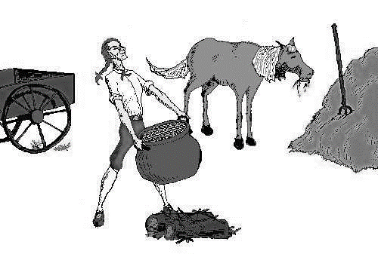
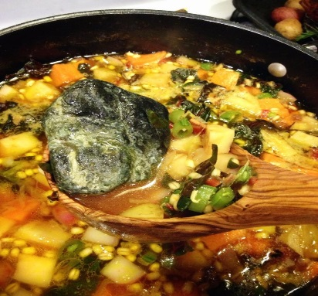
Stone Soup
Traditional Folktale
Scene 1: The soldiers are near a village. They are tired and hungry and far from home.
Narrator: A long time ago, in a different land, some soldiers were walking home from war.
Soldier 1: We have walked so far. My feet hurt and I am hungry. I would love some soup.
Soldier 2: How can we make soup we have no food?
Soldier 3: Look up there I see a town. I bet they have food and a bed.
Soldier 1: It’s no use. They will not give us any food. They will chase us out.
Soldier 2: Still we can ask.
Soldier 3: Yes, we will never know until we ask.
Soldier 1: Ok, you ask and then you will know.
Scene 2: The soldiers enter the village to talk to the townspeople.
Narrator: The townspeople saw the soldiers coming and hid their food. Each time the soldiers stopped at a house the villagers said they had no extra beds and too little food for themselves. So the soldiers kept going to the next house. Then one soldier had an idea.
Scene 3: The soldiers huddle together away from the villagers to
talk about what to do. Then they walk back to speak to the villagers.
Soldier 1: Good Villagers, since you have no food, will you let us
use a big pot? Then we can make stone soup.
Villager 1: What is stone soup?
Villager 2: I don’t know bring a pot.
Narrator: They filled the pot with water and the soldiers found some stones and put them into the water.
Soldier 2: (sniffing the soup) Something is missing…salt and pepper. Do you have a little?
Grade level equivalent: 2.8
Lexile Measure: 340L
Mean Sentence Length: 6.26
Mean Log Word Frequency: 3.51
Word Count: 526
Illustration A
Illustration B

Slide 29
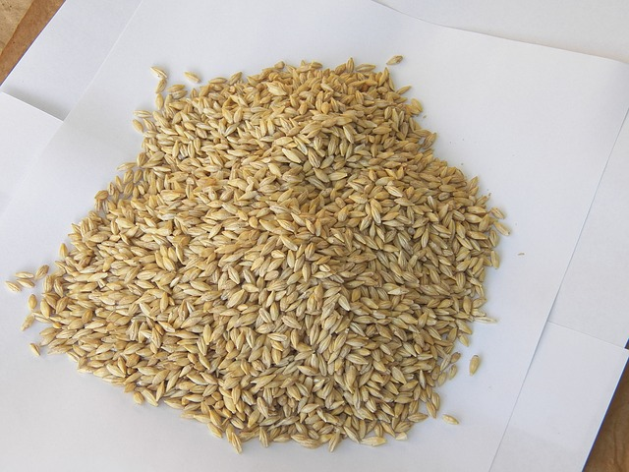
Stone Soup (continued)
Villager 1: I have a little. (put salt and pepper in the pot)
Soldier 3: Mmmmm smells good but some carrots and onions would be great.
Villager 3: I have a few. (put carrots and onions into the pot)
Soldier 1: Too bad we don’t have any potatoes.
Villager 1: I have one or two. (put potatoes in pot)
Soldier 2: Wow! Even the king would like this if it had barley and milk.
Villager 2: You can take a little of mine. (pour barley and milk in the pot)
Illustration C
Narrator: Finally the soup was ready and the soldiers tasted it.
Soldier 3: It is rich and thick.
Soldier 1: It is fit for a king.
Soldier 2: It is time to eat!!
Scene 4: The soldiers and villagers come together to eat.
Narrator: The villagers brought bread and cider and sat down to eat.
Soldier 3: Do you like it?
Villager 3: That’s very good!
Villager 1: It is hard to believe it was made from stones.
Narrator: They ate and danced into the night. The villagers let them sleep in the best beds. In the morning the village was sad to see them go.
ALL Soldiers: Thank you. This was a good day!
Villager 2: We want to thank you. You taught us how to make stone soup.
Villager 3: No one will believe us.
Soldier 1: It’s great what you can do with a few stones. (soldiers walk away)

Slide 30
Why do the soldiers say they can’t make soup?
The soldiers do not know how to cook.
The soldiers were afraid to ask the villagers for food.
The villagers would not give them any food.
They were too tired and hungry to ask for food.
DOK 2 – Cl Toward RL.35
Identify a main idea in, or a generalization about a chapter, scene or stanza using supporting details.
In what scene do the soldiers carry out their plan?
Scene one
scene two
scene three
scene four
DOK 2 – Apn Toward RL.35
Use the unique text features of chapters, scenes and stanzas to locate specific information about a story, drama or poem (which stanza refers to....).

Slide 31
Why did the townspeople hide their food from the soldiers?
The townspeople did not have very much food.
The townspeople did not like soldiers.
The townspeople were afraid the soldiers would steal their food.
The townspeople were told not to give the soldiers any food.
DOK 1 – Cf Toward RL.3.6
Describe or explain specific parts of a text that give understanding to what a character or narrator said.

Slide 32
4. This question has two parts. First answer Part A. Then answer Part B.
Part A
Which generalization supports the soldiers’ points of view about the villagers?
The soldiers thought the villagers were very kind.
The soldiers did not like the villagers.
The soldiers knew the villagers would not share their food because they did not have much.
The soldiers believed the villagers were mean.
Part B
Which statement best supports your answer in Part A?
If the villagers had given the soldiers food the first time they asked they would not have had to make stone soup.
The villagers only had to give a little of their food to help make the stone soup.
Since the soldiers did not like the villagers they decided to trick them.
Each of the soldiers were afraid to ask the villagers for food.
DOK 3 – Cu Toward RL.3.6
Explain a character’s point of view using supporting evidence from the text.

Slide 33
5. What is the purpose of Illustration A?
It explains how to make soup.
It is possible to make soup with a stone.
Illustration A emphasizes the stone in the soup.
This illustration shows what ingredients go into making stone soup.
DOK 1 – Cd Toward RL.3.7
Identify or describe specific illustrations that create mood, emphasize aspects of a character or setting.
How does Illustration C most contribute to the reader’s understanding of the play?
It shows what barley looks like.
It helps the reader to know when to add barley to the soup.
The reader understands that the villagers had barley.
It shows that barley was added to the soup.
DOK 1 – Cf Toward RL.3.7
Answer questions explaining how or in what way illustrations contribute to a specific part of a text.

Slide 34
7. How are the villagers’ and the soldiers’ points of view different in the play Stone Soup? How do you know? Use details and examples from the play.
DOK 3 – ANA Toward RL.3.6
Analyze how a character or narrator’s point of view is different than your own. Note: Students must be able to distinguish a character’s POV before differentiating it from their own or the author’s.
(Teacher Only) Final Score ____/2
8. Which part of the play Stone Soup does each illustration tell about? Give an example from the play for each illustration.
DOK 2 – Cl Toward RL.3.7
Locate information within the text that is conveyed by specific aspects of the text’s illustrations.
(Teacher Only) Final Score ____/2

Slide 35
Informational Source 1
Grade Equivalent: 7.7
Lexile Measure: 1060L
Mean Sentence Length: 14.8
Mean Log Word Frequency: 3.46
Word Count: 130
Read about.....
Choose Your Style
Choose Your Style!

Slide 36
9. According to the timeline, when did American college students refer to wagons as “dog wagons”?
1480
1980
1890
1904
Toward RI.3.5 DOK 2 - Cl
Locate information using key words, sidebars or hyperlinks (and other search tools/text features) relevant to a topic.
10. Where do people live that like cole-slaw as a topping on their hot dogs?
New York
The South
Kansas City
Chicago
Toward RI.3.5 DOK 2 – APn
Obtain and Interpret information using key words, sidebars or hyperlinks relevant to a topic.

Slide 37
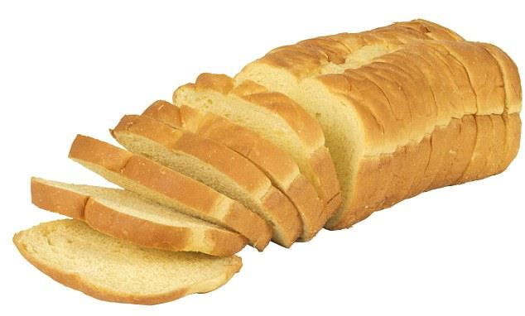
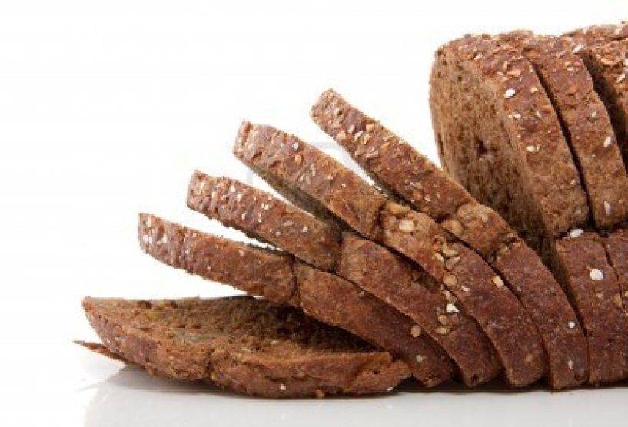
Informational Source 2
Grade Equivalent: 5.1
Lexile Measure: 810L
Mean Sentence Length: 10.1
Mean Log Word Frequency: 3.40
Word Count: 417
My Name is Graham, as in Cracker
by Janice Barrett Graham
It’s not easy having Graham for a last name. Our family gets teased a lot. One day in kindergarten my daughter, Elise, got tired of being called “graham cracker.” So she told everybody at school that her Uncle Sylvester invented graham crackers. They laughed.
“Sure he did,” they said.
Guess what? It’s true. Today we have graham crackers because of Elise’s great-great-great-great-great-uncle! He was born in 1794–a sickly boy named Sylvester Graham, who had no parents to care for him. He grew up wishing he was strong and healthy. He went to college and became a minister. But all his preaching was about good health. He watched people gulp down their food. They gulped down greasy piles of fried potatoes, slabs of red meat and pounds of pastries. He thought they looked like snakes swallowing their huge meals whole!
Then he saw the same people get sick or overweight. Doctors back then didn’t know how to cure them. Sylvester read about an experiment in which a dog, fed only white bread, got sick and died. But a dog that was fed whole-wheat bread stayed healthy. Sylvester began to wonder if the processing of grains to make white flour destroyed some of the nutrients. He changed his own diet to mostly whole grains, fresh fruits, and vegetables. He felt a lot better, and he couldn’t wait to share his new ideas.
White Processed Bread
Whole-Wheat Unprocessed Bread

Slide 38
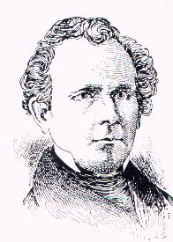
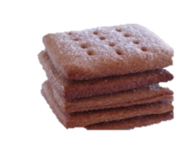
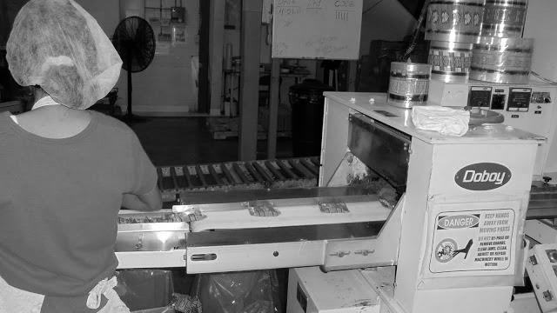
Original Graham Crackers
Other Names.............. | Graham Wafer
Creator....................... | Sylvester Graham
Place Invented........... | New Jersey, USA
Original Ingredients
Graham Flour | Milk
Molasses | Eggs
My Name Is Graham, as in Cracker (continued)
Huge crowds gathered to hear the small
excited man in a high collar and tailcoat.
“Eat foods that are good for you,”
cried Sylvester.
“Find Nature’s way and follow her!”
Many people took his advice, and
he began to hope that someday
all Americans would stop eating
like boa constrictors.
Flour made from the whole-wheat grain was named after Sylvester.
With this graham flour, his followers, called Grahamites, baked bread and crackers. Instead of hot morning gruel, the popular breakfast at the time, Grahamites ate the first cold cereal, “Granola,” made of crumbled rebaked graham crackers. Sylvester Graham had only a hunch that munching on whole-grain snacks was good for you.
Back then, newspapers called him “a nut among the crackers.” But today, 150 years later, scientists are proving he was right. And factories make millions of packages of graham crackers each year.
So now, even when Elise gets teased, she’s glad her name is Graham, as in cracker. At least it’s better than, say, Boa Constrictor!
“My Name Is Graham, as in Cracker” by Janice Barrett Graham from Highlights for Children, January 1996. Copyright © 1996 by Highlights for Children, Inc., Columbus, Ohio.

Slide 39
11. Which statement best describes Graham’s point of view about food?
He wanted to find a way to help people feel better.
People should not gulp down their food.
If people would eat natural foods they would feel better.
Graham loved to share his ideas about food.
Toward RI.3.6 DOK 2 – ANq
Identifies and lists the author’s points of views within a text. Compares an author’s point of view with their own.
12. Why does Sylvester compare people to boa constrictors?
When people gulped down food Sylvester thought “they looked like snakes swallowing a huge meal whole.”
People were sick or overweight and doctors did not know how to cure them.
Boa constrictors eat huge meals whole.
Sylvester wondered if boa constrictors ate a lot of red meat.
Toward RI.3.6 DOK 3 – Cu
Explain an author’s point of view using supporting evidence from the text.

Slide 40
What did Graham believe about white bread?
Processed white flour is healthier than whole wheat.
Processed white flour destroys some of its nutrients.
People should buy white flour rather than whole wheat.
White and whole wheat flour were both healthy.
Toward RI.3.7 DOK 1 – Cf
Answers questions using illustrations as well as words in a text.
14. Why might the author have included the illustration of two kinds of bread?
The author might have wanted to describe the kinds of bread in the story.
The author might have wanted to show a picture of the kinds of bread people eat.
The author might have wanted people to eat both types of bread.
The author might have wanted the reader to be able to see the two kinds of bread the dogs were fed.
Toward RI.3.7 DOK 2 – Cl
Identifies a main idea or generalization(s) about how or why key events occur using illustrations or text.

Slide 41
15. Explain how and why Elise Graham’s feelings about her name changed from the beginning of the passage to the end of the passage. Use details from the text. (Teacher Only) Final Score ____/3
Toward RI.3.6 DOK 3 – ANA
Analyze how an author’s point of view is different than your own.
16. Based on the passage and illustrations, explain why Sylvester chose the ingredients he used to make graham crackers. (Teacher Only) Final Score ____/2
Toward RI.3.7 DOK 2 - APn
Obtain and interpret information based on the illustrations and the words in the text to demonstrate understanding.

Slide 42
17. A student is writing a report for the class about the differences between processed and un-processed grains. Read the draft of the report and complete the task that follows. Processed or Unprocessed Bread Sylvester Graham invented the Graham Cracker. He made it because he thought it would be healthy for people. It all started when he began to study about two kinds of bread. Bread made from white flour is processed bread. When wheat goes through a process it is called processed wheat. Processed wheat is used to make white bread. Bread made from wheat that does not go through a process is unprocessed bread. Unprocessed wheat is used to make whole grain bread. Sylvester Graham wanted to make healthy foods. Task: Write an ending paragraph or paragraphs that conclude the student’s report based on details from My Name is Graham, as in Cracker. Write to Revise a Brief Text, Organization, W.3.2e, writing a conclusion ,Target 3a

Slide 43
18. A student is revising this paragraph and wants to replace the
underlined sentence to better develop the information in the
paragraph.
Sylvester did not like to see people gulp down their food so fast. He saw people eat a lot of foods that were junk food. When they ate like this he said they looked like “boa constrictors.” Boa constrictors just swallow their food whole! Sylvester wanted Americans to stop eating like this. He wanted people to eat healthy and feel better.
W.3.2a Revising a Brief Write (elaboration: developing a topic) -Target 3b
Which sentence would best replace the underlined sentence?
He saw people eat a lot of foods that were junk foods, like greasy potatoes and other greasy foods.
He saw people eat a lot of bad foods like a lot of junk food.
He saw people eat a lot of foods that were bad for their health, such as greasy foods and lots of sugary pastries.
He saw people eat a lot of red meat.
\ `
19. Sylvester began to wonder if the processing of grains to make white flour destroyed some of the nutrients.
(Lang./Vocab. L 3.3.a Choose words/phrases for effect ) Target 8
Which word could be used to replace nutrients?
vitamins
B. health
wheat
taste
\ `

Slide 44
20. What two sentences have no errors in punctuation usage?
L.2.2 punctuation use Target 9
Sylvester Graham wanted others to be healthy
B. When he grew up he preached about eating healthy foods.
C. He read about dogs that ate white and whole grain bread.
D. He told people to eat fruit, vegetables and whole grains.

Slide 45
Student Directions:
Part 2
Performance Task
Your assignment: People eat different foods for different reasons. You are going to write an
Informational article about why people choose to eat the foods they do. Use examples and details
From all three sources.
You will:
Plan your writing. You may use your notes and answers. You may use a graphic organizer.
Write, revise and edit your first draft (your teacher will give you paper).
3. Write a final draft of your informational article.
How You Will Be Scored
Purpose | You identified the topic. You gave details about the focus of the topic.
Organization | Your writing is organized the same all the way through. You can organize it by comparing and contrasting, definition, classification, problem or solution.
Elaboration: of evidence | You develop your writing with details, quotations and other information about the topic.
Elaboration: of language and vocabulary | You use words that tell specifically about the topic. You connect your ideas with linking words.
Conventions | How well you follow the rules of grammar, usage, and mechanics (spelling, punctuation, capitalization, etc.).

Slide 48
STOP
Close your books and wait for instructions!

Slide 49
Student Scoring Color the box green if your answer was correct. Color the box red if your answer was not correct.
Literary Text
1 | I can identify a main idea in, or a generalization about a chapter, scene or stanza with supporting details. RL.3.5
2 | I can use the text features of chapters, scenes and stanzas to locate specific information about a story, drama or poem (which stanza refers to....). RL.3.5
3 | I can describe or explain specific parts of a text that give understanding to what a character or narrator said. RL.3.6
4 | I can explain a character’s point of view using supporting evidence from the text. RL.3.6
5 | I can identify or describe specific illustrations that create mood, emphasize aspects of a character or setting. RL.3.7
6 | I can answer questions to show how illustrations contribute to part of a text. RL.3.7
7 | I can analyze how a character or narrator’s point of view is different than your own. RL.3.6 | 2 | 1 | 0
8 | I can locate information within the text that is shown in the text’s illustrations. RL.3.7 | 2 | 1 | 0
Informational Text
9 | I can locate information using key words, sidebars or hyperlinks (and other search tools/text features) relevant to a topic. RI.3.5
10 | I can obtain and interpret information using key words, sidebars or hyperlinks relevant to a topic. RI.3.5
11 | I can describe or explain specific parts of a text that give understanding to an author’s point of view. RI.3.6
12 | I can explain an author’s point of view using supporting evidence from the text. RI.3.6
13 | I can identify a main idea or generalization(s) about how or why key events occur using illustrations or text. RI.3.7
14 | I can obtain and interpret information based on the illustrations and the words in the text to demonstrate understanding. RI.3.7
15 | I can analyze how an author’s point of view is different than my own. RI.3.6 | 3 | 2 | 1 | 0
16 | I can obtain and interpret information based on the illustrations and the words in the text to demonstrate understanding RI.3.7 |  | 2 | 1 | 0
Writing
17 | Write a conclusion to the paragraph. W3.2e | 2 | 1 | 0
18 | Which sentence would best replace the underlined sentence? W3.2a
19 | Which word could be used to replace nutrients? L.3.3a
20 | What two sentences have no errors in punctuation usage? L.3.2

