Slide 1
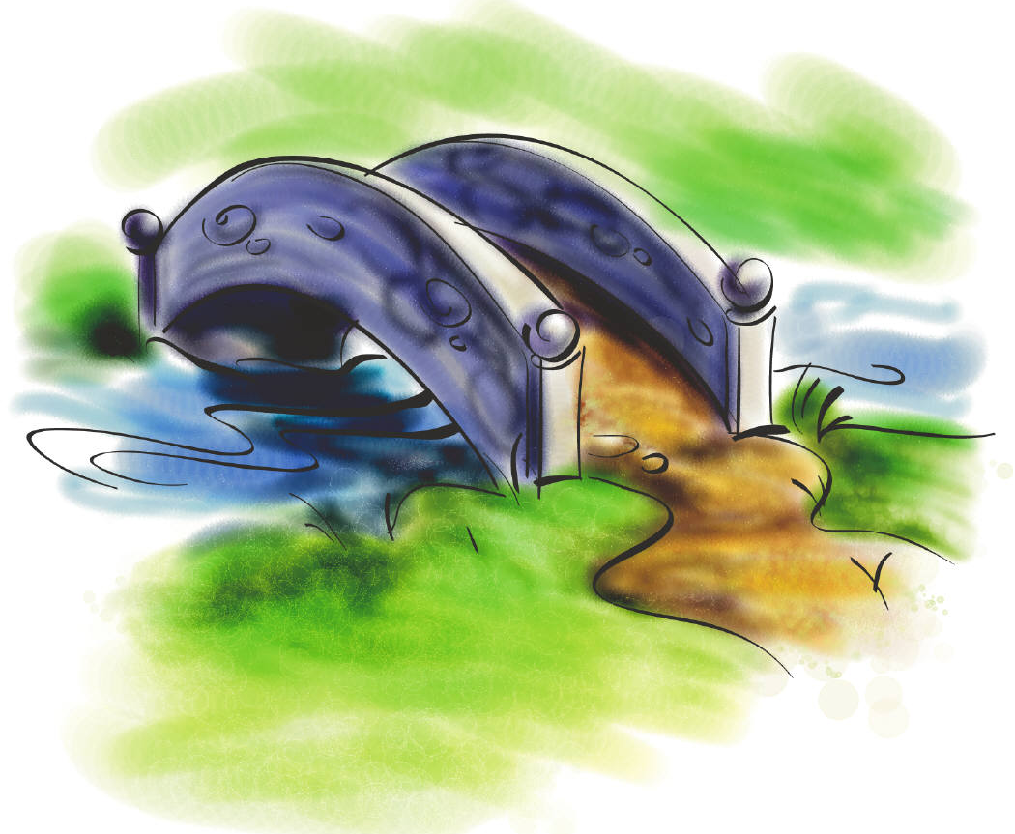







Learning Progressions ...
a normal trajectory of ordered progressions along a pathway to an end goal.
Notes:
Before we look at pre-assessments for the standards, we need to understand the basis of the pre-assessments – the LPs.
In order to focus in on standard specific instruction we begin with the standard – the end goal. Working back to front we can establish a learning progression of proficiency or a model of small steps students normally achieve along the path toward proficiency.

Slide 2
Planning Backward from the Standard
RI.4.1 Refer to details and examples in a text when explaining what the text says explicitly and when drawing inferences from the text.
Notes:
Planning backward from the standard required team planning from experts in the field – our grade level teachers.

Slide 3
Each standard is an end goal on a developmental continuum.
RI.4.1 Refer to details and examples in a text when explaining what the text says explicitly and when drawing inferences from the text.
Path to DOK - 1 |  |  | Path to DOK - 2
 |  |  |  |  |  | End Goal
 |  |  |  |  |  | Standard
 |  |  |  |  |  | RI.4.1 Refer to details and examples in a text when explaining what the text says explicitly and when drawing inferences from the text.
Notes:
Why RI first? Content and PTs. Weakest link.

Slide 4
The standard’s continuum consists of a progression of researched developmental steps along a Learning Progression.
RI.4.1 Refer to details and examples in a text when explaining what the text says explicitly and when drawing inferences from the text.
Path to DOK - 1
DOK 1 - Ka
Answer questions about details or examples in an informational text previously read in class.
Path to DOK - 1
DOK 1 - Kc
Understand the meaning of the words/terms standard academic language: details, examples, refer, explicit, draw inferences
Path to DOK - 1
DOK 1 - Cf
Answers who, what, when, where and how questions about details or examples found explicitly in the text.
Path to DOK - 2
DOK 2 - Ch
Conceptual Development Asks or answers questions about details in a text demonstrating an understanding that details and examples can provide information explicitly found in the text.
Path to DOK - 2
DOK 2 - Cj
Draws basic inferences (not too implicit) using details and examples from the text.
Path to DOK - 2
DOK 2 - Cl
Locates information that is explicitly found in the text or for drawing inferences.
Path to DOK - 2
End Goal
Standard
RI.4.1 Refer to details and examples in a text when explaining what the text says explicitly and when drawing inferences from the text.

Slide 5
This is a completed Learning Progression for standard RI.4.1
We can pre-assess specific developmental key adjustment points along the continuum of the learning progression.
Path to DOK - 1
DOK 1 - Ka
Answer questions about details or examples in an informational text previously read in class.
Path to DOK - 1
DOK 1 - Kc
Understand the meaning of the words/terms standard academic language: details, examples, refer, explicit, draw inferences
Path to DOK - 1
DOK 1 - Cf
Answers who, what, when, where and how questions about details or examples found explicitly in the text.
Path to DOK - 2
DOK 2 - Ch
Conceptual Development Asks or answers questions about details in a text demonstrating an understanding that details and examples can provide information explicitly found in the text.
Path to DOK - 2
DOK 2 - Cj
Draws basic inferences (not too implicit) using details and examples from the text.
Path to DOK - 2
DOK 2 - Cl
Locates information that is explicitly found in the text or for drawing inferences.
Path to DOK - 2
End Goal
Standard
RI.4.1 Refer to details and examples in a text when explaining what the text says explicitly and when drawing inferences from the text.
Path to DOK - 1
DOK 1 - Cf
Answers who, what, when, where and how questions about details or examples found explicitly in the text.
Path to DOK - 2
DOK 2 - Cj
Draws basic inferences (not too implicit) using details and examples from the text.
Path to DOK - 2
DOK 2 - Cl
Locates information that is explicitly found in the text or for drawing inferences.

Slide 6


B
*Beginning Quarter Pre-Assessments *Learning Progressions
Pre-Assessments
RI.4.1 Refer to details and examples in a text when explaining what the text says explicitly and when drawing inferences from the text.
Path to DOK - 1
DOK 1 - Cf
Answers who, what, when, where and how questions about details or examples found explicitly in the text.
Path to DOK - 2
DOK 2 - Cj
Draws basic inferences (not too implicit) using details and examples from the text.
Path to DOK - 2
DOK 2 - Cl
Locates information that is explicitly found in the text or for drawing inferences.
Each of the key developmental points on the learning progression are assessed.
Notes:
The pre-assessments are based on the Key Adjustment Points of the LPs. They do NOT assess the standard end goal, but the progression of proficiency toward the standard. The benefit of this is that we do not give a post-assessment at the beg. Of the year that measures only year-end goals and then have to try to “guess” what students need who didn’t “get it.” Post Assessments are the IFAs developed by teachers as part of their daily-weekly instruction for only those students who need support in specific areas as shown by pre-assessment results. The pre-assessment has 10 selected response and 2 constructed responses (CRs assess the most complex standards).

Slide 7
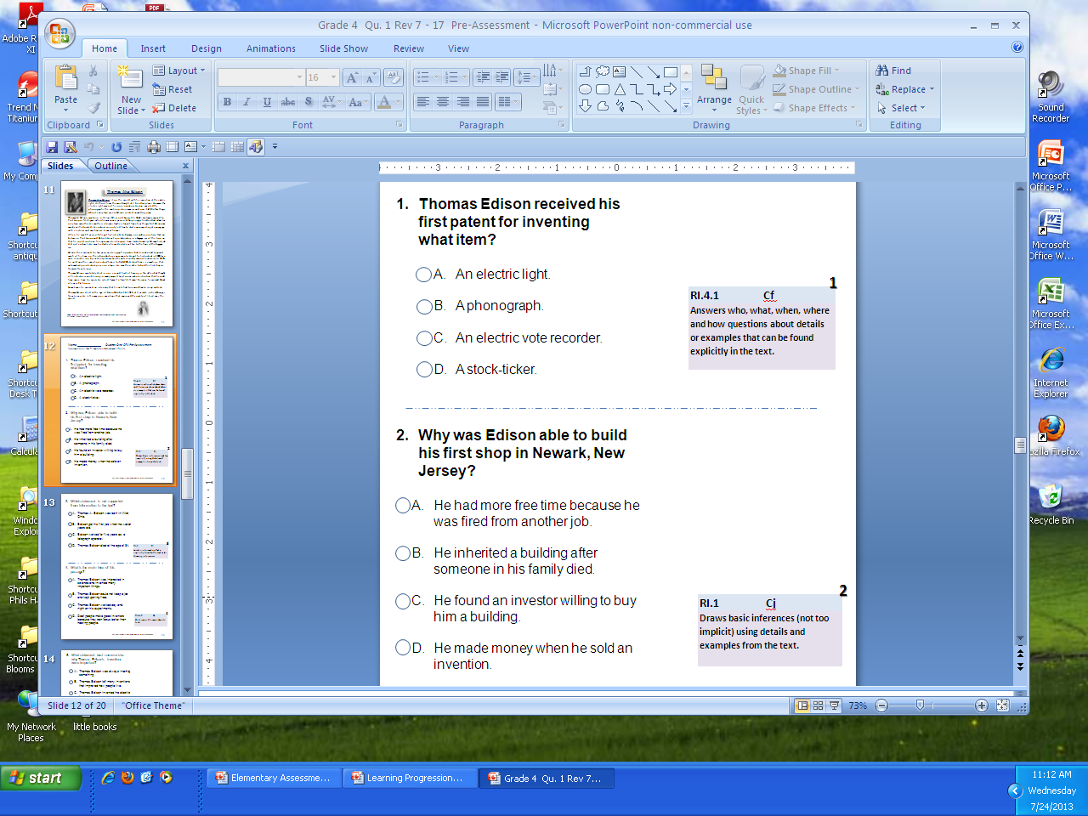
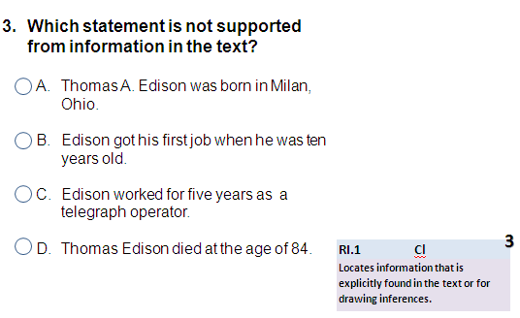
Path to DOK - 1
DOK 1 - Cf
Answers who, what, when, where and how questions about details or examples found explicitly in the text.
Path to DOK - 2
DOK 2 - Cj
Draws basic inferences (not too implicit) using details and examples from the text.
Path to DOK - 2
DOK 2 - Cl
Locates information that is explicitly found in the text or for drawing inferences.
RI.4.1 Refer to details and examples in a text when explaining what the text says explicitly and when drawing inferences from the text.
Notes:
This is a sample of the 3 SR questions for standard RI.4.1. They are at DOK levels from 1 to 2. Each SR and CR question has the accompanying Key Adjustment Point from the LP identified by each question.

Slide 8
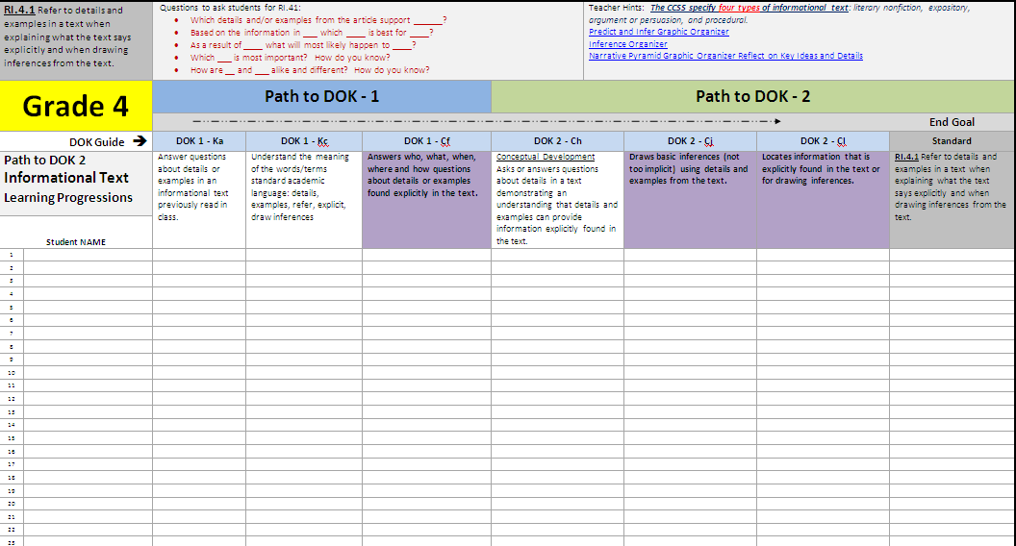
The pre-assessment results provide a beginning guide for classroom standards based instruction and scaffolding.
Class Checklist...
The pre-assessment results can be used more specifically for monitoring progress based on student need.

Slide 9

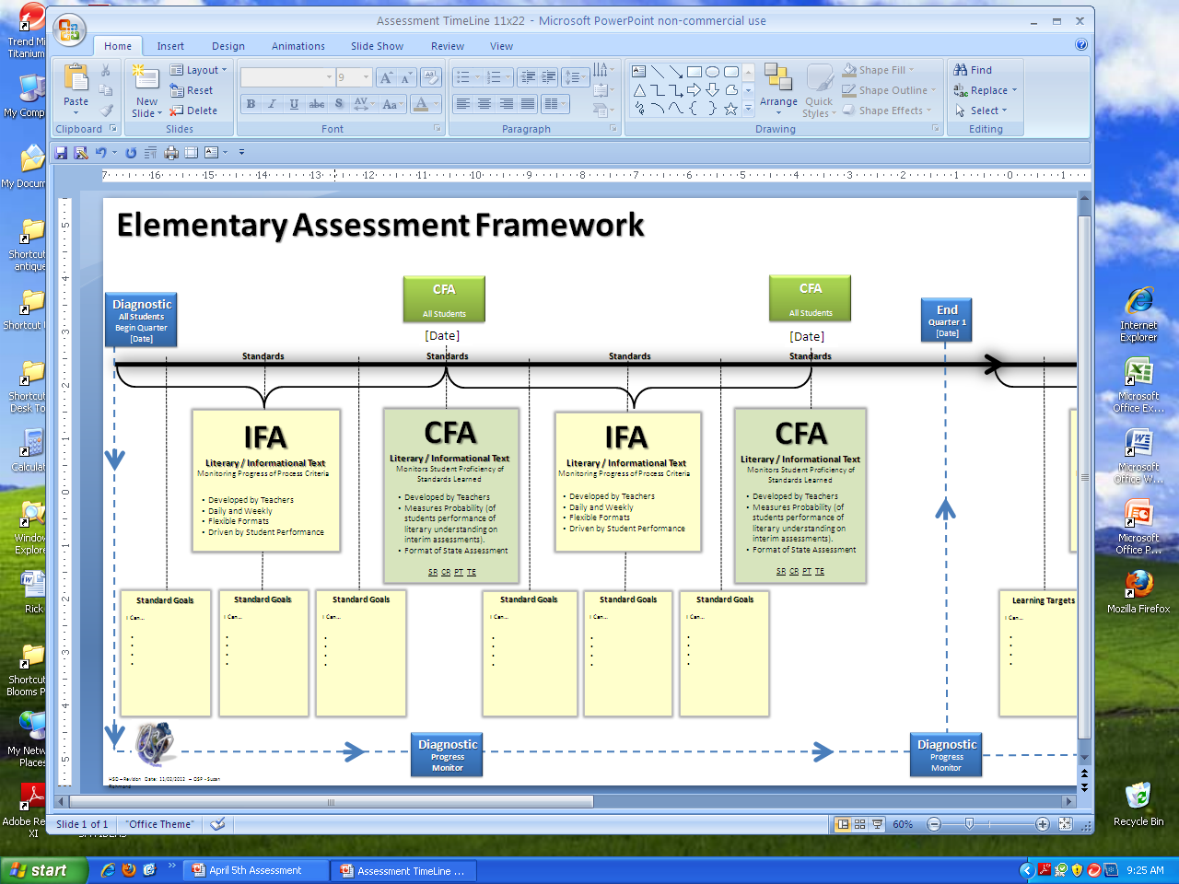



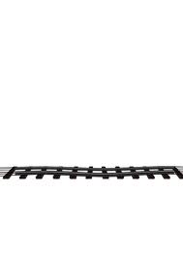

Learning Progressions Guide Classroom Instructional Goals and Assessments from Informal Formative Assessments to Common Formative Assessments (CFAs).
ALL Students Move Forward!
Learning Progressions
Standard End Goal
Path to DOK - 1 |  |  | Path to DOK - 2
 |  |  |  |  |  | End Goal
DOK 1 - Ka | DOK 1 - Kc | DOK 1 - Cf | DOK 2 - Ch | DOK 2 - Cj | DOK 2 - Cl | Standard
Locate details or examples in a text. | Understand the meaning of the words/terms: details, examples, refer, explicit, draw inferences | Answers who, what, when, where and how questions about details or examples that can be found explicitly in the text. | Asks or answers questions about details in a text demonstrating an understanding that details and examples can provide information explicitly found in the text (Contextual Development) | Draws basic inferences (not too implicit) using details and examples from the text. | Locates information that is explicitly found in the text or for drawing inferences. | RI.4.1 Refer to details and examples in a text when explaining what the text says explicitly and when drawing inferences from the text.
Notes:
Differentiated Instruction
Scaffolding
Re-Teaching
Gap Analysis
Equity – All Students Accessing Grade Level Standards
Tools for Teachers

