Slide 1
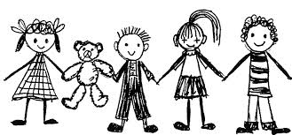



INTERIM
ASSESSMENT
indergarten
Teacher
Directions

Slide 2

All elementary ELA assessments were written, reviewed and revised by the following amazing and dedicated HSD K-6th grade teachers.
Reviewed and revised in June of 2015 by the following HSD K-6th grade teachers. |  | Written by the following HSD K-6th grade teachers in 2014.
Deborah Alvarado Lincoln Street | Ko Kagawa Minter Bridge | Deborah Alvarado
 |  | Tammy Cole
Linda Benson West Union | Jamie Lentz Mooberry | Carrie Ellis
 |  | Dori George
Anne Berg Eastwood | Sandra Maines Quatama | Heather Girad
 |  | Jamie Goldstein
Aliceson Brandt Eastwood | Gina McLain TOSA | Raquel Lemus
 |  | Jamie Lentz
Sharon Carlson Minter Bridge | Teresa Portinga Patterson | Alfonso Lule
 |  | Berta Lule
Deborah Deplanche Patterson | Judy Ramer Consultant | Sandra Maines
 |  | Heather McCullum
Alicia Glasscock Imlay | Sara Retzlaff McKinney | Gina McLain
 |  | Teresa Portinga
Sonja Grabel Patterson | Jami Rider Free Orchard | Judy Ramer
 |  | Irma Ramirez
Megan Harding Orenco | Kelly Rooke Free Orchards | Sara Retzlaff
 |  | Jean Summers
Renae Iversen Teacher Mentor | Angela Walsh Witch Hazel | Nikki Thoen
 |  | Maritza Dash
Ginger Jay Witch Hazel |  | Jill Russo
Performance Task Classroom Activities for K – 6 were written by Jamie Lentz, Gina McLain, Hayley Heider, Anna Wooley, Gretchen Erlandsen, Deborah Deplanche, Connie Briceno, Judy Ramer, Carrie Ellis, Sandra Maines, Renae Iversen, Anne Berg, Aliceson Brandt and Ko Kagawa. All assessments have been edited by Vicki Daniels.

Slide 3
The HSD Elementary Interim Assessment is required. Please enter the student scores into Synergy. The kindergarten assessment contains 11 total questions including 10 Selected Responses (SR) and 1 Constructed Response (CR). Selected Responses are 1 point each and Constructed Responses are 2 points each.
Assessment Targets
DOK-2 Key Ideas – Details Standard 1 | DOK-2 Central Idea Standard 2 | DOK 3-4 Reasoning Standards 3,6 | DOK 2-3 Text Structures Standards 5,7
1 Literature SR 1 Informational SR | 1 Literature SR 1 Informational SR | 2 Literature SRs 1 Informational SRs 1 Informational CR | 2 Literature SRs 1 Informational SR
Total: 2 | Total: 2 | Total: 4 | Total: 3
Possible Points: 2 | Possible Points: 2 | Possible Points: 5 | Possible Points: 3
Directions: The teacher reads the passages to students Students answer the SR and CR Questions. *If you are not doing the performance task have students answer questions #1-11 only. If you are not doing the performance task your students will stop at the red “stop sign.” Grades K – 2 Students in kindergarten should have the passages read to them as a listening comprehension assessment. Students in grades 1 – 2 should read the passages independently if they can; however, students not reading at grade level may have the passages read to them. Grades 3 – 6 Students in grades 3 – 6 should read the passages independently unless an IEP signifies otherwise.
Kindergarten
Literature Standard | St. 1 | St. 2 | St. 3 | St. 5 | St. 6 | St. 7
DOK Level | 2 | 2 | 2 | 2 | 2 | 2
Informational Standard | St. 1 | St. 2 | St. 3 | St. 5 | St. 6 | St. 7
DOK Level | 2 | 2 | 3 | 1 | 2 | 3

Slide 4
Directions:
Please read over the assessment before giving it. You may wish to have students working on the constructed response or performance task (the performance task is optional) independently while you give the selected response questions in small groups or individually.
Teacher directions include:
1 constructed response answer key
1 performance task answer key (optional)
For your students to view (on overhead/ELMO if possible)
1 literary passage
1 informational passage
As you give the assessment (small group or individually)
4-5 copies of the literary student picture prompts
4-5 copies of the informational student picture prompts
Each student will need a “student copy” of the assessment.
The student copy includes:
Cover page
Interim Record Form (to record each student’s scores)
1 constructed response answer sheet
1 performance task (optional)

Slide 5
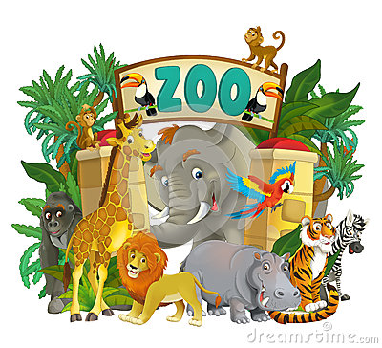
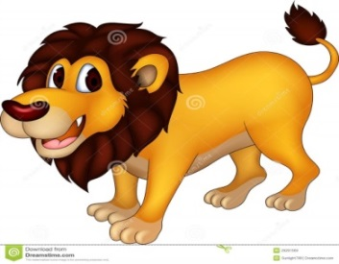



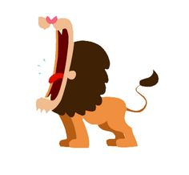
The Zoo Lion
Author?
I went to the zoo today. There were many animals there.
My favorite animal was Len the Lion. I always like to see Len at the zoo because he is so big.
Len has a large mane around his neck. Len has large paws and a long tail.
Lions like to eat meat. The zookeeper feeds Len the Lion lots of meat.
A lion can roar. Len the Lion roars so loudly that I have to cover my ears.

Slide 6
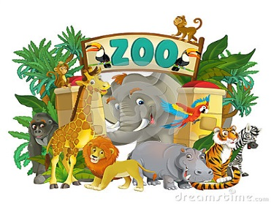
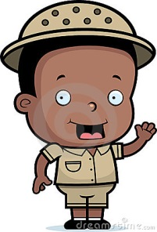


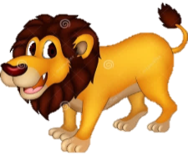




Selected Response Questions Picture Prompts
Literary Passage: The Zoo Lion
1.
2.
3.
4. What facts in the story show that Len lives at the zoo?
5.
6. Help me describe Len the Lion.
Len is big.
illustrator

Slide 7
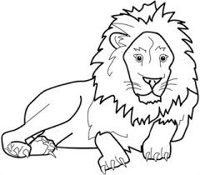
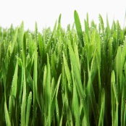
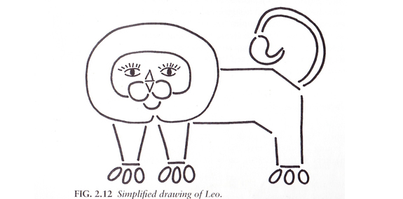
The King of the Jungle
Author?
Lions are the kings of the jungle.
They are big and strong. Lions weigh
400 pounds and stand 4 feet tall.
If you feel the hair on its face, it is soft.
You can find lions in Africa.
They can live for 15 years in the wild.
They like to sleep in the grass at night.
Lions eat meat, such as zebra,
giraffe, and buffalo.
Lions live in groups, called “prides”,
with about 15 other lions.

Slide 8
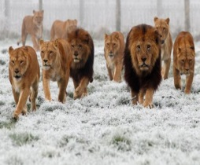

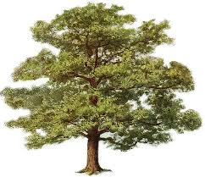
Selected Response Questions Picture Prompts
Informational Passage: The King of the Jungle
7.
8.
9. Why are the lions together?
10.

Slide 9
Constructed Response answer key
11. What do the pictures tell us about the story we read?
Standard RI.K.6
Name the author and illustrator of a text and define the role of each in presenting the ideas or information in a text. Note: As students tell about the pictures they are defining roles presented by the illustrator in connection with the text or author’s purpose.
Constructed Response Research Rubrics Target 2
Locate, Select, Interpret and Integrate Information.
The response gives sufficient evidence of the ability to locate and select information from the illustrations in order to connect ideas to the text King of the Jungle. Students may draw, write or dictate details from the pictures to connect with (1) the lion is the king of the jungle, (2) lions are strong (big – may include weight), (3) they have soft fur, (4) they live in Africa, (5) sleep in grass at night, (6) like to eat meat and (7) live in prides.
The response gives sufficient evidence of the ability to interpret and integrate information to draw, write or dictate in order to show how information from the text and illustrations integrate or connect.
2 | Student draws, writes or dictates about how the illustrations tell about the text to include: 2 different kinds of animals (zebra, buffalo and lion) 2-3 details describing a lion (soft, big, strong, king) 2 details telling what lions do (eat meat, sleep in grass, live in prides)
1 | Student draws, writes or dictates about how the illustrations tell about the text to include: The lion 1 detail describing the lion 1 detail telling what the lion does
0 | Student drawing or writing may have 1 detail about the illustration but it does not actually connect with a specific part of the text.

Slide 10
Optional
Performance Task Directions
*If you are not doing the performance task have students answer questions #1-11 only.
Important Note:
This assessment has an Optional Performance Task (it will not be recorded to Synergy). The purpose of the Performance Task (PT) is to allow teachers to give a PT to students, if so desired, as an instructional experience.
Students in kindergarten should have adult support and prompting given as needed Teachers can re-read the passages, refer back to the passages and share in discussion as needed.
Directions for Performance Task
**Please do Part 1 before beginning the assessment.
Part 1
1. A Classroom Activity (30 Minutes)
You may wish to have a 30 minute classroom activity. The purpose of a PT activity is to ensure that all students are familiar with the concepts of the topic and know and understand key terms (vocabulary) that are at the upper end of their grade level (words they would not normally know or are unfamiliar to their background or culture). The classroom activity DOES NOT pre-teach any of the content that will be assessed!
Read literary and informational passages (30 minutes)
Read the passages to your students.
Answer the selected and constructed response questions.
This can be done in small groups or individually.
Part 2 (after completing questions #1-11)
4. Students complete their performance task with much support and prompting.
SCORING
An Informational Rubric is provided for the performance task. Students receive scores in three areas:
Organization and Purpose
Evidence and Elaboration
Conventions

Slide 11
Key Details Classroom Activity
This classroom pre-activity follows the Smarter Balanced Assessment Consortium general design of contextual elements, resources, learning goals, key terms and purpose [http://oaksportal.org/resources/]
The content within each of these was written by Jamie Lentz
The Classroom Activity introduces students to the context of a performance task, so they are not disadvantaged in demonstrating the skills the task intends to assess.
Contextual elements include:
an understanding of the setting or situation in which the task is placed
potentially unfamiliar concepts that are associated with the scenario
key terms or vocabulary students will need to understand in order to meaningfully engage with and complete the performance task
The Classroom Activity is also intended to generate student interest in further exploration of the key idea(s). The Classroom Activity should be easy to implement with clear instructions.
Please read through the entire Classroom Activity before beginning the activity with students to ensure any classroom preparation can be completed in advance. Throughout the activity, it is permissible to pause and ask students if they have any questions.
Resources needed:
1 color copy of pictures 1-3 from the ancillary materials (these will be posted on chart paper)
1 large piece of chart paper
Black marker (for recording student responses on chart paper)
Tape
Learning Goals:
Students will understand the context of the key concepts related to the topic:
adding key details from the text
Students will understand the key terms:
Note: Definitions are provided here for the convenience of facilitators. Students are expected to understand these key terms in the context of the task, not memorize the definitions.
Details- small pieces of information
Key details from the text- important pieces of information from the text that need to be in our writing
[Purpose: The facilitator’s goal is to help students understand that key details need to be included when summarizing/retelling a story.]
*Facilitators can decide whether they want to display ancillary materials using an overhead projector or computer/Smartboard, or whether they want to produce them as a handout for students.

Slide 12
Key Details Classroom Activity
Discussion question:
What are key details?
Why do we need key details?
What key details match this illustration?
Facilitator says: “Today we will be getting ready for the Zoo Lion Performance Task. We are going to talk about key details. What are key details? Think about what key details are and then we will share with our partners. (Model your classroom “think” signal/cue and then signal them to begin sharing with their partners). Key details are…”
Possible student responses (unscripted):
They’re like the keys that go in the door
Parts of the story
Maybe a tail that looks like a key
Facilitator says: “Ok let’s see what you and your partner came up with. What are key details _______? (Call on a few students to share. If the correct answer is given move to the next facilitator prompt. If the correct answer is not given continue here.) “You have some great ideas! Details are small pieces of information from the text, and key details are important pieces of information from the text that need to be in our writing about the story.”
Facilitator says: “Ok, it’s time to get key details stuck in our brains, are you ready? Repeat after me… key details (make motion of turning a key) are important pieces of information (make “muscle arms” motion) that need to be in our writing (make writing motion). Wow, nice work! Let’s do it again in a whisper voice (repeat several times using different voices to keep students engaged).”
Facilitator says: “Now we’re going to practice writing key details, who remembers our story about Sammy the dog? (Show students pictures 1-3 from ancillary materials, one at a time as you share the story). “One day Sammy the dog was walking across the backyard. Sammy was happy because he liked being outside in the sun. All of a sudden Sammy slipped and fell into a huge hole! The hole was muddy and slimy. Sammy barked as loud as he could and eventually Marvin, his owner, came and pulled him out. Marvin gave Sammy a hug. He was glad that Sammy was ok! Turn to your partner and share the key details, or the important pieces of information that need to be in our writing. The key details are…”
Possible student responses (unscripted):
Sammy was walking in the backyard
Sammy was happy because it was sunny
Marvin hugged Sammy
The hole was muddy and slimy
Marvin pulled Sammy out of the hole
Facilitator needs to post the three story pictures in a vertical line on the chart paper, leaving space to record student responses to the left of each picture.

Slide 13
Facilitator says: “Let’s see what key details you and your partner came up with. ______ what key details did you and your partner discuss? (Record student’s answers on the chart paper next to the appropriate picture. Prompt students to give you additional information and/or go back to the text if students need additional support in identifying key details from the text for each illustration. Continue calling on students as need to complete the chart).”
Possibly student responses (unscripted):
Sammy was walking in the backyard
Sammy was happy
Sammy fell in the hole
The hole was muddy and slimy
Sammy barked loud so Marvin would come
Marvin pulled Sammy out of the hole
Marvin hugged Sammy
Facilitator says: “In your performance task, you will be learning more about writing key details about a text. The partner work you did today should help prepare you for the research and writing you will be doing in the performance task.”
Note: Facilitator should collect student notes from this activity.

Slide 14
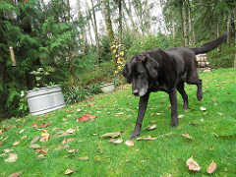
Ancillary Materials
Picture 1

Slide 15
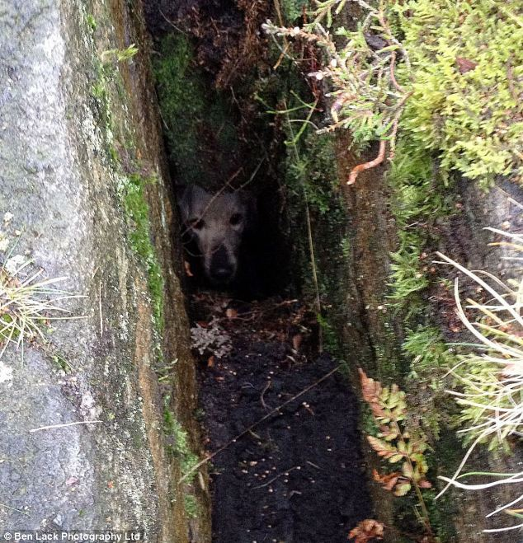
Ancillary Materials
Picture 2

Slide 16
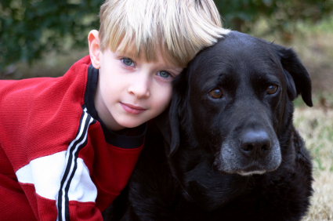
Ancillary Materials
Picture 3

Slide 17


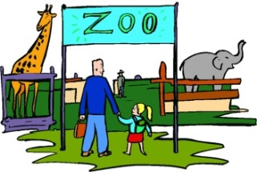





Performance Task Answer Key
Task: Draw pictures and write words to tell about each picture. Then put the pictures on the correct side. Which pictures are most about the zoo? Which pictures are most about Len? Put the pictures on the correct side.
All about Len the Lion
All about the zoo.
Example: Student may say Len is roaring or draw more pictures of how lions roar to connect with the text.
Example: Student may share that the character in the story went to the zoo or draw/write about walking into the zoo.
Example: Student can point out the lion’s mane and large paws (or long tail) to connect to the text or circle/discuss those aspects.
Example: Student may share that the noise the lion made was loud and the character had to cover his/her ears – this happened at the zoo.
Example: Student should say, write or draw something about the fact that lions like meat to connect to the text.
Example: Student may write, draw or say what animals are at the zoo.
Students receive three scores, one for each criterion. In kindergarten, use your judgment along with the writing rubric to decide how the final product best supports each of these three areas.
Purpose and Organization (4) Explains more about each picture Connects picture to what happened in text Groups or connects ideas |  |  |  | Language -Elaboration of Evidence (4) Uses relevant details of what happened Uses vocabulary learned from the passage If sharing, makes good sense. |  |  |  | Conventions (4) Uses words or letters appropriate for age If sharing, uses grammar appropriate for age
1 | 2 | 3 | 4 | 1 | 2 | 3 | 4 | 1 | 2 | 3 | 4
Total Score /12

Slide 18
Grades K - 2: Generic 4-Point Informational/Explanatory Writing Rubric for Optional Performance Task
Score | Statement of Purpose/Focus and Organization |  | Development: Language and Elaboration of Evidence |  | Conventions
 | Statement of Purpose/Focus | Organization | Elaboration of Evidence | Language and Vocabulary
4 Exemplary | Uses a combination of drawing, dictation, & writing (K) to compose Explains something more about the topic OR a connection is made between topic & broader idea(s) Clearly presents the topic and focus/controlling idea | Intro, body, and conclusion support focus Uses several transitions appropriately (e.g., because, since, and, but, also, for example, since) to connect or group ideas | Has a depth of information; insightful Elaborates using a variety of relevant details, definitions, examples, quotes, text evidence to support focus/concepts | Maintains voice/tone of knowledgeable person conveying information – knows when to use formal-informal language Uses effective, precise vocabulary and variety of sentence structures | Edits with support /resources Has few or no errors in grammar, word usage, or mechanics as appropriate to grade
3 Proficient | Uses a combination of drawing, dictation, & writing (K) to compose Topic (context) and focus/controlling idea are clearly stated (gr K-3) | Has overall coherence (K-3); Provides a concluding statement or section (gr, 1, 2, 3) Groups related ideas (gr3) that support the focus Uses transitions to connect ideas (gr3) | Some authentic details, definitions, facts, text evidence support focus Adds labels or captions to illustration, drawing, visuals, charts/tables, or diagram to enhance details, facts, and ideas | Produces complete simple (K), compound (g, 1- 3), complex (gr3) sentences Appropriate use of vocabulary (nouns, plurals, verbs, pronouns, adjectives, adverb, content-specific) Uses adult/peer feedback to Revise | Edits with support /resources (gr 2-3) Minor errors do not interfere with reader understanding (e.g., capitalization, punctuation; spelling)
2 Developing | Uses a combination of drawing, dictation, & writing (K) to compose Has topic and attempts a focus/information, but focus may shift or not be relevant to the topic chosen | Introduction, body, and conclusion are evident, but may lack clarity or Coherence (e.g., attempts to connect ideas, but may not be logical or make sense) | Some elaboration strategies are evident in drawings or writing (gr K-3), or with support/ questioning from peers or adults (gr K -1) Ideas may not be fully elaborated or details may be insufficient to support topic | Vocabulary use has minor errors Dictates, writes, and expands simple complete sentences Uses adult/peer feedback to revise | Edits with support from peers or adults (gr 2-3) Uses grade-appropriate basic mechanics and word use with some errors
1 Emerging | Uses a combination of drawing, dictation, & writing (K) to compose Attempts to identify a topic but lacks a focus or may have more than one topic or confusing topic as stated | Attempts introduction, body, and conclusion, but one or more parts are missing | No details provided or attempts to add details to drawings or writing which may be random, inaccurate, or irrelevant | Generally uses basic, incorrect, or below grade level vocabulary when dictating (K) or writing Uses adult/peer feedback to revise | Edits with support from peers or adults (gr 2-3) Uses below grade-level basic mechanics with frequent errors
0 | A response gets no credit if it provides no evidence of the ability to [fill in with key language from the intended target].
Working Drafts of ELA rubrics for assessing CCSS writing standards --- © (2010) Karin Hess, National Center for Assessment [khess@nciea.org

Slide 19
INTERIM
ASSESSMENT
Name_________________________

Slide 20
Kindergarten Literary and Informational Text Interim Selected Response Record Form Directions: Read each question to the student. Show student the answer-choice prompts for the literary and informational passages. Check the answer the student gives. Correct answers are highlighted in bold.
Literary Passage: The Zoo Lion
1 | RL.K.1: With prompting and support, ask and answer questions about key details in a text. RL.K.1 Prompt: Where does Len the Lion live? at the zoo _________ with the zoo keeper _______
2 | RL.K.2: With prompting and support, retell familiar stories, including key details. RL.K.2 Prompt: What is The Zoo Lion mostly about? what lions eat _________ Len lives at the zoo______
3 | RL.K.3: With prompting and support, identify characters, settings, and major events in a story RL.K.3 Prompt: How do we know Len is so loud? The girl has to cover her ears______ Len is so big_______
4 | RL.K.5: Recognize common types of texts (e.g., storybooks, poems). RL.K.5 Prompt: What facts in the story show that Len lives at the zoo? Student should refer to at least two facts of the following: There’s a picture of the zoo ____ a zookeeper____ the person in the story went to the zoo ____ Other facts from the child’s own experience (I’ve been to a zoo) are not answers from the text and are not acceptable.
5 | RL.K.6: With prompting and support, name the author and illustrator of a story and define the role of each in telling the story. RL.K.6 Prompt: Who was not a character in this story? Len the Lion______ The Illustrator____ The zookeeper_______
6 | RL.K.7: With prompting and support, describe the relationship between illustrations and the story in which they appear (e.g., what moment in a story an illustration depicts). RL.K.7 Prompt: Look at the illustration. Help me describe Len the Lion (both answers must be correct). Is Len the Lion roaring loudly?_____ Are there many other animals?_____ Does Len have big paws and a long tail?____ Is Len eating meat? _____
Informational Passages: King of the Jungle
7 | RI.K.1: With prompting and support, ask and answer questions about key details in a text. RI.K.1 Prompt: What does a lion eat? grass________ zebra_______ other lion______
8 | RI.K.2: With prompting and support, identify the main topic and retell key details of a text. RI.K.2 Prompt: What is the main topic of the passage (or what is the text most about)? a giraffe____ a zebra_____ a lion_____
9 | RI.K.3: With prompting and support, describe the connection between two individuals, events, ideas, or pieces of information in a text RI.K.3 Prompt: Why are the lions together? Student should connect the fact that lions live together. It is not necessary that they call it a “pride” as long as they make the connection that lions live in groups. correct______ incorrect_____
10 | RI.K.7: With prompting and support, describe the relationship between illustrations and the text in which they appear (e.g., what person, place, thing, or idea in the text an illustration depicts). RI.K.7 Prompt: Where would a lion sleep? in a cave_____ in the grass______ in a tree______
11 | Constructed Response: (refer to constructed response answer key) for RI.K.6 RI.K.6 Prompt: What do the pictures tell us about the story we read? 0 points_____ 1 point_____ 2 points_____
Each correct selected response is one point. The constructed response is two points.
1 | 2 | 3 | 4 | 5 | 6 |  | 7 | 8 | 9 | 10 | 11
/1 | /1 | /1 | /1 | /1 | /1 |  | /1 | /1 | /1 | /1 | /2
Total Listening Comprehension _____/ 12

Slide 21
Constructed Response
11. What do the pictures tell us about the story we read?

Slide 22

STOP
Close your books and wait for instructions!

Slide 23

Performance Task
Task: Draw pictures and write words to tell about each picture. Then put the pictures on the correct side. Which pictures are most about the zoo? Which pictures are most about Len? Put the pictures on the correct side.
All about Len the Lion
All about the zoo.

Slide 24
