Slide 1
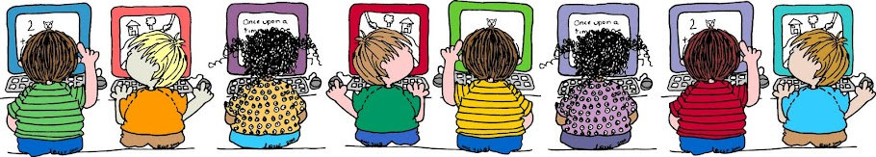



INTERIM
ASSESSMENT
Teacher Directions
Fourth Grade

Slide 2

All elementary ELA assessments were written, reviewed and revised by the following amazing and dedicated HSD K-6th grade teachers.
Reviewed and revised in June of 2015 by the following HSD K-6th grade teachers. |  | Written by the following HSD K-6th grade teachers in 2014.
Deborah Alvarado Lincoln Street | Ko Kagawa Minter Bridge | Deborah Alvarado
 |  | Tammy Cole
Linda Benson West Union | Jamie Lentz Mooberry | Carrie Ellis
 |  | Dori George
Anne Berg Eastwood | Sandra Maines Quatama | Heather Girad
 |  | Jamie Goldstein
Aliceson Brandt Eastwood | Gina McLain TOSA | Raquel Lemus
 |  | Jamie Lentz
Sharon Carlson Minter Bridge | Teresa Portinga Patterson | Alfonso Lule
 |  | Berta Lule
Deborah Deplanche Patterson | Judy Ramer Consultant | Sandra Maines
 |  | Heather McCullum
Alicia Glasscock Imlay | Sara Retzlaff McKinney | Gina McLain
 |  | Teresa Portinga
Sonja Grabel Patterson | Jami Rider Free Orchard | Judy Ramer
 |  | Irma Ramirez
Megan Harding Orenco | Kelly Rooke Free Orchards | Sara Retzlaff
 |  | Jean Summers
Renae Iversen Teacher Mentor | Angela Walsh Witch Hazel | Nikki Thoen
 |  | Maritza Dash
Ginger Jay Witch Hazel |  | Jill Russo
Performance Task Classroom Activities for K – 6 were written by Jamie Lentz, Gina McLain, Hayley Heider, Anna Wooley, Gretchen Erlandsen, Deborah Deplanche, Connie Briceno, Judy Ramer, Carrie Ellis, Sandra Maines, Renae Iversen, Anne Berg, Aliceson Brandt and Ko Kagawa. All assessments have been edited by Vicki Daniels.

Slide 3
Important Note:
The informational text “Amelia Earhart Secondhand Account excerpts from Bio.com and AmericasLibraries.com, has a grade equivalency of 5.8. while the lexile is 780.
The grade equivalent is in the middle band range for 4th – 5th grade text and at the lower band lexile level.
However, the general vocabulary of the text is simple and straightforward. The purpose of the text is clear and the structure is predictable. These qualitative measures explain why the text was posted for 4th grade.
It is the content specific vocabulary with multiple syllables, that brings this text up to a grade equivalent of 5.8 (international, America, Amelia Earhart, President Coolidge, etc.. ). Without these words the text measures closer to a grade four equivalent.
Students can understand the meaning of these words within context although they may not be able to pronounce them.
The first-hand account by Amelia Earhart is a high grade level equivalent so only one question is specifically addressed to its content that does not totally depend on readability. It does however, provide an idea for students of a first-hand account. The illustration of this account provides support for several questions.
Common Core Band | Flesch-Kincaid® | The Lexile Framework®
2nd - 3rd | 1.98 - 5.34 | 420 - 820
4th - 5rd | 4.51 - 7.73 | 740 - 1010
6th – 8th | 6.51 - 10.34 | 925 - 1185
9th – 10th | 8.32 - 12.12 | 10.50 - 1335
11th - CCR | 10.34 - 14.20 | 11.85 - 1385

Slide 4
The HSD Elementary Interim Assessment is required. Please enter the student scores into Synergy. This assessment contains 20 total questions including 18 Selected Responses and 2 Constructed Responses. Selected Responses are 1 point each and Constructed Responses are 2 points each.
Assessment Targets
DOK-2 Key Ideas – Details Standard 1 | DOK-2 Central Idea Standard 2 | DOK 3-4 Reasoning Standards 3,6 | DOK 2-3 Text Structures Standards 5,7
2 Literature SRs 2 Informational SRs | 2 Literature SRs 2 Informational SRs | 2 Literature SRs 2 Informational SRs 1 Literature CR 1 Informational CR | 3 Literature SRs 3 Informational SRs
Total: 4 | Total: 4 | Total: 6 | Total: 6
Possible Points: 4 | Possible Points: 4 | Possible Points: 8 | Possible Points: 6
Directions: Students read the passages Students answer the SR and CR Questions. *If you are not doing the performance task have students answer questions #1-20 only. If you are not doing the performance task your students will stop on the red “stop sign.” Grades K – 2 Students in kindergarten should have the passages read to them as a listening comprehension assessment. Students in grades 1 – 2 should read the passages independently if they can; however, students not reading at grade level may have the passages read to them. Grades 3 – 6 Students in grades 3 – 6 should read the passages independently unless an IEP signifies otherwise.
Grade 4
Literature Standard | St. 1 | St. 2 | St. 3 | St. 5 | St. 6 | St. 7
DOK Level | 2 | 2 | 3 | 3 | 4 | 3
Informational Standard | St. 1 | St. 2 | St. 3 | St. 5 | St. 6 | St. 7
DOK Level | 2 | 2 | 3 | 2 | 4 | 3

Slide 5
Optional
Performance Task Directions
*If you are not doing the performance task have students answer questions #1-20 only.
Important Note:
This assessment has an Optional Performance Task ( it will not be recorded in Synergy). The purpose of the Performance Task (PT) is to allow those teachers to give a PT to students, if so desired, as an instructional experience for the SBAC assessment which will include a PT.
Students should have access to spell-check resources but no grammar-check resources. Students can refer back to their passages, notes and 2 research constructed responses, as often as they’d like if they are participating in the Performance Task.
Directions for Performance Task
Part 1
1. A Classroom Activity (30 Minutes)
You may wish to have a 30 minute classroom activity. The purpose of a PT activity is to ensure that all students are familiar with the concepts of the topic and know and understand key terms (vocabulary) that are at the upper end of their grade level (words they would not normally know or are unfamiliar to their background or culture). The classroom activity DOES NOT pre-teach any of the content that will be assessed!
2. Read literary and informational passages (30 minutes)
Remind students to take notes as they read. During an actual SBAC assessment students are allowed to keep their notes as a reference in order to complete their performance task.
Answer the selected and constructed response questions.
Part 2 (after questions #1-20)
A Full-Composition (70 Minutes)
15 minute break
70 Minutes
4. Students write their full composition (informational piece).
SCORING
An Informational Rubric is provided for the performance task. Students receive three scores:
Organization and Purpose
Evidence and Elaboration
Conventions

Slide 6
Amelia Earhart Classroom Activity
This classroom pre-activity follows the Smarter Balanced Assessment Consortium general design of contextual elements, resources, learning goals, key terms and purpose [http://oaksportal.org/resources/]
The content within each of these was written by……Carrie Ellis and Judy Ramer
The Classroom Activity introduces students to the context of a performance task, so they are not disadvantaged in demonstrating the skills the task intends to assess.
Contextual elements include:
an understanding of the setting or situation in which the task is placed
potentially unfamiliar concepts that are associated with the scenario
key terms or vocabulary students will need to understand in order to meaningfully engage with and complete the performance task
The Classroom Activity is also intended to generate student interest in further exploration of the key idea(s). The Classroom Activity should be easy to implement with clear instructions.
Please read through the entire Classroom Activity before beginning the activity with students to ensure any classroom preparation can be completed in advance. Throughout the activity, it is permissible to pause and ask students if they have any questions.
Resources needed:
Video about flight in the 1930s; https://www.youtube.com/watch?v=CJX7it9f0yI
Photos of Amelia Earhart’s planes
Learning Goals:
Students will know the purpose of flight in the 1930s
Students will learn some facts about a plane in the 1930s, i.e., size, range, equipment, etc.
Students will understand the key terms:
Note: Definitions are provided here for the convenience of facilitators. Students are expected to understand these key terms in the context of the task, not memorize the definitions.
Aviation: the flying or operating of air craft.
[Purpose: The facilitator’s goal is to develop and awareness for the student about the purpose of flight during the early years of it’s development, particularly during the 1930s. Specifically students will learn what airplanes looked like at that time.

Slide 7
Amelia Earhart Classroom Activity continued…
Facilitator says:
“Today we will get ready for the “Amelia Earhart” Performance Task, which is about the early days of aviation. Let’s start by discussing what you know about the first planes that were built. Turn to a partner/discuss in your group for two minutes about what you know about those planes.” [Have paper & pencils/whiteboards available for students to record their ideas if they wish.]
Discussion question: What do you know about the first planes that were built? [write the discussion question on chart paper/board for students to refer to].
Facilitator says: “When I call on your group, I want one person to share with the class what your group discussed. I will record your responses on our chart.”
Possible student responses (unscripted):
They were small.
Not many people could fly.
It was dangerous.
The planes looked funny compared to today’s planes.
Facilitator says: “Good ideas. Let’s watch a video that shows one of these early planes. As you watch pay close attention to how this plane is different from the planes we see today.”
[video: https://www.youtube.com/watch?v=CJX7it9f0yI]
Discussion Questions:
What did you notice about the size of the plane and how many people could ride in it?
What did you notice about how the plane operated?
Did you notice anything about the pilot or the copilot that was interesting?
[2 minute discussion; share out]
Facilitator says: “Now let’s take a look at some very specific planes that a famous pilot, Amelia Earhart, flew in. Notice there are two of them. The first plane is the plane she learned to fly in the early 1920s. The second plane is the one in which she last flew in the late 1930s. With a partner, discuss how those two planes have changed during that time.”
[¹See planes in the Ancillary Materials. 2 minute discussion; share out]
Possible student responses (unscripted):
The first plane has more wings.
The pilot seat in the first one is open to the air and the second one is closed up.
Both are climbing into the airplane through the top.
The second plane has two propellers and the first one has only one.
*Facilitators can decide whether they want to display ancillary materials using an overhead projector or computer/Smartboard, or whether they want to produce them as a handout for students.

Slide 8
Amelia Earhart Classroom Activity continued…
Facilitator says: “With your partner, discuss what these planes might have been used for.”
[two minute discussion; share out]
Possible student responses (unscripted):
To see how far they could fly.
To be a pilot in the war.
To put out a fire.
[Make sure that they are aware that these were planes that were early in the development of aviation. Point out how much had changed in that 10+ year period, much like computers change rapidly. Also, point out that the main purpose of planes at that time was for: military use, long distance travel for the rich and powerful, development of new flight technology, and setting distance records.]
Facilitator says: “In your performance task, you will be learning more about ….
The group work you did today should help prepare you for the research and writing you will be doing in the performance task.”
Note: Facilitator should collect student notes from this activity.

Slide 9
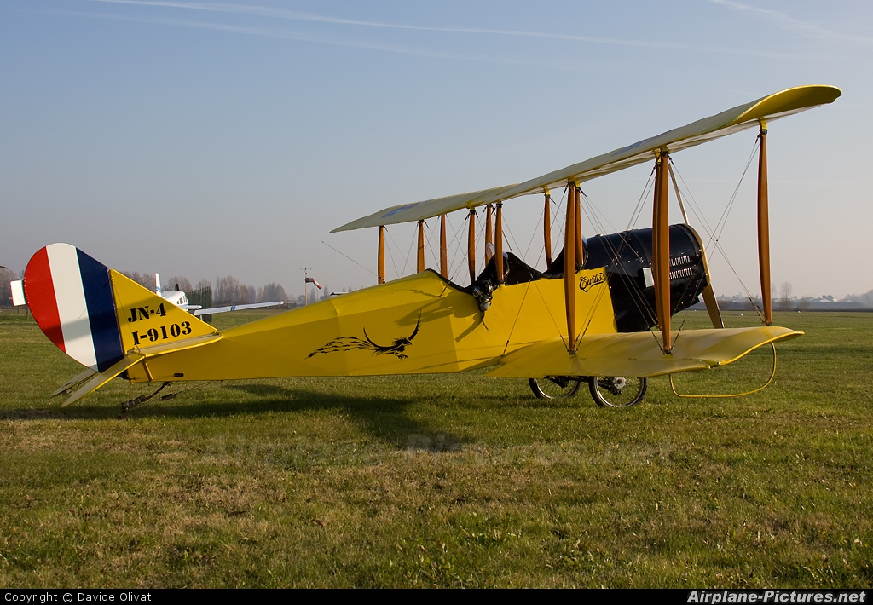
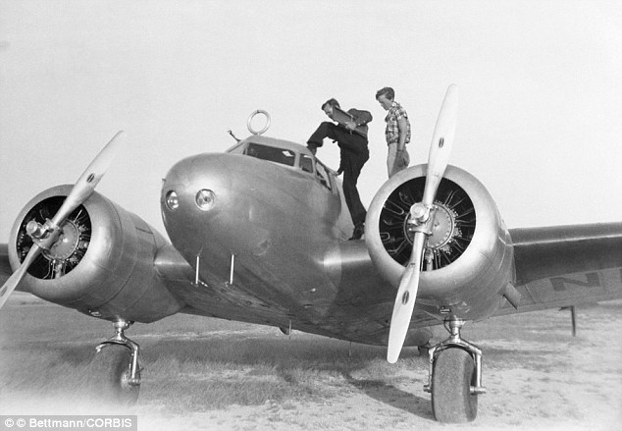
Ancillary Materials
Video on flight in the 1930s: https://www.youtube.com/watch?v=CJX7it9f0yI

Slide 10
Grades 3 - 5: Generic 4-Point Informational/Explanatory Writing Rubric Performance Task
Score | Statement of Purpose/Focus and Organization |  | Development: Language and Elaboration of Evidence |  | Conventions
 | Statement of Purpose/Focus | Organization | Elaboration of Evidence | Language and Vocabulary
4 Exemplary | The response is fully sustained and consistently and purposefully focused: controlling idea or main idea of a topic is focused, clearly stated, and strongly maintained. controlling idea or main idea of a topic is introduced and communicated clearly within the context . | The response has a clear and effective organizational structure creating unity and completeness: use of a variety of transitional strategies logical progression of ideas from beginning to end. effective introduction and conclusion for audience and purpose. | The response provides thorough and convincing support/evidence for the controlling idea or main idea that includes the effective use of sources, facts, and details: use of evidence from sources is smoothly integrated comprehensive, and relevant . effective use of a variety of elaborative techniques . | The response clearly and effectively expresses ideas, using precise language: use of academic and domain-specific vocabulary is clearly appropriate for the audience and purpose. | The response demonstrates a strong command of conventions: few, if any, errors are present in usage and sentence formation. effective and consistent use of punctuation, capitalization, and spelling.
3 Proficient | The response is adequately sustained and generally focused: focus is clear and for the most part maintained, though some loosely related material may be present. some context for the controlling idea or main idea of the topic is adequate. | The response has an evident organizational structure and a sense of completeness, though there may be minor flaws and some ideas may be loosely connected: adequate use of transitional strategies with some variety adequate progression of ideas from beginning to end. adequate introduction and conclusion | The response provides adequate support/evidence for the controlling idea or main idea that includes the use of sources, facts, and details: some evidence from sources is integrated, though citations may be general or imprecise . adequate use of some elaborative techniques . | The response adequately expresses ideas, employing a mix of precise with more general language. Use of domain-specific vocabulary is generally appropriate for the audience and purpose. | The response demonstrates an adequate command of conventions: some errors in usage and sentence formation may be present, but no systematic pattern of errors is displayed. adequate use of punctuation, capitalization, and spelling.
2 Developing | The response is somewhat sustained and may have a minor drift in focus: may be clearly focused on the controlling or main idea, but is insufficiently sustained. controlling idea or main idea may be unclear and somewhat unfocused . | The response has an inconsistent organizational structure, and flaws are evident: inconsistent use of transitional strategies with little variety uneven progression of ideas from beginning to end. conclusion and introduction, if present, are weak. | The response provides uneven, cursory support/evidence for the controlling idea or main idea that includes partial or uneven use of sources, facts, and details: evidence from sources is weakly integrated, and citations, if present, are uneven. weak or uneven use of elaborative techniques | The response expresses ideas unevenly, using simplistic language: use of domain-specific vocabulary that may at times be inappropriate for the audience and purpose. | The response demonstrates a partial command of conventions: frequent errors in usage may obscure meaning. inconsistent use of punctuation, capitalization, and spelling.
1 Emerging | The response may be related to the topic but may provide little or no focus: may be very brief may have a major drift focus. may be confusing or ambiguous . | The response has little or no discernible organizational structure: few or no transitional strategies are evident . frequent extraneous ideas may intrude . | The response provides minimal support/evidence for the controlling idea or main idea that includes little or no use of sources, facts, and details: use of evidence from the source material is minimal, absent, in error, or irrelevant . | The response expression of ideas is vague, lacks clarity, or is confusing: uses limited language or domain-specific vocabulary. may have little sense of audience and purpose . | The response demonstrates a lack of command of conventions: errors are frequent and severe. meaning is often obscure.
0 | A response gets no credit if it provides no evidence of the ability to [fill in with key language from the intended target].

Slide 11
Interim Research Constructed Response Answer Key
Constructed Response Research Rubrics Target 3 evidence of the ability to distinguish relevant from irrelevant information such as fact from opinion
Question #10 RL.4.6 (Prompt): Kurt is writing a letter to his friends about the experience of going through an airport for the first time. Pretend you are Kurt and write the letter.
Teacher /Rubric “Language Response”
The response gives sufficient evidence of the ability to distinguish relevant from irrelevant information about Kurt’s experience of going through an airport for the first time. Student responses should be given in the first person, using pronouns such as I, you, we, etc. Students will give a narration of only the events of going through the airport (not being on the airplane, etc…). Details should be explicitly from the text (text-dependent) and not from personal experience.
Student “Language” Response Example
2 | The response gives sufficient evidence of the ability to distinguish information relevant to the prompt and the experiences of going through an airport for the first time explicitly from the passage. It seemed like it took us forever to get to the airport today because every car got in our way! I helped my mom get the bags from the car because, as usual, Joachim wouldn’t put his phone down. I was surprised by how big the airport is. There were people rushing everywhere and I could just imagine all of the exciting places they were travelling to. When we finally got to the counter, a nice lady took our passports and I helped her with the bags. She was really glad because they were heavy! When we took our tickets, we had to go through the security machines, just like you see on T.V. At first, I was worried because the old lady in front of me got beeped and had to go back. When I went through though, nothing happened and I got to go straight to get my bag. Going through an airport for the first time was exciting and also confusing but I did it!
1 | The response gives limited evidence of the ability to distinguish information relevant to the prompt and the experiences of going through an airport for the first time explicitly from the passage. Today I got to ride on an airplane for the first time. It took a long time to get to the airport. We checked in our bags and went through the security machine. Kurt didn’t get beeped and he got to go get his bags. We finally got through and could now wait for our plane.
0 | The response does not show the ability to distinguish information relevant to the prompt . Kurt got to ride on an airplane. He was excited.
Standard RL.4.6
Compare and contrast the point of view from which different stories are narrated, including the difference between first- and third-person narrations.

Slide 12
Interim Research Constructed Response Answer Key
Constructed Response Research Rubrics Target 4 ability to cite evidence to support opinions and/or ideas
Question # 20 RI.4.6 (Prompt): After reading the information from both the first and second-hand accounts, what character traits did Amelia have that helped her to be a successful pilot? Use examples from both passages to support your answer.
Teacher /Rubric “Language Response”
The response gives sufficient evidence of the ability to cite evidence to support the student’s response to the prompt of “what character traits Amelia have that helped her to be a successful pilot…?” Students should mention the specific character traits inferred from both passages that they feel support why she was a successful pilot. From the passage Amelia Earhart, the specific traits could include (1) she was determined to fly, (2) she was motivated enough to take flying lessons, (3) she borrowed money to buy a plane – showing she followed through on her plans, (4) she got her flying license which took practice and skill, (5) she was consistent – she kept setting records and had many aviation achievements and (6) she did things she didn’t always like to do but felt she should do – doing the “right thing,” (like flying as a passenger instead of as a pilot across the Atlantic). In the passage Amelia Earhart’s Interview character traits could include (1) Amelia was willing to share her experiences with others – thoughtful, (2) Amelia showed bravery in her experience of flying her first Atlantic flight. Other character traits inferred are acceptable if there are details or examples to support them.
Student “Language” Response Example
2 | Student response shows the ability to cite sufficient evidence from both texts, in order to support an opinion of which character traits Earhart had that helped her to become a successful pilot. Amelia Earhart was a great pilot. She was one of the first women pilots to have an international pilot’s license! How did she become such a great pilot? Character Traits! In the passage Amelia Earhart she showed certain traits from the beginning of her journey of becoming a successful pilot. First, she was determined to fly, take flying lessons and even buying her own plane. That determination helped her to never quit! Next, she kept trying and trying. Her consistent efforts paid off. She kept breaking aviation records throughout her career. In Amelia Earhart’s Interview, she showed consideration of others who wanted to know her story. More than anything I think the interview just showed once again the character trait of bravery. When her plane had engine trouble she stayed calm and brave until she found a place to land. You have to have a “cool head,” to stay calm in emergencies. Another great trait!
1 | Student response shows the some ability to cite limited evidence from both texts, in order to partially support an opinion of which character traits Earhart had that helped her to become a successful pilot. Amelia Earhart was a successful pilot because she had good character. That means she was strong and brave. It took courage to fly like she did especially since women didn’t fly much long ago. Those are important character traits.
0 | Student response does not show the ability to cite sufficient evidence from both texts, in order to support an opinion of which character traits Earhart had that helped her to become a successful pilot. Character means you do the right thing. Good character is important for everyone especially pilots.
Standard RI.4.6
Compare and contrast a firsthand and secondhand account of the same event or topic; describe the differences in focus and the information provided.

Slide 13
2014-2015 Interim Assessment Selected Response Answer Key
Question 1 Which detail from the text best supports the idea that Kurt was excited to fly for the first time? RL.4.1 | A
Question 2 What is the main idea of the text Up in the Air? RL.4.1 | C
Question 3 One theme from the story Up in the Air is that doing something for the first time can help you grow as a person. Select the 2 facts from the text that support this theme. RL.4.2 | A,D
Question 4 Which event could you leave out if you were summarizing the text? RL.4.2 | D
Question 5 Which two details support the idea that Kurt is helpful? RL.4.3 (BOTH MUST BE CORRECT) | A,C
Question 6 Imagine that the story Up in the Air was written as a drama, instead of prose. What is an example of a structural element that would not occur in both types of writing? RL.4.5 | B
Question 7 Which two quotes from the story Up in the Air give evidence that the story is a third person narration? RL.4.6 (BOTH MUST BE CORRECT) | A,B
Question 8 Which photograph best illustrates the scene Kurt experiences as he first enters the airport? RL.4.7 | C
Question 9 Which statement below best explains why you selected the photograph in question #8? RL.4.7 | B
Question 10 Constructed Response | RL.4.6
Question 11 When did Amelia Earhart first know that she wanted to be a pilot? RI.4.1 | B
Question 12 What was one of the first indicators that Amelia would be a success as a pilot? RI.4.1 | A
Question 13 Which of these would be an appropriate addition to paragraph 3 of the passage Amelia Earhart? RI.4.2 | B
Question 14 Which statement best summarizes the account of the passage Amelia Earhart ? RI.4.2 | A
Question 15 Why was receiving an international pilot’s license considered a major event for Amelia? RI.4.3 | C
Question 16 Which structure did the author use to organize the passage Amelia Earhart? RI.4.5 | A
Question 17 Why would a reader want to read Amelia Earhart’s Interview instead of Amelia Earhart ? RI.4.6 | A
Question 18 Based on the map, what was Amelia probably trying to accomplish on her final flight? RI.4.7 | C
Question 19 According to the map, how did Amelia’s flights change over time? RI.4.7 | D
Question 20 Constructed Response | RI.4.6

Slide 14

INTERIM
ASSESSMENT
Name______________________________

Slide 15
Grade Equivalent: 4.4
Lexile Measure: 710L
Mean Sentence Length: 12.21
Mean Log Word Frequency: 3.81
Word Count: 647
Up in the Air
Readworks.org
Kurt closed the door of his mother’s car. He was happy! Today was the day he was going to be on a plane. For the first time in his life, he was going to soar through the skies and see the clouds from high above. He had imagined this since he was little.
“Are you excited my boy?” said Kurt’s mother, Val, from the front of the car.
“I can’t believe today’s the day!” said Kurt.
“Believe it!” said Kurt’s older brother Joachim as he lifted his head from his phone for just a second to speak to Kurt.
The car ride felt like forever. Kurt could not wait to get to the airport and begin the adventure. It felt like they were stuck in traffic for hours. Kurt felt like all the cars were moving slowly just to drive him crazy. But really they arrived at the airport in just a few minutes.
Val parked their car in the under-ground parking lot. She found a cart to load the suitcases and her hatbox she always took with her on a trip. Joachim never helped with anything, so Kurt knew he was the best man for the job. He helped his mother load the cart and pushed it towards the airport proudly. It was bigger than Kurt thought it would be. It was a huge building filled with hundreds of people looking around and rushing to get to where they were going. He felt a rush of energy as he walked towards the check-in desk.
He watched as Val took out their passports and gave them to the kind lady on the other side of the desk. His mother asked Joachim to help lift the bags onto the scale so that they could get checked in. But he wasn’t listening. Kurt gloated as he lifted the bags and put them on the scale. The check-in lady was thankful for his help. He loved the feeling.
Val was handed some tickets. Then off they went to security. After what felt like a long wait in line, the security officer asked Kurt to empty his pockets and put his bag through the big X-ray scanner. Kurt had never done this before and felt a little nervous. It was such a big and scary machine. It started beeping loudly when a woman in front of him walked through.

Slide 16
Up in the Air continued…
Kurt was less afraid now as he walked through the machine. Not a beep. He waited for his family to come through security as he grabbed his bag. Then, he saw the plane through the massive glass windows. It was huge! And it looked much bigger than what it looked like in his dreams.
Kurt ran down the ramp towards the gate. After a few minutes, the plane was ready for boarding. Everyone lined up and showed their tickets. Walking on a ramp down towards the plane, Kurt nearly tripped from all the excitement. And then he arrived, he was one foot away from the plane, and feeling like a grown-up who would fly all over the globe.
The air steward took his ticket and showed him to his seat. Kurt ran ahead of his mother and brother and quickly sat down in his seat, buckling his seat belt. With his eyes on the wing of the plane, he was waiting for everyone to sit down. He wanted to know what it felt like when a plane takes off.
The plane started to move, and reversed a little. Moving like a giant metal bird, the plane taxied towards the runway. Kurt clenched his mother’s hand. The plane started to speed up, faster than Kurt had ever gone in his life in any car or boat. And then, as if by magic, the plane lifted off the ground. And Kurt knew this would be the first of many adventures that started this way.

Slide 17
1. Which detail from the text best supports the idea that Kurt was excited to fly for the first time?
“I can’t believe today’s the day!”, said Kurt.
They arrived at the airport in just a few minutes.
The airport was a huge building filled with hundreds of people.
Kurt gloated as he lifted the bags and put them on the scale.
Standard RL.4.1
Refer to details and examples in a text when explaining what the text says explicitly and when drawing inferences from the text.
What is the main idea of the text Up in the Air?
It is exciting to go to an airport.
Kurt is a helpful person.
Kurt is excited about his first airplane flight.
There are many things you have to do before boarding an airplane.

Slide 18
3. One theme from the text Up in the Air is that doing something for the first time can help you grow as a person. Select the 2 facts from the text that support this theme.
Joachim never helped with anything, so Kurt knew he was the best man for the job.
Kurt gloated as he lifted the bags and put them on the scale.
He felt the rush of energy as he walked towards the check-in desk.
Kurt started to feel more confident now as he walked
through the machine.
Standard RL.4.2
Determine a theme of a story, drama, or poem from details in the text; summarize the text.
Which event could you leave out if you were summarizing the text?
Kurt couldn’t wait to get to the airport and take his
first trip on a plane.
Kurt helped his mother with checking in, because his brother never helped.
Kurt felt nervous about passing through the security checkpoint, but everything went fine.
Kurt waited for his family to come through security as he grabbed his bag.

Slide 19
5. Which two details support the idea that Kurt is helpful?
Kurt loaded the cart for his mom and pushed it towards the building.
Kurt emptied his pockets and put his bag through the big X-ray scanner.
Kurt lifted the bags and put them on the scale.
Kurt sat down in his seat and buckled his seatbelt.
Standard RL.4.3
Describe in depth a character, setting, or event in a story or drama, drawing on specific details in the text (e.g., a character's thoughts, words, or actions).
Imagine that the story Up in the Air was written as a drama, instead of prose. What is an example of a structural element that would not occur in both types of writing?
characters
stage directions
dialogue
setting
Standard RL.4.5
Explain major differences between poems, drama, and prose, and refer to the structural elements of poems (e.g., verse, rhythm, meter) and drama (e.g., casts of characters, settings, descriptions, dialogue, stage directions) when writing or speaking about a text

Slide 20
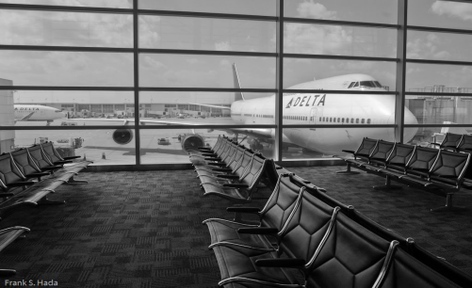
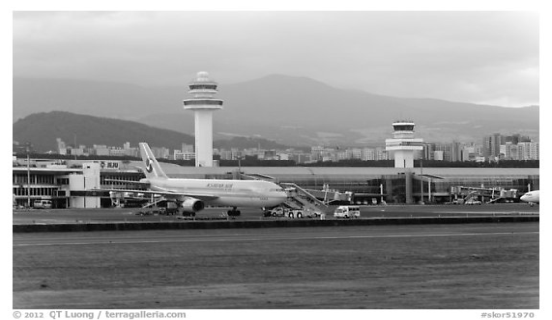
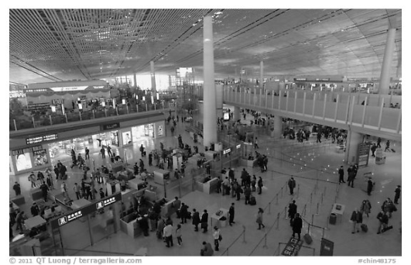
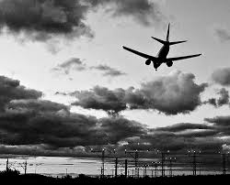
7. Which sentences from the story Up in the Air give evidence that the story is a third person narration?
“I can’t believe that today’s the day!” said Kurt.
He immediately felt the rush of energy as he walked towards the check-in desk.
It was a huge building filled with hundreds of people looking around and rushing to get to where they were going.
The plane started to move, and reversed slightly.
Standard RL.4.6
Compare and contrast the point of view from which different stories are narrated, including the difference between first- and third-person narrations.
Which photograph best illustrates the scene Kurt experiences as he first enters the airport?
A.
B.
C.
D.
Standard RL.4.7
Make connections between the text of a story or drama and a visual or oral presentation of the text, identifying where each version reflects specific descriptions and directions in the text.

Slide 21
9. Which statement below best explains why you selected the photograph in question number 8?
Kurt was going to soar through the skies and see the clouds.
The airport was massive and filled with hundreds of people.
When Kurt saw the plane, it was much bigger than how it looked in his dreams.
As if by magic, the plane lifted off the ground.
Standard RL.4.7
Make connections between the text of a story or drama and a visual or oral presentation of the text, identifying where each version reflects specific descriptions and directions in the text.
10. Kurt is writing a letter to his friends about the experience of going through an airport for the first time. Pretend you are Kurt and write the letter.
Standard RL.4.6
Compare and contrast the point of view from which different stories are narrated, including the difference between first- and third-person narrations.

Slide 22
Amelia Earhart
Secondhand Account
excerpts from Bio.com and AmericasLibraries.com
Amelia Earhart Learns to Fly
Amelia Earhart was born in Kansas, on July 24, 1897. In those days, airplanes were not as common as they are today.
Earhart was twelve years old when she first saw an airplane. She did not go on her first flight until 1920.
Earhart was so thrilled by her first airplane ride that she soon began to take flying lessons. She wrote, "As soon as I left the ground, I knew I had to fly."
Earhart was a great pilot. Her first teacher was Neta Snook. She was one of the first women to go to a pilot school.
Earhart’ mother loaned her money to buy a two-seat plane. She got her flying license in December 1921. By October 1922, she set a new women’s record for flying the highest at 14,000 feet.
In 1923, Earhart received her international pilot's license. She was only the 16th woman to do so. At the same time, she was becoming famous for her flying feats.
Amelia Earhart Flies Across the Atlantic
In 1928, Amelia Earhart got a phone call that would change her life. She was asked to become the first woman passenger to cross the Atlantic Ocean in a plane.
But, she would not be the pilot. "The idea of just going as 'extra weight' did not appeal to me at all," she said, but she went anyway.
On June 17, after a few delays due to bad weather, Amelia Earhart flew in a plane named Friendship. She flew with co-pilots Bill Stultz and Louis Gorden. The plane landed in South Wales, with just a little fuel left.
Earhart's first trip across the Atlantic took more than 20 hours! After that flight Earhart became famous. After the trip, she was given parties and even a parade in New York City.
President Coolidge even called to praise her on crossing the Atlantic. Because Earhart made many flying records and looked like the famous pilot Charles Lindbergh, she earned the nickname "Lady Lindy”.
Earhart wrote a book about her first flight across the Atlantic, called 20 Hrs., 40 Min. She kept breaking records. She became a good speaker and writer, and told women they could become pilots too.
Grade Level: 5.9
Lexile Measure 780L
Mean Sentence Length 12.30
Mean Log Word Frequency 3.65 Word Count 369

Slide 23
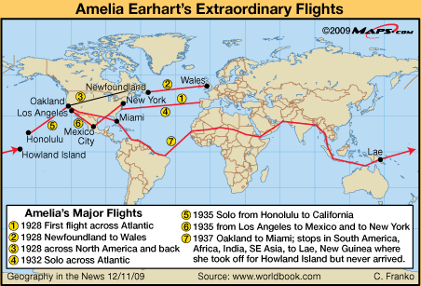
Grade Level: 6.8
Lexile Measure: 1010L
Mean Sentence Length: 17.31
Mean Log Word Frequency: 3.70
Word Count: 225
Amelia Earhart’s Interview
Firsthand hand Account
This passage is part of an interview that Amelia Earhart gave after her first Atlantic flight in 1932.
“Well, I’ll try to give you some of the highlights of the trip if you wish.
“I took off from the famous Harbor Grace runway at dusk at about 7:30 I believe. I flew for a couple of hours while sunset lasted and then two more hours as the moon came up over a bank of clouds. I had fair weather for 4 hours.
Then I ran into a storm, which was one of the most severe I had ever been in. I [wandered] around in the storm for probably an hour and, with difficulty, kept my course. I had been troubled with my [part of the engine] burning through all night. A weld broke shortly after I left Harbor Grace and I could see the damage increasing as the night wore on.
I found thunderstorms probably three or four hundred miles off the coast of Ireland. I believe I saw land and I decided to come down …in the best available pasture. I got down without any trouble and [drove the plane] to the front door of a surprised farmer’s cottage. After receiving a real Irish welcome, I took a plane to London and there received a real English welcome.”

Slide 24
When did Amelia Earhart first know that she wanted to be a pilot?
before she was 12 years old
after her first airplane ride
when she first saw an airplane
when she was invited to cross the Atlantic Ocean
Standard RI.4.1
Refer to details and examples in a text when explaining what the text says explicitly and when drawing inferences from the text.
12. What was one of the first indicators that Amelia would be a success as a pilot?
In 1922 she set an altitude record.
She got her flying license in 1921.
She bought a two seat plane.
She flew in a plane named Friendship.

Slide 25
13. Which of these would be an appropriate addition to paragraph 3 of the passage Amelia Earhart?
  Amelia Earhart was excited to be the first woman passenger to cross the Atlantic in a plane.
  Amelia would rather fly the plane herself than just being “added weight”.
  Many people congratulated Amelia for being the first woman passenger to cross the Atlantic in a plane.
  Amelia was surprised to land in a farmer’s pasture.
Standard RI.4.2
Determine the main idea of a text and explain how it is supported by key details; summarize the text.
14. Which statement best summarizes the account of the passage Amelia Earhart ?
  Amelia Earhart excelled as a pilot and had many flying achievements.
  Amelia Earhart was the 16th woman to gain an international pilot’s license.
  Amelia Earhart told other women they could be pilots too.
  Amelia Earhart was 12 when she saw her first plane.

Slide 26
15. Why was receiving an international pilot’s license considered a major event for Amelia?
Very few people had international pilot’s licenses.
It meant Amelia could fly across the ocean.
Amelia was only the 16th woman to do so.
Amelia needed a license to fly.
Standard RI.4.3
Explain events, procedures, ideas, or concepts in a historical, scientific, or technical text, including what happened and why, based on specific information in the text
16. Which structure did the author use to organize the passage Amelia Earhart?
  chronology
  comparison
  cause and effect
  problem and solution
Standard RI.4.5
Describe the overall structure (e.g., chronology, comparison, cause/effect, problem/solution) of events, ideas, concepts, or information in a text or part of a text.

Slide 27
17. Why would a reader want to read Amelia Earhart’s Interview
instead of Amelia Earhart ?
Readers may want to hear Earhart tell about an experience from her perspective.
Readers may want a neutral point of view when learning about Earhart.
Readers may want a very brief account of Earhart’s experiences.
Readers may want to learn about Earhart’s life.
Standard RI.4.6
Compare and contrast a firsthand and secondhand account of the same event or topic; describe the differences in focus and the information provided.
18. Based on the map, what was Amelia probably trying to accomplish on her final flight?
Amelia was attempting to fly to 3 different continents in one trip.
Amelia was trying to make the longest flight without stopping.
Amelia was attempting to circle the globe.
Amelia wanted to fly to every country.
Standard RI.4.7
Interpret information presented visually, orally, or quantitatively (e.g., in charts, graphs, diagrams, time lines, animations, or interactive elements on Web pages) and explain how the information contributes to an understanding of the text in which it appears.

Slide 28
According to the map, how did Amelia’s flights change over time?
Amelia set an altitude record in 1922.
After setting an altitude record she received an international pilots license.
She was the first woman passenger to cross the Atlantic.
With most flights the distance traveled increased.
Standard RI.4.7
Interpret information presented visually, orally, or quantitatively (e.g., in charts, graphs, diagrams, time lines, animations, or interactive elements on Web pages) and explain how the information contributes to an understanding of the text in which it appears.
20. After reading the information from both the first and second-hand accounts, what character traits did Amelia have that helped her to be a successful pilot? Use examples from both passages to support your answer.
Standard RI.4.6
Compare and contrast a firsthand and secondhand account of the same event or topic; describe the differences in focus and the information provided.

Slide 29

STOP
Close your books and wait for instructions!

Slide 30
Part 2
Performance Task
You will:
Plan your writing. You may use your notes and answers. You may use a graphic organizer.
Write – Revise and Edit your first draft (your teacher will give you paper).
3. Your assignment: Part 2
Your class has been asked to write informational articles explaining what it is like to fly on a plane as a passenger and what is it like to fly a plane as a pilot.
You will write an informational article comparing the differences between being a passenger and a pilot. Your article will be read by students, teachers and parents.
Use your own words except when quoting directly from the sources. Your article should give the readers an understanding of what it would be like to be a passenger on a plane and a pilot of a plane.
How your report will be scored:
1. Statement of Purpose/Focus—how well you clearly state and maintain your controlling idea or main idea.
2. Organization – how well the ideas progress from the introduction to the conclusion using effective transitions and how well you stay on topic throughout .
3. Elaboration of Evidence – how well you provide evidence from sources about your topic and elaborate with specific information.
4. Language and Vocabulary – how well you effectively express ideas using precise language that is appropriate for your audience and purpose.
5. Conventions – how well you follow the rules of usage, punctuation, capitalization, and spelling.

