Slide 1
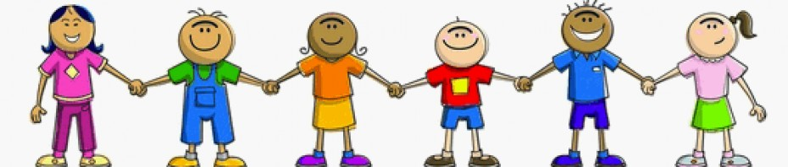



INTERIM ASSESSMENT
Teacher Directions
First Grade

Slide 2

All elementary ELA assessments were written, reviewed and revised by the following amazing and dedicated HSD K-6th grade teachers.
Reviewed and revised in June of 2015 by the following HSD K-6th grade teachers. |  | Written by the following HSD K-6th grade teachers in 2014.
Deborah Alvarado Lincoln Street | Ko Kagawa Minter Bridge | Deborah Alvarado
 |  | Tammy Cole
Linda Benson West Union | Jamie Lentz Mooberry | Carrie Ellis
 |  | Dori George
Anne Berg Eastwood | Sandra Maines Quatama | Heather Girad
 |  | Jamie Goldstein
Aliceson Brandt Eastwood | Gina McLain TOSA | Raquel Lemus
 |  | Jamie Lentz
Sharon Carlson Minter Bridge | Teresa Portinga Patterson | Alfonso Lule
 |  | Berta Lule
Deborah Deplanche Patterson | Judy Ramer Consultant | Sandra Maines
 |  | Heather McCullum
Alicia Glasscock Imlay | Sara Retzlaff McKinney | Gina McLain
 |  | Teresa Portinga
Sonja Grabel Patterson | Jami Rider Free Orchard | Judy Ramer
 |  | Irma Ramirez
Megan Harding Orenco | Kelly Rooke Free Orchards | Sara Retzlaff
 |  | Jean Summers
Renae Iversen Teacher Mentor | Angela Walsh Witch Hazel | Nikki Thoen
 |  | Maritza Dash
Ginger Jay Witch Hazel |  | Jill Russo
Performance Task Classroom Activities for K – 6 were written by Jamie Lentz, Gina McLain, Hayley Heider, Anna Wooley, Gretchen Erlandsen, Deborah Deplanche, Connie Briceno, Judy Ramer, Carrie Ellis, Sandra Maines, Renae Iversen, Anne Berg, Aliceson Brandt and Ko Kagawa. All assessments have been edited by Vicki Daniels.

Slide 3
The HSD Elementary Interim Assessment is required. Please enter the student scores into Synergy. This assessment contains 20 total questions including 18 Selected Responses and 2 Constructed Responses. Selected Responses are 1 point each and Constructed Responses are 2 points each.
Assessment Targets
DOK-2 Key Ideas – Details Standard 1 | DOK-2 Central Idea Standard 2 | DOK 3-4 Reasoning Standards 3,6 | DOK 2-3 Text Structures Standards 5,7
2 Literature SRs 2 Informational SRs | 2 Literature SRs 2 Informational SRs | 2 Literature SRs 2 Informational SRs 1 Literature CR 1 Informational CR | 3 Literature SRs 3 Informational SRs
Total: 4 | Total: 4 | Total: 6 | Total: 6
Possible Points: 4 | Possible Points: 4 | Possible Points: 8 | Possible Points: 6
Directions: Students read the texts Students answer the SR and CR Questions. *If you are not doing the performance task have students answer questions #1-20 only. If you are not doing the performance task your students will stop on the red “stop sign.” Grades K – 2 Students in kindergarten should have the texts read to them as a listening comprehension assessment. Students in grades 1 – 2 should read the texts independently if they can; however, students not reading at grade level may have the texts read to them. Grades 3 – 6 Students in grades 3 – 6 should read the texts independently unless an IEP signifies otherwise.
Grade 1
Literature Standard | St. 1 | St. 2 | St. 3 | St. 5 | St. 6 | St. 7
DOK Level | 2 | 2 | 3 | 3 | 3 | 2
Informational Standard | St. 1 | St. 2 | St. 3 | St. 5 | St. 6 | St. 7
DOK Level | 2 | 2 | 3 | 2 | 3 | 2

Slide 4
Optional
Performance Task Directions
*If you are not doing the performance task have students answer questions #1-20 only.
Important Note:
This assessment has an Optional Performance Task ( it will not be recorded into Synergy). The purpose of the Performance Task (PT) is to allow those teachers to give a PT to students, if so desired, as an instructional experience for the SBAC assessment which will include a PT.
Students should have access to spell-check resources but no grammar-check resources. Students can refer back to their texts, notes and 2 research constructed responses, as often as they’d like if they are participating in the Performance Task.
Directions for Performance Task please do Part 1 before beginning the assessment.
Part 1
1. A Classroom Activity (30 Minutes)
You may wish to have a 30 minute classroom activity. The purpose of a PT activity is to ensure that all students are familiar with the concepts of the topic and know and understand key terms (vocabulary) that are at the upper end of their grade level (words they would not normally know or are unfamiliar with due to their background or culture). The classroom activity DOES NOT pre-teach any of the content that will be assessed! Skills your students need to have:
You may also want to give background information on what a map is and how to create one.
Looking at pictures and text for different kinds of information.
Writing only from text-based details (not experiences).
2. Read literary and informational texts (30 minutes)
Remind students to take notes as they read. During an actual SBAC assessment students are allowed to keep their notes as a reference in order to complete their performance task.
Answer the selected and constructed response questions.
Part 2 (after questions #1-20)
A Full-Composition (70 Minutes)
15 minute break
70 Minutes
4. Students write their full composition (informational piece).
SCORING
An Informational Rubric is provided for the performance task. Students receive three scores:
Organization and Purpose
Evidence and Elaboration
Conventions

Slide 5
Key Details Performance Task Classroom Activity
This classroom pre-activity follows the Smarter Balanced Assessment Consortium general design of contextual elements, resources, learning goals, key terms and purpose [http://oaksportal.org/resources/]
The classroom activity was written by Jamie Lentz.
The Classroom Activity introduces students to the context of a performance task, so they are not disadvantaged in demonstrating the skills the task intends to assess.
Contextual elements include:
an understanding of the setting or situation in which the task is placed
potentially unfamiliar concepts that are associated with the scenario
key terms or vocabulary students will need to understand in order to meaningfully engage with and complete the performance task
The Classroom Activity is also intended to generate student interest in further exploration of the key idea(s). The Classroom Activity should be easy to implement with clear instructions.
Please read through the entire Classroom Activity before beginning the activity with students to ensure any classroom preparation can be completed in advance. Throughout the activity, it is permissible to pause and ask students if they have any questions.
Resources needed:
1 color copy of pictures 1-3 from the ancillary materials (these will be posted on chart paper)
1 large piece of chart paper
Black marker (for recording student responses on chart paper)
Tape
Learning Goals:
Students will understand the context of the key concepts related to the topic:
adding key details from the text
Students will understand the key terms:
Note: Definitions are provided here for the convenience of facilitators. Students are expected to understand these key terms in the context of the task, not memorize the definitions.
Details- small pieces of information
Key details from the text- important pieces of information from the text that need to be in our writing
[Purpose: The facilitator’s goal is to help students understand that key details need to be included when summarizing/retelling a story.]
*Facilitators can decide whether they want to display ancillary materials using an overhead projector or computer/Smartboard, or whether they want to produce them as a handout for students.

Slide 6
Key Details Classroom Activity
Discussion question:
What are key details?
Why do we need key details?
What key details match this illustration?
Facilitator says: “Today we will be getting ready for the Zoo Lion Performance Task. We are going to talk about key details. What are key details? Think about what key details are and then we will share with our partners. (Model your classroom “think” signal/cue and then signal them to begin sharing with their partners). Key details are…”
Possible student responses (unscripted):
They’re like the keys that go in the door
Parts of the story
Maybe a tail that looks like a key
Facilitator says: “Ok let’s see what you and your partner came up with. What are key details _______? (Call on a few students to share. If the correct answer is given move to the next facilitator prompt. If the correct answer is not given continue here.) “You have some great ideas! Details are small pieces of information from the text, and key details are important pieces of information from the text that need to be in our writing about the story.”
Facilitator says: “Ok, it’s time to get key details stuck in our brains, are you ready? Repeat after me… key details (make motion of turning a key) are important pieces of information (make “muscle arms” motion) that need to be in our writing (make writing motion). Wow, nice work! Let’s do it again in a whisper voice (repeat several times using different voices to keep students engaged).”
Facilitator says: “Now we’re going to practice writing key details, who remembers our story about Sammy the dog? (Show students pictures 1-3 from ancillary materials, one at a time as you share the story). “One day Sammy the dog was walking across the backyard. Sammy was happy because he liked being outside in the sun. All of a sudden Sammy slipped and fell into a huge hole! The hole was muddy and slimy. Sammy barked as loud as he could and eventually Marvin, his owner, came and pulled him out. Marvin gave Sammy a hug. He was glad that Sammy was ok! Turn to your partner and share the key details, or the important pieces of information that need to be in our writing. The key details are…”
Possible student responses (unscripted):
Sammy was walking in the backyard
Sammy was happy because it was sunny
Marvin hugged Sammy
The hole was muddy and slimy
Marvin pulled Sammy out of the hole
Facilitator needs to post the three story pictures in a vertical line on the chart paper, leaving space to record student responses to the left of each picture.

Slide 7
Facilitator says: “Let’s see what key details you and your partner came up with. ______ what key details did you and your partner discuss? (Record student’s answers on the chart paper next to the appropriate picture. Prompt students to give you additional information and/or go back to the text if students need additional support in identifying key details from the text for each illustration. Continue calling on students as need to complete the chart).”
Possibly student responses (unscripted):
Sammy was walking in the backyard
Sammy was happy
Sammy fell in the hole
The hole was muddy and slimy
Sammy barked loud so Marvin would come
Marvin pulled Sammy out of the hole
Marvin hugged Sammy
Facilitator says: “In your performance task, you will be learning more about writing key details about a text. The partner work you did today should help prepare you for the research and writing you will be doing in the performance task.”
Note: Facilitator should collect student notes from this activity.

Slide 8
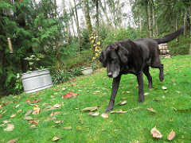
Ancillary Materials
Picture 1

Slide 9
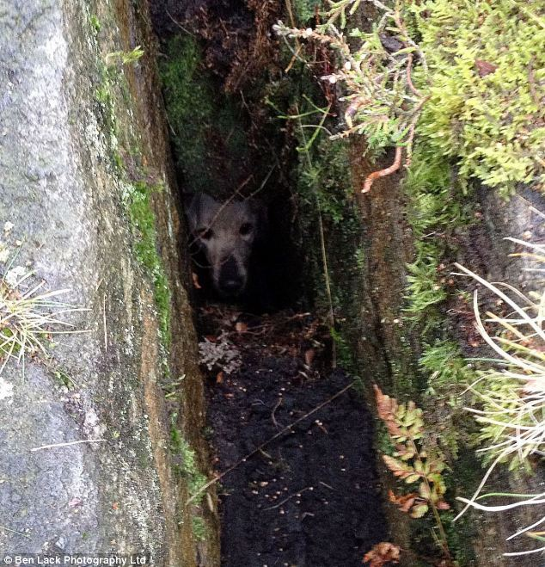
Ancillary Materials
Picture 2

Slide 10
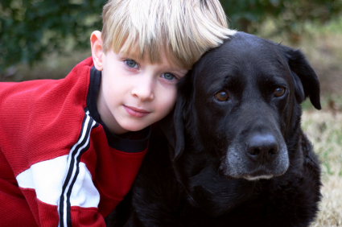
Ancillary Materials
Picture 3

Slide 11
Grades K - 2: Generic 4-Point Informational/Explanatory Writing Rubric
Score | Statement of Purpose/Focus and Organization |  | Development: Language and Elaboration of Evidence |  | Conventions CCSS and Report Card Alignment Conventions: Kinder-L.K.1a, L.K.2a, & L.K.2d 1st-L.1.1a, L.1.2 2nd-L.2.2
 | Statement of Purpose/Focus CCSS and Report Card Alignment Text Types & Purposes: Kinder-W.K.2 1st-W.1.2.1-3 2nd-W.2.2.1-3 | Organization CCSS and Report Card Alignment Text Types & Purposes: Kinder-none 1st-W.1.2.4 2nd-W.2.2.4 | Elaboration of Evidence CCSS and Report Card Alignment Text Types & Purposes/Production and Distribution of Writing: Kinder-W.K.2.3 & L.K.6 1st-W.1.5.2 2nd-W.2.2.3 | Language and Vocabulary CCSS and Report Card Alignment Conventions & Vocab. Acquisition: Kinder-L.K.1b-f & L.K.6 1st-L.1.1b-j & L.1.6 2nd-L.2.1 & L.2.6
4 Exemplary (E) | Uses a combination of drawing, dictation, & writing (K) to compose Explains something more about the topic OR a connection is made between topic & broader idea(s) Clearly presents the topic and focus/controlling idea | Intro, body, and conclusion support focus Uses several transitions appropriately (e.g., because, since, and, but, also, for example, since) to connect or group ideas | Has a depth of information; insightful Elaborates using a variety of relevant details, definitions, examples, quotes, text evidence to support focus/concepts | Maintains voice/tone of knowledgeable person conveying information – knows when to use formal-informal language Uses effective, precise vocabulary and variety of sentence structures | Edits with support /resources Has few or no errors in grammar, word usage, or mechanics as appropriate to grade
3 Proficient (M) | Uses a combination of drawing, dictation, & writing (K) to compose Topic (context) and focus/controlling idea are clearly stated (gr K-3) | Has overall coherence (K-3); Provides a concluding statement or section (gr, 1, 2, 3) Groups related ideas (gr3) that support the focus Uses transitions to connect ideas (gr3) | Some authentic details, definitions, facts, text evidence support focus Adds labels or captions to illustration, drawing, visuals, charts/tables, or diagram to enhance details, facts, and ideas | Produces complete simple (K), compound (g, 1- 3), complex (gr3) sentences Appropriate use of vocabulary (nouns, plurals, verbs, pronouns, adjectives, adverb, content-specific) Uses adult/peer feedback to Revise | Edits with support /resources (gr 2-3) Minor errors do not interfere with reader understanding (e.g., capitalization, punctuation; spelling)
2 Developing (NM) | Uses a combination of drawing, dictation, & writing (K) to compose Has topic and attempts a focus/information, but focus may shift or not be relevant to the topic chosen | Introduction, body, and conclusion are evident, but may lack clarity or Coherence (e.g., attempts to connect ideas, but may not be logical or make sense) | Some elaboration strategies are evident in drawings or writing (gr K-3), or with support/ questioning from peers or adults (gr K -1) Ideas may not be fully elaborated or details may be insufficient to support topic | Vocabulary use has minor errors Dictates, writes, and expands simple complete sentences Uses adult/peer feedback to revise | Edits with support from peers or adults (gr 2-3) Uses grade-appropriate basic mechanics and word use with some errors
1 Merging (NY) | Uses a combination of drawing, dictation, & writing (K) to compose Attempts to identify a topic but lacks a focus or may have more than one topic or confusing topic as stated | Attempts introduction, body, and conclusion, but one or more parts are missing | No details provided or attempts to add details to drawings or writing which may be random, inaccurate, or irrelevant | Generally uses basic, incorrect, or below grade level vocabulary when dictating (K) or writing Uses adult/peer feedback to revise | Edits with support from peers or adults (gr 2-3) Uses below grade-level basic mechanics with frequent errors
0 | A response gets no credit if it provides no evidence of the ability to [fill in with key language from the intended target].
Working Drafts of ELA rubrics for assessing CCSS writing standards --- © (2010) Karin Hess, National Center for Assessment [khess@nciea.org

Slide 12
Performance Task Answer Key (optional)
Tamika’s Trip to the Zoo Polar Bear Map
The student “map” must have three things: a zoo entrance of some kind a pathway that turns left a straight path that leads to the polar bears Other information on the map is acceptable if it has the 3 criteria, but does not count toward a full composition score.
What the Baby Polar Bears Did at the Zoo By ___________________ Students were asked to write “what the polar bears were doing,” at the zoo based on the texts, Tamika’s Trip to the Zoo and A Baby Polar Bear Grows Up. It is challenging for students to not write about their own experiences or background knowledge, but the task requires text-based evidence. If students put in their own experiences it is acceptable in first grade as long as they still have sufficient evidence from the texts, of what could be expected for a polar bear to be seen doing at the zoo.
Students receive three scores, one for each criterion. In grade one, use your judgment along with the writing rubric to decide how the final product best supports each of these three areas.
Purpose and Organization (4) Introduces the topic Explains more about what happened. |  |  |  | Language -Elaboration of Evidence (4) Uses relevant details from the texts. Uses vocabulary learned from the passage If sharing, makes good sense. |  |  |  | Conventions (4) Uses words or letters appropriate for age If sharing, uses grammar appropriate for age
1 | 2 | 3 | 4 | 1 | 2 | 3 | 4 | 1 | 2 | 3 | 4
Total Score /12

Slide 13
Interim Research Constructed Response Answer Key
Constructed Response Research Rubrics Target 2 Locate, Select, Interpret and Integrate Information.
Question #10 RL.1.6 Prompt: What do you think Tamika’s father might have said to Tamika as they were looking for the polar bears?
Teacher /Rubric “Language Response”
The response gives sufficient evidence of the ability to locate and select information that would contribute to what Tamika’s father might have said based on the details in the text. This does require reasoning and inference which is at the DOK 3 level of standard RL.1.6. The response gives sufficient evidence of the ability to interpret and integrate information from textual details into an integrated response based on reasoning. The response could include any actions in the text that would support dialogue including Tamika’s father talking about (1) meeting Jesse at the zoo, (2) going to see Milly and Tilly, (3) explaining how to get to the bears as he draws a map, (4) greeting Jesse when they arrived. This is a very subjective constructed response. Any answer is acceptable if it can be linked to details from the text and makes logical sense.
Student “Language” Response Example
2 | Student uses reasoning and logic to connect what Tamika’s father could have said based on sufficient details from the text. Tamika’s father took Tamika to the zoo. He probably told her we are going to the zoo! We will see Milly and Tilly and guess what…your friend Jesse will be there! I bet Tamika was happy to hear that. Then I think the dad said Tamika this is how we will find the polar bears and lets draw a map. The map goes like this and this. Then when they saw Jesse dad said Hi Jesse!
1 | Student uses some reasoning to connect what Tamika’s father could have said but with vague details from the text. Dad told Tamika they could go to the zoo. He drew a map and he helped her find the bears.
0 | Student does not use reasoning to connect what Tamika’s father could have said with the text as a reference. I want to go to the zoo someday like Tamika and see polar bears.

Slide 14
Interim Research Constructed Response Answer Key
Constructed Response Research Rubrics Target 4 ability to cite evidence to support opinions and/or ideas
Question #20 RI.1.6 Prompt: What does a polar bear cub have to learn to live by itself? Give details from the passage to support your answer.
Teacher /Rubric “Language Response”
The response gives sufficient evidence of the ability to cite evidence to support the student’s response of what the polar bear cub has to learn in order to live by itself. The student response should connect details specifically from the text (not prior knowledge) using some inference to what polar bears normally do as necessary for survival. Evidence to support ideas could include that polar bear cubs need to (1) know how to hunt, (2) be able to swim, (3) and grow stronger (more of an inference). Students may also come to their own conclusions based on the text that a cub needs to be able to do what its mother does.
Student “Language” Response Example
2 | Student explains what a polar bear cub needs to be able to do to live on its own using specific and sufficient details from the text as evidence. To live on its own a polar bear cub needs to learn how to hunt so it can find its own food and swim from its mother. When a polar bear grows up it gets stronger and can do what the mother used to do for it.
1 | Student vaguely explains what a polar bear cub needs to be able to do to live on its own but using only partial details from the text as evidence. When the cub grows bigger it can walk. Then the mother shows it how to hunt.
0 | Student does not explain what a polar bear cub needs to be able to do to live on its own. The polar bear cub likes to play and roll in the snow.

Slide 15
Interim Assessment Selected Response Answer/Points Key
Question 1 Why did Tamika and her father plan a trip to the zoo? RL.1.1 | A
Question 2 Where did they need to show their tickets? RL.1.1 | B
Question 3 What is the main idea of the story Tamika’s Trip to the Zoo? RL.1.2 | B
Question 4 How did Tamika and her father find the baby polar bears? RL.1.2 | B
Question 5 After the path turned left what happened next? RL.1.3 | B
Question 6 What can you learn in Tamika’s Trip to the Zoo ? RL.1.5 | A
Question 7 Who is telling the story of Tamika’s trip to the Zoo? RL.1.6 | B
Question 8 What two things does the story tell you about Tamika’s father? Choose two answers. RL.1.7 | A,C
Question 9 What two things does the story tell you about Tamika? Choose two answers. RL.1.7 | B,C
Question 10 Constructed Response | RL.1.6
Question 11 What is a cub? RI.1.1 | A
Question 12 What is a polar bear like when it is first born? RI.1.1 | B
Question 13 What is the main topic of “A Baby Polar Bear Grows Up”? RI.1.2 | B
Question 14 What would be another good title for this story? RI.1.2 | C
Question 15 If a polar bear cub can walk, find its own food and swim, what do you know about the cub? RI.1.3 | B
Question 16 When do polar bear cubs come out of their den? RI.1.5 | A
Question 17 What would be the best caption to go with the picture? RI.1.6 | B
Question 18 What information is the same in A Baby Polar Bear Grows Up and Fun Facts? RI.1.7 | A
Question 19 What can you learn from Fun Facts that you can not learn from A Baby Polar Bear Grows Up? RI.1.7 | A
Question 20 Constructed Response | RI.1.6

Slide 16
INTERIM
ASSESSMENT
Name _______________

Slide 17
Tamika’s Trip to the Zoo
Readworks.org
Tamika and her father planned a trip to the zoo.
The new baby polar bears were there.
They were called Milly and Tilly.
Tamika would meet her friend Jesse near the polar bears.
Tamika’s father drew a map of the path they would follow. He drew a picture of the zoo’s front gate. That is where they had to show their tickets.
He drew a path from the gate to the polar bears. The path turned left. Then it went straight. The polar bears would be right there.
He drew a picture of a baby polar bear on the map.
When they got to the bear house, Jesse was there!
Grade Equivalent 1.7
Lexile Measure 490L
Mean Sentence Length 8.85
Mean Log Word Frequency 3.77
Word Count 115

Slide 18
Why did Tamika and her father plan a trip to the zoo?
  They wanted to see the new baby polar bears.
  Tamika wanted to meet her friend Jesse.
  They wanted to draw a map.
Standard RL.1.1
Ask and answer questions about key details in a text.
2. Where did they need to show their tickets?
A. They needed to show their tickets to her
friend Jesse.
B. They needed to show their tickets at the
zoo’s front gate.
C. They needed to show their tickets at the
polar bear house.

Slide 19
3. What is the main idea of the text Tamika’s Trip to the Zoo?
There were new baby polar bears called Milly and
Tilly.
Tamika and her father went to the zoo to see the polar bears.
Tamika’s father drew a map.
Standard RL.1.2
Retell stories, including key details, and demonstrate understanding of their central message or lesson
How did Tamika and her father find the baby
polar bears?
They met her friend Jesse.
They followed a map.
Her father drew a picture of a baby polar bear.

Slide 20
After the path turned left what happened next?
  Tamika’s father drew a map.
  The path went straight.
  They got to the polar bear house.
Standard RL.1.3
Describe characters, settings, and major events in a story, using key details.
What can you learn in Tamika’s Trip to the Zoo ?
  Maps can help you find what you are looking for.
  A polar bear cub is born with its eyes closed.
  A baby polar bear is a cub.
Standard RL.1.5
Explain major differences between books that tell stories and books that give information, drawing on a wide reading of a range of text types

Slide 21
Who is telling the story of Tamika’s trip to the Zoo?
  Tamika
  A person not in the story
  Jesse
Standard RL.1.6
Identify who is telling the story at various points in a text.
What two things does the text tell you about Tamika’s father? Choose two answers.
  He planned a trip to the zoo.
  He likes polar bears.
  He knows how to draw a map.
Standard RL.1.7
Use illustrations and details in a story to describe its characters, setting, or events

Slide 22
9. What two things does the text tell you about
Tamika? Choose two answers.
  The baby polar bears were named Milly and Tilly.
  She has a friend named Jesse.
  She went to the zoo with her dad.
Standard RL.1.7
Use illustrations and details in a story to describe its characters, setting, or events
What do you think Tamika’s father might have said to Tamika as they were looking for the polar bears?
Standard RL.1.6
Identify who is telling the story at various points in a text.

Slide 23
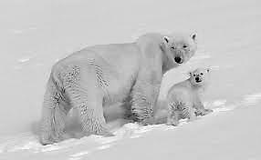
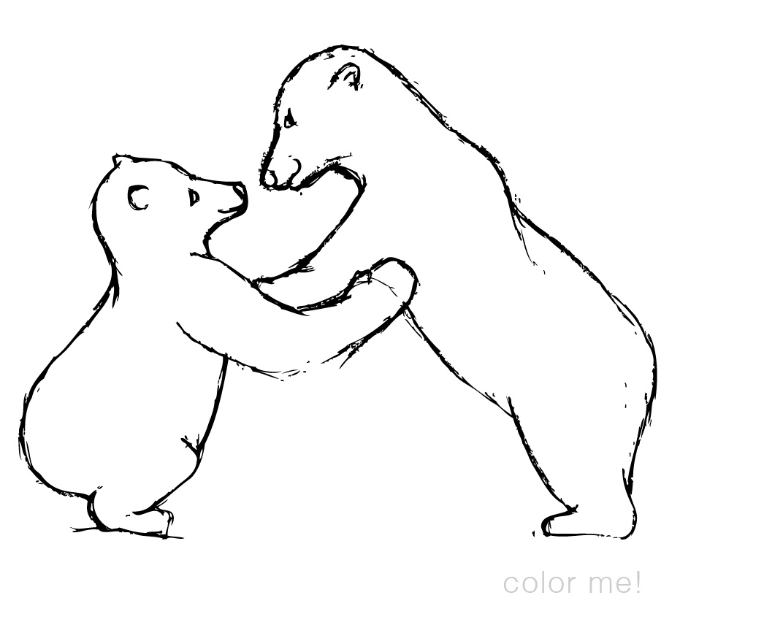
Grade Equivalent 0.0
Lexile Measure 350L
Mean Sentence Length 6.25
Mean Log Word Frequency 3.48
Word Count 100
A Baby Polar Bear Grows Up
By Elizabeth Yeo
1
Polar bears live in ice and snow. A polar bear baby is a cub. A cub is born with its eyes closed. It does not have much hair. A cub drinks its mother’s milk. The mother keeps the cub warm.
2
The cub grows bigger. Soon the cub can walk. Its mother shows it how to hunt. She shows it how to swim. The cub likes to play. It rolls in the snow.
3
The cub grows stronger. The cub learns to swim. It can find its own food. Now the cub can live by itself.
Fun Facts
Polar bear cubs are playful. They chase and slide.
A new cub weighs two pounds.
They come out of the den when they are four months old.
They stay with their mother for two years.

Slide 24
11. What is a cub?
    A baby polar bear
    A grown up polar bear
    A mother polar bear
Standard RI.1.1
Ask and answer questions about key details in the text.
12. What is a polar bear like when it is first born?
    It likes to play and roll in the snow.
    Its eyes are closed and it does not have much hair.
    It can live by itself.

Slide 25
13. What is the main topic of “A Baby Polar Bear Grows
Up”?
    It is about how a baby polar bear cub learns to swim.
    It is about what a polar bear cub is like and how it learns to live by itself.
    It is about why a baby polar bear cub rolls in the snow.
Standard RI.1.2
Identify the main topic and recall the key details of a text.
14. What would be another good title for this story?
    An Animal in the Arctic
    A Polar Bear Learns to Swim
    The Life of a Polar Bear Cub

Slide 26
15. If a polar bear cub can walk, find its own food and
swim, what do you know about the cub?
    The cub was just born.
    The cub can live by itself.
    The cub lives in ice and snow.
Standard RI.1.3
Describe the connection between two individuals, events, ideas, or pieces of information in a text.
16. When does a polar bear cub come out of its den?
    at four months old
    at two years old
    when it is hungry
Standard RI.1.5
Know and use various text features (e.g., headings, tables of contents, glossaries, electronic menus, icons) to locate key facts or information in a text.

Slide 27
17. What would be the best caption to go with this picture?
    Polar bear cubs are born with their eyes closed.
    A baby polar bear stays with its mother until it can live by itself.
    The polar bear is hungry.
Standard RI.1.6
Distinguish between information provided by pictures or other illustrations and information provided by the words in a text.
18. What information is the same in A Baby Polar Bear Grows Up and Fun Facts?
Polar bear cubs like to play.
Polar bears are born with their eyes closed.
Bear cubs stay with their mother for two
years.
Standard RI.1.7
Use the illustrations and details in a text to describe its key ideas

Slide 28
19. What can you learn from Fun Facts that you can not learn from A Baby Polar Bear Grows Up?
A new cub weighs two pounds.
Cubs drink their mother’s milk.
Cubs do not have much hair.
Standard RI.1.7
Use the illustrations and details in a text to describe its key ideas
What does a polar bear cub have to learn to live by itself? Give details from the passage to support your answer.
Standard RI.1.6
Distinguish between information provided by pictures or other illustrations and information provided by the words in a text.

Slide 29

STOP
Close your books and wait for instructions!

Slide 30
Performance Task
Student Directions:
Part 2
Your assignment:
Your class is going to the zoo to see the polar bears. First you will make a map to show how to find the polar bears based on Tamika’s Trip to the Zoo.
Your map should have these things:
The zoo’s front gate
A path turning left from the gate
A straight path to the polar bears.
Then, you will write an article about what the polar bears were doing at the zoo based on Tamika’s Trip to the Zoo and A Baby Polar Bear Grows Up. Use details from both texts to write your article. When you get back to school you will share your writing with the class and your teacher.
Plan your writing. You may use your notes and answers.
Write – Revise and Edit your first draft.
Write a final draft about what you saw on your trip to the zoo.
How you will be scored

Slide 31
Tamika’s Trip to the Zoo Polar Bear Map
What the Baby Polar Bears Did at the Zoo By ___________________

