Slide 1
Grade
K
Quarter Four
CFA
Reading: Literature
Targets |  | Standards | DOK
3 | Reasoning and Evidence | RL.3 | 1-2
6 | Reasoning and Evidence | RL.6 | 2
5 | Analysis Within and Across Texts | RL.9 | 4
Reading: Informational
Targets |  | Standards | DOK
10 | Reasoning and Evidence | RI.3 | 1-2
11 | Reasoning and Evidence | RI.6 | 3-4
12 | Analysis Within and Across Texts | RI.9 | 2-3-4
Note: There may be more than one standard per target. Standards can have different DOKs per target.
Only standards assessed are listed.
Opinion Writing and Language
Targets |  | Standards | DOK
1a | Brief Opinion Write | W.1a, W.1b | 3
1b | Write-Revise Opinion | W.1a, W.1b | 2
2 | Full Opinion Composition | W-1a, W-1b, W-4, W-8 | 4
8 | Language-Vocabulary Use | L.K.6 | 1-2
9 | Edit and Clarify | L.K.1.a | 1-2
Reading
10 Selected-Response Items
2 Constructed-Response Items
1 Performance Task
Writing
1 Brief Write
1 Write to Revise a Text
0 Write to Revise Language/Vocabulary
0 Write to Edit or Clarify

Slide 2
Quarter Four English Language Arts Common Formative Assessments
Team Members and Writers
This assessment was developed working backwards by identifying the deep understanding of the two passages. Key Ideas were identified to support constructed responses and key details were aligned with the selected response questions. All questions support students’ background knowledge of a central insight or message.
Thank you to all of those who reviewed and edited and a special appreciation to Vicki Daniels and her amazing editing skills and our “in-house” writer Ginger Jay.
Deborah Alvarado | Berta Lule |  | Judy Ramer
Christina Orozco | Alfonso Lule |  | Jill Russo
Linda Benson | Sandy Maines |  | Sharon Carlson
Maritza Dash | Gina McLain |  | Anne Berg
Heather Giard | Nicole Thoen |  | Aliceson Brandt
Translator: Zaida Rosa |  | Translator: Martha Mendez
All elementary ELA assessments were reviewed and revised in June of 2015 by the following amazing and dedicated HSD K-6th grade teachers.
Deborah Alvarado Lincoln Street | Sonja Grabel Patterson | Gina McLain TOSA
Linda Benson West Union | Megan Harding Orenco | Teresa Portinga Patterson
Anne Berg Eastwood | Renae Iversen TOSA | Judy Ramer Consultant
Aliceson Brandt Eastwood | Ginger Jay Witch Hazel | Sara Retzlaff McKinney
Sharon Carlson Minter Bridge | Ko Kagawa Minter Bridge | Jami Rider Free Orchards
Deborah Deplanche Patterson | Jamie Lentz Mooberry | Kelly Rooke Free Orchards
Alicia Glasscock Imlay | Sandra Maines Quatama | Angela Walsh Witch Hazel

Slide 3
Note:
During kindergarten students are normally not reading. Read the stories to the students and ask the questions as Listening Comprehension questions. Most students should be able to point to pictures and answer questions with support and prompting. Please DO tell students what the pictures show if students aren’t clear about the image.
Recommendation: The literary section can be assessed at a different time than the informational section. The informational section includes two passages as required by standard RI.K.9 and may require more time.
Listening comprehension prepares students for the kind of questions that are higher leveled questions (rather than decodable text which is not conducive to higher leveled questioning).
Kindergarten Directions:
Teachers will need:
Teacher Directions Section
Literary and Informational texts. Read each to your class 2-3 times. Discuss the story so that students are clear about language and vocabulary terms. Some teachers choose to project these onto an overhead screen.
For Assessing Students Individually (if you assess in small groups you may want to make more than one copy of the following):
A copy of the Literary and Informational Stories
A copy of the Picture Prompts
Students will need:
The Student Assessment Copy, including:
a. Student Record Form (for teacher to mark)
b. Constructed Response Answer Sheets
c. Student Check-List (optional use)
Performance Task Optional (after the assessment):
The performance task can be used for the end quarter CFA as a post-test when compared to the quarter 4 CFA pre-assessment performance task.

Slide 4
Using Key Details
Classroom Activity for Performance Task
This classroom pre-activity follows the Smarter Balanced Assessment Consortium general design of contextual elements, resources, learning goals, key terms and purpose [http://oaksportal.org/resources/]
The content within each of these was written by Jamie Lentz.
The Classroom Activity introduces students to the context of a performance task, so they are not disadvantaged in demonstrating the skills the task intends to assess.
Contextual elements include:
an understanding of the setting or situation in which the task is placed
potentially unfamiliar concepts that are associated with the scenario
key terms or vocabulary students will need to understand in order to meaningfully engage with and complete the performance task
The Classroom Activity is also intended to generate student interest in further exploration of the key idea(s). The Classroom Activity should be easy to implement with clear instructions.
Please read through the entire Classroom Activity before beginning the activity with students to ensure any classroom preparation can be completed in advance. Throughout the activity, it is permissible to pause and ask students if they have any questions.
Resources needed:
1 copy of Text #1 and Text #2 from the ancillary materials
White chart paper (you will model writing your opinion piece on this)
Chart paper marker
Learning Goals:
Students will understand the context of the key concepts related to the topic:
using key details from the text in our opinion writing
Students will understand the key terms:
Note: Definitions are provided here for the convenience of facilitators. Students are expected to understand these key terms in the context of the task, not memorize the definitions.
Key details- important pieces of information from the text that need to be in our writing
Opinion- what someone thinks about something
Evidence- pieces of information that show something is true or right
[Purpose: The facilitator’s goal is to help students understand that key details from texts need to be included when writing an opinion piece. The key details are pieces of evidence to support their opinion.]
*Facilitators can decide whether they want to display ancillary materials using an overhead projector or computer/Smartboard, or whether they want to produce them as a handout for students.

Slide 5
Using Key Details Classroom Activity
Discussion questions:
What is an opinion?
What are key details? (this should be a review from the interim classroom activity)
What is evidence?
Facilitator says: “Today we will be getting ready for the Seasons Performance Task. We are going to talk about including key details from texts that we read into our writing. We have already learned about key details, so I’m going to give you a minute to talk to your partner about what key details are. Key details are….”
Possible student responses (unscripted):
Important things from the story
The important parts
Stuff we have to put in our writing
Facilitator says: “Let’s see what you remember about key details. __________ what did you and _______ talk about? (Call on several students and provide the definition if needed before moving on).”
Facilitator says: “Today I am going to write an opinion piece about soccer. An opinion is what someone thinks about something. I think soccer is a great sport, so my opinion writing is going to be telling why soccer is a great sport. What is your opinion about soccer? Do you think soccer is fun, boring, hard, easy. Turn and tell your partner your opinion about soccer. I think soccer is ….. (give your class “go” signal).”
Possible student responses (unscripted):
Fun and you have to run a lot
I think soccer is fun.
I play soccer!
Facilitator says: “Before I begin writing my opinion piece, I need to do some reading to get more information about soccer. Let’s read these two texts. (Read Text #1 and Text #2 from the ancillary materials).”
Facilitator says: “Now I know more about soccer and I can use the key details from the texts in my opinion writing. I can use this information as evidence. Evidence shows why my opinion is right or correct.”
(Begin writing on the chart paper as you continue through the next section).

Slide 6
Facilitator says: “Let’s see I am going to start with my opinion… Soccer is a great sport! Hmm… why do I think soccer is so great? I’m going to look back at the first text for some key details. I’m going to write this part about scoring a goal and this first part where the text says that everyone can play…. Everyone can play soccer and score a goal. Alright now I’m going to look for some key details to use from the second text. I need to make sure they are evidence, or show that my opinion is right. Sofia loved scoring goals… turn to your partner and talk about whether or not I should add that to my opinion writing (give class “go” signal).”
Possible student responses (unscripted):
Yes she should
She should say she loves scoring goals because it makes soccer great
Yes
No
Facilitator says: “_______ what do you and your partner think? Should I add that key detail? (call on a few students and clarify why you would/wouldn’t use it- it is evidence that soccer is great but would be repetitive).“
(Continue modeling with as many key details as needed).
Facilitator says: “In your performance task, you will be learning more about opinion writing. The partner work you did today should help prepare you for the research and writing you will be doing in the performance task.”
Note: Facilitator should collect student notes from this activity.

Slide 7
Ancillary Materials
Soccer
Soccer is a fun sport that everyone can play. There are eleven players on each team. Most of the time players kick the ball but sometimes they use their heads too! Each team tries to get the soccer ball into the other team’s net and score a goal!
Sofia the Soccer Star
Sofia loved playing soccer! She played on a team with boys and girls from school every Saturday. Sofia loved running and scoring goals. Her favorite part about playing soccer was having fun with her friends. One Saturday they even won a trophy!

Slide 8
Grade Equivalent 1.6
Lexile Measure 370L
Mean Sentence Length 7.46
Mean Log Word Frequency 3.76
Word Count 261
Ana’s Four Seasons
Ginger Jay
Ana lived where it was sunny most of the time. It did not rain very much. It did not snow. In the summer it was very hot. The sky was always very blue. Ana was happy but she wanted it to rain and snow.
One day Ana's dad told her they were going to move. They were moving to Oregon. Her dad said it would rain a lot there. He said it might even snow! Ana was excited! She could not wait to splash in puddles. She could not wait to make a snowball.
When her family got to Oregon it was summer. It was very sunny and hot. Ana was sad. She wanted to see the rain. She wanted to see the snow. Her mom said it would rain and snow soon. Her mom said it was fall but winter was coming. Ana waited and waited.
In the fall the clouds began to come. The sky sometimes looked dark and cold. Some days Ana watched it rain all day. In the winter it snowed two inches. Schools and malls were closed. People stayed home to keep safe and warm. Ana played outside in her new snowsuit. She made snowballs and she was happy.
Then one day Ana woke up to blue skies and lots of singing. Her mom said it was spring. Her mom said spring was her favorite time of year. Ana thought about this. She did love spring. But what she really loved was the fact that she now had four beautiful seasons!

Slide 9
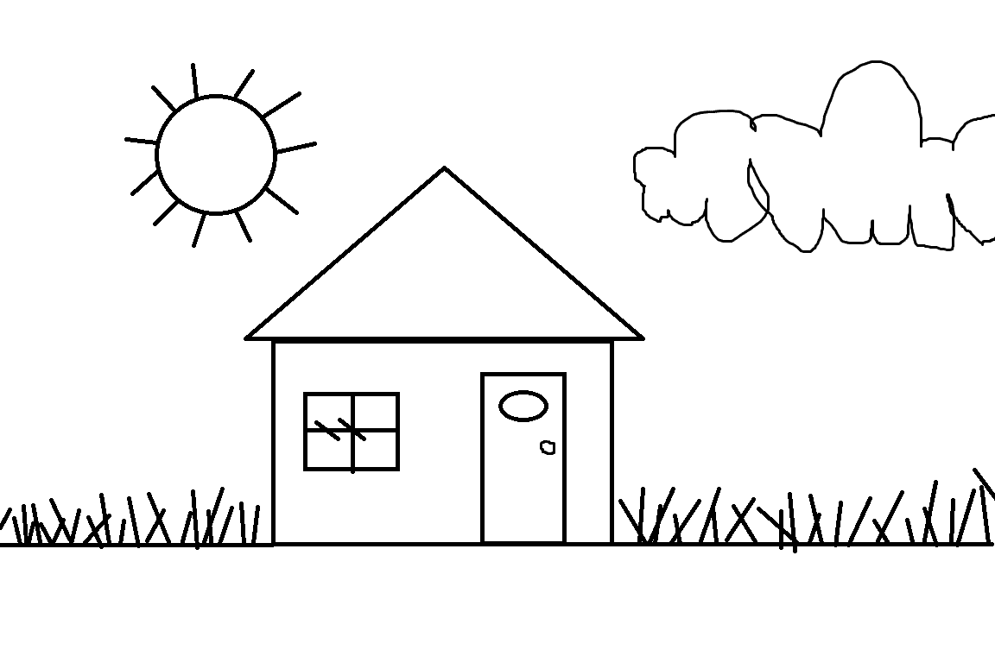
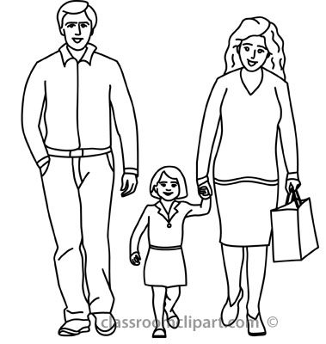
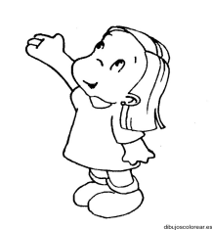
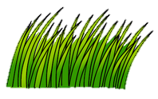
Ana’s Four Seasons
Ginger Jay
Ana lived where it was sunny most of the time. It did not rain very much. It did not snow. In the summer it was very hot. The sky was always very blue. Ana was happy but she wanted it to rain and snow.

Slide 10
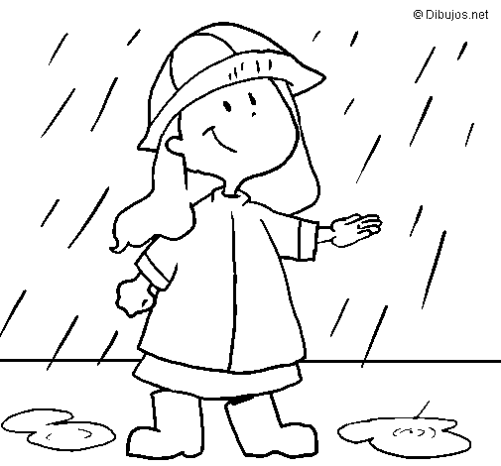
One day Ana's dad told her they were going to move. They were moving to Oregon. Her dad said it would rain a lot there. He said it might even snow! Ana was excited! She could not wait to splash in puddles. She could not wait to make a snowball.

Slide 11

When her family got to Oregon it was summer. It was very sunny and hot. Ana was sad. She wanted to see the rain. She wanted to see the snow. Her mom said it would rain and snow soon. Her mom said it was fall but winter was coming. Ana waited and waited.

Slide 12

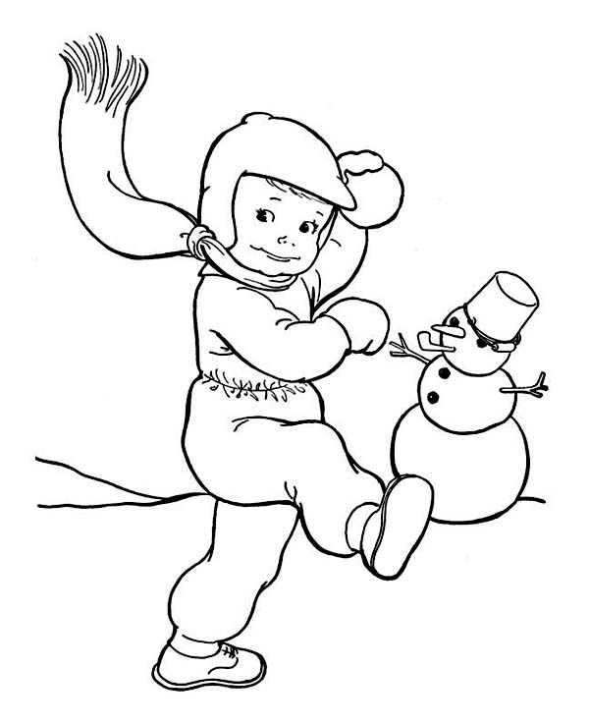
In the fall the clouds began to come. The sky sometimes looked dark and cold. Some days Ana watched it rain all day. In the winter it snowed two inches. Schools and malls were closed. People stayed home to keep safe and warm. Ana played outside in her new snowsuit. She made snowballs and she was happy.

Slide 13

Then one day Ana woke up to blue skies and lots of singing. Her mom said it was spring. Her mom said spring was her favorite time of year. Ana thought about this. She did love spring. But what she really loved was the fact that she now had four beautiful seasons!

Slide 14



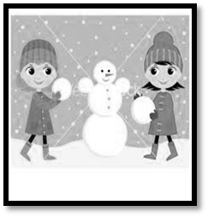
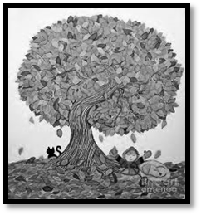

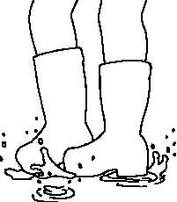
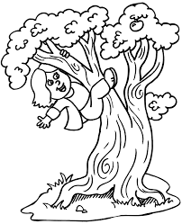
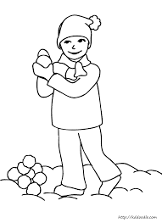
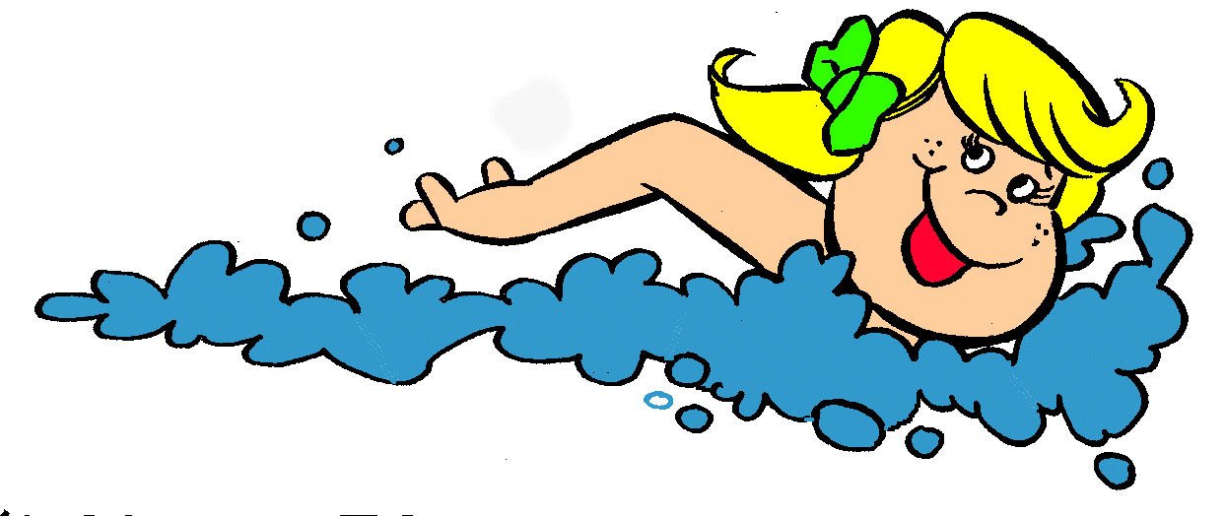
Selected Response Picture Prompts for:
Literary Passage: Ana’s Four Seasons
1.
2.
3. Why did the author write Ana’s Four Seasons?
4.
5.

Slide 15
A note about constructed responses: Constructed response answers are not written “in stone.” There is no perfect way a student should respond. Look for the general intent of the prompt and student response and follow the rubric below as much as possible. Use your best judgment. Unlike DOK-1 questions where there is one right and wrong answer, constructed responses are more difficult to assess. Overall consistency of intent based on most of your student responses can guide you.
Quarter 4 CFA Constructed Response Answer Key
Standard RL.K.3: 2 Point Reading Constructed Response Rubric RL.K.3 With prompting and support, identify characters, settings, and major events in a story.
Question (prompt): #6 Draw pictures and write words about what Ana did when it snowed.
Directions for Scoring Notes: Write an overview of what students could include in a proficient response with examples from the text. Be very specific and “lengthy.” Teacher Language and Scoring Notes: Sufficient Evidence (general idea) of the ability to locate and select information that shows or tells what Ana did when it snowed. Specific Identifications (supporting details) could include pictures or words that indicate (1) Ana played outside in her new snowsuit and (2) she made snowballs. Specific: Full Support other information that is related to Ana’s being in the snow (i.e., she was happy) is acceptable if supported by the text as informative, but must address what Ana “did.”
2 | Student draws or writes with sufficient details to show understanding of what Ana did in the snow. Student writes or draws that Ana played outside (in her snowsuit). Student writes or draws that Ana made snowballs.
1 | Student draws or writes with partial details to show some understanding what Ana did in the snow. Student writes or draws that Ana played outside (may or not include snowsuit or that she made snowballs.
0 | Student does not show understanding of what Ana did in the snow. The student response is not consistent with the prompt.

Slide 16
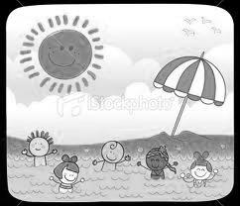
Grade Equivalency 1.1
Lexile Measure 40L
Mean Sentence Length 3.35
Mean Log Word Frequency 3.10
Word Count 67
Four Seasons
Daniel likes spring. Spring is green. Spring is fresh. Spring has flowers. Spring has bees.
Tina likes summer. Summer is hot.
Summer is sunny. Summer is a time to swim. Summer is fun.
Thomas likes fall. Fall is cool. Fall is windy. Fall has pretty trees. Fall has many fruits.
Jenny likes winter. Winter is cold. Winter is white. Winter has snow. Winter has snowmen.

Slide 17

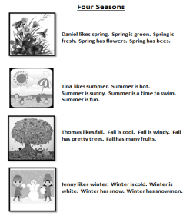
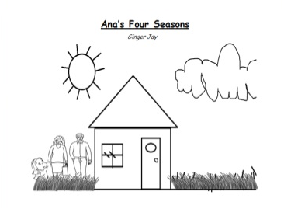
Selected Response Picture Prompts for…
Informational Passage: Four Seasons
7.
8. What is another name for Winter, Fall, Spring and Summer?
9. What does the author want you to know in the passage Four Seasons?
10.
11..

Slide 18
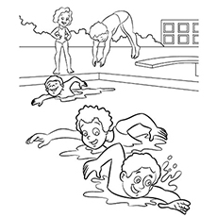

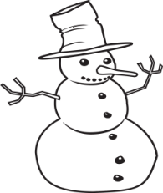



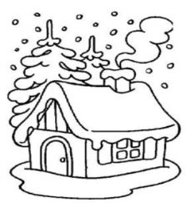
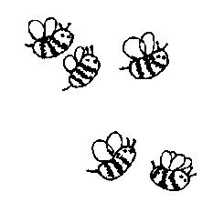
Quarter 4 CFA Research Constructed Response Answer Key Literary Text: Four Seasons
Constructed Response Research Rubrics Target 3 Evidence of the ability to distinguish relevant from irrelevant information such as fact from opinion
Question #12 RI.K.9 Prompt: Cut and paste the pictures into the correct season boxes
Teacher “Language Response” Rubric
Student “Language” Response Example
2 | Student correctly selects all relevant pictures for each season.
1 | Student correctly selects 3-7 relevant pictures.
0 | Student selects 0 – 2 relevant pictures.
Summer
Fall
Winter
Spring
Toward RI.K.9 DOK 2-3-4
With prompting and support, identify basic similarities in and differences between two texts on the same topic (e.g., in illustrations, descriptions, or procedures).

Slide 19
Questions #13 and #14 address language standards that are assessed on SBAC as part of Claim #2 – Writing. These two questions are not on the student Listening Comprehension answer key and recording sheet, but may be used for instructional guidance in language and writing as desired. Questions #13 and #14 are combined as a two-part question.
13. Draw pictures and write words to tell about each season. Write a Brief Text, W.K.1a State Topic, Target 6a
14. Circle the words or pictures you made that show what you liked best about each season. Revise a Text, W.K.1b - support with reasons, Writing Target 6b
2 | The response supports a topic for each season using words or pictures. The student has circled what he or she likes best about each season. Student writes and/or draws about each season. The student has circled sufficient words or pictures that explain or show what he or she likes best about each season.
1 | The response partially supports a topic for each season using words or pictures. The student has circled what he or she likes best about each season. Student writes and/or draws about each season using partial or some information. The student has circled some of the words or pictures that explain what he or she likes most about each season.
0 | The response does not support a topic for each season using words or pictures. Student does not write or draw about each season.

Slide 20
Performance Task
(optional!)
The following pages support a student performance task.
In kindergarten a performance task is more of an instructional lesson and has much support. If you choose to do a performance task as part of your instruction you can break this down into several days. This should be done after you have given the entire assessment (both literary and informational sections).
Directions:
Re- Read the passages and model how to take notes - (a teacher note-taking form with instructions and a student form that can be used for modeling, are included). Kindergarten students are not expected to take notes independently.
Have students share their two completed constructed response questions from this assessment (these are research questions).
The Performance Task
A Classroom Activity
Review any vocabulary students may struggle with.
Prompt:
What is your favorite season and why? Use ideas and details from the stories in
your drawing and writing.

Slide 21
Name_____________________
What is the text mostly about? This is the main topic.
Draw a main topic picture.
1
Read the text with the students. Ask the students if the text is about (use irrelevant examples – a french-fry?, a hair?).
This will help students understand that when you ask what a text is mostly about you are referring to the subject or what is called a main topic.
Ask students to draw a picture of the main topic.
Remember students will need to have a note-taking form for each passage.
Draw pictures and write words. Tell more about the main topic.
Ask students to explain more about the main topic.
Tell students, “When we want to explain more about (name the main topic), we can look to see what else happened. We are looking for ideas and details.”
Ask students, “What ideas or details can you find and tell about?”
2
Differentiation:
Students who need more pages – print as needed. In kindergarten you can scaffold students to start with illustrating the main topic, then move to details and ideas in another lesson. Students who would benefit from enrichment can continue on with more specific details or a new text.
Students who need more direct instruction – teach each part in mini lessons. These concepts can be taught separately:
Main Topic
Ideas
Details
ELs may need each part taught using language (sentence) frames emphasizing transitional words.

Slide 22
Name_____________________
What is the text mostly about? This is the main topic.
Draw a main topic picture.
Draw pictures and write words. Tell more about the main topic.

Slide 23
15. Performance Task Answer Key: CCSS.ELA-Literacy.W.K.1 Use a combination of drawing, dictating, and writing to compose opinion pieces in which they tell a reader the topic or the name of the book they are writing about and state an opinion or preference about the topic or book (e.g., My favorite book is...).. Task: What is your favorite season and why? Use ideas and details from the stories in your drawing and writing.
My Favorite Season
Questions #17 (Performance Task) is optional. If scoring, language standards L.K.6 (using words learned in the texts) and L.K.1a (capitals and lower case letters) as listed on the cover sheet of this assessment, are integrated in the scoring key below. In grades 1 – 6 language and vocabulary, and edit and clarify are assessed separately.
Students receive three scores, one for each criterion. In kindergarten, use your judgment along with the writing rubric (below) to decide how the final product best supports each of these three areas.
Purpose and Organization (4) Uses drawing and writing to compose. Explains more about the topic (favorite season) Connects the topic (favorite season) to words or pictures that show details about the favorite season. |  |  |  | Language -Elaboration of Evidence (4) Uses relevant details or examples to support the opinion of the favorite season. Uses vocabulary learned from the passages L.K.6 Uses complete sentences when sharing L.K.1f |  |  |  | Conventions (4) Uses words or letters appropriate for age especially capitals and lower case letters L.K.1a. If sharing, uses grammar appropriate for age as well as any plural pronouns L.K.1c
1 | 2 | 3 | 4 | 1 | 2 | 3 | 4 | 1 | 2 | 3 | 4
Total Score /12

Slide 24
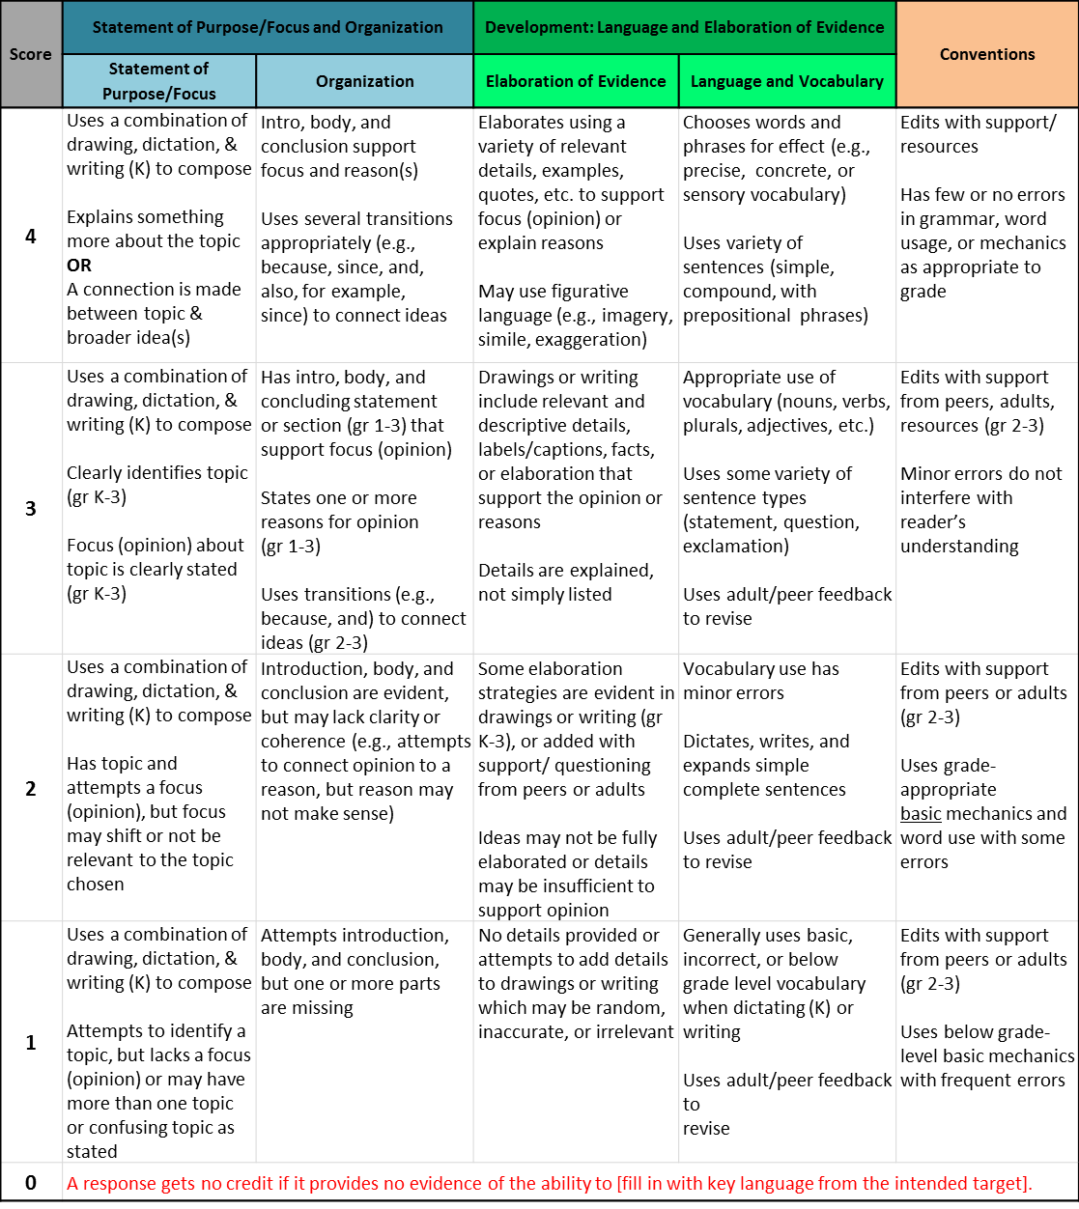
Grades K - 2: Generic 4-Point Opinion Writing Rubric
NOTE: Anchor papers illustrate how descriptors for each performance level are evidenced at each grade.
Working Drafts of ELA rubrics for assessing CCSS writing standards --- © (2010) Karin Hess, National Center for Assessment [khess@nciea.org] using several
sources: CCSS for writing; Learning Progressions Framework for ELA (Hess, 2011); the VT analytic writing rubrics; Biggam & Itterly, Literacy Profiles; Hill,
Developmental Continuum; Exemplars Young Writers rubrics; and input from NYC K-5 performance assessment pilot Assessment Development Leaders
CCSS Writing Standard #1a: Compose Opinion Pieces on Topics/ Persuasive Writing K-3
Students compose opinion pieces on topics by stating and supporting a point of view /judgment with reasons and information.

Slide 25
ELP Kindergarten Standards Organized by Modality
Receptive modalities*: Ways in which students receive communications from others (e.g., listening, reading, viewing). Instruction and assessment of receptive modalities focus on students’ communication of their understanding of the meaning of communications from others. | Listening & reading | 9 - create clear and coherent grade-appropriate speech and text | 10 - make accurate use of standard English to communicate in grade-appropriate speech and writing | 1 | construct meaning from oral presentations and literary and informational text through grade-appropriate listening, reading, and viewing
 |  |  |  | 8 | determine the meaning of words and phrases in oral presentations and literary and informational text
Productive modalities*: Ways in which students communicate to others (e.g., speaking, writing, and drawing). Instruction and assessment of productive modalities focus on students’ communication of their own understanding or interpretation. | Speaking & Writing |  |  | 3 | speak and write about grade-appropriate complex literary and informational texts and topics
 |  |  |  | 4 | construct grade-appropriate oral and written claims and support them with reasoning and evidence
 |  |  |  | 7 | adapt language choices to purpose, task, and audience when speaking and writing
Interactive modalities*: Collaborative use of receptive and productive modalities as “students engage in conversations, provide and obtain information, express feelings and emotions, and exchange opinions” (Phillips, 2008, p. 3). | Listening, speaking, reading, and writing |  |  | 2 | participate in grade-appropriate oral and written exchanges of information, ideas, and analyses, responding to peer, audience, or reader comments and questions
 |  |  |  | 5 | conduct research and evaluate and communicate findings to answer questions or solve problems
 |  |  |  | 6 | analyze and critique the arguments of others orally and in writing
Standard | An ELL can… | By the end of an English language proficiency level, an ELL Kindergarten can . . .
4 Productive (S & W) | …construct grade-appropriate oral & written claims & support them with reasoning & evidence. | 1 | 2 | 3 | 4 | 5
 |  | …express a feeling or opinion about a familiar topic. | …express an opinion or preference about a familiar topic | …express an opinion or preference about a familiar topic or story. | …express an opinion or preference about a variety of topics or stories. | …express an opinion or preference about a variety of topics or stories.
This performance task is based on writing. As an option if you’d like to monitor growth for ELP as a second goal, teachers can choose to assess ELP standard 4 because it aligns with this specific performance task. Your student’s full composition can be analyzed to identify English language proficiency levels. It is evident that students will be navigating through the modalities to get to the end product. However, it is important to keep in mind what the full opinion writing performance task is assessing and how deeply the student understands class content and language. The ELP growth goal is to provide the “just-right scaffolds” for students to demonstrate their understanding in order for them to move from one proficiency level to the next.

Slide 26
Opinion Writing CFA Performance Task
Student and Class Scoring: |  |  | School Year: |  | Grade:
 |  | Teachers Name:
 |  | School:
Student Name: |  |  | Focus and Organization | Elaboration and Evidence | Conventions | Student Total | ELP Score
 |  |  | Score | Score | Score
1.
2.
3.
4.
5. |  |  |  |  |  | 0
6. |  |  |  |  |  | 0
7. |  |  |  |  |  | 0
8. |  |  |  |  |  | 0
9. |  |  |  |  |  | 0
10. |  |  |  |  |  | 0
11. |  |  |  |  |  | 0
12. |  |  |  |  |  | 0
13. |  |  |  |  |  | 0
14. |  |  |  |  |  | 0
15. |  |  |  |  |  | 0
16. |  |  |  |  |  | 0
17. |  |  |  |  |  | 0
18. |  |  |  |  |  | 0
19. |  |  |  |  |  | 0
20. |  |  |  |  |  | 0
21. |  |  |  |  |  | 0
22. |  |  |  |  |  | 0
23. |  |  |  |  |  | 0
24. |  |  |  |  |  | 0
25. |  |  |  |  |  | 0
26. |  |  |  |  |  | 0
27. |  |  |  |  |  | 0
28. |  |  |  |  |  | 0
29. |  |  |  |  |  | 0
30. |  |  |  |  |  | 0
31. |  |  |  |  |  | 0
32. |  |  |  |  |  | 0
33. |  |  |  |  |  | 0
34. |  |  |  |  |  | 0
35. |  |  |  |  |  | 0
 | Total Students
 | % Proficient
 | % Exemplary
Scoring Key:
Total # Correct
1
= Emerging
0 - 4
2
= Developing
5 - 7
3
= Proficient
8 - 10
4
= Exemplary
11 - 12
To use the Excel Version of this Score sheet. http://sresource.homestead.com/index.html

Slide 27
Grade
K
Quarter Four CFA
Listening Comprehension
Student Copy
Student Name
_______________________

Slide 28
Kindergarten Reading Informational and Literary Text Quarter 4 CFA Record Form Selected Response Directions: Read each question and the answer choices to the student. Show student the answer-choice prompt for the literary and the informational passages. Check the answer the student gives. Correct answers are highlighted in bold.
Literary Passage: Ana’s Four Seasons
1 | RL.K.3 With prompting and support, identify characters, settings, and major events in a story. RL.K.3 Prompt: Who is the story mostly about? Ana_____ Dad _____ Mom _____
2 | RL.K.3 With prompting and support, identify characters, settings, and major events in a story. RL.K.3 Prompt: Where does Ana live in the beginning of the story? A snowy place_____ A sunny place_____ A place where birds sang_____
3 | RL.K.6 With prompting and support, name the author and illustrator of a story and define the role of each in telling the story. RL.K.6 Prompt: Why did the author write the story? Any answer that connects to four seasons in a logical response is acceptable. Student connects 4 seasons ________ Student does not connect 4 seasons______
4 | RL.K.9 With prompting and support, compare and contrast the adventures and experiences of characters in familiar stories. RL.K.9 Prompt: Which picture is like the season Ana was most excited about? Winter____ Fall_____ Spring_____
5 | RL.K.9 With prompting and support, compare and contrast the adventures and experiences of characters in familiar stories. RL.K.9 Prompt: What two pictures show what Ana wants to do in Oregon? Rain puddles and snowballs____ Swimming and tree climbing____
6 | Constructed Response for RL.K.3 RL.K.3 Prompt: Draw, write or tell about what Ana did when it snowed.
Informational Passage: Four Seasons
7 | RI.K.3 With prompting and support, describe the connection between two individuals, events, ideas, or pieces of information in a text. RI.K.3 Prompt: What can you do when it is hot and sunny? Make a Snowman___ Go swimming____ Play in the leaves___
8 | RI.K.3 With prompting and support, describe the connection between two individuals, events, ideas, or pieces of information in a text RI.K.3 Prompt: What is another name for Winter, Fall, Spring and Summer? Seasons_____
9 | RI.K.6 Name the author and illustrator of a text and define the role of each in presenting the ideas or information in a text. RI.K.6 Prompt: What does the author want you to know in the passage Four Seasons? Any answer that describes how the 4 seasons are different from each other is acceptable. Student describes differences_____ Student does not describe differences_____
10 | RI.K.9 With prompting and support, identify basic similarities in and differences between two texts on the same topic … RI.K.9 Prompt: Which details about summer are the same in both texts? Summer is hot and sunny ____ Summer is a time to swim____ Summer made Ana sad____
11 | Toward RI.K.9 RI.K.9 Prompt: Which text tells a story? Four Seasons____ Ana’s Four Seasons_____
12 | Constructed Response for RI.K.9 RI.K.9 Prompt: Cut and paste the pictures into the correct season boxes.
Each correct selected response is one point.
1 | 2 | 3 | 4 | 5 | 6 | 7 | 8 | 9 | 10 | 11 | 12
/1 | /1 | /1 | /1 | /1 | /2 | /1 | /1 | /1 | /1 | /1 | /2
Total Listening Comprehension _____/ 14 For students needing support with any one standard, please refer to your grade-level Reading Learning Progressions for instructional tasks and differentiation.

Slide 29
Draw pictures and write words about what Ana did when it snowed.
Ana’s Four Seasons

Slide 30

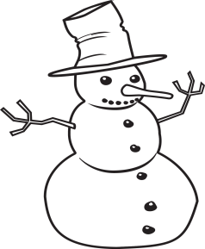






12. Cut out the pictures at the bottom of the page. Glue the pictures into the correct season boxes.
Summer
Fall
Winter
Spring
- - - - - - - - - - - - - - - - - - - - - - - - - - - - - - - - - - - - - - - - - - - - - - - - - - - - - - -
snowman | fruit tree | swimming | flowers
bees | pretty tree | snow | sunny

Slide 31
#13 - #14 Writing Practice SBAC Assessed brief writes and revised writes. The activity below is a prelude to this concept at a kindergarten level.
13. Draw pictures and write words to tell about each season. Write a Brief Text, W.K.1a State Topic, Target 6a
Winter | Spring
Summer | Fall
14. Circle the words or pictures you made that show what you like best about each season. Revise a Text, W.K.1b support with reasons (opinion) , Writing Target 6b

Slide 32
Performance Task (Optional)
15. What is your favorite season and why? Use ideas and details from the stories in your drawing and writing.
My Favorite Season

Slide 33

STOP
Close your books and wait for instructions!

Slide 34
Color the box green if your answer was correct. Color the box red if your answer was not correct.
Literary Text
1 | Who is the story mostly about? RL.K.3
2 | Where does Ana live at the beginning of the story? RL.K.3
3 | Why did the author write the story? RL.K.6
4 | Which picture is like the season Ana likes? RL.K.9
5 | What two pictures show what Ana wants to do in Oregon? RL.K.9
6 | Draw pictures and write words about what Ana did when it snowed. RL.K.9 | 2 | 1 | 0
Informational Text
7 | What can you do when it is hot and sunny? RI.K.3
8 | What is another name for winter, fall, spring and summer? RI.K.3
9 | What does the author want you to know in the passage Four Seasons? RI.K.6
10 | Which details about summer are the same in both texts? RI.K.9
11 | Which text tells a story? RI.K.9
12 | Cut and paste the pictures into the correct season boxes. RI.K.9 | 2 | 1 | 0
Writing
13 | Draw pictures and write words to tell about each season. W.K.1b (Brief write) | 2 | 1 | 0
14 | Circle the words or pictures you made that show what you like best about each season. W.K.1c (Revise a brief text) | 2 | 1 | 0

