Slide 1
Order at HSD Print Shop…
http://www.hsd.k12.or.us/Departments/PrintShop/WebSubmissionForms.aspx
Grade
6
Quarter Four CFA – ELA
Reading: Literature Grade Six
Targets |  | Standards | DOK
3 | Reasoning and Evidence | RL.6.3 | 1-2
6 | Reasoning and Evidence | RL.6.6 | 2
5 | Analysis Within and Across Texts | RL.6.9 | 4
Reading: Informational Grade Six
Targets |  | Standards | DOK
10 | Reasoning and Evidence | RI. 6.3 | 1-2
11 | Reasoning and Evidence | RI. 6.6 | 3
12 | Analysis Within and Across Texts | RI. 6.9 | 4
Note: There may be more standards per target. Writing standards assessed in this assessment are boxed.
Opinion Writing and Language
Targets |  | Standards | DOK
1a | Brief Opinion Write | W.1a, W.1b, W.1c, W.1d | 3
1b | Write-Revise Opinion | W.1a, W.1b, W.1c, W.1d | 2
2 | Full Opinion Composition | W-1a, W-1b, W-1c, W-1d, W-4, W-5, W-8 | 4
8 | Language-Vocabulary Use | W.6.2d | 1-2
9 | Edit and Clarify | L.L.6.1c | 1-2

Slide 2
Quarter Four English Language Arts Common Formative Assessments
Team Members and Writers
This assessment was developed working backwards by identifying the deep understanding of the two passages. Key Ideas were identified to support constructed responses and key details were aligned with the selected response questions. All questions support students’ background knowledge of a central insight or message.
Thank you to all of those who reviewed and edited and a special appreciation to Vicki Daniels and her amazing editing skills and our “in-house” writer Ginger Jay.
Deborah Alvarado | Patty Gallardo | Sandra Maines | Jennifer Robbins
Aliceson Brandt | Dori George | Gina McLain | Kelly Rooke
Linda Benson | Heather Giard | Christina Orozco
Hailey Christenson | Sonja Grabel | Teresa Portinga
Tammy Cole | Dovina Greco | Judy Ramer
Translator: Zaida Rosa |  | Translator: Martha Mendez
All elementary ELA assessments were reviewed and revised in June of 2015 by the following amazing and dedicated HSD K-6th grade teachers.
Deborah Alvarado Lincoln Street | Sonja Grabel Patterson | Gina McLain TOSA
Linda Benson West Union | Megan Harding Orenco | Teresa Portinga Patterson
Anne Berg Eastwood | Renae Iversen TOSA | Judy Ramer Consultant
Aliceson Brandt Eastwood | Ginger Jay Witch Hazel | Sara Retzlaff McKinney
Sharon Carlson Minter Bridge | Ko Kagawa Minter Bridge | Jami Rider Free Orchard
Deborah Deplanche Patterson | Jamie Lentz Mooberry | Kelly Rooke Free Orchards
Alicia Glasscock Imlay | Sandra Maines Quatama | Angela Walsh Witch Hazel

Slide 3
This is a CFA to measure the task of writing an opinion piece. Full compositions are always part of a Performance Task. A complete performance task would have:
Part 1
A classroom activity (30 Minutes)
Passages or stimuli to read
3 research questions
There may be other constructed response questions.
Part 2
A Full-Composition (70 Minutes)
Students should have access to spell-check resources but no grammar-check resources. Students can refer back to their passages, notes and 3 research questions and any other constructed responses, as often they’d like. The note-taking forms in this pre-assessment were created for informational text. If you choose to use these, please have your students take notes while reading the passages.
Directions
30 minutes
You may wish to have a 30 minute classroom activity. The purpose of a PT activity is to ensure that all students are familiar with the concepts of the topic and know and understand key terms (vocabulary) that are at the upper end of their grade level (words they would not normally know or are unfamiliar to their background or culture).The classroom activity DOES NOT pre-teach any of the specific content that will be assessed!
35 minutes
Students read the passages independently. If you have students who can not read the passages you may read them to those students but please make note of the accommodation. Remind students to take notes as they read. During an actual SBAC assessment students are allowed to keep their notes as a reference.
Students answer the 3 research questions or other constructed response questions. Students should also refer to their answers when writing their full opinion piece.
15 minute break
70 Minutes
4. Students write their full composition (opinion piece).
SCORING
An Opinion Rubric is provided. Students receive three scores:
Organization and Purpose
Evidence and Elaboration
Conventions

Slide 4
Pangea Classroom Activity for Performance Task
This classroom pre-activity follows the Smarter Balanced Assessment Consortium general design of contextual elements, resources, learning goals, key terms and purpose [http://oaksportal.org/resources/]
The content within each of these was written by Anne Berg, Aliceson Brandt and Ko Kagawa.
The Classroom Activity introduces students to the context of a performance task, so they are not disadvantaged in demonstrating the skills the task intends to assess.
Contextual elements include:
an understanding of the setting or situation in which the task is placed
potentially unfamiliar concepts that are associated with the scenario
key terms or vocabulary students will need to understand in order to meaningfully engage with and complete the performance task
The Classroom Activity is also intended to generate student interest in further exploration of the key idea(s). The Classroom Activity should be easy to implement with clear instructions.
Please read through the entire Classroom Activity before beginning the activity with students to ensure any classroom preparation can be completed in advance. Throughout the activity, it is permissible to pause and ask students if they have any questions.
Resources needed:
A document camera attached to a projector.
Student Puzzle Pieces from USGS (1 copy cut out OR 1 per group if you wish to extend the activity) : http://volcanoes.usgs.gov/about/edu/dynamicplanet/wegener/puzzlepieces.pdf
Teacher’s Key from USGS: http://volcanoes.usgs.gov/about/edu/dynamicplanet/wegener/continentkey6.pdf
Key from Wegener’s Evidence Sheet from USGS (1 per group): http://volcanoes.usgs.gov/about/edu/dynamicplanet/wegener/puzzlelegend.pdf
Learning Goals:
Students will understand the context of the key concepts related to the topic:
Pangea and continental drift
Students will understand the key terms:
Note: Definitions are provided here for the convenience of facilitators. Students are expected to understand these key terms in the context of the task, not memorize the definitions.
Pangea: a theory that an original, gigantic supercontinent existed 200 million years ago. Pangaea was a supercontinent consisting of all of Earth's land masses.
Plate Tectonics: The plates that make up Earth's crust are all different shapes and sizes and are in constant motion.
Continental Drift: the gradual movement of the continents across the earth's surface over time.
Fossil: the remains of an animal or plant preserved from an earlier era inside a rock.
[Purpose: The facilitator’s goal is to introduce students to plate tectonics and Pangea. This activity will allow students to be active participants as they explore continental drift.]
[Divide the students in small groups of two to four students. Give each group a piece of a paper and a pencil.]
*Facilitators can decide whether they want to display ancillary materials using an overhead projector or computer/Smartboard, or whether they want to produce them as a handout for students.

Slide 5
Pangea continued…
Facilitator says: “A widely accepted scientific theory is plate tectonics. Alfred Wegener was a scientist who believed that large pieces of land (continents) move over long periods of time. These continents are constantly moving, as they are riding on top of Earth’s crust, also known as tectonic plates. Alfred Wegener believed that at one time, hundreds of millions of years ago, a super continent existed, which he named Pangea. Over time he believed that Pangea split and the parts of it moved apart from each other. Scientists began looking for evidence to back up his claims and found enough evidence to accept it as a theory. In this activity you will be exploring some of the pieces of evidence scientists have used to back up that theory.”
[Pass out Key to Wegener’s Evidence Sheet from USGS (1 per group): http://volcanoes.usgs.gov/about/edu/dynamicplanet/wegener/puzzlelegend.pdf ]
[Display a copy of Key to Wegener’s Evidence Sheet on the document camera and read through the information together. You can read it using some of the following strategies: pair read, popcorn, cloze read, choral read, etc.]
[Display the Student Puzzle Pieces from USGS on the document camera OR hand out one per group from: http://volcanoes.usgs.gov/about/edu/dynamicplanet/wegener/puzzlepieces.pdf ]
Facilitator says: “What do you notice about the shapes of the land masses?”
[Do this as a quick, whole group discussion]
Possible student responses (unscripted)
They look like puzzle pieces that fit together.
One looks like Africa.
The other looks like South America.
That one looks like India.
Facilitator says: “What do you notice about the fossils? Do any of them match? Be sure to keep in mind that there are different types of fossils shown on the puzzle pieces.”
[Give the students five minutes to discuss and write down their thoughts. After about five minutes, have students share their ideas with the class. Ask the students to share their responses to the question and record them on the board.]
Student responses (unscripted)
I notice that three of the five have land reptile fossils.
I notice all five land masses have plant fossils on them.
I notice that only one continent has only plant fossils.
I notice that some fossils match in the same way that shapes fit together.

Slide 6
Pangea continued…
Facilitator says: “Great observations! We are now going to manipulate the pieces based off of your observations of fossils.”
[If you chose to do this as a whole group activity, you will select one student to come manipulate the piece on the document camera. If you chose to have your students work in small groups, have them work together to manipulate the individual pieces.]
Facilitator says: “Now that you have had time to manipulate the puzzle pieces, what do you notice about the shapes you have created?”
[Give the students three minutes to discuss and write down their thoughts. After about three minutes, have students share their ideas with the class. Ask the students to share their response to the question and record them on the board.]
Student responses (unscripted)
All of the land masses fit together.
We made two land masses.
We couldn’t get ours to fit together at all.
We lined up the fossils with their match.
Facilitator says: “You should have formed one supercontinent. Remember this continent is called Pangea and supports Wegener’s theory of Continental Drift. It is supported by matching fossil types on different land masses. In your performance task, you will be learning more about movement of tectonic plates. The group work you did today should help prepare you for the research and writing you will be doing in the performance task.”
Note: Facilitator should collect student notes from this activity.

Slide 7
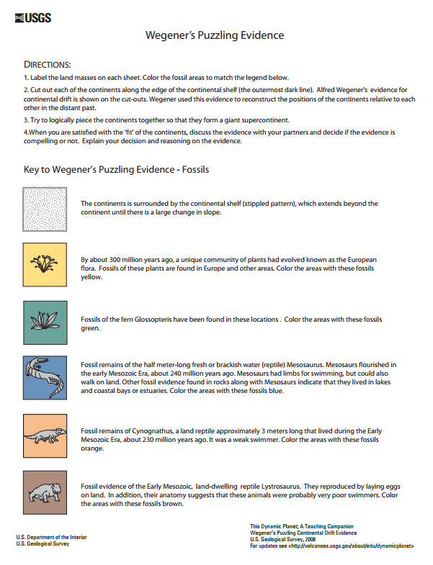
Ancillary Materials

Slide 8
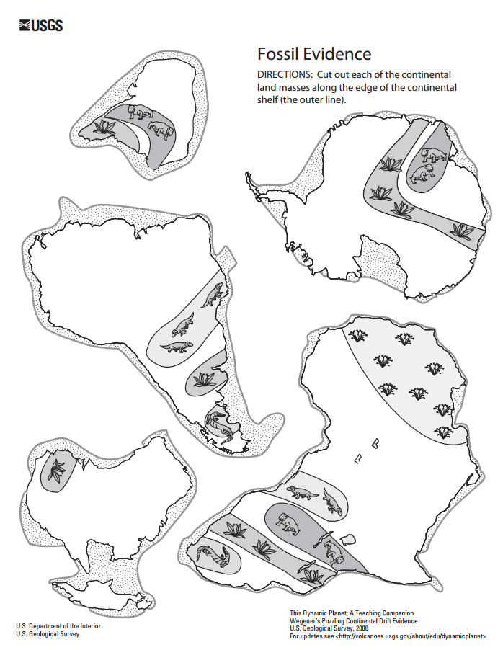
Ancillary Materials

Slide 9
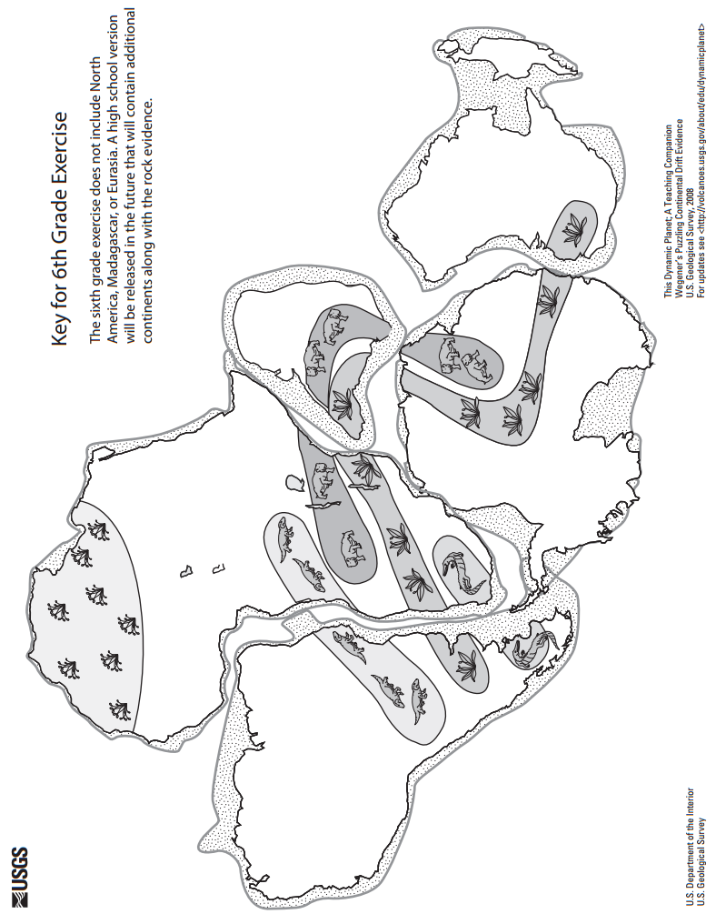
Ancillary Materials

Slide 10
Directions
The HSD Elementary assessments are neither scripted nor timed assessments. They are a tool to inform instructional decision making.
All students should “move toward” taking the assessments independently but many will need scaffolding strategies. If students are not reading at grade level and can’t read the text, please read the stories to the students and ask the questions. Allow students to read the parts of the text that they can. Please note the level of differentiation a student needed.
About this Assessment
This assessment includes: Selected-Response, Constructed-Response, and a Performance Task.
Types of SBAC Constructed Response Rubrics in this Assessment http://www.livebinders.com/play/play?id=774846
Reading 2 Point Short Response 2-3 Point Extended Response | Writing 4 Point Full Composition Rubric (Performance Task) 2-3 Point Brief Write Rubric ( 1-2 Paragraphs) 2-3 Point Write to Revise Rubrics | Research 2 Point Rubrics measuring research skill use
Quarter 4 Performance Task The underlined sections are those scored on SBAC. Please take 2 days to complete performance tasks.
Part 1 | Part 2
Classroom Activity if Desired/Needed Read two paired passages. Take notes while reading (note-taking). Answer SR and CR research questions about sources Components of Part 1 Note-Taking: Students take notes as they read passages to gather information about their sources. Students are allowed to use their notes to later write a full composition (essay). Note-taking strategies should be taught as structured lessons throughout the school year in grades K – 6. assessment if you choose to use it. A teacher’s note-taking form with directions and a note-taking form for your students to use for this assessment is provided, or you may use whatever formats you’ve had past success with. Please have students practice using the note-taking page in this document before the actual Research: In Part 1 of a performance task students answer constructed response questions written to measure a student’s ability to use research skills needed to complete a performance task. These CR questions are scored using the SBAC Research Rubrics rather than reading response rubrics. | Class activity Plan your essay (brainstorming -pre-writing). Write, revise and edit (W.5) Writing a Full Composition or Speech Components of Part 2 Planning Students review notes and sources and plan their composition. Write, Revise and Edit Students draft, write, revise and edit their writing. Word processing tools should be available for spell check (but no grammar check). This protocol focuses on the key elements of writing opinion pieces: Statement of Purpose/Focus: Do you clearly state your opinion? Do you stay on topic? Organization: Do your ideas flow logically from the introduction to conclusion? Do you use effective transitions? Elaboration of Evidence: Do you provide evidence from sources about your opinions and elaborate with specific information? Language and Vocabulary: Do you express your ideas effectively? Do you use precise language that is appropriate for your audience and purpose? Conventions: Do you use punctuation, capitalization and spelling correctly?
There are NO Technology-enhanced Items/Tasks (TE) Note: It is highly recommended that students have experiences with the following types of tasks from various on-line instructional practice sites, as they are not on the HSD Elementary Assessments: reordering text, selecting and changing text, selecting text, and selecting from drop-down menu

Slide 11
Teacher: Grade 6 Central Idea Note-Taking Page
(replaces research note-taking page from previous assessments – changes made with permission from author)
Teacher Directions:
Use this process to teach students how to answer a central idea prompt.
Be sure
to model how to restate the prompt in the topic sentence;
students know how to use direct quotes from the text;
students elaborate on how each quote connects to the central idea (how do they know this);
model adding transitions—these help the reader/scorer follow student’s thinking.
Name______________________ Passage ________________________ Central Idea ______________________
Directions: Complete the following steps to answer a prompt on central idea.
1. Determine the central idea. The central idea becomes your topic sentence in your paragraph response.
Who or what is the article mostly about?
B. What is important about the who or the what?
C. Combine A and B to state the central idea.
2. Provide text evidence and explain how the evidence connects to the central idea.
First evidence and explanation
Second evidence and explanation
Third evidence and explanation
3. Conclusion
Restate your central idea from 1c using synonyms to make it different from the topic sentence.
*Modified from original 6th grade version

Slide 12
Grade 6 Central Idea Note-Taking Page
Student
Name______________________ Passage ________________________ Central Idea ______________________
Directions: Complete the following steps to answer a prompt on central idea.
Determine the central idea. The central idea becomes your topic sentence in your paragraph response. Be sure to restate the prompt first.
Who or what is the article mostly about?
________
B. What is important about the who or the what?
________
________
C. Combine A and B to state the central idea.
________
________ _________
2. Provide text evidence and explain how the evidence connects to the central idea.
First evidence and explanation
________
________
________
________
Second evidence and explanation
______
________
________
________
Third evidence and explanation
________
________
________
________
3. Conclusion
Restate your central idea from 1c using synonyms to make it different from the topic sentence.
________
________
________

Slide 13
Grades 6 - 8: Generic 4-Point Opinion Writing Rubric
Score | Statement of Purpose/Focus and Organization |  | Development: Language and Elaboration of Evidence |  | Conventions CCSS & Report Card Alignment Conventions: 6th-L.6.2 & L.6.3
 | Statement of Purpose/Focus CCSS and Report Card Alignment Text Types & Purposes: 6th-W.6.1b-d | Organization CCSS and Report Card Alignment Text Types & Purposes: 6th-W.6.1a & W.6.1e | Elaboration of Evidence CCSS and Report Card Alignment Research to Build and Present Knowledge: 6th-W.6.1.b & W.6.7-9 | Language and Vocabulary CCSS and Report Card Alignment Conventions & Vocab. Acquisition: 6th-L.6.1, L.6.3 & L.6.6.1
4 Exemplary (E) | The response is fully sustained and consistently and purposefully focused: claim is clearly stated, focused and strongly maintained alternate or opposing claims are clearly addressed* claim is introduced and communicated clearly within the context | The response has a clear and effective organizational structure creating unity and completeness: effective, consistent use of a variety of transitional strategies logical progression of ideas from beginning to end effective introduction and conclusion for audience and purpose strong connections among ideas, with some syntactic variety | The response provides thorough and convincing support/evidence for the writer’s claim that includes the effective use of sources, facts, and details. The response achieves substantial depth that is specific and relevant: use of evidence from sources is smoothly integrated, comprehensive, relevant, and concrete effective use of a variety of elaborative | The response clearly and effectively expresses ideas, using precise language: use of academic and domain-specific vocabulary is clearly appropriate for the audience and purpose | The response demonstrates a strong command of conventions: few, if any, errors are present in usage and sentence formation effective and consistent use of punctuation, capitalization, and spelling
3 Proficient (M) | The response is adequately sustained and generally focused: claim is clear and for the most part maintained, though some loosely related material may be present context provided for the claim is adequate | The response has an evident organizational structure and a sense of completeness, though there may be minor flaws and some ideas may be loosely connected: adequate use of transitional strategies with some variety adequate progression of ideas from beginning to end adequate introduction and conclusion adequate, if slightly inconsistent, connection among ideas | The response provides adequate support/evidence for writer’s claim that includes the use of sources, facts, and details. The response achieves some depth and specificity but is predominantly general: some evidence from sources is integrated, though citations may be general or imprecise adequate use of some elaborative techniques | The response adequately expresses ideas, employing a mix of precise with more general language: use of domain-specific vocabulary is generally appropriate for the audience and purpose | The response demonstrates an adequate command of conventions: some errors in usage and sentence formation may be present, but no systematic pattern of errors is displayed adequate use of punctuation, capitalization, and spelling
2 Developing (NM) | The response is somewhat sustained and may have a minor drift in focus: may be clearly focused on the claim but is insufficiently sustained claim on the issue may be somewhat unclear and unfocused | The response has an inconsistent organizational structure, and flaws are evident: inconsistent use of basic transitional strategies with little variety uneven progression of ideas from beginning to end conclusion and introduction, if present, are weak weak connection among ideas | The response provides uneven, cursory support/evidence for the writer’s claim that includes partial or uneven use of sources, facts, and details, and achieves little depth: evidence from sources is weakly integrated, and citations, if present, are uneven weak or uneven use of elaborative techniques | The response expresses ideas unevenly, using simplistic language: use of domain-specific vocabulary may at times be inappropriate for the audience and purpose | The response demonstrates a partial command of conventions: frequent errors in usage may obscure meaning inconsistent use of punctuation, capitalization, and spelling
1 Merging (NY) | The response may be related to the purpose but may offer little relevant detail: may be very brief may have a major drift claim may be confusing or ambiguous | The response has little or no discernible organizational structure: few or no transitional strategies are evident frequent extraneous ideas may intrude | The response provides minimal support/evidence for the writer’s claim that includes little or no use of sources, facts, and details: use of evidence from sources is minimal, absent, in error, or irrelevant | The response expression of ideas is vague, lacks clarity, or is confusing: uses limited language or domain-specific vocabulary may have little sense of audience and purpose | The response demonstrates a lack of command of conventions: errors are frequent and severe and meaning is often obscure
0 | A response gets no credit if it provides no evidence of the ability to [fill in with key language from the intended target].
Working Drafts of ELA rubrics for assessing CCSS writing standards --- © (2010) Karin Hess, National Center for Assessment [khess@nciea.org

Slide 14
Opinion Writing CFA
Student and Class Scoring: |  |  | School Year: |  | Grade:
 |  | Teachers Name:
 |  | School:
Student Name: |  |  | Focus and Organization | Elaboration and Evidence | Conventions | Student Total | ELP Score
 |  |  | Score | Score | Score
1.
2.
3.
4.
5 |  |  |  |  |  | 0
6 |  |  |  |  |  | 0
7 |  |  |  |  |  | 0
8 |  |  |  |  |  | 0
9 |  |  |  |  |  | 0
10 |  |  |  |  |  | 0
11 |  |  |  |  |  | 0
12 |  |  |  |  |  | 0
13 |  |  |  |  |  | 0
14 |  |  |  |  |  | 0
15 |  |  |  |  |  | 0
16 |  |  |  |  |  | 0
17 |  |  |  |  |  | 0
18 |  |  |  |  |  | 0
19 |  |  |  |  |  | 0
20 |  |  |  |  |  | 0
21 |  |  |  |  |  | 0
22 |  |  |  |  |  | 0
23 |  |  |  |  |  | 0
24 |  |  |  |  |  | 0
25 |  |  |  |  |  | 0
26 |  |  |  |  |  | 0
27 |  |  |  |  |  | 0
28 |  |  |  |  |  | 0
29 |  |  |  |  |  | 0
30 |  |  |  |  |  | 0
31 |  |  |  |  |  | 0
32 |  |  |  |  |  | 0
33 |  |  |  |  |  | 0
34 |  |  |  |  |  | 0
35 |  |  |  |  |  | 0
Scoring Key:
Total # Correct
1
= Emerging
0 - 4
2
= Developing
5 - 7
3
= Proficient
8 - 10
4
= Exemplary
11 - 12

Slide 15
A note about constructed responses: Constructed response answers are not written “in stone.” There is no perfect way a student should respond. Look for the general intent of the prompt and student response and follow the rubric below as much as possible. Use your best judgment. Unlike DOK-1 questions where there is one right and wrong answer, constructed responses are more difficult to assess. Overall consistency of intent based on most of your student responses can guide you.
Quarter 4 CFA Research Constructed Response Answer Key
Constructed Response Research Rubrics Target 3 evidence of the ability to distinguish relevant from irrelevant information such as fact from opinion
Question #7 Prompt RL.6.6: Explain how the students’ points of view develops through the story, Earthquake Drill. Use examples from the story in your explanation.
Teacher /Rubric Language Response
The response: gives sufficient evidence of the ability to distinguish relevant from irrelevant information in order to answer the prompt. Students must distinguish what evidence from the passage is relevant to explaining how the students’ points of view change about earthquake drills from the beginning of the passage to the end of the passage. Relevant information from the beginning of the passage to explain how the students first felt about earthquake drills could include (1) they were annoyed (“Why do we always have earthquake drills right in the middle of something awesome-like science experiments or recess?”), (2) another example of being annoyed was: “Everyone was clamoring under desks and moaning at the thought of sitting there silently for even a few minutes.”; “Ms. Miller, why do we have to have earthquake drills?). Relevant information that leads toward the end of the passage and how students changed their minds about the earthquake drills could include (1) they took them more seriously (“Perhaps the most important thing students learned was that it was quite possible their own city would have a major quake sometime in the future,” and (2) they began to understand the importance; “...this gave them a new passion for learning how to stay safe in such an event,” and (3) at the end of the text...”the next time there was an earthquake drill, no one needed to be told to take it seriously.”
Student Language Response Example
2 | Student response gives sufficient details from the passage that shows how the students’ points of view developed through the story. At the beginning of the story, the students were annoyed that they had to miss fun things like science experiments and recess for earthquake drills. They moaned having to sit silently under their desks and said it was such a waste of time because it wasn’t like they were going to have an actual earthquake. After learning all about earthquakes and how their city could be on a fault line and have a major earthquake in the future, they wanted to learn more about being safe is this happened. And the next time there was a drill everyone took it seriously.
1 | Student response gives partial or minimal details from the passage that shows how the students’ points of view developed through the story. The students were annoyed they had to do an earthquake drill. Once they learned about earthquakes, they weren’t annoyed and took the drills more seriously.
0 | No credit; Students present no evidence of point of view change. Earthquakes can cause lots of damage to the earth and change it.
RL.6.6
Explain how an author develops the point of view of the narrator or speaker in a text.

Slide 16
Quarter 4 CFA Research Constructed Response Answer Key
Constructed Response Research Rubrics Target 2 Locate, Select, Interpret and Integrate Information. Constructed Response
Question #8 Prompt RL.6.9: Because of the information about how the earth is physically changing from these three passages, what can you conclude about what the earth might look like in the future?
Teacher /Rubric Language Response
Sufficient Evidence: For a proficient response, students will present sufficient details from the passage that show evidence of changes to the earth and that land masses will look different. Specific Identifications (supporting details) of how the earth and land masses may look in the future could include: (1)earthquakes cause hundreds of crevices which can split the land because the plates are drifting apart, (2) magma flowing up from the ocean floor may cause parts of the continent to sink, (3) when the ground sinks, this makes way for water from oceans to fill in that space and can make portions of the land break off from a continent, (4) earthquakes may affect the earth’s landscape by creating new landforms, and (5) all of these changes help to conclude that not only will there be new and different landforms on the earth where these plates come together, but parts of the continents could break off and create new continents. Full Support (other details): supporting land mass changes could include: (1) the earth is like a giant jigsaw puzzle and the tectonic plates are constantly moving because of earthquakes, (2) new chains of volcanoes are rising up in different parts of the world, like the Rift Valley, (3) this can also be a sign of a breaking apart of a continent and (4) the landforms that earthquakes create are cliffs, cracks, lakes and canyons.
Student Language Response Example
3 | Student gives sufficient details from all of the passages that show how the earth’s landscape will be different over time due to earth’s forces. I can conclude that the earth will look very different in the future because of what I read in these three passages about how forces in the earth change what the continents look like. In “Earthquake Drill” it said that earthquakes affect the earth’s landscape by creating all sorts of landforms like cliffs, cracks, lakes and canyons. It talked about how this happens along the fault lines-the place where two plates come together and either collide or break apart. In both “Cracking Up” and “The East African Rift” it told us that this is happening right now between the two plates, the African Plate and the Arabian Plate. It said that over time, the Red Sea will pour into the huge crevice that is being created and make a new sea and possibly cause part of the continent to break off! It also stated in these two articles that volcanoes are forming along these fault lines, making the earth look very different. This all makes me conclude that in the future there will not only be new landforms on the continents but maybe even new continents.
2 | Student response gives minimal key details from one of the passages about how the earth’s landscape will be different over time due to earth’s forces. There are lots of changes that take place on the earth from the movement of plates on the earth. Because those plates are moving, they can cause volcanoes to erupt, crevices and lakes to form. It said in “Cracking UP that a new sea might be created in Africa because of this type of action. It said in The East African Rift that magma from the ocean floor will rise up. All of this will make the land look different in the future.
1 | Student response gives minimal key details from one of the passages about how the earth’s landscape will be different over time due to earth’s forces. There are lots of changes that take place on the earth from the movement of plates on the earth. It said in “Cracking Up” that a new sea might be created in Africa because of this type of action. This will make the land look different.
0 | Students response gives no evidence of how the earth’s landscape will be different over time due to earth’s forces. Earthquakes cause a lot of damage to the earth. My city might be on a fault line.
RI.6.6
Determine an author's point of view or purpose in a text and explain how it is conveyed in the text.

Slide 17
Quarter 4 CFA Research Constructed Response Answer Key
Constructed Response Research Rubrics Target 2 Locate, Select, Interpret and Integrate Information. Constructed Response
Question #15 Prompt RI.6.6: How much time does it take for a new ocean to form? How does the author convey this in Cracking Up? Use examples and quotes from the text.
Teacher /Rubric “Language Response”
The response gives evidence of students being able to locate and select the specific information necessary to answer the prompt (e.g., how much time does it take for a new ocean to form?). Information that is specific will have language that is consistent with time elements. The response gives evidence of students being able to interpret the selected information and how it relates to the prompt in order to write an integrative response. Student responses could include (from Cracking Up): (1) the geological process is slowly building a new ocean in eastern Africa, (2) the tectonic plates are moving very slowly, (3) in the long course of Earth’s history, the plates have created oceans, (4) the tectonic activity has been going on for 30 million years and (5) a million years from now – possibly sooner – The Great Rift Valley will lie at the bottom of an ocean that divides Africa in two.
Student “Language” Response Example
2 | Student gives sufficient examples and direct quotes from the text in order to answer the prompt. It takes a very long time for a new ocean to form. The author of Cracking Up gives examples of what happened in Ethiopia when a series of Earthquakes split open the ground. A new ocean was being formed in eastern Africa but it is a “slow building process.” The author states the tectonic plates are moving and “in the long course of Earth’s history,” this has caused oceans to be created. The “tectonic activity has been going on for 30 million years,” as the author states. He concludes the text by mentioning that “a million years from now – possibly sooner – an ocean will divide Africa in two.” These examples and quotes from the text tell the reader that it takes a very long time for a new ocean to form.
1 | Student gives partial or minimal examples from the text mentioning time elements but loses focus of the prompt. Oceans do not happen overnight. Some take millions of years. One way they are made is that the tectonic plates start moving and soon the ground opens up so water comes in to make a new ocean.
0 | Student does not answer the prompt. Oceans are very large. They are so big they take up a lot of space.
RI.6.6
Determine an author's point of view or purpose in a text and explain how it is conveyed in the text.

Slide 18
Quarter 4 CFA Research Constructed Response Answer Key
Research Rubrics Target 4 ability to cite evidence to support opinions and/or ideas
Question #16 Prompt RI.6.9: Which text more specifically explains how the moving tectonic plates are affecting Africa? Use examples from both Cracking Up and The East African Rift. Use examples from both Cracking Up and The East African Rift.
Teacher /Rubric Language Response
The response gives evidence to support the opinion in the prompt (e.g., which text more specifically explains how the moving tectonic plates are affecting Africa?) by citing specific evidence from both texts. Evidence of the effects of the moving plates from Cracking Up could include: (1) a 3 foot cliff was discovered after the earthquakes, (2) new fissures and cracks are being discovered in Ethiopia, (3) volcanoes have erupted, (4) magma rose from the ground, (5) a 35 mile stretch of desert in Ethiopia is continuing to have cracks. Evidence of the effects of the moving plates from The East African Rift could include: (1) the earth split open, creating crevices some dozens of meters deep ,(2) hundreds of crevices are splitting the desert floor, (3) the ground has slumped 100 meters, (4) magma has been seen rising from below in crevices, (5) The ground is sinking around the Afar Triple Junction, (6) the ground opened up across 345 square miles, (7) earthquakes are constantly shaking the region ,(8) new crevices are discovered weekly, (9) fumes from the crevices are as hot as 400 degrees Celsius, (10) bubbling magma is coming through the crevices, (11) molten rock is slicing through the African continental plate and (12) a chain of volcanoes have erupted. Student responses can be many and varied but there should be some consistency in which to compare the two texts. Consistencies between the two texts may includes the crevices, earthquakes and volcanoes.
Student Language Response Example
2 | Student states an opinion, and cites sufficient examples with many details from both texts, to support the opinion. Both texts provide evidence to show the moving of the tectonic plates is affecting Africa. Both explain that crevices are opening in the ground and earthquakes, caused by volcanoes erupting below the ground, are constant. But, it is my opinion that the text The East African Rift explains more about how the plates are affecting Africa than the text Cracking Up. To begin with the crevices, Cracking Up states that crevices are being discovered in Ethiopia. The East African Rift expands on this idea by stating that some of the crevices are dozens of meters deep, are happening on 345 square miles of desert and that there are hundreds discovered weekly. Then the text Cracking Up says that there have been a series of earthquakes after which a 3 foot cliff was discovered. The East African Rift expands on this idea by stating that the earthquakes are constantly shaking the region, the ground has slumped 100 meters and the Afar Triple Junction is sinking. These are two examples of how the text The East Africa Rift explains more about how the plate movement is affecting Africa.
1 | Student infers an opinion at the conclusion and cites some or partial examples of effects, but does not give specific details to support the opinion. I read two texts about how two kinds of plates are moving apart. This makes things happen to the land in Africa. The first text was called Cracking Up. The second text was called The East African Rift. Both of the texts describe how earthquakes are shaking the ground and making cracks and both texts talk about volcanos and lava coming out of the cracks. I think they both have good information.
0 | Student does not answer the prompt. Volcanoes are huge. Lava comes out of volcanoes. Someday I want to see a real one.
RI.6.9
Compare and contrast one author's presentation of events with that of another (e.g., a memoir written by and a biography on the same person).

Slide 19
Quarter 4 CFA Brief Write Constructed Response Answer Key
Organization: Writing Standard: W.6.1c Target: 6a Brief Write, Organization, words, phrases and clauses clarify relationships among claims or reasons
Question #17 Prompt: A student is writing an argumentative letter to the principal about needing more earthquake drills during the school day. Read the student’s draft and complete the task that follows. (student draft is in student copy for #17)Write an introduction to the student’s argumentative letter that establishes and introduces a clear claim about having more earthquake drills.
Teacher /Rubric Language Response
Teacher Language and Scoring Notes: The student response should provide an introduction to the student’s argumentative letter (draft) of 1-2 paragraphs that logically precludes and supports the claims of the argument by introducing a clear claim about having more earthquake drills. The claim is supported with reasonable arguments based on evidence from the provided sources and transition logically into the student’s draft. Some of the evidence from these sources for more earthquake drills could include from Earthquake Drill that (1) earthquake drills are “serious business” and, (2) earthquakes can happen anywhere. Information from the other two texts may be included as long as it supports the given draft (there are many possibilities). For examples in the text Cracking Up evidence to support more earthquake drills might include that (1) in time the plates in the earth will “crack up” and earthquakes will then happen. From The East African Rift students may include the fact that (1) the earth is constantly having small earthquakes.
Student Language Response Example
2 | The response provides a clear introductory claim about having more earthquake drills at school and supports the claim with more than just a list of arguments. The response provides a logical transition to the student’s draft. Dear Principal, As a sixth grade student I feel I should write you on the behalf of all our students at Duck Dale elementary school. I am writing to you about your new rule that we will have fewer earthquake drills than last year because of time restrictions. I would like to give you some alternative to this problem. I will show you that this is not a wise choice for our school because these drills are serious business and an earthquake can happen anytime and anywhere! Do you realize that the earth is experiencing small earthquakes constantly and someday we may have a big one?
1 | The response provides a partial or limited introductory claim about having more earthquake drills at school and supports the claim with limited reasoning but has a few listed arguments. The response provides a limited transition to the student’s draft. Earthquake drills are really important. I think we should have them every week. What do you think?
0 | The response provides no adequate claim about having more earthquake drills at school and without information. The response provides no transition to the student’s draft. Earthquakes can be really dangerous and scary. I think I would not like to experience an earthquake. The ground opens up and sometimes whole cars can be swallowed up!

Slide 20
Grade 6 - Quarter 4 CFA Selected Response Answer Key
Question 1 What information was the most likely reason for the students’ change in how they viewed earthquake drills? RL.6.3 | D
Question 2 Which events led the geologists to the conclusion that the African and Arabian plates are drifting apart? Select all that apply. RL.6.3 (both must be correct) | C,D
Question 3 What was the author’s main purpose for writing the text Earthquake Drill? RL6.6 | D
Question 4 How does the teacher giving factual information about earthquakes influence the story? RL.6 | B
Question 5 How are the purposes of the texts, Earthquake Drills and Cracking Up, different? RL.6.9 | B
Question 6 Because of the information about earthquakes from The East African Rift and Earthquake Drill, what can you conclude about what changes earthquakes can make to the earth? RL.6.9 | A
Question 7 Literary Constructed Response RL.6.6 | 2 pts
Question 8 Literary Constructed Response RL.6.9 | 3 pts
Question 9 What do the chain of volcanos along the East African Rift indicate? RI.6.3 | C
Question 10 According to Cracking Up, What role do the tectonic plates play in the creation of mountains, oceans, and continents? RI.6.3 | B
Question 11 What was the author’s main purpose for writing the text The East African Rift? RI.6.6 | D
Question 12 Why does the author of The East African Rift emphasize that changes take place slowly? RI.6.6 | C
Question 13 How are the purposes of each text most different? RI.6.9 | D
Question 14 How are Cracking Up and The East African Rift different in their approach to explaining the tectonic plates? RI.6.9 | A
Question 15 Informational Text Constructed Response RI.6.6 | 2 pts
Question 16 Informational Text Constructed Response RI.6.9 | 2 pts
Write and Revise
Question 17 Brief Write | 2 pts
Question 18 Choose the two sentences that should be deleted because they are least supportive of the claim in the student’s draft of an argumentative essay. 6.W.1b (both must be correct) | A,C
Question 19 Which two verbs would be more precise and grade appropriate to replace the underlined verbs? L.6.2d | A
Question 20 A student needs to edit his sentences. Which two sentences do not have errors in grammar usage? L.6.1c (both must be correct) | A,B

Slide 21
Grade
6
Quarter Four
CFA – ELA
Student Name
_______________________

Slide 22
Read the Directions.
Part 1 – Selected Response and Constructed Response Prompts
You will read several literary and informational text sources about earthquakes.
As you read, take notes on these sources.
Then you will answer several research questions about these sources.
Steps you will be following:
In order to help you plan and write your opinion piece you will do all of the following:
Read the literary and informational sources.
2. Answer several questions about the sources.
3. Plan your opinion piece.
Directions for beginning:
You will now read several literary and informational sources. Take notes because you may want to refer to your notes when you later plan your opinion piece. You can refer to any of the sources as often as you like.
Questions:
Answer the questions. Your answers to these questions will be scored. Also, they will help you think about the sources you’ve read, which should help you plan your opinion piece.
Part 2 – Performance Task
Many people have strong feelings about earthquake preparedness in the Pacific Northwest. You will read three articles about earthquake activity in the African continent area. You will then write a speech on the issue of earthquake preparedness in the Pacific Northwest, in which you argue either for or against being prepared for a potential earthquake in our region. Your speech will eventually be given to your class.
You will:
Plan your writing. You may use your notes and answers.
Write – revise and edit your first draft (your teacher will give you paper).
Write a final draft of your opinion piece.
How you will be scored
Purpose | Do you clearly state your opinion? Do you stay on topic?
Organization | Do your ideas flow logically from the introduction to conclusion? Do you use effective transitions?
Elaboration: of evidence | Do you provide evidence from sources about your opinions and elaborate with specific information?
Elaboration: of language and vocabulary | Do you express your ideas effectively? Do you use precise language that is appropriate for your audience and purpose?
Conventions | Do you use punctuation, capitalization and spelling correctly?

Slide 23
Grade Equivalent 6.7
Lexile Measure 1080L
Mean Sentence Length 18.27
Mean Log Word Frequency 3.62
Word Count 475
Earthquake Drill
Ginger Jay
"Earthquake drill? Why do we always have earthquake drills right in the middle of something awesome- like science experiments or recess ?" Everyone was clamoring under desks and moaning at the thought of sitting there silently for even a few minutes. Ms. Miller asked them to be quiet and reminded them that all drills were serious business. When the "all clear" alarm sounded, students returned to their desks and then the questions began in earnest. "Ms. Miller, why do we have to have earthquake drills? It's not like we ever have an actual earthquake, and it seems like such a waste of time." Ms. Miller stood there looking at them for a few minutes and then asked, "Have you ever heard of the tectonic plates?"
"Tectonic what?" most of them replied. She went on to explain that all of the land on earth is formed on top of gigantic plates or pieces, and that most of these plates are constantly moving. She continued her unplanned lesson explaining that the plates move slowly up or down, away from each other or towards each other, all the time. Once in a while they collide with great force, causing an earthquake. The students had a hard time believing that huge chunks of the earth could actually move, but then again how else would you explain an earthquake?
"The earth has been changing since the beginning of time. and it continues to change today," she told them. "If you look at a map of the world, it almost looks like a giant jigsaw puzzle and that all of the pieces might have been fit together once upon a time. Perhaps earthquakes are what split those pieces apart- who knows?" The students agreed that it did look like it could happen, but it was hard to fathom none the less. That's when she advised them to do some research of their own and see what they could discover.
The next few weeks were filled with books and internet searches. New facts about earthquakes and their effect on the earth's landscape were posted on the class blog and bulletin boards daily. Students discovered that earthquakes created cliffs, and cracks, lakes and canyons, where they had never been before. They also learned that most of the earth's seven continents lay on a fault line. Fault lines are places where earthquakes are most likely to happen and that many major cities were at risk.
Perhaps the most important thing students learned was that it was quite possible their own city would have a major quake sometime in the future. While this worried most students it also gave them a new passion for learning about how to stay safe in such an event. And the next time there was an earthquake drill, no one needed to be told to take it seriously.

Slide 24
Grade Equivalent 6.6
Lexile Measure 950L
Mean Sentence Length 13.71
Mean Log Word Frequency 3.42
Word Count 425
The East African Rift
Elizabeth Yeo
The geologists with Dereje Ayalew were amazed and frightened. They had only just stepped out of their helicopter onto the desert plains of central Ethiopia when the ground began to shake under their feet.
The pilot shouted for the scientists to get back to the helicopter. And then it happened! The earth split open. Crevices began racing toward them like a zipper opening up. After a few seconds, the ground stopped moving. After they had recovered from their shock, Ayalew and his colleagues knew they had just witnessed history. For the first time ever, human beings were able to witness the first stages in the birth of an ocean.
Normally we don’t see changes taking place in our environment because they happen so slowly. A life time is too short to see rivers changing course, mountains rising skywards or valleys opening up.
Recently though, in northeastern Africa's Afar Junction though, there have been hundreds of crevices splitting the desert floor. The ground has sunk up to328 feet. At the same time, scientists have observed magma from volcanos rising from deep below as it begins to form what will eventually become a basalt ocean floor.
In Earth years at least, it won't be long until the Red Sea floods
the area. The ocean that will be born will split Africa apart.
In the Afar Triple Junction, the African and Arabian plates are
drifting apart. While the two plates move apart, the ground
sinks to make room for the Red Sea and the Gulf of Aden.
Bubbling Magma and the Smell of Sulphur
The event that Ayalew and his colleagues saw in the Afar Desert on Sept. 26, 2005, was the first seen proof of the plates moving apart. It was followed by a week-long series of earthquakes.
During the months that followed, hundreds of crevices opened up in the ground. They spread across 345 square miles. "The earth has not stopped moving since," scientists Tim Wright says. The ground is still splitting open and sinking, he says; small earthquakes are constantly shaking the region.
Scientists have made many trips to the area since last September. Locals have seen a number of new cracks opening in the ground, and new crevices are being discovered weekly. Volcanic magma with fumes as hot as 752 degrees shoot up from some of the crevices. The sound of bubbling magma and the smell of sulphur rise from others. The larger crevices are dozens of meters deep and several hundred meters long. Traces of recent volcanic eruptions are also visible.

Slide 25
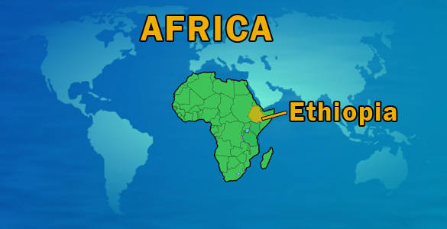
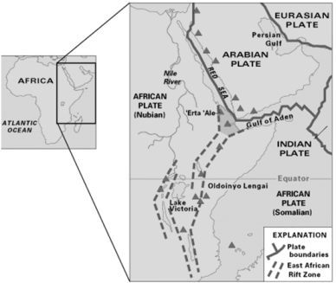
East African Rift Continued
A new ocean floor on the Earth’s surface, a gigantic steam of molten rock (lava) rising from beneath the Earth’s crust is slicing through the African continental plate like a blow torch. The lava has risen into some of the crevices. This kind of lava comes out of volcanic ridges deep under the ocean. This slowly pushes older lava sediments away on either side. The process begins the birth of a new ocean floor. Now Afar Triple Junction is sinking rapidly.
The chain of volcanoes that run
along the East African Rift System
is a sign of the breaking apart of
the continent. In some areas around
the outer edges of the Rift system, the
Earth’s crust has already cracked open,
making room for the magma below.
Diagram 1 - Ethiopia
Afar region triple junction.
Afar: darker shading. Volcanoes: triangles
Image: From ‘This Dynamic Earth’ by Kious and Tilling, courtesy of the US Geological Survey.
The Plates are being split apart.

Slide 26
Grade Equivalent 6.9
Lexile Measure 940L
Mean Sentence Length 13.40
Mean Log Word Frequency 3.40
Word Count 402
Cracking Up
Elizabeth Yeo
Splitting Up
A new ocean will one day separate Africa.
A group of nomads got a shock several years ago in a desert in Ethiopia. A series of earthquakes rattled the ground one night, making a loud noise. The next morning, the nomads found that a 3-foot cliff had risen from the ground behind them. The event wasn’t just any earthquake. It was one step in a geological process that is slowly building a new ocean in eastern Africa.
Spreading Apart
Earth’s shell is made up of huge pieces that fit together like those in a jigsaw puzzle. Called tectonic plates, the pieces are moving very slowly. Some plates are crashing together. Some are pulling apart. In the long course of Earth’s history, the movements of plates have created mountains, oceans, and continents.
In eastern Africa, two large tectonic plates, the African Plate and the Arabian Plate, are pulling away from each other. “There’s true plate spreading going on there,” Cindy Ebinger, an earth scientist from New York, told ScienceSpin.
That’s not all. As the two plates pull apart, the African Plate
is splitting into two pieces. One tectonic plate is becoming two plates.
Recently, that tectonic activity has gotten intense. In 2005, the
cracking of the African Plate triggered a volcanic eruption in
Ethiopia. That was followed by the series of earthquakes the
nomads felt. The earthquakes occurred as magma (liquid rock)
rose from deep within Earth, splitting the ground wide open. A series of crevices, some as wide as 10 feet, opened along a 35-mile stretch of desert in Ethiopia. Since then, the cracks have continued to grow.
A Natural Lab
Africa’s tectonic action has been going on for 30 million years. The spreading and cracking is what formed the Red Sea, and the Great Rift Valley. The rift runs south from the bottom of the Red Sea through eastern Africa.
As the two sides of the rift valley pull even farther apart, the entire area will someday fall below sea level. Someday, water from the Red Sea will rush in to fill the rift. This will form a new body of water.
A million years from now, and maybe possibly sooner, the Great Rift Valley will lie at the bottom of an ocean that divides Africa in two. Then, an ocean will one day fill the Great Rift Valley, where Africa is pulling apart.
A scientist inspects one of many narrow cracks, that opened during a series of earthquakes in Ethiopia several years ago.

Slide 27
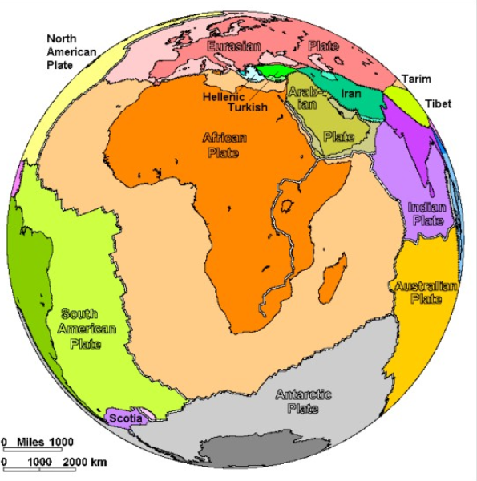
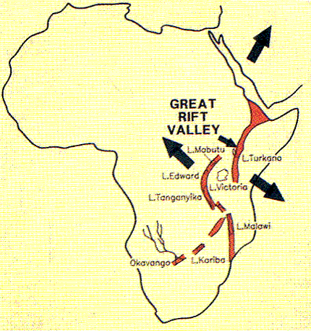
Cracking Up Continued…
The Splitting Up of Africa
An ocean will one day fill the Great Rift Valley, where Africa is pulling apart.

Slide 28
What information was the most likely reason for the students’ change in how they viewed earthquake drills?
Ms. Miller asked them if they had heard of tectonic plates.
Earth has been changing since the beginning of time.
Many cities are on fault lines where earthquakes are likely to happen.
Students learned that it was quite possible that their own city would have a major earthquake.
RL.6.3
Describe how a particular story's or drama's plot unfolds in a series of episodes as well as how the characters respond or change as the plot moves toward a resolution.
Which events led the geologists to the conclusion that the African and Arabian plates are drifting apart? Select all that apply.
The geologists were amazed and frightened by the crevices.
The rivers were changing course and mountains were rising skyward.
For several months, hundreds of crevices were opening up in the ground.
Traces of recent volcanic eruptions are also visible.

Slide 29
What was the author’s main purpose for writing the text Earthquake Drill?
The author is describing what happens to the earth during an earthquake.
The author is convincing the reader that earthquakes damage cities.
The author is wanting students to worry about their safety.
The author wanted to explain the importance of earthquake drills
RL.6.6
Explain how an author develops the point of view of the narrator or speaker in a text.
How does the teacher giving factual information about earthquakes influence the story?
The students learn about tectonic plates and changes in Earth’s surface
The students’ view of the importance of earthquake drills has changed.
The students could see how the continental pieces could have fit together at one time
The students had a hard time believing that huge chunks of the earth could move.

Slide 30
How are the purposes of the texts, Earthquake Drills and Cracking Up, different?
Earthquake Drills talks about the experience of a class, whereas Cracking Up discusses the experience of a group of nomads.
Earthquake Drills discusses earthquakes in general ways, while Cracking Up focuses on a specific region.
Cracking Up explains the African and Arabian Plates, while Earthquake Drills explained what to do in an earthquake.
Cracking Up uses maps to support the information, whereas Earthquake Drills uses dialogue.
RL.6.9
Compare and contrast texts in different forms or genres (e.g., stories and poems; historical novels and fantasy stories) in terms of their approaches to similar themes and topics.
Because of the information about earthquakes from The East African Rift and Earthquake Drills, what can you conclude about what changes earthquakes can make to the earth?
Both of the selections state that crevices are forming from earthquakes caused by moving plates.
In both selections it says that the earth’s continents are like a giant puzzle with the pieces moving very slowly.
Both selections state that as the earth splits apart an ocean will be born from Africa splitting apart.
In both selections it says that cities on fault lines can be impacted.

Slide 31
7. Explain how the students’ points of view develops through the story, Earthquake Drill. Use examples from the story in your explanation.
RL.6.6
Explain how an author develops the point of view of the narrator or speaker in a text.
8. Because of the information about how the earth is physically changing from these three passages, what can you conclude about what the earth might look like in the future?
RL.6.9
Compare and contrast texts in different forms or genres (e.g., stories and poems; historical novels and fantasy stories) in terms of their approaches to similar themes and topics.

Slide 32
What do the chain of volcanos along the East African Rift
indicate?
The chain of volcanos indicate that there will be many eruptions and earthquakes.
The chain of volcanos indicate that many crevices are forming.
The chain of volcanos indicate that there is lava beneath the Earth’s crust breaking the continental plate.
The chain of volcanos indicate that new crevices have very hot fumes.
RI.6.3
Analyze in detail how a key individual, event, or idea is introduced, illustrated, and elaborated in a text (e.g., through examples or anecdotes).
According to Cracking Up, What role do the tectonic plates
play in the creation of mountains, oceans, and continents?
Volcanos create earthquakes.
Tectonic plates crash together and some pull apart slowly.
The earthquakes occur as magma rises from within Earth.
Earth’s shell is made up of enormous pieces that fit together.

Slide 33
What was the author’s main purpose for writing the text The East
African Rift?
The author is describing the land changes occurring in East Africa.
The author is convincing the reader that East Africa’s geological changes make the area a dangerous place to live.
The author wanted to explain how a group of nomads got a shock several years ago in a desert in Ethiopia.
The author is informing the reader about the geological formation taking place in East Africa.
RI.6.6
Determine an author's point of view or purpose in a text and explain how it is conveyed in the text.
Why does the author of The East African Rift emphasize that changes take place slowly?
It takes time for new lava to push old lava away.
The author is explaining that it will be a long time before a new ocean is formed.
People do not usually get to see changes taking place in our environment.
The African and Arabian plates will take millions of years to totally drift apart.

Slide 34
13. How are the purposes of each text most different?
Cracking Up is investigative, while The East African Rift is about the causes and effects of the earthquakes.
Cracking Up is about nomads, while The East African Rift is about geologists.
Cracking Up is more about tectonic plates and the impact on land, while The East African Rift is more about the making of a new ocean.
Cracking Up is more about the tectonic plates, while The East African Rift is more about the impact of volcanoes on the land.
RI.6.9
Compare and contrast one author's presentation of events with that of another (e.g., a memoir written by and a biography on the same person).
14. How are Cracking Up and East African Rift different in their approach to explaining the tectonic plates?
Cracking Up explains the tectonic plates overall as part of Earth’s geological history.
The East African Rift states that the plates are drifting apart.
The East African Rift and Cracking Up have different viewpoints as to why the tectonic plates are moving.
Cracking Up states that the tectonic plates move constantly.

Slide 35
15. How much time does it take for a new ocean to form? How does the author convey this in Cracking Up? Use examples and quotes from the text.
RI.6.6
Determine an author's point of view or purpose in a text and explain how it is conveyed in the text.
16. Which text more specifically explains how the moving tectonic plates are affecting Africa? Use examples from both Cracking Up and The East African Rift.
RI.6.9
Compare and contrast one author's presentation of events with that of another (e.g., a memoir written by and a biography on the same person).

Slide 36
17. A student is writing an argumentative letter to the principal about needing more earthquake drills during the school day. Read the student’s draft and complete the task that follows. Brief Write, Organization, W.6.1c, words, phrases and clauses clarify relationships among claims or reasons, Target 6a To begin with, we need to make sure all the children here are protected from a possible earthquake. It is true that we had a lot of drills last year but it is also true that children (especially the younger ones), need frequent practice to learn and remember things. If we have fewer drills they are less likely to remember what to do in an event of a real earthquake and that would be disastrous. Secondly, there are many other ways to deal with a lack of time for earthquake drills. For example, if we were to start school just five minutes earlier each day we would have more than enough time to bring back the earthquake drills. Yet another way would be to have the earthquake drills during the last few minutes of our lunch recess. It would not be very often and I really think the students wouldn’t miss a few minutes once in a while. Finally, please remember that our lives may be in your hands one day and that there are frequent earthquakes where we live. How would you feel if a really strong quake happened and we weren’t ready? Write an introduction to the student’s argumentative letter that establishes and introduces a clear claim about having more earthquake drills. Use information from the passages to support your introduction.

Slide 37
A student is writing an argumentative essay for her teacher, about raising money so the students can go on a Big Lab field trip. The student wants to revise the draft to be more convincing.
Read the draft of the student’s argumentative essay and complete
the task that follows.
Revise a Text, W1b identify techniques to develop opinion or delete details not supporting opinion, Writing Target 6b
Since I’ve been at this school we have not had a science field trip. We have visited several places where people work (like businesses and hospitals) and that has been great. But, many of us are interested on knowing what causes earthquakes and volcanoes and have other scientific interests. You can learn about these things at the Big Lab Museum. When I ask the teachers if we can go they say we’ve had enough field trips!
First, let’s think about all of the field trips we’ve had this year. They have all been about places where people work and future careers. Some kids don’t even like to ride buses. But, most careers involve science in someway. So regardless of what career we choose we need to know more about science!
Secondly, if the school would plan better we could have an equal amount of different kinds of field trips. When I was little I went to the Dairy Queen on a field trip.
Finally, I think all student interests are equally important.
Choose the two sentences that should be deleted because they are least supportive of the claim in the student’s draft of an argumentative essay.
Some kids don’t even like to ride buses.
“When I ask the teachers if we can go they say we’ve had enough field trips!”
“When I was little I went to the Dairy Queen on a field trip.”
“Finally, I think all student interests are equally important.”
\ `

Slide 38
19. A student is writing a report about the African Plate. Read the sentence from the student’s draft below and then answer the question that follows.
In 2005, the cracking of the African Plate set off a terrible volcanic eruption in Ethiopia.
Which two verbs would be more precise and grade appropriate to replace the underlined verbs?
Language and Vocabulary, L.6.2d precise language and domain-specific vocabulary, Target 8
A. triggered, catastrophic
B. made, awful
produced, dreadful
formed, frightful
20. A student needs to edit his sentences. Which two sentences do not have errors in grammar usage?
Edit and Clarify L.61c, Inappropriate shifts in pronoun number and person, Target 9
If my team of scientists wants to study the Great Rift, we should join another team of geologists.
If scientists want to study the Great Rift, they should join a team of other geologists.
If scientists want to study the Great Rift, he should join a team of other geologists.
If scientists want to study the Great Rift, she should join a team of other geologists.

Slide 39
Part 2
Performance Task
Your assignment
In the Pacific Northwest , many people have strong feelings about earthquake preparedness. You will read three articles about earthquake activity in the African continent area. You will then write a speech on the issue of earthquake preparedness in the Pacific Northwest, in which you argue either for or against being prepared for a potential earthquake in our region. Your speech will eventually be given to your class.
You will:
Plan your writing. You may use your notes and answers.
Write – revise and edit your first draft (your teacher will give you paper).
Write a final draft of your opinion piece.
How you will be scored
Purpose | Do you clearly state your opinion? Do you stay on topic?
Organization | Do your ideas flow logically from the introduction to conclusion? Do you use effective transitions?
Elaboration: of evidence | Do you provide evidence from sources about your opinions and elaborate with specific information?
Elaboration: of language and vocabulary | Do you express your ideas effectively? Do you use precise language that is appropriate for your audience and purpose?
Conventions | Do you use punctuation, capitalization and spelling correctly?

Slide 42

STOP
Close your books and wait for instructions!

Slide 43
Student Scoring Color the box green if your answer was correct. Color the box red if your answer was not correct.
Literary Text
1 | What information was the most likely reason for the students’ change in how they viewed earthquake drills? RL.6.3
2 | Which events led the geologists to the conclusion that the African and Arabian plates are drifting apart? Select all that apply. RL.6.3 (both must be correct)
3 | What was the author’s main purpose for writing the text Earthquake Drill? RL.6.6
4 | How does the teacher giving factual information about earthquakes influence the story? RL.6
5 | How are the purposes of the texts, Earthquake Drills and Cracking Up, different? RL.6.9
6 | Because of the information about earthquakes from The East African Rift and Earthquake Drill, what can you conclude about what changes earthquakes can make to the earth? RL.6.9
7 | Explain how the students’ point of view develops through the story, Earthquake Drill. Use examples from the story in your explanation. RL.6.6 |  | 2 | 1 | 0
8 | Because of the information about how the earth is physically changing from these three passages, what can you conclude about what the earth might look like in the future. RL.6.9 | 3 | 2 | 1 | 0
Informational Text
9 | What do the chain of volcanos along the East African Rift indicate? RI.6.3
10 | According to Cracking Up, What role do the tectonic plates play in the creation of mountains, oceans, and continents? RI.6.3
11 | What was the author’s main purpose for writing the text The East African Rift? RI.6.6
12 | Why does the author of The East African Rift emphasize that changes take place slowly? RI.6.6
13 | How are the purposes of each text most different? RI.6.9
14 | How are Cracking Up and The East African Rift different in their approach to explaining the tectonic plates? RI.6.9
15 | How much time does it take for a new ocean to form? How does the author convey this in Cracking Up? Use examples and quotes from the text. RI.6.6 |  | 2 | 1 | 0
16 | Which text more specifically explains how the moving tectonic plates are affecting Africa? Use examples from both Cracking Up and The East African Rift. RI.6.9 | 3 | 2 | 1 | 0
Writing
17 | Write an introduction to the student’s argumentative letter that establishes and introduces a clear claim about having more science field trips. W.6.1c | 2 | 1 | 0
18 | Choose the two sentences that should be deleted because they are least supportive of the claim in the student’s draft of an argumentative essay. W.6.1b
19 | Which two verbs would be more precise and grade appropriate to replace the underlined verbs? L.2.6d
20 | A student needs to edit his sentences. Which two sentences do not have errors in grammar usage? L.6.1c

