Slide 1
1st
Quarter Three CFA
Reading: Literature Grade One
Targets |  | Standards | DOK
3 | Word Meanings | RL.4 | 1-2
6 | Text Structures/Features | RL.7 | 2
5 | Analysis Within and Across Texts | RL.9 | 4
Reading: Informational Grade One
Targets |  | Standards | DOK
10 | Word Meanings | RI.4 | 1-2
11 | Reasoning and Evidence | RI.8 | 3-4
12 | Analysis Within and Across Texts | RI.9 | 2-3-4
Note: There may be more standards per target. Writing standards assessed in this assessment are boxed.
Narrative Writing and Language
Targets |  | Standards | DOK
6a | Brief Narrative Write | W.3a, W.3b, W.3c, W.3d | 3
6b | Write-Revise Narrative | W.3a, W.3b, W.3c, W.3d | 2
2 | Full Narrative Composition | W-3a, W-3b, W-3c, W-3d, W-4, W-5, W-8 | 4
8 | Language-Vocabulary Use | L.1.6 | 1-2
9 | Edit and Clarify | L.1.1.d | 1-2

Slide 2
Quarter Three English Language Arts Common Formative Assessments
Team Members and Writers
This assessment was developed working backwards by identifying the deep understanding of the two passages. Key Ideas were identified to support constructed responses and key details were aligned with the selected response questions. All questions support students’ background knowledge of a central insight or message.
Thank you to all of those who reviewed and edited and a special appreciation to Vicki Daniels and her amazing editing skills and our “in-house” writer Ginger Jay.
Deborah Alvarado | Berta Lule |  | Judy Ramer
Christina Orozco | Alfonso Lule |  | Jill Russo
Linda Benson | Sandy Maines |  | Sharon Carlson
Maritza Dash | Gina McLain |  | Anne Berg
Heather Giard | Nicole Thoen |  | Aliceson Brandt
Translator: Zaida Rosa |  | Translator: Patricia Ramirez
All elementary ELA assessments were reviewed and revised in June of 2015 by the following amazing and dedicated HSD K-6th grade teachers.
Deborah Alvarado Lincoln Street | Sonja Grabel Patterson | Gina McLain TOSA
Linda Benson West Union | Megan Harding Orenco | Teresa Portinga Patterson
Anne Berg Eastwood | Renae Iversen TOSA | Judy Ramer Consultant
Aliceson Brandt Eastwood | Ginger Jay Witch Hazel | Sara Retzlaff McKinney
Sharon Carlson Minter Bridge | Ko Kagawa Minter Bridge | Jami Rider Free Orchards
Deborah Deplanche Patterson | Jamie Lentz Mooberry | Kelly Rooke Free Orchards
Alicia Glasscock Imlay | Sandra Maines Quatama | Angela Walsh Witch Hazel

Slide 3
This is a CFA to measure the task of writing a narrative piece. Full compositions are always part of a Performance Task (PT). A complete performance task would have:
Part 1 of a Performance Task
A Classroom Activity (30 Minutes)
Passages or stimuli to read
3 Research questions
There may be other constructed response questions.
Part 2 of a Performance Task
A Full-Composition (70 Minutes)
Students should have access to spell-check resources but no grammar-check resources. Students can refer back to their passages, notes and 3 research questions and any other constructed responses, as often they’d like.
Directions
30 minutes
You may wish to have a 30 minute classroom activity. The purpose of a PT activity is to
ensure that all students are familiar with the concepts of the topic and know and
understand key terms (vocabulary) that are at the upper end of their grade level (words
they would not normally know or are unfamiliar to their background or culture).
The classroom activity DOES NOT pre-teach any of the content that will be assessed!
35 minutes
Students read the passages independently. If you have students who can not read
the passages you may read them to those students but please make note of the
accommodation. Remind students to take notes as they read. During an actual SBAC assessment students are allowed to keep their notes as a reference.
Students answer the 3 research questions or other constructed response questions. Students should also refer to their answers when writing their full opinion piece.
15 minute break
70 Minutes
4. Students write their full composition (narrative piece).
SCORING
An Informational Rubric is provided. Students receive three scores:
Organization and Purpose
Evidence and Elaboration
Conventions

Slide 4
Peaches Classroom Activity
This classroom pre-activity follows the Smarter Balanced Assessment Consortium general design of contextual elements, resources, learning goals, key terms and purpose [http://oaksportal.org/resources/]
The content within each of these was written by……
The Classroom Activity introduces students to the context of a performance task, so they are not disadvantaged in demonstrating the skills the task intends to assess.
Contextual elements include:
an understanding of the setting or situation in which the task is placed
potentially unfamiliar concepts that are associated with the scenario
key terms or vocabulary students will need to understand in order to meaningfully engage with and complete the performance task
The Classroom Activity is also intended to generate student interest in further exploration of the key idea(s). The Classroom Activity should be easy to implement with clear instructions.
Please read through the entire Classroom Activity before beginning the activity with students to ensure any classroom preparation can be completed in advance. Throughout the activity, it is permissible to pause and ask students if they have any questions.
Resources needed:
Copy of Reader’s Theater Script for each student or each pair of students
Copy of Reader’s Theater Script to display
Some method of displaying ancillary materials*
Learning Goals:
Students will understand the context of the key concepts related to the topic of
harvesting crops
fruits/vegetables ready to sell
Students will understand the key terms:
Note: Definitions are provided here for the convenience of facilitators. Students are expected to understand these key terms in the context of the task, not memorize the definitions.
country
orchard
warehouse
sort(ed)
ripe
[Purpose: The facilitator’s goal is to help students understand how fruits/vegetables get from a farm to thee grocery store.]
*Facilitators can decide whether they want to display ancillary materials using an overhead projector/ELMO or computer/Smartboard.

Slide 5
Peaches continued…
Facilitator says: “Today we will get ready for the Apple Performance Task where you will be writing a narrative about planting and growing apple trees.”
Facilitator says: “We get to do a Reader’s Theater about peaches. Peaches are fruit that grow on trees. Here is a picture of a peach.”
[Display picture of peach.]
Discussion question:
I wonder how peaches get from farms to the grocery store?
Facilitator says: “Talk with your partner about how you think peaches get from farms to the grocery store. I will give you three minutes to talk to your partner.”
[Give students at least three minutes to discuss the question. Walk around to check for ideas and understanding.]
Possible student responses (unscripted)
Peaches grow on trees, get picked and the farmer takes them to the grocery store
Peaches get picked and a big truck takes them to the store
The farmer takes them to the store
Facilitator says: “You have a lot of ideas about how peaches get to stores. Now we are going to practice our Reader’s Theater about peaches. We will find out how peaches get from farms to grocery stores. This story is called Peaches. “
[Give each student or each pair a copy of the Reader’s Theater Script. Display script.]
Facilitator says: “First, we are going to read this through together. I will read it out loud and you follow along with your finger.”
[Read through the script so students get familiar with the text.]
Facilitator says: “I am going to assign you a role. You and your partner will have the same role. You can practice your lines with your partner. Many students will have the same role as you.”
[Assign roles based on your knowledge of students’ abilities. The role of Narrator should be given to a higher reader or Facilitator can read that role. Partner appropriately.]
Facilitator says: “I will give you at least 5 minutes to practice your roles. If you need help, raise your hand and I will come around to help you.”
[If students need less or more time to practice, adjust accordingly.]

Slide 6
Peaches continued…
Facilitator says: “Now that everyone has practiced, we are going to read through our Reader’s Theater.”
[Read through script at least one time. Read through it more than once if time allows.”
Facilitator says: “In your performance task, you will be learning more about how fruit gets from farms to grocery stores.
The group work you did today should help prepare you for the research and writing you will be doing in the performance task.”
Note: Facilitator should collect student notes from this activity.

Slide 7
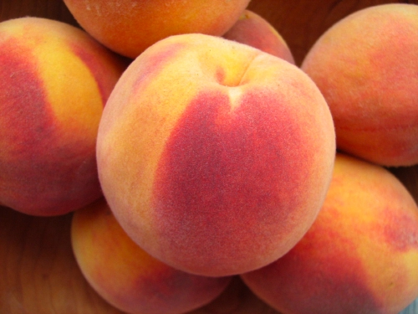
ancillary materials
Figure 1: peach

Slide 8
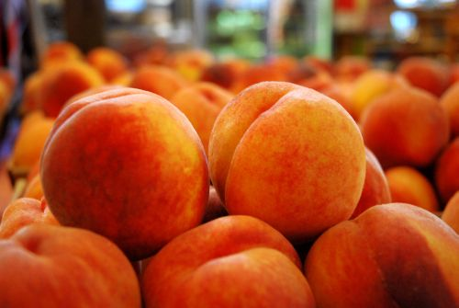
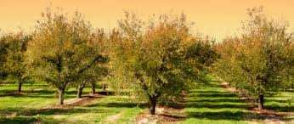
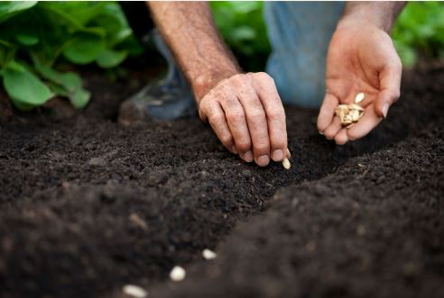
ancillary materials continued
Reader’s Theater Script: Peaches
Roles: Narrator, Farmer, Seeds, Trees, Peaches,
Child, Mom
Narrator: Our story takes place out in the country. The country is a place that is outside of a city or town. There are a lot of farms in the country. Farmers grow fruits and vegetables on farms. Here is our farmer now…
Farmer: Oh boy, I really want to grow a peach orchard! It’s time for me to plant some peach seeds. If I plant a lot of seeds in rows, they will turn into a great orchard full of big peach trees!
Narrator: The farmer went out onto his farm and started planting peach seeds.
Seeds: Plant us, plant us and we will grow! Water us, water us and we will grow!

Slide 9
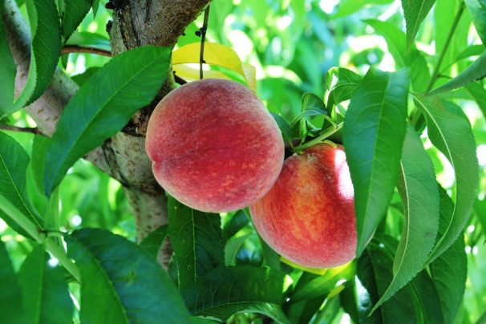
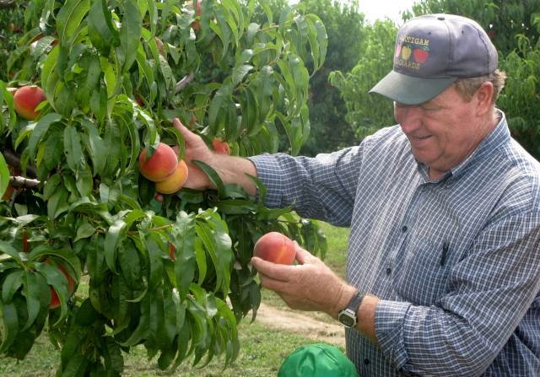
Narrator: The farmer planted the seeds. Then he watered the seeds. After awhile, the seeds began to grow.
Seeds: The farmer took care of us and now we are growing.
Narrator: The seeds grew into trees. Pretty soon the farmer had an orchard of peach trees.
Trees: Oh my, look at us! We are big peach trees. Look at all of our beautiful peaches. They are big and round!
Narrator: All of the peach trees had grown many, many peaches on their branches. The farmer was so happy!
Trees: We have so many peaches on our branches. I hope the farmer comes soon to pick them.
Farmer: I’m so excited! The peach tree orchard has so many peaches! They all look ripe, which means they are ready to pick.
Narrator: The farmer picked the ripe peaches. Then he sorted the peaches.
Farmer: I’m going to sort the peaches. I will keep the peaches that look good and I will throw away the bad peaches.
Peaches: The farmer picked us and sorted us. Now where will we go?

Slide 10
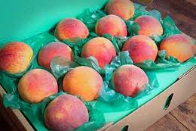
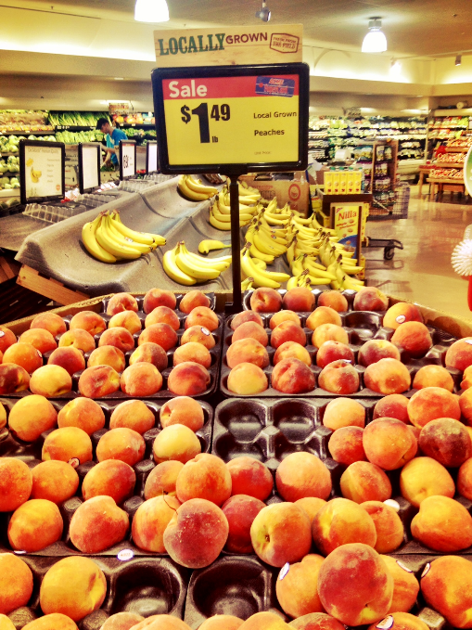
Narrator: The good peaches were sent to a warehouse. A warehouse is a big building where fruit is kept until it is sent to the grocery stores.
Peaches: Wow! Look at this warehouse. It is so big and there are so many peaches here.
Narrator: Pretty soon the peaches were put into boxes and taken to the grocery store.
Peaches: Yippee! We are at the grocery store. I hope people come and buy us.
Child: Mom, can we buy some peaches?
Mom: Yes! Those peaches look ripe and yummy!
Child: Thanks Mom. I can’t wait to eat those peaches!
Narrator: THE END!

Slide 11
Determining Grade Level Text
Grade level text is determined by using a combination of both the CCSS new quantitative ranges and qualitative measures.
Example: If the grade equivalent for a text is 6.8 and has a lexile of 970, quantitative data shows that placement should be between grades 4 and 8.
Four qualitative measures can be looked at from the lower grade band of grade 4 to the higher grade band of grade 8 to determine a grade level readability.
The combination of the quantitative ranges and qualitative measures for this particular text shows that grade 6 would be the best readability level for this text.
Common Core Band | Flesch-Kincaid® | The Lexile Framework®
2nd - 3rd | 1.98 - 5.34 | 420 - 820
4th - 5rd | 4.51 - 7.73 | 740 - 1010
6th – 8th | 6.51 - 10.34 | 925 - 1185
9th – 10th | 8.32 - 12.12 | 10.50 - 1335
11th - CCR | 10.34 - 14.20 | 11.85 - 1385
4 Qualitative Factors | Rate your text from easiest to most difficult between bands.
 | Beginning of lower (band) grade | End of lower (band) grade | Beginning of higher (band) to mid | End of higher (band) grade | Not suited to band
Purpose/Meaning
Structure
Language Clarity
Language
Overall Placement
To see more details about each of the qualitative measures please go to slide 6 of: http://www.corestandards.org/assets/Appendix_A.pdf

Slide 12
Order at HSD Print Shop…
http://www.hsd.k12.or.us/Departments/PrintShop/WebSubmissionForms.aspx
Directions
The HSD Elementary assessments are neither scripted nor timed assessments. They are a tool to inform instructional decision making. It is not the intent of these assessments to have students “guess and check” answers for the sake of finishing an assessment.
All students should “move toward” taking the assessments independently but many will need scaffolding strategies. If students are not reading at grade level and can’t read the text, please read the stories to the students and ask the questions. Allow students to read the parts of the text that they can. Please note the level of differentiation a student needed.
About this Assessment
This assessment includes: Selected-Response, Constructed-Response, and a Performance Task.
Types of SBAC Constructed Response Rubrics in this Assessment http://www.livebinders.com/play/play?id=774846
Reading 2 Point Short Response 3 Point Extended Response | Writing 4 Point Full Composition Rubric (Performance Task) 3 Point Brief Write (1-2 Paragraphs) Rubric 3 Point Write to Revise Rubrics as Needed | Research 2 Point Rubrics Measuring Research Skill Use
Quarter 3 Performance Task The underlined sections are those scored on SBAC. Please take 2 days to complete performance tasks.
Part 1 | Part 2
Classroom Activity if Desired/Needed Read two paired passages. Take notes while reading (note-taking). Answer SR and CR research questions about sources Components of Part 1 Note-Taking: Students take notes as they read passages to gather information about their sources. Students are allowed to use their notes to later write a full composition (essay). Note-taking strategies should be taught as structured lessons throughout the school year in grades K – 6. A teacher’s note-taking form with directions and a note-taking form for your students to use for this assessment is provided, or you may use whatever formats you’ve had past success with. Please have students practice using the note-taking page in this document before the actual assessment if you choose to use it. Research: In Part 1 of a performance task students answer constructed response questions written to measure a student’s ability to use research skills needed to complete a performance task. These CR questions are scored using the SBAC Research Rubrics rather than reading response rubrics. | Plan your essay (brainstorming/pre-writing). Write, Revise and Edit (W.5) Writing a Full Composition or Speech Components of Part 2 Planning Students review notes and sources and plan their composition. Write, Revise and Edit Students draft, write, revise and edit their writing. Word processing tools should be available for spell check (but no grammar check). This protocol focuses on the key elements of writing narratives: introduction (narrator and/or setting and characters) organization (event sequence) development (narrative techniques such as dialogue, pacing, description reflection, and multiple plot lines) transitions (to sequence events) conclusion conventions of standard English.
There are NO Technology-enhanced Items/Tasks (TE) Note: It is highly recommended that students have experiences with the following types of tasks from various on-line instructional practice sites, as they are not on the HSD Elementary Assessments: reordering text, selecting and changing text, selecting text, and selecting from drop-down menu

Slide 13
Grade 1
R E- read | S | E | A | R | C | H
 | SOMETHING NEW | EXPLAIN MORE | AGAIN and AGAIN | RELEVANT OR NOT? | CONCLUDE | HAVE EVIDENCE
Write one new key idea you learned about the main topic.
.
.
Instruct students to look at a part of the passage they liked or one you’ve chosen for them (a paragraph or section).
Ask students “Does this part of the paragraph or section tell you something new about the main topic? (remind them of the main topic). This is a key idea about the main topic.
1
Explain more key details about the new key idea you learned. You can use words and pictures to tell about it.
Ask students to look for key details that explain more about the “something new.”
key details give evidence to support a key idea (or idea).
Example: if the main topic is about dogs and ...
“The dog likes to play,” (is the key Idea),
Then some key details might be:
the dog likes to play fetch.
the dog likes to play with the ball.
2
Remember students will need to have a note-taking form for each passage.
3
Differentiation:
In grade one you can scaffold students by starting with writing just a key idea and move toward writing key details. Students who would benefit from enrichment can continue on with more sections or paragraphs.
Students who need more direct instruction – teach each part in a mini lesson. These concepts can be taught separately:
Main topic
Key Ideas
Key Details
ELL Students may need each part taught using language (sentence) frames emphasizing transitional words.

Slide 14
Grade 1
Note-Taking Form
Name_____________________ Passage_________________
Write one new key idea you learned about the main topic.
Explain more key details about the new key idea you learned. You can use words and pictures to tell about it.

Slide 15
A Note about constructed responses: Constructed response answers are not written “in stone.” There is no perfect way a student should respond. Look for the general intent of the prompt and student response and follow the rubric below as much as possible. Use your best judgment. Unlike DOK-1 questions where there is one right and wrong answer, constructed responses are more difficult to assess. Overall consistency of intent based on most of your student responses can guide you.
Quarter 3 CFA Research Constructed Response Answer Key
Constructed Response Research Rubrics Target 3 evidence of the ability to distinguish relevant from irrelevant information such as fact from opinion
Question #7 RL.1.7 Prompt: Based on details in Johnny Appleseed, what can you tell about the setting for this story?
Teacher /Rubric “Language Response”
The response gives sufficient evidence of the ability to distinguish relevant from irrelevant information. The response should show details from the text that support the setting of the story. They may include: (1) the setting is outside, (2) it is in the country, (3) there are apple trees ,(4) it can be rainy and snowy, and (5) there are animals.
Student “Language” Response Example
2 | Student presents sufficient relevant details (4 or more) from the text that support the setting of the story. The setting of this story is outside. It is in the country and there are a lot of apple trees. There are bears. It may rain or snow outside in the winter.
1 | Student presents sufficient relevant details (2-3) from the text that support the setting of the story. The response shows The setting is outside and there are a lot of apple trees.
0 | Student does not present sufficient relevant details that support the setting of the story. It is outside.
RL.1.7 Use illustrations and details in a story to describe its characters, setting, or events

Slide 16
A Note about constructed responses: Constructed response answers are not written “in stone.” There is no perfect way a student should respond. Look for the general intent of the prompt and student response and follow the rubric below as much as possible. Use your best judgment. Unlike DOK-1 questions where there is one right and wrong answer, constructed responses are more difficult to assess. Overall consistency of intent based on most of your student responses can guide you.
Quarter 3 CFA Constructed Response Answer Key
Standard RL.1.9: 3 Point Reading Constructed Response Rubric
Question #8 (prompt): From the story Johnny Appleseed, what can you tell about his life?
Directions for Scoring: Write an overview of what students could include in a proficient response with examples from the text. Be very specific and “lengthy.” Sufficient Evidence would be a complete answer with an explanation including specific details from the story. Specific Identifications (supporting details): Responses should include some of the following: (1) he spent his life planting apple seeds, (2) he didn’t want people to be hungry, (3) he was kind to people and animals, (4) he liked the outdoors and spent a lot of time there, and (5) he had a lot of friends like people and animals.
3 | Student presents an explanation that provides sufficient supporting details (3 or more) from the story. Johnny Appleseed planted apple seeds, because he didn’t want anyone to be hungry. He liked the outdoors. He slept there and cooked there. Everybody liked him. He had friends like the Indians and he even pulled a bear’s tooth out and became friends with the bears.
2 | Student presents an explanation that provides some supporting details (2) from the story. Johnny Appleseed planted apple seeds, because he didn’t want anyone to be hungry. He liked the outdoors.
1 | Student presents an explanation that provides limited supporting details (1) from the story. Johnny Appleseed planted apple seeds, because he didn’t want anyone to be hungry.
0 | Student does not present an explanation and/or sufficient supporting details from the story. He was nice to bears.
RL.1.9 Compare and contrast the adventures and experiences of characters in stories.

Slide 17
A Note about constructed responses: Constructed response answers are not written “in stone.” There is no perfect way a student should respond. Look for the general intent of the prompt and student response and follow the rubric below as much as possible. Use your best judgment. Unlike DOK-1 questions where there is one right and wrong answer, constructed responses are more difficult to assess. Overall consistency of intent based on most of your student responses can guide you.
Quarter 3 CFA Research Constructed Response Answer Key
Constructed Response Research Rubrics Target 3 evidence of the ability to distinguish relevant from irrelevant information such as fact from opinion
Question #15 RI.1.8 Prompt: What key details in Apple Picking Time and How Do Apples Get to You? explain how apples are picked from trees?
Teacher /Rubric “Language Response”
The response gives sufficient evidence of the ability to distinguish relevant from irrelevant information in order to answer the prompt. Student should cite evidence about how apples are picked from trees. Evidence from both texts should include (1) workers pick apples, (2) machines pick apples, (3) workers climb ladders to reach apples in tall trees, and (4) workers put the apples into bags. Students may use information to add to meaning (such as apples are picked in the fall) but only information specific to the prompt is given credit.
Student “Language” Response Example
2 | Student presents sufficient relevant facts (3-4 facts) from both texts. When its time to pick apples people climb up on ladders. The ladders help them reach apples that are high up in the trees. They put the apples in bags. Sometimes machines pick the apples.
1 | Student presents relevant facts (1-2 facts) from both texts. People can pick apples. Machines can pick apples.
0 | Student presents no evidence to distinguish relevant from irrelevant information about the prompt. Apples are red and green.
RI.1.8 Identify the reasons an author gives to support points in a text.

Slide 18
A Note about constructed responses: Constructed response answers are not written “in stone.” There is no perfect way a student should respond. Look for the general intent of the prompt and student response and follow the rubric below as much as possible. Use your best judgment. Unlike DOK-1 questions where there is one right and wrong answer, constructed responses are more difficult to assess. Overall consistency of intent based on most of your student responses can guide you.
Quarter 3 CFA Research Constructed Response Answer Key
Constructed Response Research Rubrics Target 4 ability to cite evidence to support opinions and/or ideas
Question # 16 RI.1.9 How do apples get from the trees to your home? Use examples from both texts.
Teacher /Rubric “Language Response”
The response gives sufficient evidence of the ability to distinguish relevant from irrelevant information in order to answer the prompt. Students should cite evidence about how apples get from trees to home. Evidence from both texts should include (1) apples grow in orchards, (2) workers or machines pick apples, (3) apples are put in a warehouse, (4) apples are sorted (one text says rotten apples are thrown away), (5) one text says clean apples are packed into boxes, (6) apples are delivered to the store (one text says the apples are put on shelves) and (6) people go to the store and buy the apples. Students may use information to add to meaning but only information specific to the prompt is given credit for. The response should have some type of sequential order (enough to make sense of the process).
Student “Language” Response Example
2 | Student presents relevant and sufficient details (4-5) in sequential order from both texts. Apples grow on trees. When its time people or machines pick the apples and put them in bins. The bins go to a warehouse to keep apples cold and crunchy. Then the apples are sorted. Rotten apples are thrown away and clean apples are packed into boxes. Trucks take the clean apples to the grocery stores. People put the apples on shelves. We go to the store and buy apples. Then we take them home and eat them!
1 | Student presents limited relevant details (2-3) in sequential order, but it isn’t apparent if they are from both texts. Apples are good to eat at home. After the apples are picked they are taken to the store. We buy the apples and eat them.
0 | Student presents no evidence to distinguish relevant from irrelevant information about the prompt. I like green apples best.
RI.1.9 Identify basic similarities in and differences between two texts on the same topic (e.g., in illustrations, descriptions, or procedures).

Slide 19
Note: “Brief Writes” should take no longer than 10 minutes. Brief writes are scored with a 2-3 point rubric. Full compositions are scored with a 4 point rubric. The difference between this rubric and the constructed response reading rubrics, is that the Brief Write Rubric is assessing writing proficiency in a specific area, while the reading rubrics are assessing comprehension.
Quarter 3 CFA Brief Write Constructed Response Answer Key Organization: Conclusion W.1.3.c Target: 6a In your concluding statement, use temporal words to signal event order.
W.3 Write narratives in which they recount two or more appropriately sequenced events, include some details regarding what happened, use temporal words to signal event order, and provide some sense of closure.
17. Read the story below. Write an ending for the story that solves the problem. The Little Apple Tree Johnny Appleseed planted a little apple seed by Tom’s house. The seed began to grow. It grew into a little tree. Then one day it stopped raining. The little apple tree began to wilt. Write a Brief Text, W.1.3c Temporal Words Target 6a
Teacher /Rubric “Language Response”
Directions for Scoring: Write an overview of what students could include in a proficient response with examples from the text. Be very specific and “lengthy.” Teacher Language and Scoring Notes: The student response should provide a conclusion (1-2 sentences) that logically follows and supports the preceding information about the little apple seed. Students show transitioning from the beginning to the end using specific temporal words to signal event order as this is the central focus of this brief write. The student will show that they recognize event sequence from the beginning of the story to the ending by using temporal words to signal event order. These words may include but are not limited to: (1) then, (2) but, (3) finally, (4) next, (5) and so, and (6) now (etc..). The conclusion should make sense and support the preceding information about the apple seed.
Student “Language” Response Example
2 | The brief write transitions from a beginning to a conclusion using multiple temporal transitioning words to signal an event order that follows logically from the preceding information. Then, a little girl came by and saw that the apple seed was not growing anymore. She looked at the seed and said, “Oh no,” it needs water. So she ran to the pond and got a pail of water. Next, she gave the water to the little seed. Now the apple seed is growing bigger again.
1 | The brief write transitions from a beginning to a conclusion using at least one temporal transition word to signal an event order but vaguely or somewhat follows logically from the preceding information. A boy saw the apple seed. It looked sad. So the boy went to tell his mom.
0 | The brief write does not show transitions from a beginning to a conclusion. The little seed is not getting bigger.

Slide 20
ELP 1st Grade Band Standards Organized by Modality
Receptive modalities*: Ways in which students receive communications from others (e.g., listening, reading, viewing). Instruction and assessment of receptive modalities focus on students’ communication of their understanding of the meaning of communications from others. | Listening & reading | 9 - create clear and coherent grade-appropriate speech and text | 10 - make accurate use of standard English to communicate in grade-appropriate speech and writing | 1 | construct meaning from oral presentations and literary and informational text through grade-appropriate listening, reading, and viewing
 |  |  |  | 8 | determine the meaning of words and phrases in oral presentations and literary and informational text
Productive modalities*: Ways in which students communicate to others (e.g., speaking, writing, and drawing). Instruction and assessment of productive modalities focus on students’ communication of their own understanding or interpretation. | Speaking & Writing |  |  | 3 | speak and write about grade-appropriate complex literary and informational texts and topics
 |  |  |  | 4 | construct grade-appropriate oral and written claims and support them with reasoning and evidence
 |  |  |  | 7 | adapt language choices to purpose, task, and audience when speaking and writing
Interactive modalities*: Collaborative use of receptive and productive modalities as “students engage in conversations, provide and obtain information, express feelings and emotions, and exchange opinions” (Phillips, 2008, p. 3). | Listening, speaking, reading, and writing |  |  | 2 | participate in grade-appropriate oral and written exchanges of information, ideas, and analyses, responding to peer, audience, or reader comments and questions
 |  |  |  | 5 | conduct research and evaluate and communicate findings to answer questions or solve problems
 |  |  |  | 6 | analyze and critique the arguments of others orally and in writing
Standard | An ELL can… | By the end of an English language proficiency level, an ELL in 1st Grade can . . .
4 Productive (S & W) | …construct grade-appropriate oral and written claims and support them with reasoning and evidence. | 1 | 2 | 3 | 4 | 5
 |  | …express a preference or opinion about a familiar topic. | …express an opinion about a familiar topic. | …express an opinion about a familiar topic or story, & give a reason for the opinion. | …express opinions about a variety of texts & topics, & give a reason for the opinion. | …express opinions about a variety of texts & topics, introducing the topic & giving a reason for the opinion, & providing a sense of closure.
This performance task is based on writing. As an option if you’d like to monitor growth for ELP as a second goal, teachers can choose to assess ELP standard 4 because it aligns with this specific performance task. Your student’s full composition can be analyzed to identify English language proficiency levels. It is evident that students will be navigating through the modalities to get to the end product. However, it is important to keep in mind what the full opinion writing performance task is assessing and how deeply the student understands class content and language. The ELP growth goal is to provide the “just-right scaffolds” for students to demonstrate their understanding in order for them to move from one proficiency level to the next.
Oregon ELP Standards Aligned with Performance Task, 2014; Arcema Tovar

Slide 21
Narrative Writing CFA
Student and Class Scoring: |  |  | School Year: |  | Grade:
 |  | Teachers Name:
 |  | School:
Student Name: |  |  | Focus and Organization | Elaboration and Evidence | Conventions | Student Total | ELP Score
 |  |  | Score | Score | Score
1.
2.
3.
4.
5 |  |  |  |  |  | 0
6 |  |  |  |  |  | 0
7 |  |  |  |  |  | 0
8 |  |  |  |  |  | 0
9 |  |  |  |  |  | 0
10 |  |  |  |  |  | 0
11 |  |  |  |  |  | 0
12 |  |  |  |  |  | 0
13 |  |  |  |  |  | 0
14 |  |  |  |  |  | 0
15 |  |  |  |  |  | 0
16 |  |  |  |  |  | 0
17 |  |  |  |  |  | 0
18 |  |  |  |  |  | 0
19 |  |  |  |  |  | 0
20 |  |  |  |  |  | 0
21 |  |  |  |  |  | 0
22 |  |  |  |  |  | 0
23 |  |  |  |  |  | 0
24 |  |  |  |  |  | 0
25 |  |  |  |  |  | 0
26 |  |  |  |  |  | 0
27 |  |  |  |  |  | 0
28 |  |  |  |  |  | 0
29 |  |  |  |  |  | 0
30 |  |  |  |  |  | 0
31 |  |  |  |  |  | 0
32 |  |  |  |  |  | 0
33 |  |  |  |  |  | 0
34 |  |  |  |  |  | 0
35 |  |  |  |  |  | 0
Scoring Key:
Total # Correct
1
= Emerging
0 - 4
2
= Developing
5 - 7
3
= Proficient
8 - 10
4
= Exemplary
11 - 12

Slide 22
Grades K - 2: Generic 4-Point Narrative Writing Rubric
Score | Statement of Purpose/Focus and Organization |  | Development: Language and Elaboration of Evidence |  | Conventions
 | Statement of Purpose/Focus | Organization | Elaboration of Evidence | Language and Vocabulary
4 Exemplary | Beginning establishes engaging context for story line/events (e.g., asks a question; starts with action or feelings) Effectively presents and maintains focus (controlling idea) of story line | Has a beginning, middle, and an ending with a sense of closure(e.g., a lesson learned –next time…; he never did that again) Variety of transitions used appropriately Chronology is logical | Relevant, concrete details create vivid images or ideas Effective use of dialogue, sensory and concrete details, strong verbs to advance the action; or to show how characters’ motivation, development or growth change in the text. | Maintains consistent narrator’s voice Uses precise language and sentence variety (simple, compound, with phrases) May use figurative language (e.g., imagery) | Edits with support from peers, adults, resources Has few or no errors in grammar, word usage, mechanics as appropriate to grade (e.g., uses conventional spelling for words with common patterns)
3 Proficient | Uses a combination of drawings, dictation, and writing (K) Event/ series of events is supported with key elements (gr K-2) Has title (gr 1-2) and clear focus (gr K-2) | Clear order of events; provides a reaction (K) Has beginning, middle, and end or problem solution (gr 1-2) Uses basic transitions (e.g., before, after, then, next, later) to show event order or chronology (gr 1-2) | Details include nouns, verbs, and adjectives May use dialogue, sensory or concrete details for effect (gr 1-2) Elaborates on actions, reactions, motivations, thoughts, or feelings orally or in writing | Appropriate use of words (singular-plural) and prepositional phrases Produces variety of complete sentences – orally (K) or in writing Uses adult/peer feedback to revise | Edits with support from peers, adults, or resources (gr 2) Minor errors do not interfere with reader’s understanding
2 Developing | Beginning has some context (when, why, etc.) for story line/events Includes key elements (characters, problem or main event) and attempts to establish a central focus | Has beginning, middle, and end, but some parts need work or need more clarity (e.g., may have digressions or gaps in the story; sequence or connection of events is not clear) Transitions are lacking or cause confusion | Some elaboration strategies are evident in drawings or writing, or added with support/questioning from peers or adults Uses some details or dialogue to elaborate on images or ideas (actions, thoughts, feelings) | Vocabulary use has minor errors Dictates, writes, and expands simple complete sentences Uses adult/peer feedback torevise | Edits with support from peers, adults, or resources (gr 2) Uses grade-appropriate basic mechanics and word use with some errors
1 Emerging | Beginning may have confusing context or no context for story line/events Lacks key elements of the story line/events (character(s), problem, or main event) | Attempts a beginning, middle, and end, but one or more parts are missing or generic (e.g., once upon a time…; the end) | Attempts to add details to drawings or writing are random, generic (e.g., good, nice, pretty), or may seem irrelevant to story line OR May identify literary elements (characters, setting, action) without any added description or details | Generally uses basic, incorrect, or below grade level vocabulary when dictating (K) or writing Uses adult/peer feedback to revise | Edits with support from peers or adults(gr 2) Grade-appropriate mechanics are not used or have frequent errors
0 | A response gets no credit if it provides no evidence of the ability to [fill in with key language from the intended target].
Working Drafts of ELA rubrics for assessing CCSS writing standards --- © (2010) Karin Hess, National Center for Assessment [khess@nciea.org

Slide 23
W.1.3 Write narratives in which they recount two or more appropriately sequenced events, include some details regarding what happened, use temporal words to signal event order, and provide some sense of closure.
Narrative Full Composition Performance Task Score “4” Example
score | Statement of Purpose/Focus and Organization |  | Development: Language and Elaboration of Evidence |  | Conventions
 | Statement of Purpose/Focus | Organization | Elaboration of Evidence | Language and Vocabulary
4 Rubric | Beginning establishes engaging context for story line/events (e.g., asks a question; starts with action or feelings) Effectively presents and maintains focus (controlling idea) of story line | Has a beginning, middle, and an ending with a sense of closure(e.g., a lesson learned –next time…; he never did that again) Variety of transitions used appropriately Chronology is logical | Relevant, concrete details create vivid images or ideas Effective use of dialogue, sensory and concrete details, strong verbs to advance the action; or to show how characters’ motivation, development or growth, change in the text. | Maintains consistent narrator’s voice Uses precise language and sentence variety (simple, compound, with phrases) May use figurative language (e.g., imagery) | Edits with support from peers, adults, resources Has few or no errors in grammar, word usage, mechanics as appropriate to grade (e.g., uses conventional spelling for words with common patterns)
Student Explanation | The student establishes the story line and engages the reader when apple seeds are taken to her class. | The student has a beginning, middle and an ending in sequential order that moves forward with transitional words. | The student elaborates on the topic of apple seeds by using concrete details and some sensory words (laughing, wet) as well as dialogue to advance the action in the story. | The student’s voice is knowledgeable about the information. The student knows uses precise vocabulary (orchard, seeds, watered) and a variety of sentence structures. | The student has few or no errors in grammar, word usage, or mechanics as appropriate to grade. The student is beginning to use some quotes for dialogue, but not scored in grade one.
Performance Task:
You are going to write a narrative story. This means it has a beginning, middle and an ending. This is a make-believe story. In your story, you will write about a character who plants apple seeds and when they grow into trees, will get the ripe apples ready for people to eat. You will use details to help you write your story from all of the passages you have read. Then you will tell the following:
Where is the setting? Who is the main character?
Where did the character plant the seeds?
What did the character see, hear and feel?
How did the character get them ready for people to eat.
Exemplar Student Writing Sample:
Lucy is in first grade. She lives on an orchard. There are lots of apple trees. She took some of the apple trees’ seeds to school.
Then, she shared and her class planted apple seeds in the school yard. It was fun. The other kids were laughing.
Later, they watered the seeds and everyone got wet.
When the trees get big they will have apples. Lucy said, “Then they can have an apple eating party.”
Uses topic vocabulary from texts.
Engages reader and Establishes storyline
Transitional words move story in event order.
Elaborates with concrete, sensory details and dialogue.
Has a clear and logical conclusion.
Conventions for grammar and mechanics are used appropriately throughout. Dialogue is in the beginning stages.

Slide 24
Quarter 3 CFA Selected Response Answer/Point Key
Question 1 In paragraph 1, which word describes how a person might feel? RL.1.4 | B | 1
Question 2 Why did Johnny Appleseed plant apple seeds? RL.1.4 | A | 1
Question 3 Which two words from the story describe Johnny Appleseed? Choose two answers. RL.1.7 | B and C | 1
Question 4 Why did Johnny Appleseed wear a tin pot on his head? RL.1.7 | B | 1
Question 5 Based on the story, what is the same about the Indians, settlers and bears? RL.1.9 | C | 1
Question 6 Johnny Appleseed pulled out the bear’s tooth. What does this tell you about him? RL.1.9 | A | 1
Question 7 Literature Text Constructed Response | RL.1.7 | 2
Question 8 Literature Text Constructed Response | RL.1.9 | 3
Question 9 According to the two texts, what is a warehouse? RI.1.4 | B | 1
Question 10 How do apples get to a warehouse? RI.1.4 | B | 1
Question 11 During what time of year are apples picked? RI.1.8 | B | 1
Question 12 What is something that workers use to pick apples? RI.1.8 | A | 1
Question 13 According to both texts, where do the trucks take the apples after the warehouse? RI.1.9 | C | 1
Question 14 According to both texts, where do some people buy apples? RI.1.9 | C | 1
Question 15 Informational Text Constructed Response | RI.1.8 | 2
Question 16 Informational Text Constructed Response | RI.1.9 | 2
Write and Revise
Question 17 Brief Write | W.1.3c | 2
Question 18 Which sentence could be added to the end of the paragraph? W.1.3d | A | 1
Question 19? Which word or phrase helps the reader best understand the meaning of the word stored in the sentence below? L.1.6 | C | 1
Question 20 Which word should go in the blank to finish the sentence? L.1.1d | B | 1

Slide 25
1st
Quarter Three
CFA
Student Copy
Student Name
_______________________

Slide 26
Student Directions:
Part 1
Your assignment:
You will read three texts.
Read the texts.
Take notes about the texts.
Answer the questions.
Part 2
Your assignment:
You are going to write a narrative story. This means it has a beginning, middle and an ending. This is a make-believe story. In your story, you will write about a character who plants apple seeds and when they grow into trees, will get the ripe apples ready for people to eat. You will use details to help you write your story from all of the passages you have read. Then you will tell the following:
Where is the setting? Who is the main character?
Where did the character plant the seeds?
What did the character see, hear and feel?
How did the character get them ready for people to eat?
How you will be scored
Purpose | Did you write only about the topic?
Organization | Do your ideas go together? Do they make sense?
Elaboration: of evidence | Did you show evidence to tell about your topic?
Elaboration: of language and vocabulary | Did you use words about the topic? Are your sentences easy to read and understanding?
Conventions | Did you follow rules for capitals, punctuation and spelling?

Slide 27
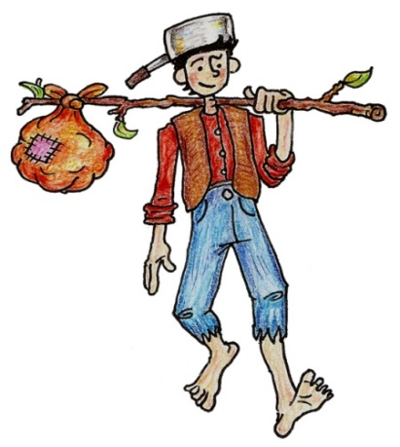
Grade Equivalent 4.7
Lexile Measure 950L
Mean Sentence Length 16.00
Mean Log Word Frequency 3.71
Word Count 176
Johnny Appleseed
Retold by 1st Grade HSD Teachers
1
Johnny Appleseed’s real name was John Chapman.
He dreamed of a land where apple trees were everywhere and no one was hungry. He spent his life walking around the country planting apple seeds.
2
Johnny Appleseed was kind. He slept outdoors in the rain and snow, and walked barefoot everywhere he went. In the winter when it snowed, he made snow shoes out of tree branches to keep his feet safe. His clothes were made from sacks and he wore a tin pot on his head for a hat so he wouldn’t have to carry it. When he took it off he could use it to cook.
3
Johnny made a lot of friends everywhere he went. The settlers and the Indians called him their friend. It has been said that he even made friends with animals like bears. One story tells of a bear who told Johnny his tooth hurt, so Johnny carefully pulled out the bear’s tooth. The bear let Johnny go, and the bears protected Johnny from other animals from that day on.

Slide 28
In paragraph 1, which word describes how a
person might feel?
dreamed
hungry
planting
RL.1.4 Identify words and phrases in stories or poems that suggest feelings or appeal to the senses.
Why did Johnny Appleseed plant apple seeds?
He didn’t want anyone to be hungry.
He made lots of friends.
His name was Johnny Appleseed.

Slide 29
Which two words from the story describe Johnny Appleseed? Choose two answers.
hungry
kind
friendly
RL.1.7 Use illustrations and details in a story to describe its characters, setting, or events
4. Why did Johnny Appleseed wear a tin pot on his head?
He wore it to keep his head safe.
He wore it so he didn’t have to carry it.
He could use it to cook.

Slide 30
5. Based on the story, what is the same about the
Indians, settlers, and bears?
They all liked apples.
They all slept outdoors.
They were all friends with Johnny Appleseed.
RL.1.9 Compare and contrast the adventures and experiences of characters in stories.
Johnny Appleseed pulled out the bear’s tooth. What does this tell you about him?
He was not afraid of bears.
He had a bear as a pet.
He liked planting apples.

Slide 31
7. Based on details from Johnny Appleseed, what can you tell about the setting for this story?
RL.1.7 Use illustrations and details in a story to describe its characters, setting, or events
8. From the story Johnny Appleseed, what can you tell about his life?
RL.1.9 Compare and contrast the adventures and experiences of characters in stories.

Slide 32
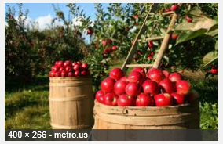
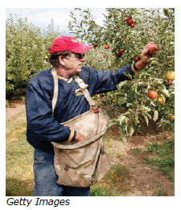
Text 1
Grade Equivalent 2.1
Lexile Measure 470L
Mean Sentence Length 7.27
Mean Log Word Frequency 3.45
Word Count 160
Apple Picking Time
Author: Readworks.org
Follow an apple from the tree to the store.
Section 1 Fall is apple season! That is when most apples are ripe. Ripe apples are fully grown. They are ready to be picked. Apples grow in orchards. An orchard is a kind of farm. It has rows and rows of apple trees. How does the fruit make its way to you? Follow the steps to find out.
Section 2 Workers pick apples. They put the apples into bags. Workers climb ladders to reach apples in tall trees.
Wiki License Adapted by HSD Teachers

Slide 33
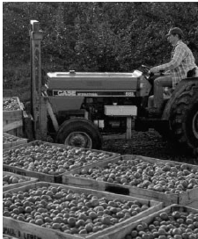
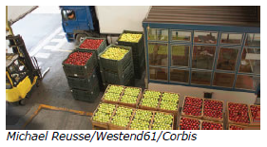
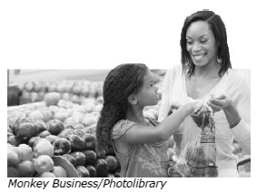
Apple Picking Time
Section 3 The apples are put into large bins. Trucks take the bins to a warehouse. That is a building where things are stored. The rooms are kept cold so the apples stay crunchy.
Section 4 The apples are sorted by color and size. Rotten apples are thrown out. The good apples are packed in boxes.
Section 5 Trucks take the apples to grocery stores across the country. The apples are unloaded and placed on shelves. People go to the grocery store to buy apples and bring them home to eat. Crunch!
Wiki License Adapted by HSD Teachers

Slide 34
Text 2
Grade Equivalent 3.1
Lexile Measure 530L
Mean Sentence Length 7.36
Mean Log Word Frequency 3.32
Word Count 103
How Do Apples Get to You?
Author: Readworks.org
Section 1 Apple farmers grow apple trees in orchards. Sometimes the apple trees stand in rows.
Section 2 In the fall, the trees have apples on them. That is when the apples are picked. Sometimes workers pick the apples. Sometimes big machines pick the apples.
Section 3 Next, the apples go into bins. The bins are put into cool warehouses. Then workers pack clean apples into boxes. Big trucks take the boxes of apples to grocery stores.
Section 4 People shop in those stores. They buy apples to eat. The apples can be red, green, or yellow. Why not have an apple? Crunch!

Slide 35
According to the two texts, what is a warehouse?
A bin
a building where things are stored
a store for apples
RI.1.4 Ask and answer questions to help determine or clarify the meaning of words and phrases in a text.
How do apples get to a warehouse?
The apples are packed in boxes.
Trucks take bins of apples there.
Big trucks take them to the grocery store.

Slide 36
11. During what time of year are apples picked?
summer
fall
spring
RI.1.8 Identify the reasons an author gives to support points in a text.
12. What is something that workers use to pick apples?
ladders
bins
trucks

Slide 37
According to both texts, where do the trucks
take the apples after the warehouse?
Trucks take apples to the orchard.
Trucks take apples to the warehouse.
Trucks take apples to the stores.
RI.1.9 Identify basic similarities in and differences between two texts on the same topic (e.g., in illustrations, descriptions, or procedures).
14. According to both texts, where do some people
buy apples?
orchards
warehouses
grocery stores

Slide 38
What key details in Apple Picking Time and How Do Apples Get to You? explain how apples are picked from trees?
RI.1.8 Identify the reasons an author gives to support points in a text.
16. How do apples get from the trees to your home? Use examples from both texts.
RI.1.9 Identify basic similarities in and differences between two texts on the same topic (e.g., in illustrations, descriptions, or procedures).

Slide 39
17. Read the story below. Write an ending for the story that solves the problem. The Little Apple Tree Johnny Appleseed planted a little apple seed by Tom’s house. The seed began to grow. It grew into a little tree. Then one day it stopped raining. The little apple tree began to wilt. Write a Brief Text, W.1.3c Temporal Words Target 6a

Slide 40
18. Read the paragraph a student wrote about apples.
Revising a text W.1.3d elaboration Target 6b
We went to pick apples. We went to an orchard. Mom
climbed up a ladder to get some apples.
Which sentence could be added to end the paragraph?
Mom picked some red apples for each of us.
I like the red apples best.
At the top of the ladder she could see far away.

Slide 41
Which word or phrase helps the reader best understand the meaning of the word stored in the sentence below?
That is a building where things are stored.
Language and Vocabulary L.1.6 Lang. Use Target 8
laid
made
put away
20. Read the sentence below.
Edit and Clarify L.1.1d Indefinite Pronouns Target 9
The man picked _____ of the apples.
Which word should go in the blank to finish the sentence?
A. somewhere
B. some
C. any

Slide 42
Student Directions:
Your assignment:
You are going to write a narrative story. This means it has a beginning, middle and an ending. This is a make-believe story. In your story, you will write about a character who plants apple seeds and when they grow into trees, will get the ripe apples ready for people to eat. You will use details to help you write your story from all of the passages you have read. Then you will tell the following:
Where is the setting? Who is the main character?
Where did the character plant the seeds?
What did the character see, hear and feel?
How did the character get them ready for people to eat?
PLAN your writing. You may use your notes and answers.
Write – Revise and Edit your first draft.
Write a final draft about the character who plants apple seeds and gets the ripe apples ready for people to eat.
How you will be scored
Purpose | Did you write only about the topic?
Organization | Do your ideas go together? Do they make sense?
Elaboration: of evidence | Did you show evidence to tell about your topic?
Elaboration: of language and vocabulary | Did you use words about the topic? Are your sentences easy to read and understanding?
Conventions | Did you follow rules for capitals, punctuation and spelling?

Slide 43
Performance Task
Name____________________________

Slide 44
STOP
Close your books and wait for instructions!

Slide 45
Color the box green if your answer was correct. Color the box red if your answer was not correct.
Literary Text
1 | In Paragraph 1, which words describes how a person might feel? RL.1.4
2 | Why did Johnny Appleseed plant apple seeds? RL.1.4
3 | Which two words from the story describe Johnny Appleseed? Choose two answers. RL.1.7
4 | Why did Johnny Appleseed wear a tin pot on his head? RL.1.7
5 | Based on the story, what is the same about the Indians, settlers and bears? RL.1.9
6 | Johnny Appleseed pulled out the bear’s tooth. What does this tell you about him? RL.1.9
7 | Based on details in the text, what can you tell about the setting for this story? RL.1.7 |  | 2 | 1 | 0
8 | From the story Johnny Appleseed, what can you tell about his life? RL.1.9 | 3 | 2 | 1 | 0
Informational Text
9 | According to the two texts, what is a warehouse? RI.1.4
10 | How do apples get to a warehouse? RI.1.4
11 | During what time of year are apples picked? RI.1.8
12 | What is something that workers use to pick apples? RI.1.8
13 | According to both texts, where do the trucks take the apples after the warehouse? RI.1.9
14 | According to both texts, where do some people buy apples? RI.1.9
15 | What key details in Apple Picking Time and How Do Apples Get to You? explain how apples are picked from trees? RI.1.8 | 2 | 1 | 0
16 | How do apples get from the trees to your home? Use examples from both texts. RI.1.9 | 2 | 1 | 0
Writing
17 | Read the story below. Write an ending for the story that solves the problem. W.1.3c | 2 | 1 | 0
18 | Which sentence could be added to the end of the paragraph? W.1.3d
19 | Which word or phrase helps the reader best understand the meaning of the word stored in the sentence below? L.1.6
20 | Which word should go in the blank to finish the sentence? L.1.1d

